Slide 1

UNIT 15:OUR HEALTH
LESSON 1 ( 1, 2, 3)
Notes:
MADE BY FACEBOOK :TRAN THI THANH TAM

Slide 2
VOCABULARY
Toothache:đau răng
headache:đau đầu
Sore throat:đau họng
Stomach ache: đau dạ dày

Slide 3
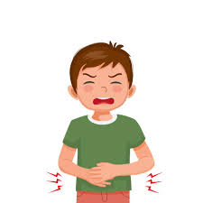
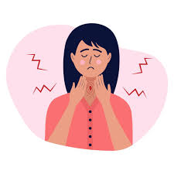
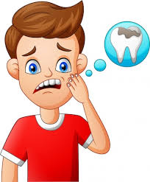
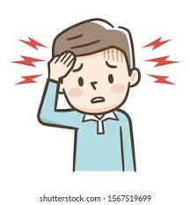
1.toothache
A
2.Stomach ache
B
3.headache
C
4. Sore throat
D
Notes:
MADE BY FACEBOOK :TRAN THI THANH TAM

Slide 4

Hỏi và trả lời xem ai đó có vấn đề gì
What’s the matter?
( Bạn có vấn đề gì vậy?)
I have a toothache
( Tôi bị đau răng.)

Slide 5
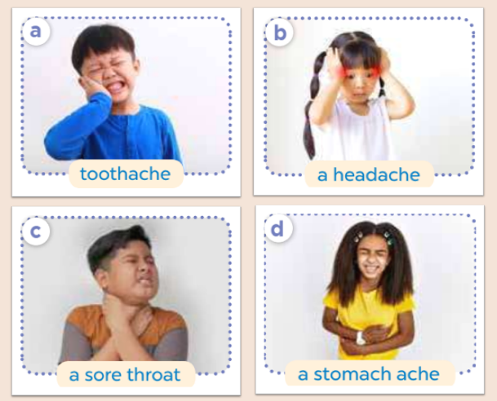
2.Listen, point and say
toothache
What’s the matter?
I have a..................
Notes:
MADE BY FACEBOOK :TRAN THI THANH TAM

Slide 6
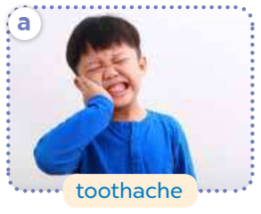
What’s the matter?
toothache
I have a..................
Notes:
MADE BY FACEBOOK :TRAN THI THANH TAM

Slide 7
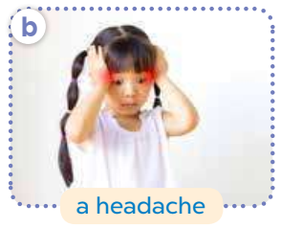
What’s the matter?
headache
I have a..................
Notes:
MADE BY FACEBOOK :TRAN THI THANH TAM

Slide 8
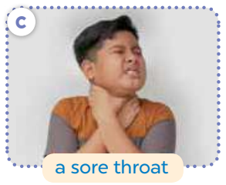
What’s the matter?
sore throat
I have a..........................
Notes:
MADE BY FACEBOOK :TRAN THI THANH TAM

Slide 9
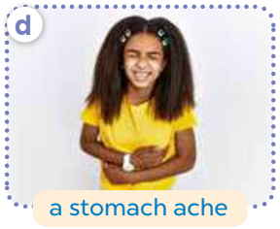
What’s the matter?
stomach ache
I have a.........................
Notes:
MADE BY FACEBOOK :TRAN THI THANH TAM

Slide 10
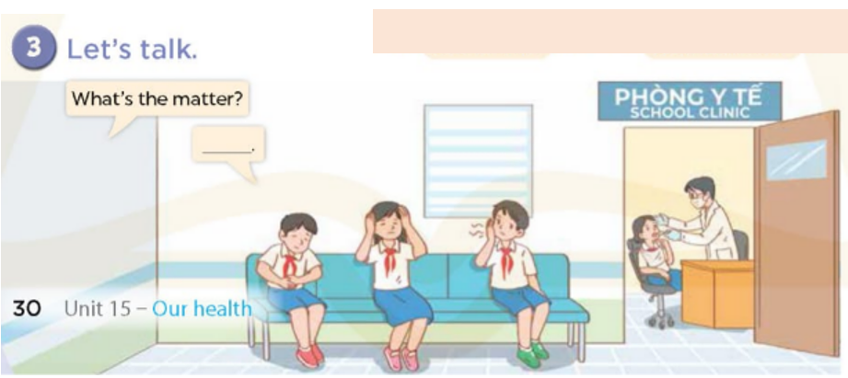
Notes:
MADE BY FACEBOOK :TRAN THI THANH TAM

