Slide 1

UNIT 15:OUR HEALTH
LESSON 1 (4, 5, 6)
Notes:
MADE BY FACEBOOK :TRAN THI THANH TAM

Slide 2

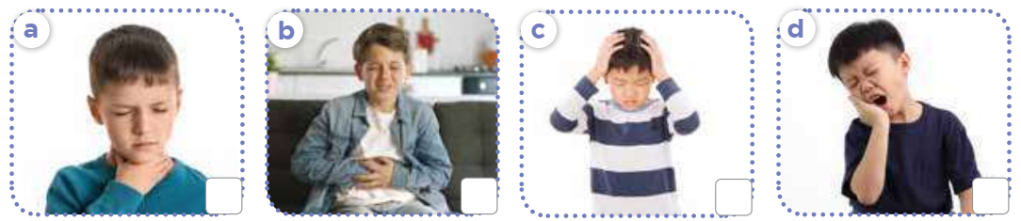
4. Listen and number
3
1
2
4
Notes:
MADE BY FACEBOOK :TRAN THI THANH TAM

Slide 3
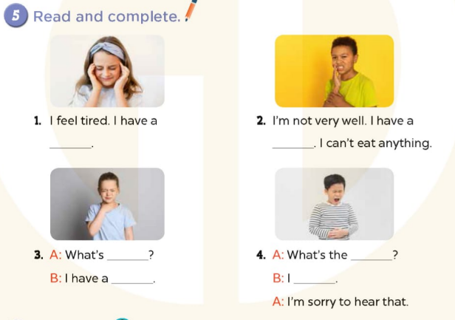
headache
toothache
the matter ?
the matter ?
sore throat
have a stomach ache
Notes:
MADE BY FACEBOOK :TRAN THI THANH TAM

Slide 4
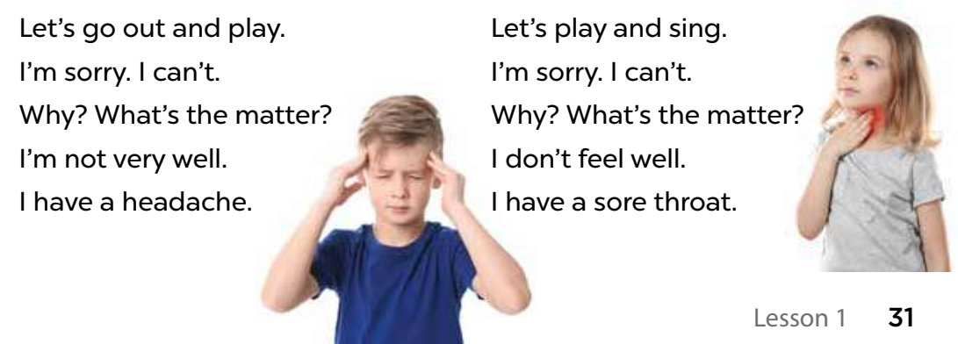
6. Let’s sing
Notes:
MADE BY FACEBOOK :TRAN THI THANH TAM

