Slide 1

UNIT 15:OUR HEALTH
LESSON 2 ( 1, 2, 3)
Notes:
MADE BY FACEBOOK :TRAN THI THANH TAM

Slide 2

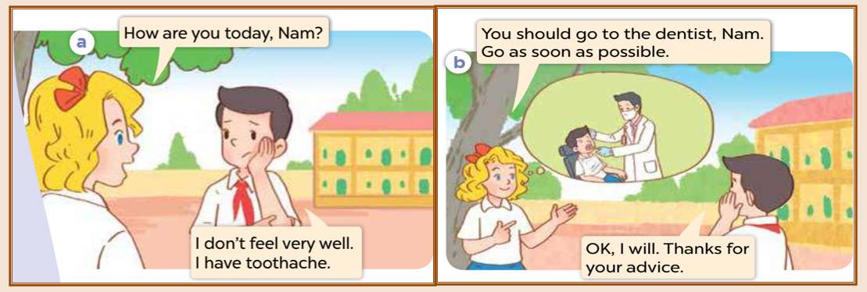
1.Look, listen and repeat
Notes:
MADE BY FACEBOOK :TRAN THI THANH TAM

Slide 3
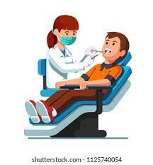
go to the dentist /teɪk sʌm 'medɪsn/
: đi khám nha sĩ
Notes:
MADE BY FACEBOOK :TRAN THI THANH TAM

Slide 4
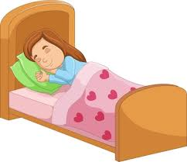
have a rest /ˌhæv ə ˈrest/ : nghỉ ngơi
Notes:
MADE BY FACEBOOK :TRAN THI THANH TAM

Slide 5
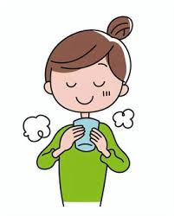
drink warm water /drɪŋk wɔːm wɔːtə/
: uống nước ấm
Notes:
MADE BY FACEBOOK :TRAN THI THANH TAM

Slide 6
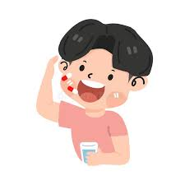
take some medicine /teɪk sʌm 'medɪsn/
: uống thuốc
Notes:
MADE BY FACEBOOK :TRAN THI THANH TAM

Slide 7
VOCABULARY
Go to the dentist: đi khám nha sĩ
Have a rest:nghĩ ngơi
Drink warm water:uống nước ấm
Take some medicine: uống thuốc

Slide 8
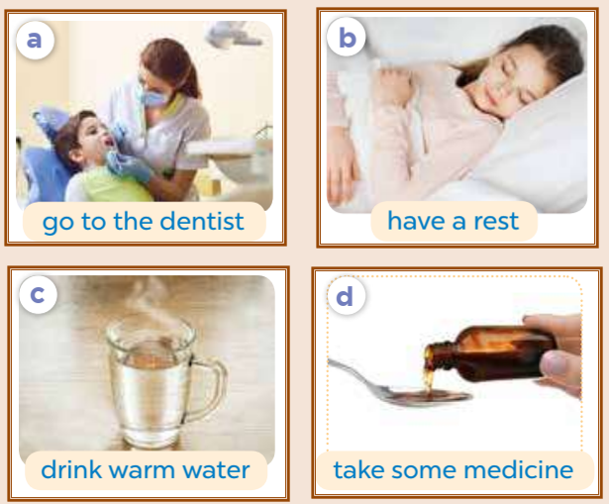
2.Listen, point and say
go to the dentist
You should………………..........
Thanks for your advice.
Notes:
MADE BY FACEBOOK :TRAN THI THANH TAM

Slide 9
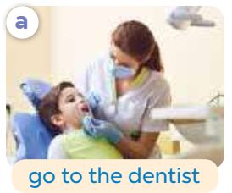
go to the dentist
You should………………..........
Thanks for your advice.
Notes:
MADE BY FACEBOOK :TRAN THI THANH TAM

Slide 10
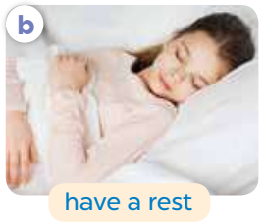
have a rest
You should………………..........
Thanks for your advice.
Notes:
MADE BY FACEBOOK :TRAN THI THANH TAM

Slide 11
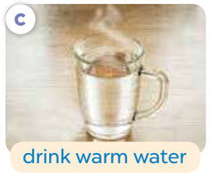
drink warm water
You should………………..........
Thanks for your advice.
Notes:
MADE BY FACEBOOK :TRAN THI THANH TAM

Slide 12
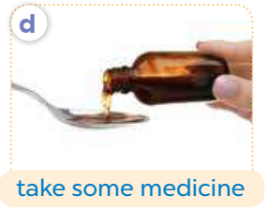
take some medicine
You should………………..........
Thanks for your advice.
Notes:
MADE BY FACEBOOK :TRAN THI THANH TAM

Slide 13
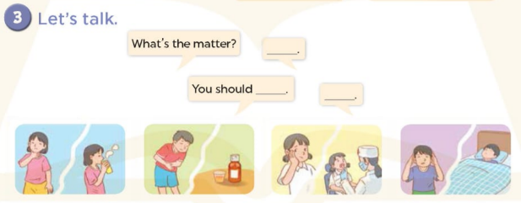
Notes:
MADE BY FACEBOOK :TRAN THI THANH TAM

