Slide 1
UNIT 15: OUR HEALTH
LESSON 2 ( 4, 5, 6)
Notes:
MADE BY FACEBOOK :TRAN THI THANH TAM

Slide 2

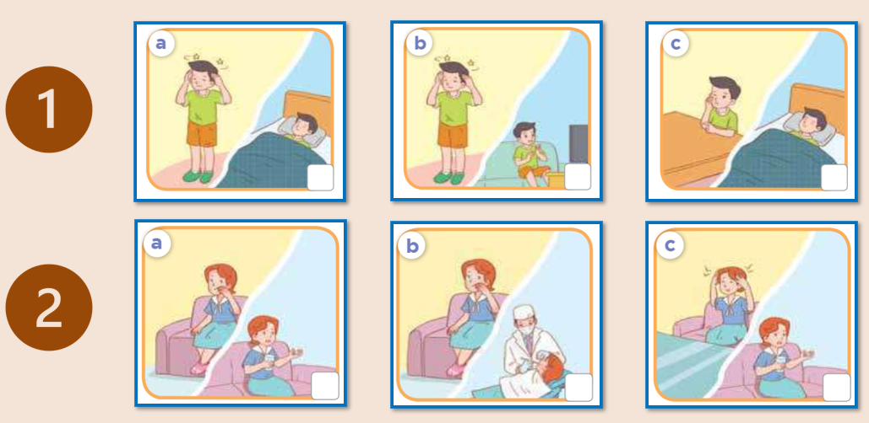

4. Listen and tick
✔
✔
Notes:
MADE BY FACEBOOK :TRAN THI THANH TAM

Slide 3
5. Read and complete
the matter
1. A: What’s ___________?
B: I have ___________. I don’t feel very well.
A: You should take ____________ and have a rest.
B: Yes, I will. Thank you, Mum.
a headache
some medicine
2. A: I have __________. It hurts.
B: You should rinse your mouth with salt water, Mai.
A: OK, Mum.
B: And you ________________________.
A: That’s a good idea. I’ll go tomorrow.
toothache
should go to the dentist
Notes:
MADE BY FACEBOOK :TRAN THI THANH TAM

Slide 4

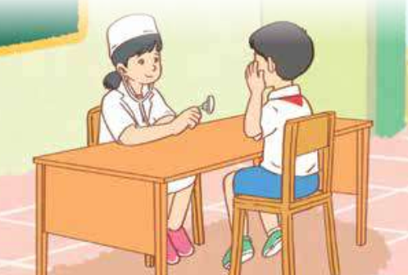
6. Let’s play
Notes:
MADE BY FACEBOOK :TRAN THI THANH TAM

