Slide 1
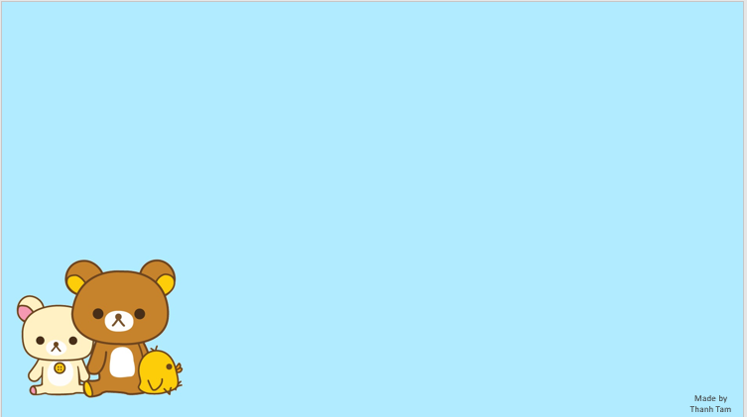

Nguyen Du Primary School
WELCOME TO
OUR CLASS 5
Teacher: Trần Thị Thanh Tâm

Slide 2

UNIT 15:OUR HEALTH
LESSON 3 (1, 2, 3)
Notes:
MADE BY FACEBOOK :TRAN THI THANH TAM

Slide 3
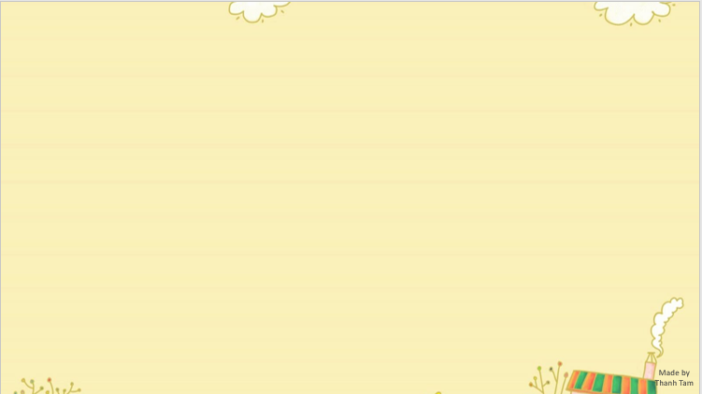

CONTENTS
1
WARM -UP
2
LISTEN AND REPEAT
3
LISTEN AND UNDERLINE ONE MORE STRESSED WORD. THEN REPEAT
4
LET’S CHANT
5
PLAY GAME
Notes:
MADE BY FACEBOOK :TRAN THI THANH TAM

Slide 4

Let's play
LISTEN AND CHOOSE TRUE OR FALSE
Notes:
MADE BY FACEBOOK :TRAN THI THANH TAM

Slide 5

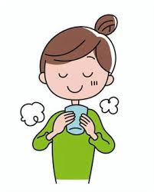



TRUE
FALSE
Notes:
MADE BY FACEBOOK :TRAN THI THANH TAM

Slide 6
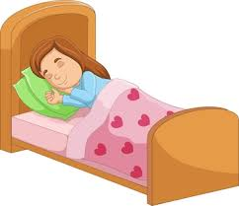
TRUE
FALSE
Notes:
MADE BY FACEBOOK :TRAN THI THANH TAM

Slide 7
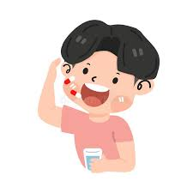
TRUE
FALSE
Notes:
MADE BY FACEBOOK :TRAN THI THANH TAM

Slide 8
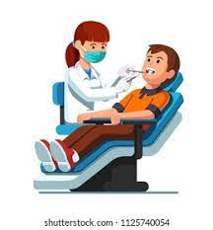
TRUE
FALSE
Notes:
MADE BY FACEBOOK :TRAN THI THANH TAM

Slide 9

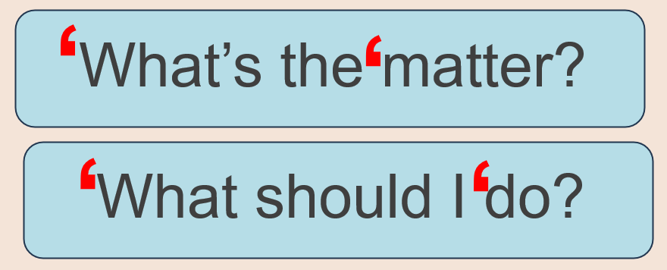
1.Listen and repeat
Notes:
MADE BY FACEBOOK :TRAN THI THANH TAM

Slide 10
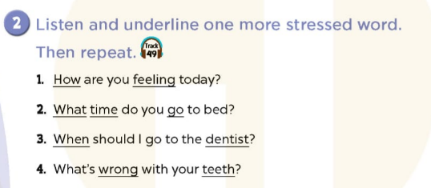
Notes:
MADE BY FACEBOOK :TRAN THI THANH TAM

Slide 11
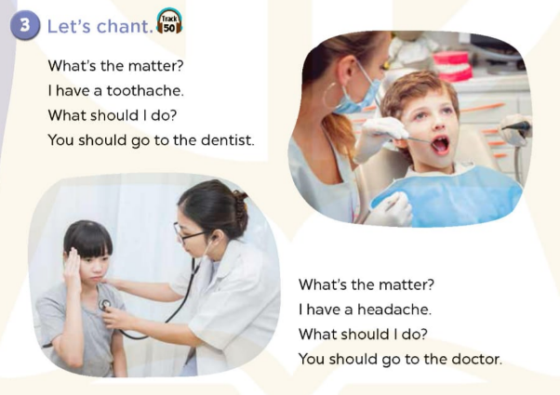
Notes:
MADE BY FACEBOOK :TRAN THI THANH TAM

Slide 12




PLAY GAME
HOT SEAT
Notes:
Step 2: Have groups put the posters on the desk and practice the presentation. Encourage all members in the group to present. Go around the classroom and offer help where necessary.

Slide 13
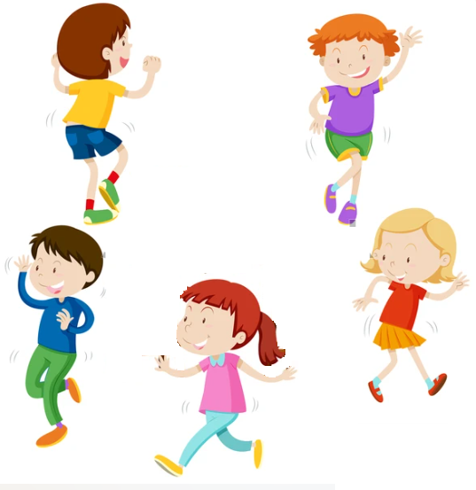
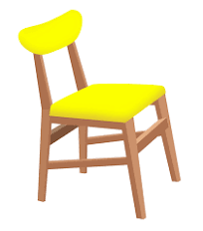
Hot seat
Game

Slide 14

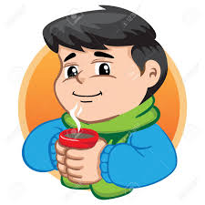
drink warm water
You should………………..........
Thanks for your advice.
Notes:
MADE BY FACEBOOK :TRAN THI THANH TAM

Slide 15
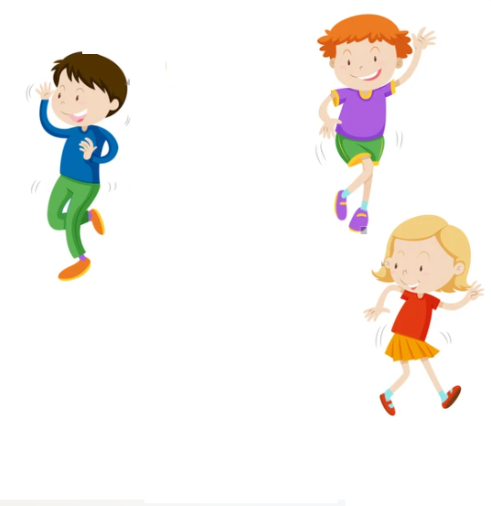
Notes:
MADE BY FACEBOOK :TRAN THI THANH TAM

Slide 16

go to the dentist
You should………………..........
Thanks for your advice.
Notes:
MADE BY FACEBOOK :TRAN THI THANH TAM

Slide 17
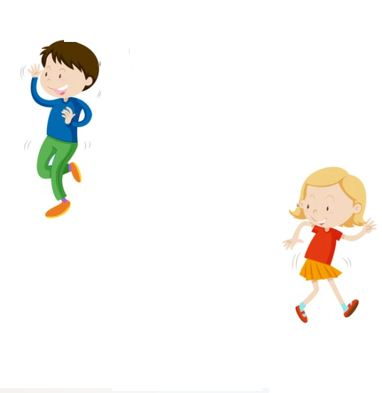
Notes:
MADE BY FACEBOOK :TRAN THI THANH TAM

Slide 18
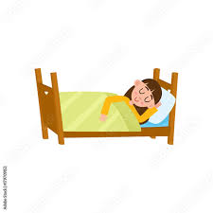
have a rest
You should………………..........
Thanks for your advice.
Notes:
MADE BY FACEBOOK :TRAN THI THANH TAM

Slide 19
Notes:
MADE BY FACEBOOK :TRAN THI THANH TAM

Slide 20
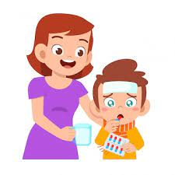
take some medicine
You should………………..........
Thanks for your advice.
Notes:
MADE BY FACEBOOK :TRAN THI THANH TAM

Slide 21


Notes:
MADE BY FACEBOOK :TRAN THI THANH TAM

Slide 22

Homework:
- Practice more at home
- Prepare Unit 15- lesson 3 ( 4, 5, 6)
Notes:
MADE BY FACEBOOK :TRAN THI THANH TAM

Slide 23

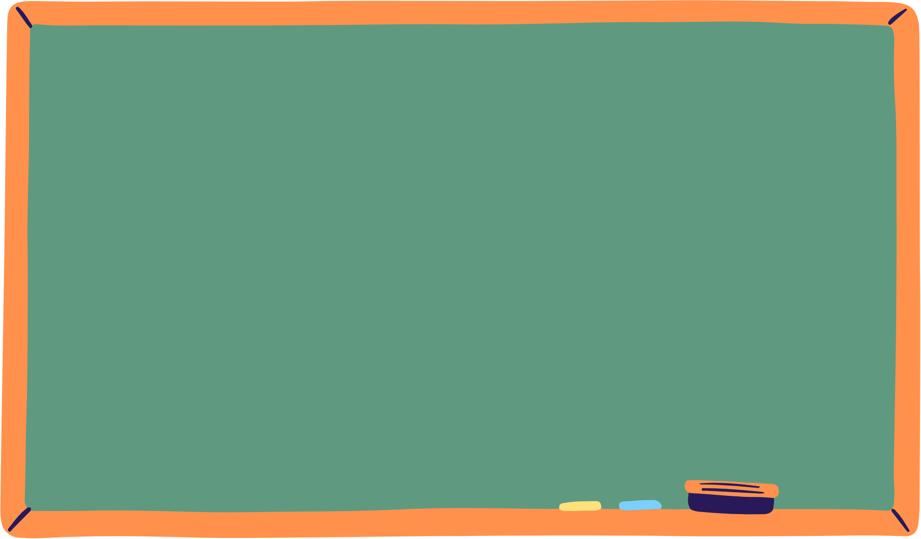




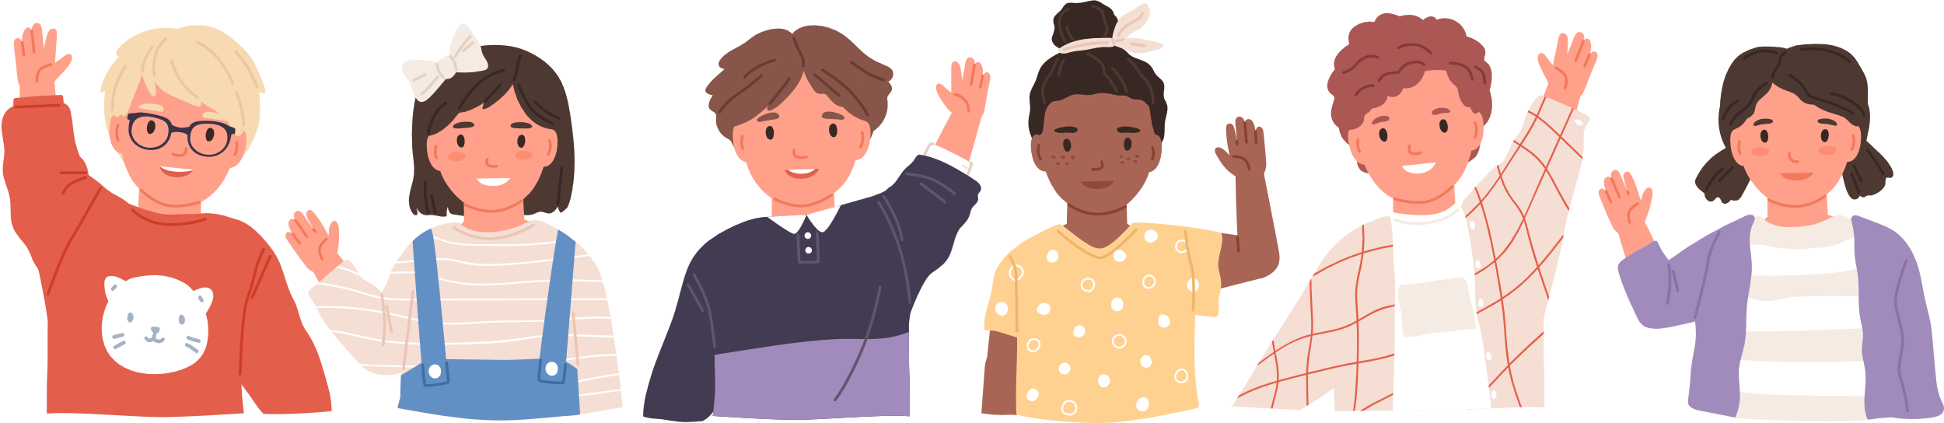
See you
next time!

Slide 24




The bye bye song
Bye, bye.
See you tomorrow.
Bye, bye.
See you tomorrow.
Bye, bye.
See you tomorrow.
Bye, bye. Bye, bye.
The bye bye song
Made by Thanh Tam
Notes:
MADE BY FACEBOOK :TRAN THI THANH TAM

