Slide 1
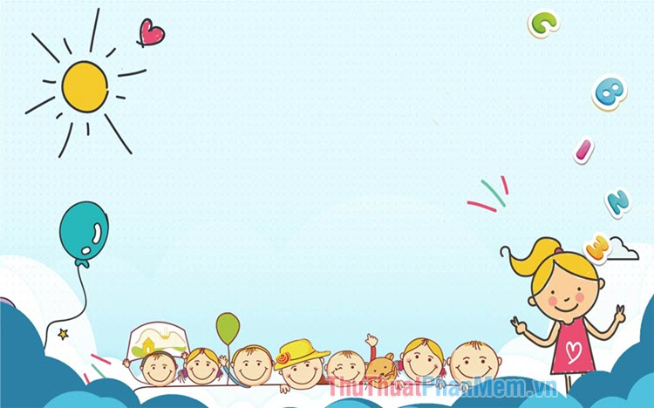

UNIT 15: OUR HEALTH
LESSON 3 ( 4, 5, 6)

Slide 2
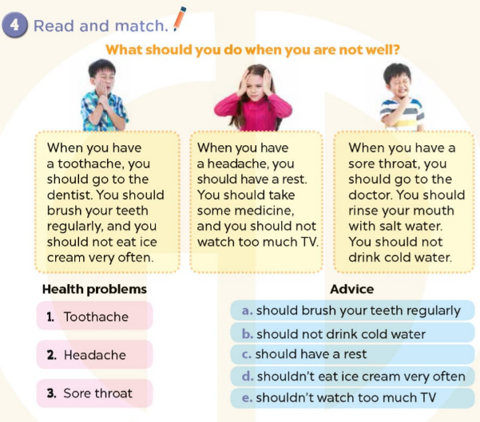









Notes:
MADE BY FACEBOOK :TRAN THI THANH TAM

Slide 3
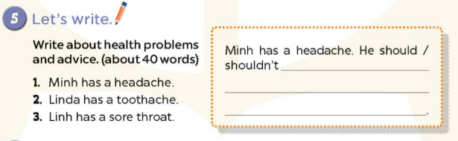
Notes:
MADE BY FACEBOOK :TRAN THI THANH TAM

Slide 4
5. Let’s write
have a rest.
Minh has a headache. He should……………..…
He shouldn’t watch TV too much.
Linda has toothache. She should go to the dentist. She shouldn’t eat sweets too much.
Linh has a sore throat. She should go to the doctor. She shouldn’t eat ice cream.
Notes:
MADE BY FACEBOOK :TRAN THI THANH TAM

Slide 5
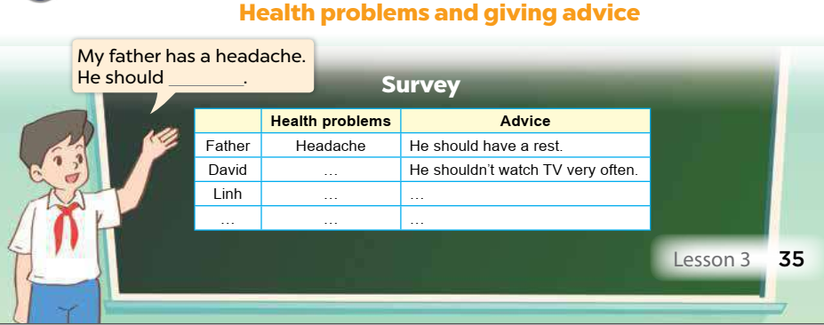
6. Project
Notes:
MADE BY FACEBOOK :TRAN THI THANH TAM

