Slide 1

UNIT 16 :SEASONS AND
THE WEATHER
LESSON 1 ( 1, 2, 3)
Notes:
MADE BY FACEBOOK :TRAN THI THANH TAM

Slide 2

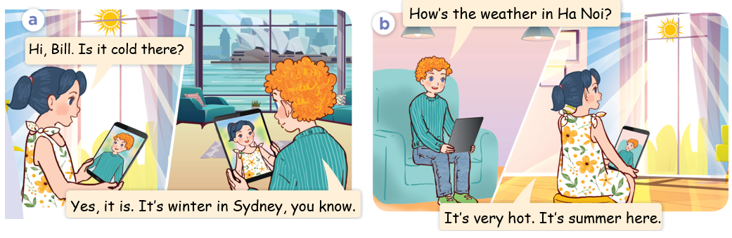
1.Look, listen and repeat
Notes:
MADE BY FACEBOOK :TRAN THI THANH TAM

Slide 3

Spring /sprɪŋ/ : mùa xuân
Notes:
MADE BY FACEBOOK :TRAN THI THANH TAM

Slide 4

Summer /ˈsʌmə/ : mùa hè
Notes:
MADE BY FACEBOOK :TRAN THI THANH TAM

Slide 5

Autumn /ˈɔːtəm/ : mùa thu
Notes:
MADE BY FACEBOOK :TRAN THI THANH TAM

Slide 6

Winter /ˈwɪntə/ : mùa đông
Notes:
MADE BY FACEBOOK :TRAN THI THANH TAM

Slide 7
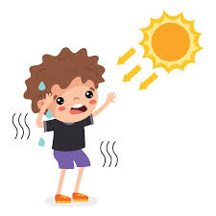
Hot /hɒt/: nóng
Notes:
MADE BY FACEBOOK :TRAN THI THANH TAM

Slide 8
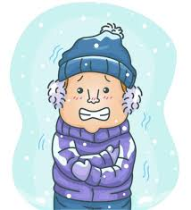
Cold /kəʊld/ : lạnh
Notes:
MADE BY FACEBOOK :TRAN THI THANH TAM

Slide 9
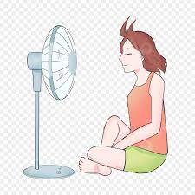
Cool /kuːl/: mát
Notes:
MADE BY FACEBOOK :TRAN THI THANH TAM

Slide 10

Warm /wɔːm /: ấm
Notes:
MADE BY FACEBOOK :TRAN THI THANH TAM

Slide 11

VOCABULARY
Spring: mùa xuân
Summer: mùa hè
Autumn: mùa thu
Winter: màu đông
Warm: ấm
Hot: nóng
Cool:mát
Cold: lạnh

Slide 12
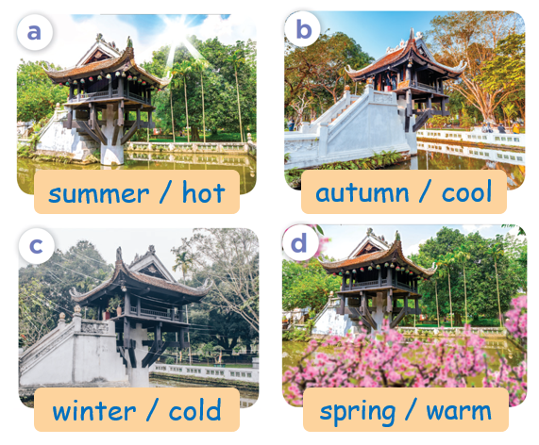
2.Listen, point and say
summer
How’ the weather in Ha Noi in..................?
hot
It’s...............
Notes:
MADE BY FACEBOOK :TRAN THI THANH TAM

Slide 13

3. Let’s talk
summer
How’ the weather in Ha Noi in..................?
hot
It’s...............
Notes:
MADE BY FACEBOOK :TRAN THI THANH TAM

