Slide 1

UNIT 16 :SEASONS AND
THE WEATHER
LESSON 1 (4, 5, 6)
Notes:
MADE BY FACEBOOK :TRAN THI THANH TAM

Slide 2



4. Listen and number
3
1
4
2
Notes:
MADE BY FACEBOOK :TRAN THI THANH TAM

Slide 3
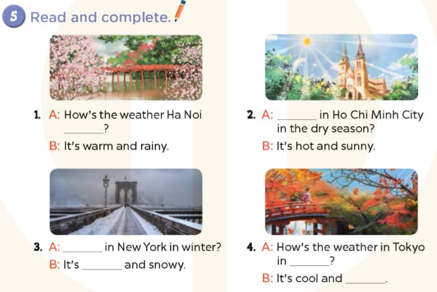
Notes:
MADE BY FACEBOOK :TRAN THI THANH TAM

Slide 4
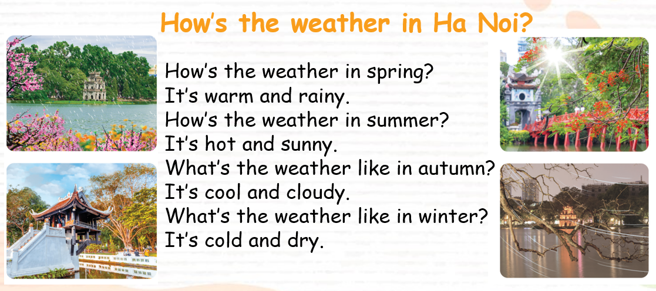
6. Let’s sing
Notes:
MADE BY FACEBOOK :TRAN THI THANH TAM

Slide 5



The weather is cold in summer in Quy Nhon City.
TRUE
FALSE

Slide 6


The weather is cold in winter in America.
TRUE
FALSE

Slide 7

It’s very hot in Spring in Da Lat.
TRUE
FALSE

Slide 8

It’s cool in autumn in Gia Lai Province.
TRUE
FALSE

Slide 9





