Slide 1

UNIT 16 :SEASONS AND
THE WEATHER
LESSON 2 ( 1, 2, 3)
Notes:
MADE BY FACEBOOK :TRAN THI THANH TAM

Slide 2

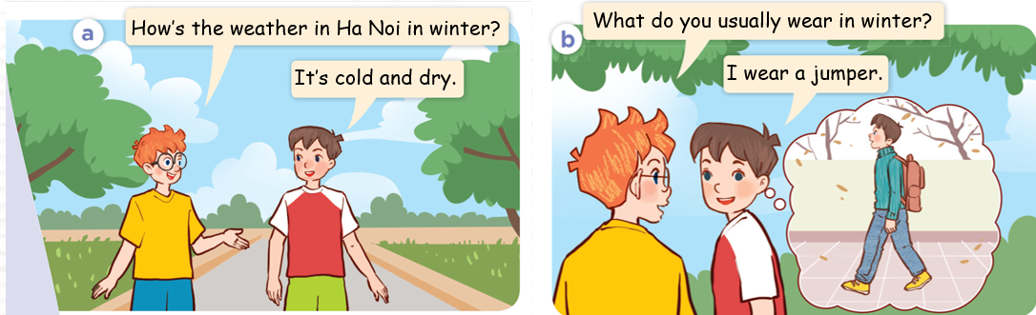
1. Look, listen and repeat
Notes:
MADE BY FACEBOOK :TRAN THI THANH TAM

Slide 3
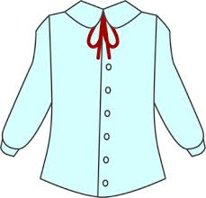
Blouse /blaʊz/ : áo cánh, áo sơ mi nữ
Notes:
MADE BY FACEBOOK :TRAN THI THANH TAM

Slide 4
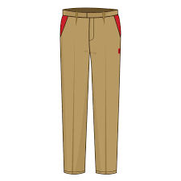
Trousers /ˈtraʊzəz/ : quần dài
Notes:
MADE BY FACEBOOK :TRAN THI THANH TAM

Slide 5
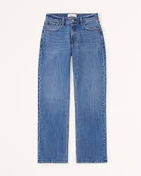
Jeans /dʒiːnz/ : quần bò, quần Jeans
Notes:
MADE BY FACEBOOK :TRAN THI THANH TAM

Slide 6
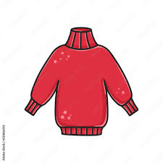
Jumper /ˈdʒʌmpə/ : áo len cao cổ
Notes:
MADE BY FACEBOOK :TRAN THI THANH TAM

Slide 7
VOCABULARY
Blouse: áo cánh, áo sơ mi nữ
Jeans: quần bò, quần jean
Trousers:quần dài
Jumper:áo len cao cổ

Slide 8
1.Blouse
A
2.Jeans
B
3.Trousers
C
4. Jumper
D
Notes:
MADE BY FACEBOOK :TRAN THI THANH TAM

Slide 9
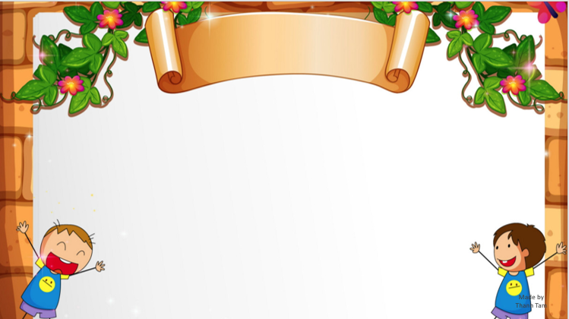
SENTENCE PATTERN
Notes:
MADE BY FACEBOOK :TRAN THI THANH TAM

Slide 10
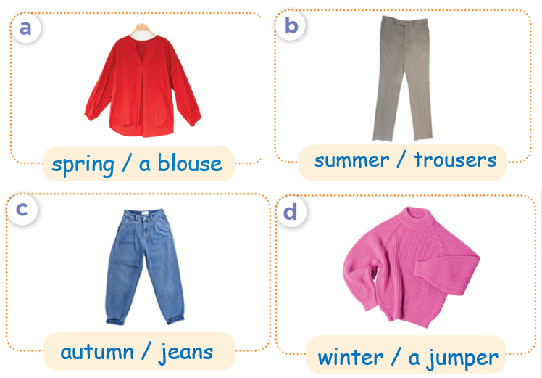
2.Listen, point and say
spring
What do you usually wear in ...............?
a blouse
I wear…...............
Notes:
MADE BY FACEBOOK :TRAN THI THANH TAM

Slide 11
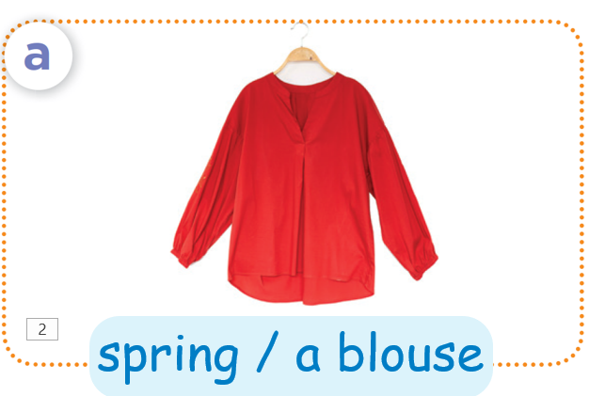
spring
What do you usually wear in ...............?
a blouse
I wear…...............
Notes:
MADE BY FACEBOOK :TRAN THI THANH TAM

Slide 12
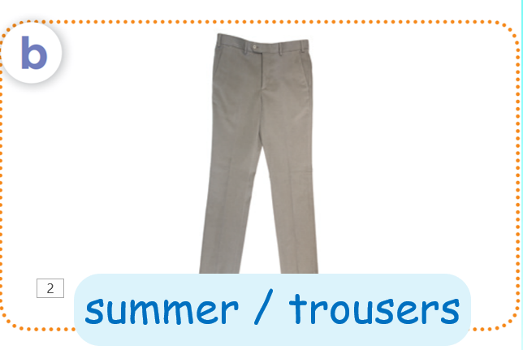
spring
What do you usually wear in ...............?
a blouse
I wear…...............
Notes:
MADE BY FACEBOOK :TRAN THI THANH TAM

Slide 13
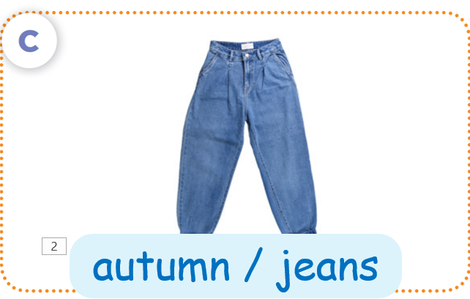
spring
What do you usually wear in ...............?
a blouse
I wear…...............
Notes:
MADE BY FACEBOOK :TRAN THI THANH TAM

Slide 14
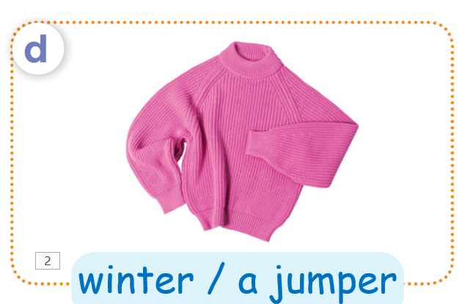
spring
What do you usually wear in ...............?
a blouse
I wear…...............
Notes:
MADE BY FACEBOOK :TRAN THI THANH TAM

Slide 15
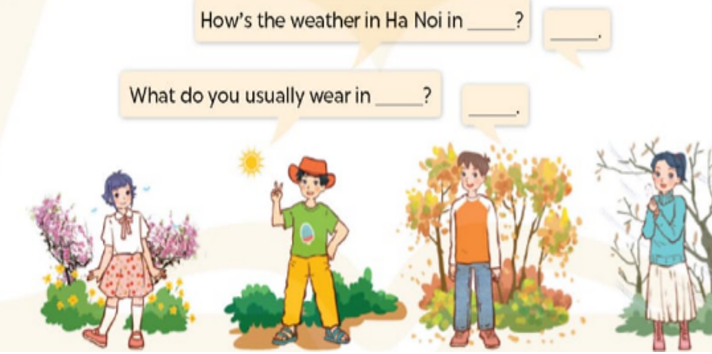
3. Let’s talk
Notes:
MADE BY FACEBOOK :TRAN THI THANH TAM

