Slide 1
UNIT 16 :SEASONS AND
THE WEATHER
LESSON 2 ( 4, 5, 6)
Notes:
MADE BY FACEBOOK :TRAN THI THANH TAM

Slide 2
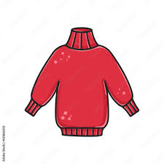



TRUE
FALSE
Notes:
MADE BY FACEBOOK :TRAN THI THANH TAM

Slide 3
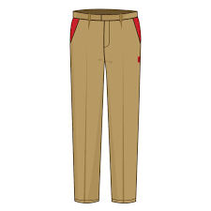
TRUE
FALSE
Notes:
MADE BY FACEBOOK :TRAN THI THANH TAM

Slide 4
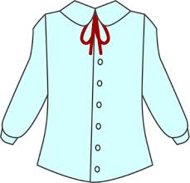
TRUE
FALSE
Notes:
MADE BY FACEBOOK :TRAN THI THANH TAM

Slide 5
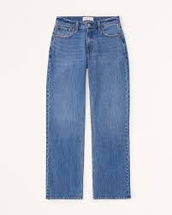
TRUE
FALSE
Notes:
MADE BY FACEBOOK :TRAN THI THANH TAM

Slide 6
4. Listen and circle
1. A: What season is it in Sydney? – It’s ________.
a. autumn b. summer
B: What does he usually wear? – He wears _______.
a. shorts and a T-shirt b. jeans and a T-shirt
2. A: What season is it in Ha Noi? – It’s ______.
a. winter b. summer
B: What does she usually wear? – She wears _____.
a. a skirt and a jumper b. jeans and a jumper
Notes:
MADE BY FACEBOOK :TRAN THI THANH TAM

Slide 7
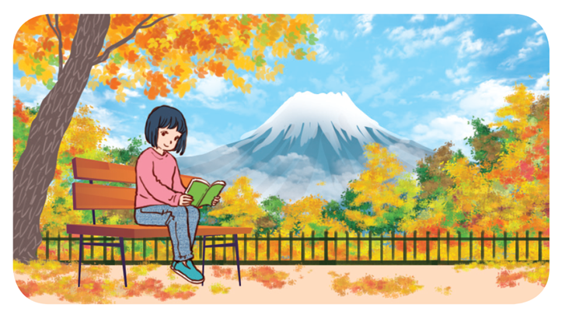
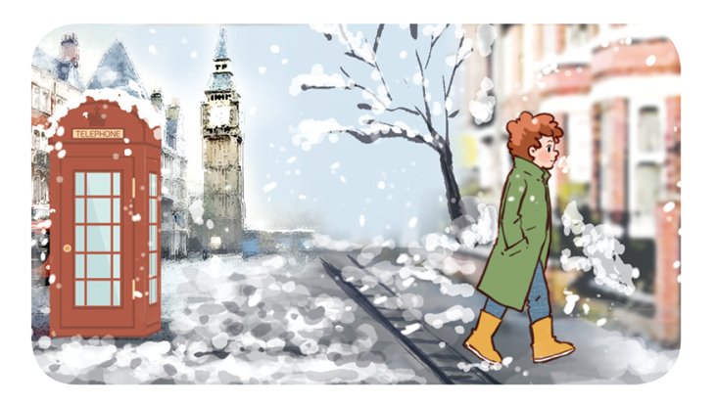
5. Read and complete
the weather
1.A:How’s__________ in your place, Akiko?
B: It’s cool and windy. It’s autumn.
A: What do you usually wear in this season?
B: I wear _____ and a ______.
2.A: What season is it in London now, Tom?
B: It’s ______. It’s very cold and snowy.
A:What________________ in winter?
B: I wear ______ and a coat.
winter
do you usually wear
jeans
jumper
jeans
Notes:
MADE BY FACEBOOK :TRAN THI THANH TAM

Slide 8
Game:
RING THE BELL!

Slide 9

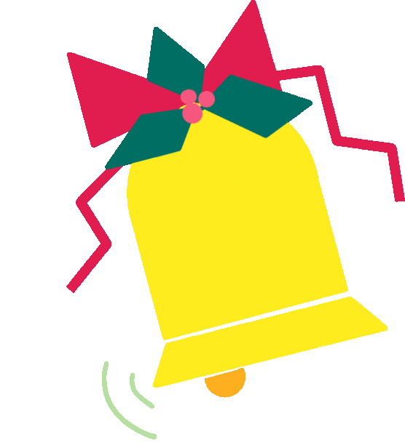




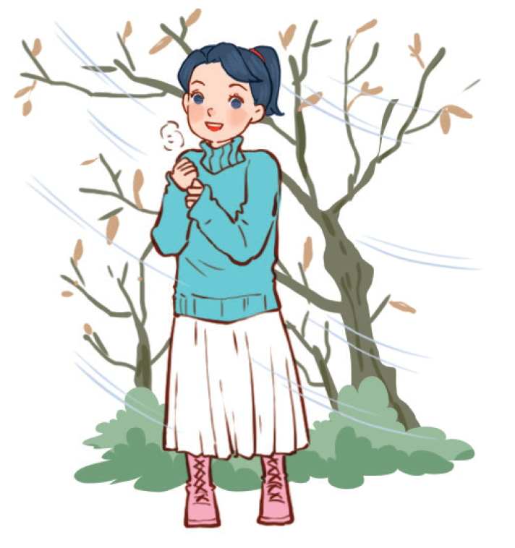


6
1
2
3
4
5
7
8
9
Choose a, b or c, then Say.
10
START
I wear a ………. and a skirt .
a. shirt
b. jumper
c. shorts
Notes:
*Key: 1. b, 2. a, 3. b, 4. c

Slide 10
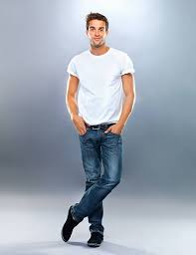
6
1
2
3
4
5
7
8
9
Choose a, b or c, then Say.
10
START
He wears a T- shirt and…………
a. Jeans
b. shorts
c. shirt
Notes:
*Key: 1. b, 2. a, 3. b, 4. c

Slide 11
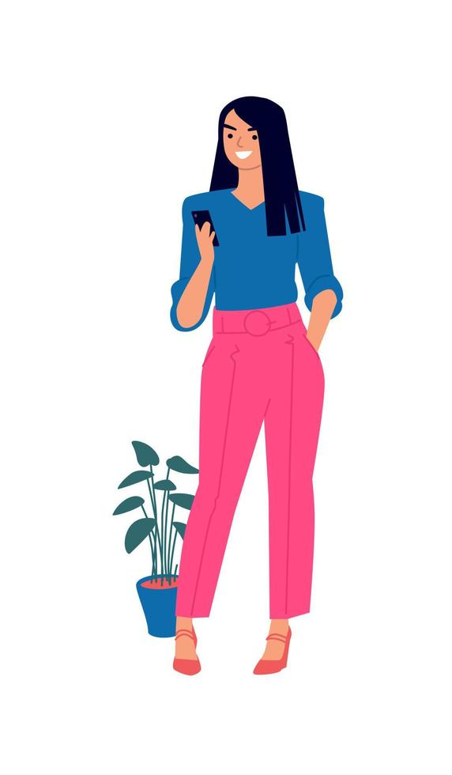
6
1
2
3
4
5
7
8
9
Choose a, b or c, then Say.
10
START
She wears a blouse and…………..
a. Jeans
b. trousers
c. shorts
Notes:
*Key: 1. b, 2. a, 3. b, 4. c

Slide 12
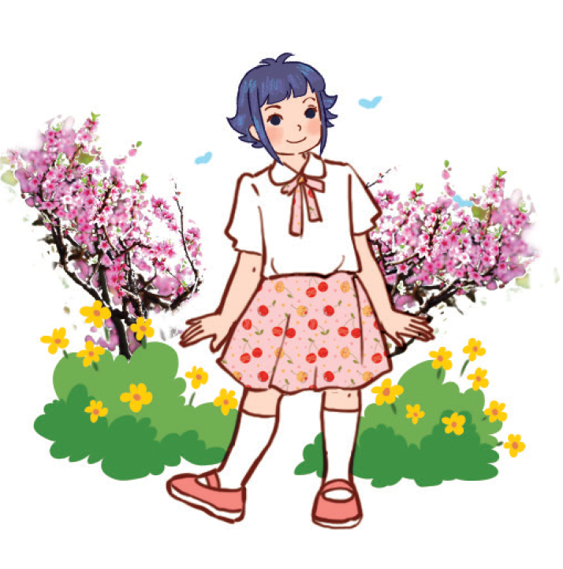
6
1
2
3
4
5
7
8
9
Choose a, b or c, then Say.
10
START
She wears a……….and a skirt.
a. jumper
b. T- shirt
c. blouse
Notes:
*Key: 1. b, 2. a, 3. b, 4. c

