Slide 1

?
?
?
Food and drinks
?
?
?
?

Slide 2
rice
water
fish
fresh fruit
Food and drinks
milk
apple
lemonade
vegetables
chips

Slide 3
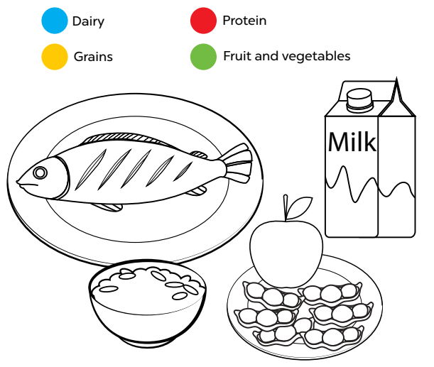
1, Look, read and colour
Notes:
MADE BY FACEBOOK :TRAN THI THANH TAM

Slide 4
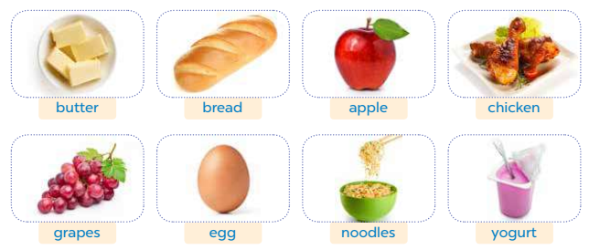
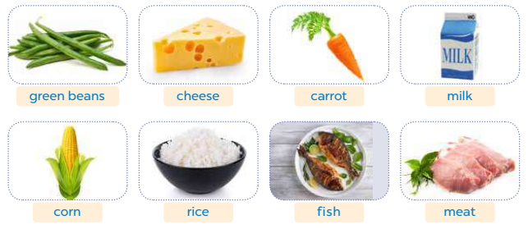
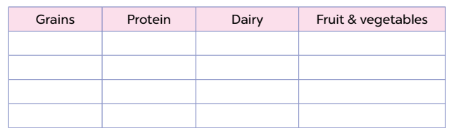
2. Look and write
bread
chicken
butter
apple
noodles
eggs
yogurt
grapes
corn
fish
cheese
green beans
rice
meat
milk
carrot
Notes:
MADE BY FACEBOOK :TRAN THI THANH TAM

Slide 5
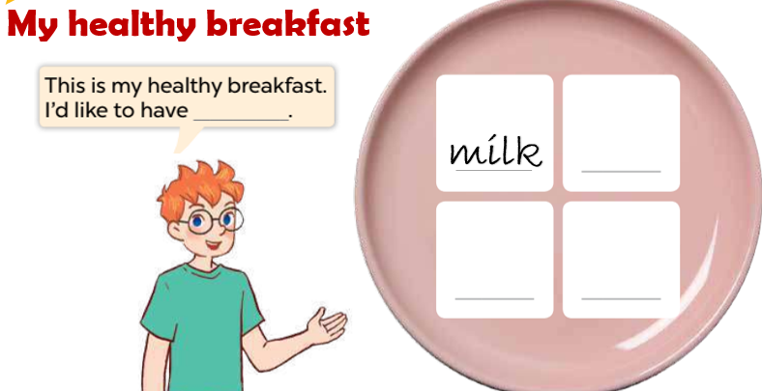
3. Write and say
cereals
eggs
bread
Notes:
MADE BY FACEBOOK :TRAN THI THANH TAM

Slide 6


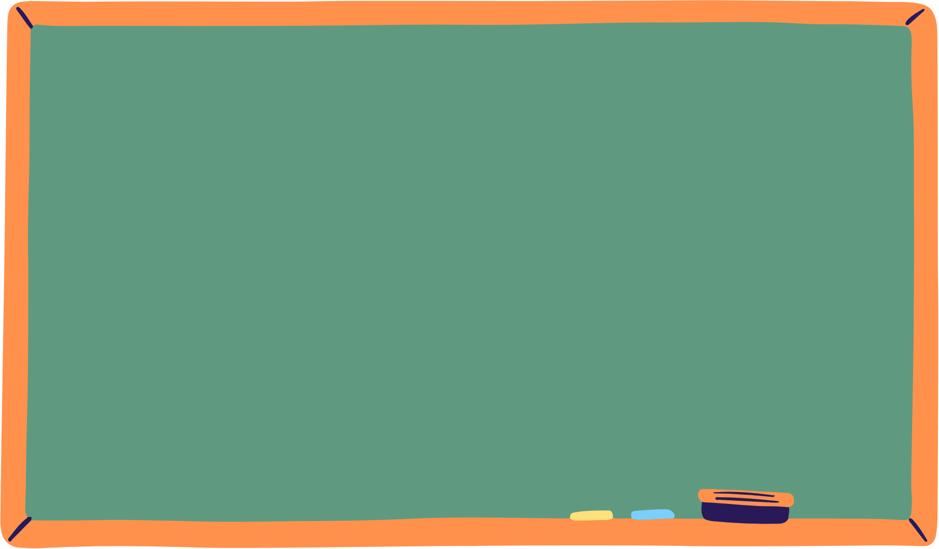
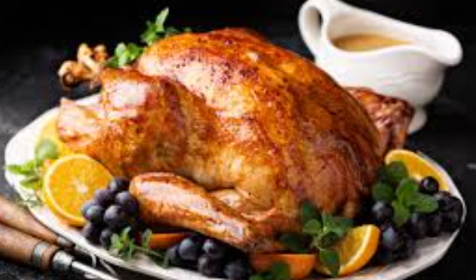
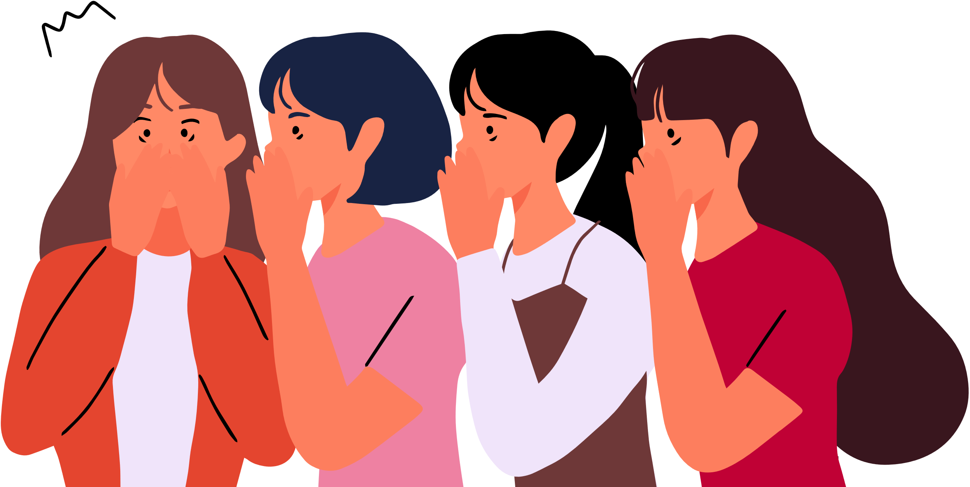

I’d like to have chicken.
Notes:
Step 5: Invite a few pairs to point at the pictures and say the questions and answers in front of the class.

Slide 7
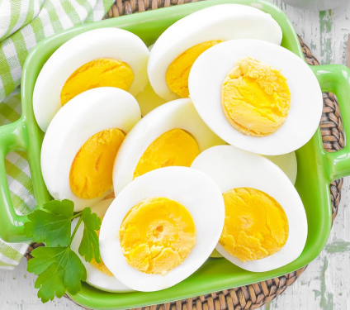
I’d like to have eggs.
Notes:
Step 5: Invite a few pairs to point at the pictures and say the questions and answers in front of the class.

Slide 8
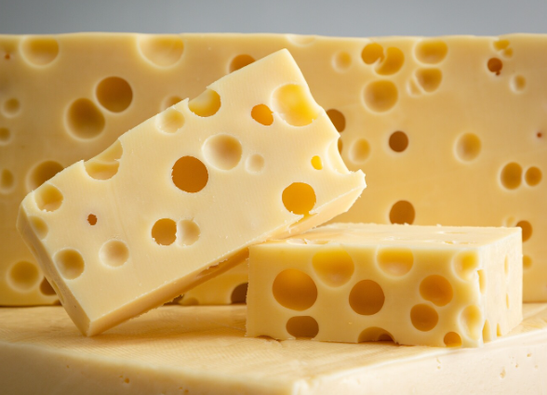
I’d like to have cheese.
Notes:
Step 5: Invite a few pairs to point at the pictures and say the questions and answers in front of the class.

Slide 9

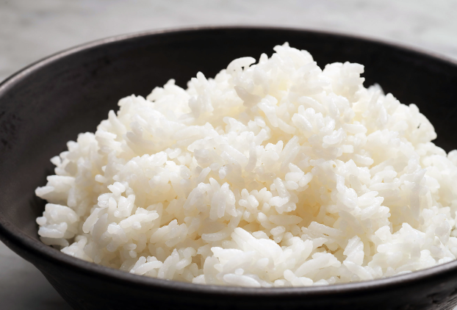

I’d like to have rice.
Notes:
Step 5: Invite a few pairs to point at the pictures and say the questions and answers in front of the class.

