Slide 1

EXTENSION
ACTIVITIES
Notes:
MADE BY FACEBOOK :TRAN THI THANH TAM

Slide 2
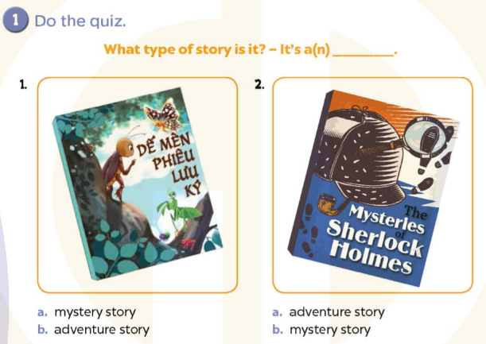
Notes:
MADE BY FACEBOOK :TRAN THI THANH TAM

Slide 3
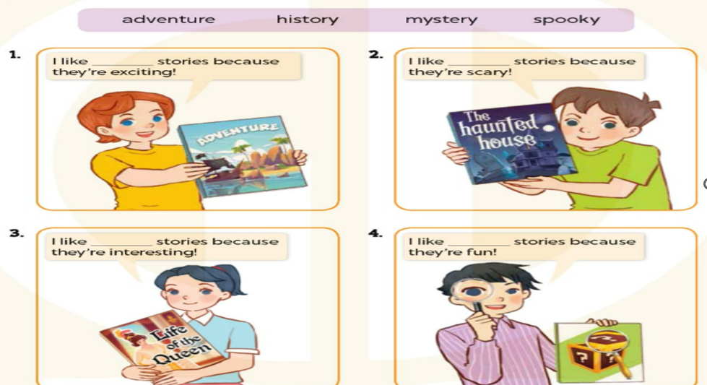
2. Read and complete
adventure
spooky
history
mystery
Notes:
MADE BY FACEBOOK :TRAN THI THANH TAM

Slide 4
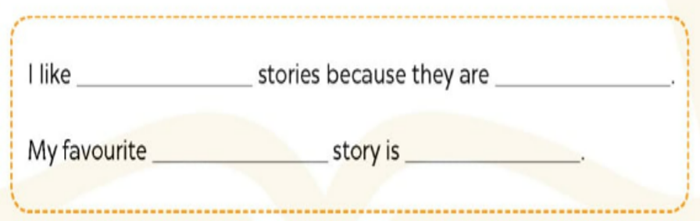
3. Write and say
adventure
exciting
adventure
Treasure island
Notes:
MADE BY FACEBOOK :TRAN THI THANH TAM

Slide 5
LET’S PLAY
Who’s faster?

Slide 6
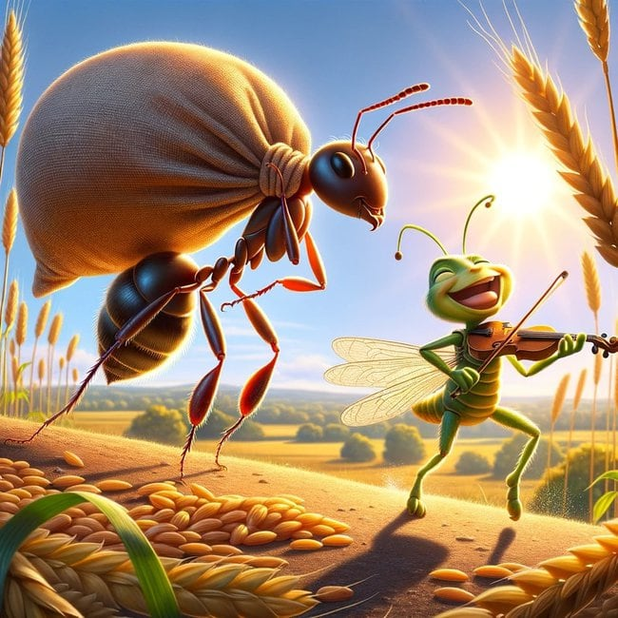
Who are the main characters in the story?
They’re the Ant and the Grasshopper.
Notes:
MADE BY FACEBOOK :TRAN THI THANH TAM

Slide 7
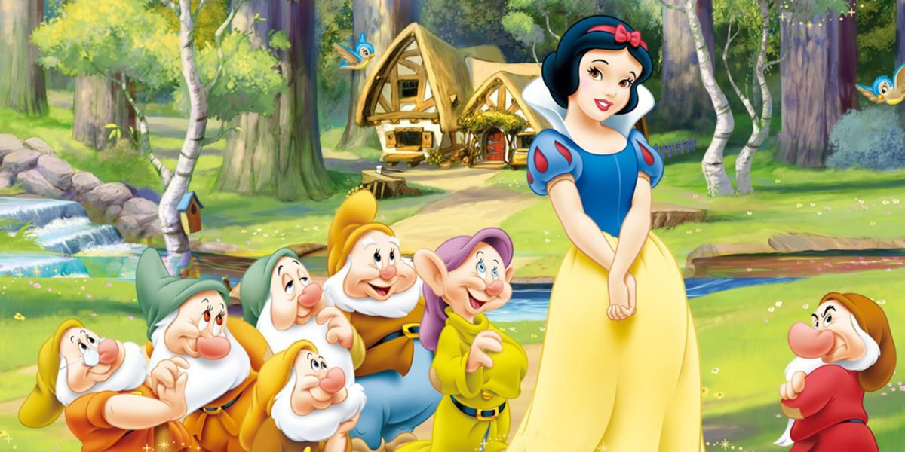
Who are the main characters in the story?
They’re Snow White and the Seven Dwarfs.
Notes:
MADE BY FACEBOOK :TRAN THI THANH TAM

Slide 8
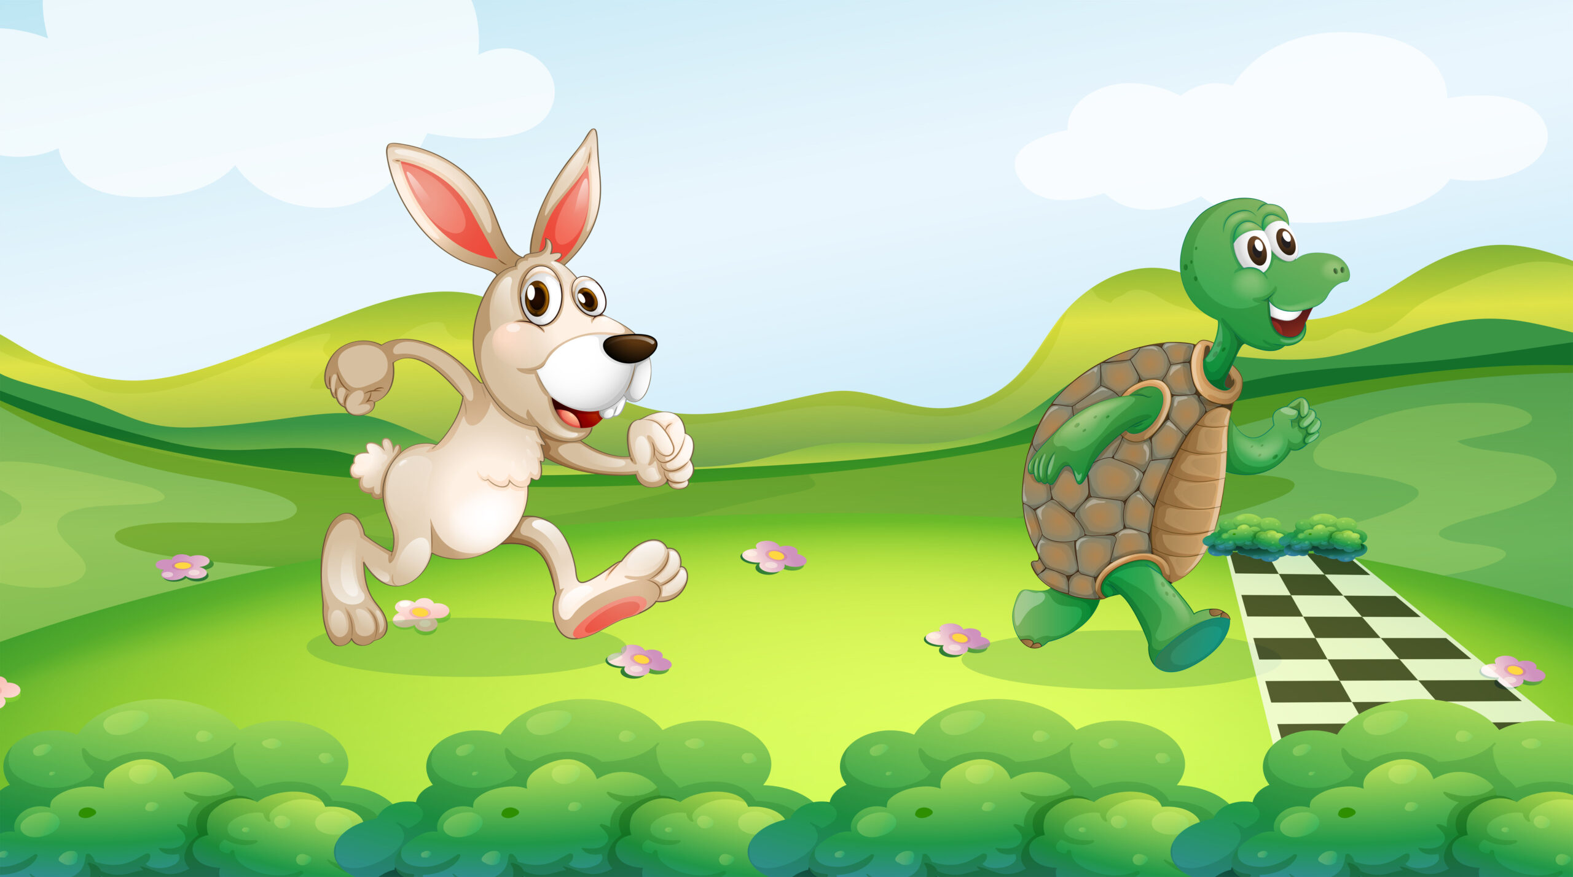
Who are the main characters in the story?
They’re the Tortoise and the Hare.
Notes:
MADE BY FACEBOOK :TRAN THI THANH TAM

