Slide 1
Unit 20
At The summer camp
Lesson 1 – Period 1

Slide 2
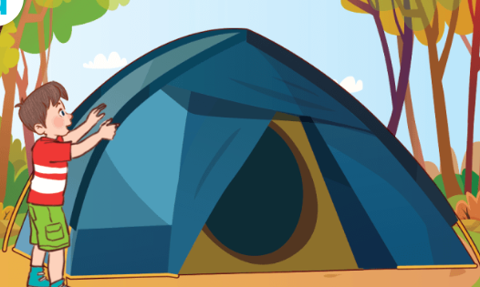
putting up a tent
pʊtɪŋ ʌp ə ˈtent/
dựng, cắm trại, lều

Slide 3
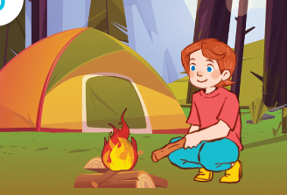
building a campfire
/bɪldɪŋ ə ˈkæmpfaɪə/
đốt lửa trại

Slide 4
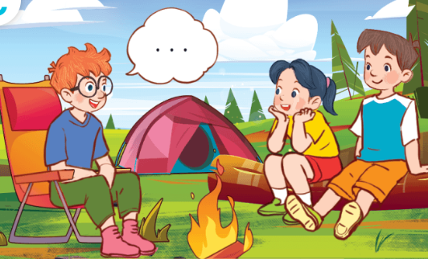
telling a story
/telɪŋ ə ˈstɔːri/
kể chuyện

Slide 5

taking a photo
/teɪkɪŋ ə ˈfəʊtəʊ/
chụp ảnh

Slide 6
Vocabulary
putting up a tent
: dựng, cắm trại, lều
building a campfire
: đốt lửa trại
taking a photo
: chụp ảnh
telling a story
: kể chuyện

Slide 7
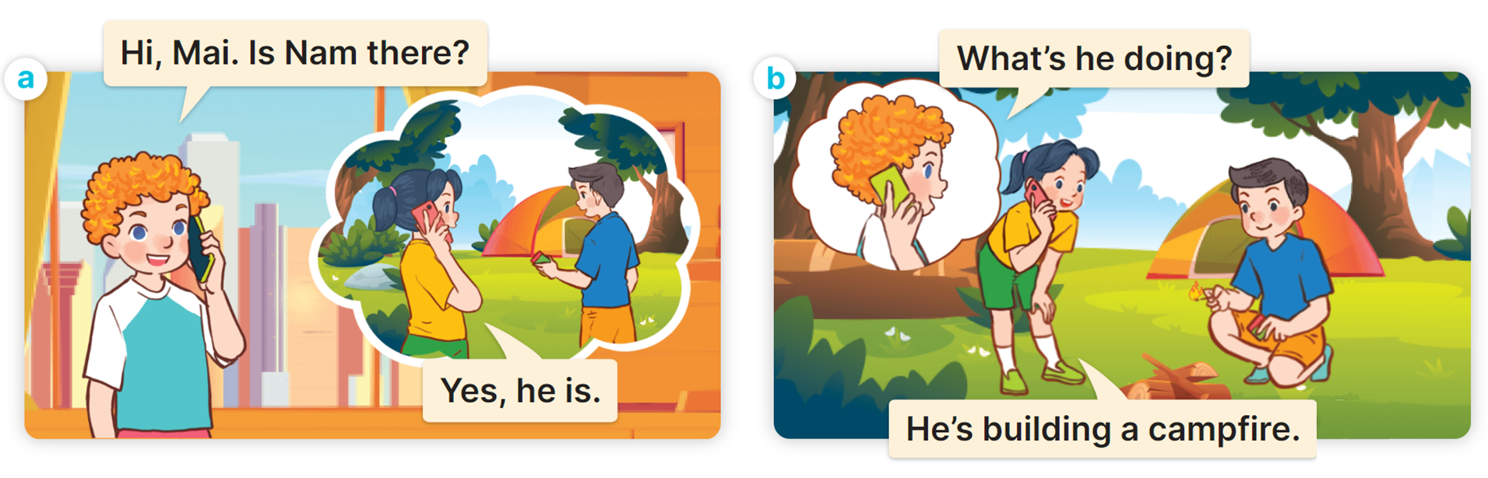

1
Look, listen and read.

Slide 8
Cách hỏi 1 người nào đó đang làm gì:
What’s he / she doing?
(Anh ấy/Cô ấy đang làm gì?)
He’s / She’s ________.
(Anh ấy/Cô đang ________.)
Ex:

Slide 9
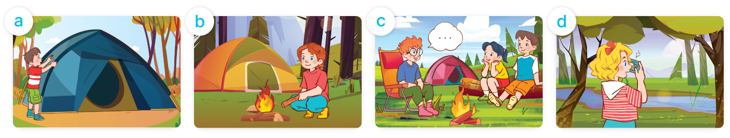
2
Listen, point and say.
What’s he / she doing?
He’s / She’s ________.
putting up a tent
building a campfire
telling a story
taking a photo

Slide 10
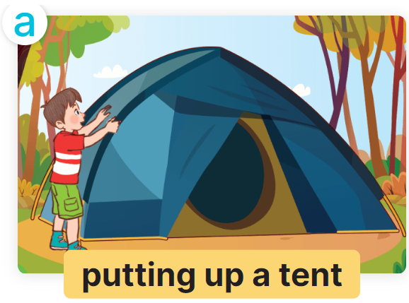


2
Listen, point and say.
What’s he doing?
He’s putting up a tent .

Slide 11
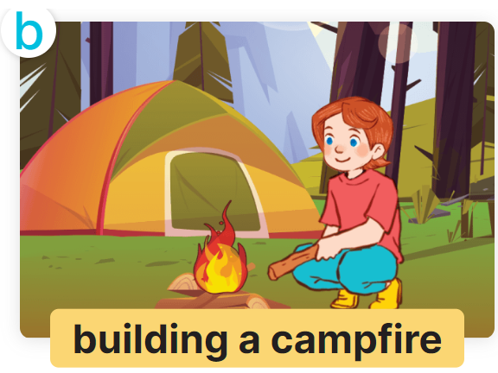
2
Listen, point and say.
What’s she doing?
She’s building a campfire.

Slide 12
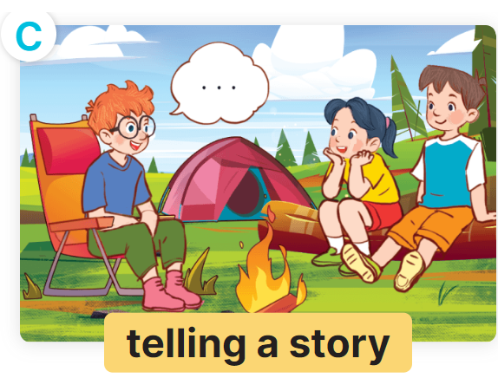
2
Listen, point and say.
What’s he doing?
He’s telling a story.

Slide 13
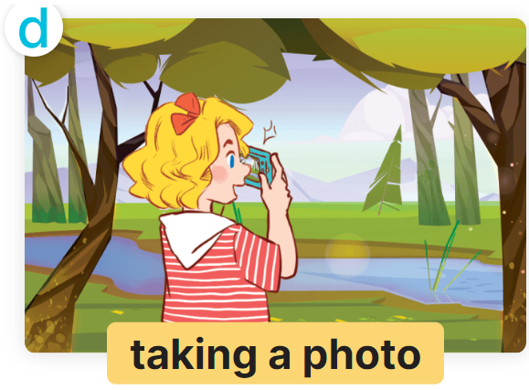
2
Listen, point and say.
What’s she doing?
She’s taking a photo.

Slide 14
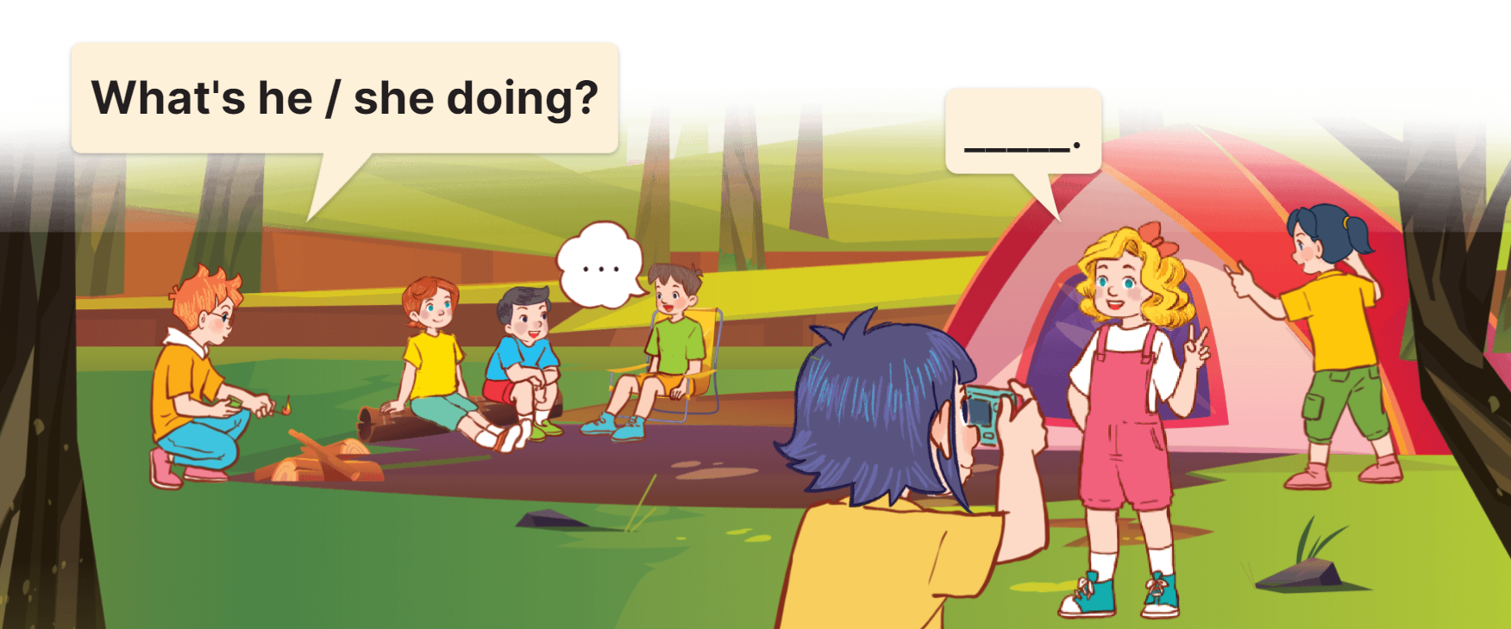
3
Let’s talk.

