Slide 1


Unit 20
At The summer camp
Lesson 1 – Period 2

Slide 2
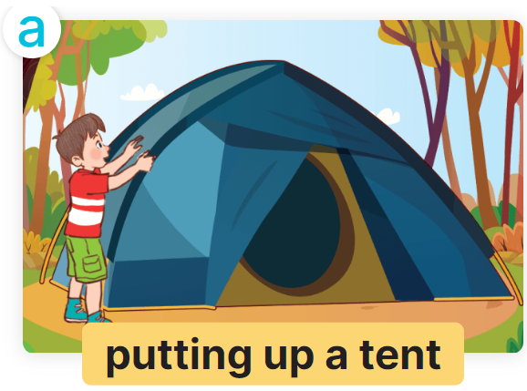
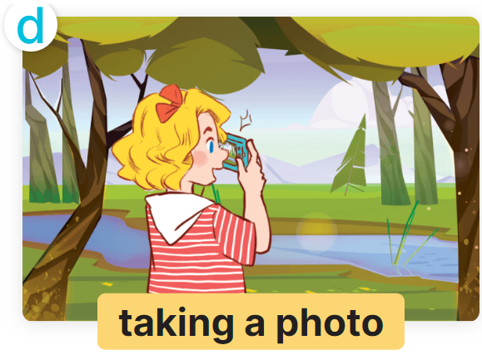

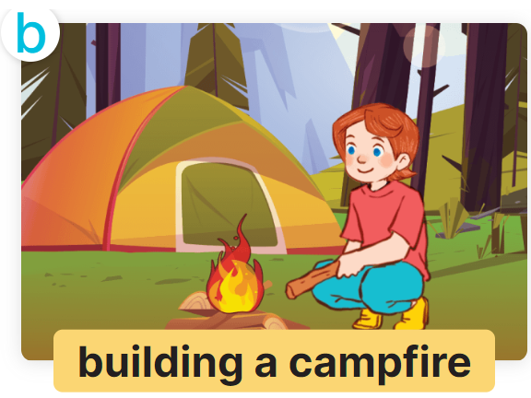

He’s / She’s ________.
What’s he / she doing?
MsPham
0936082789

Slide 3

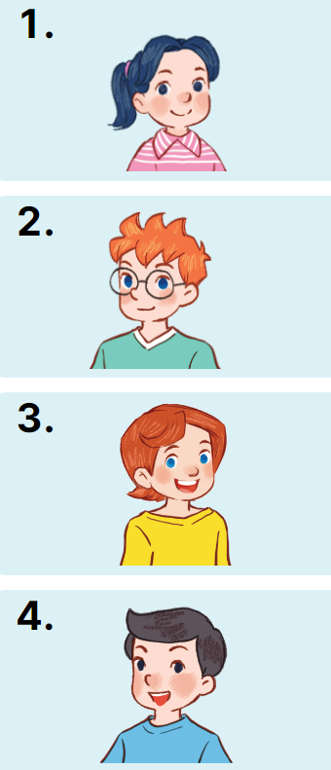

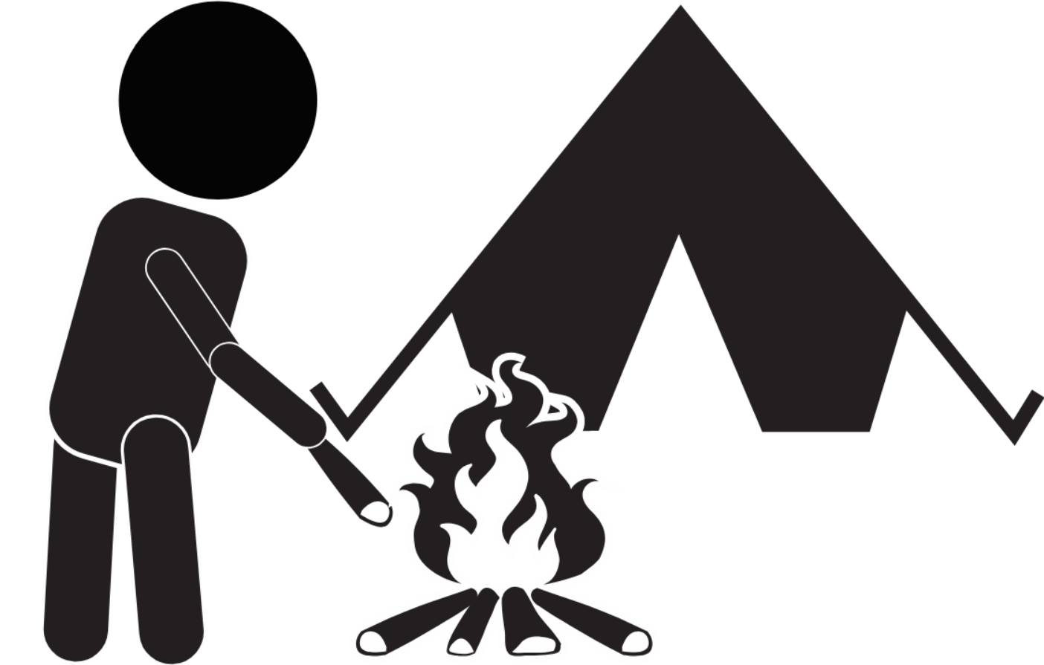
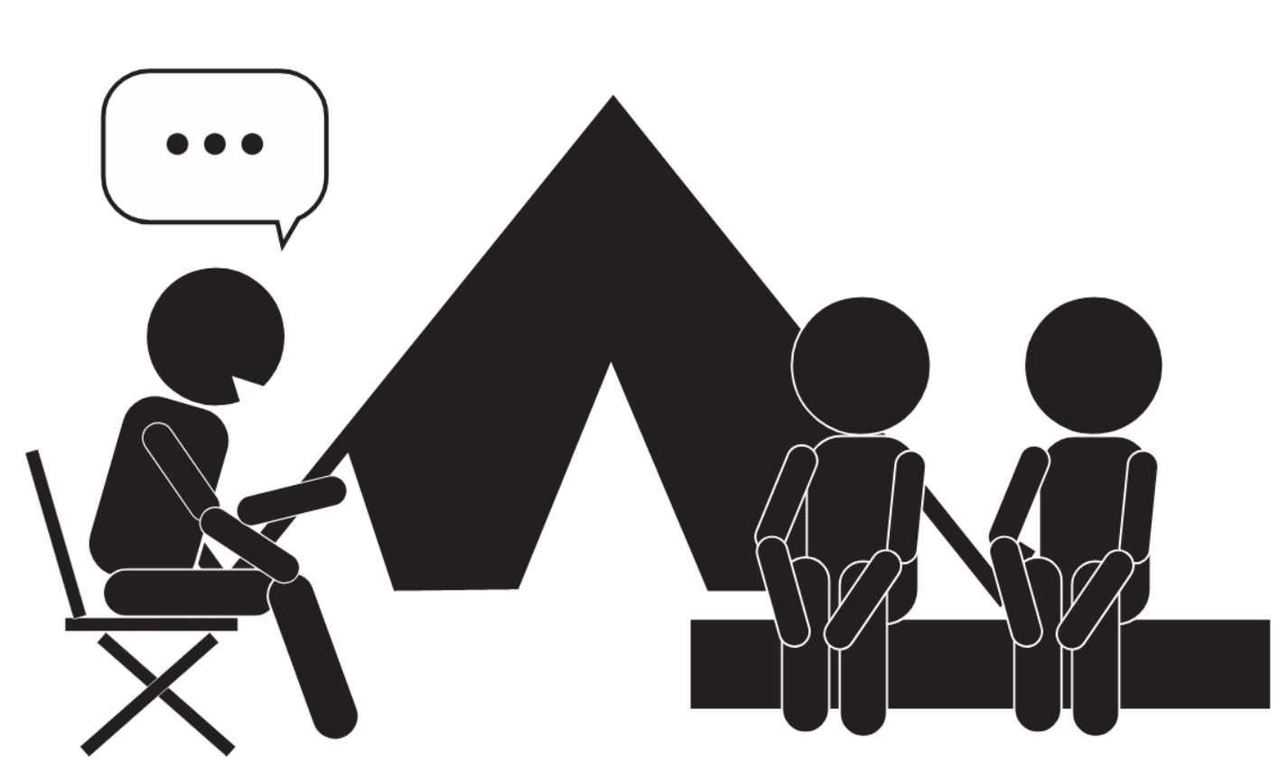
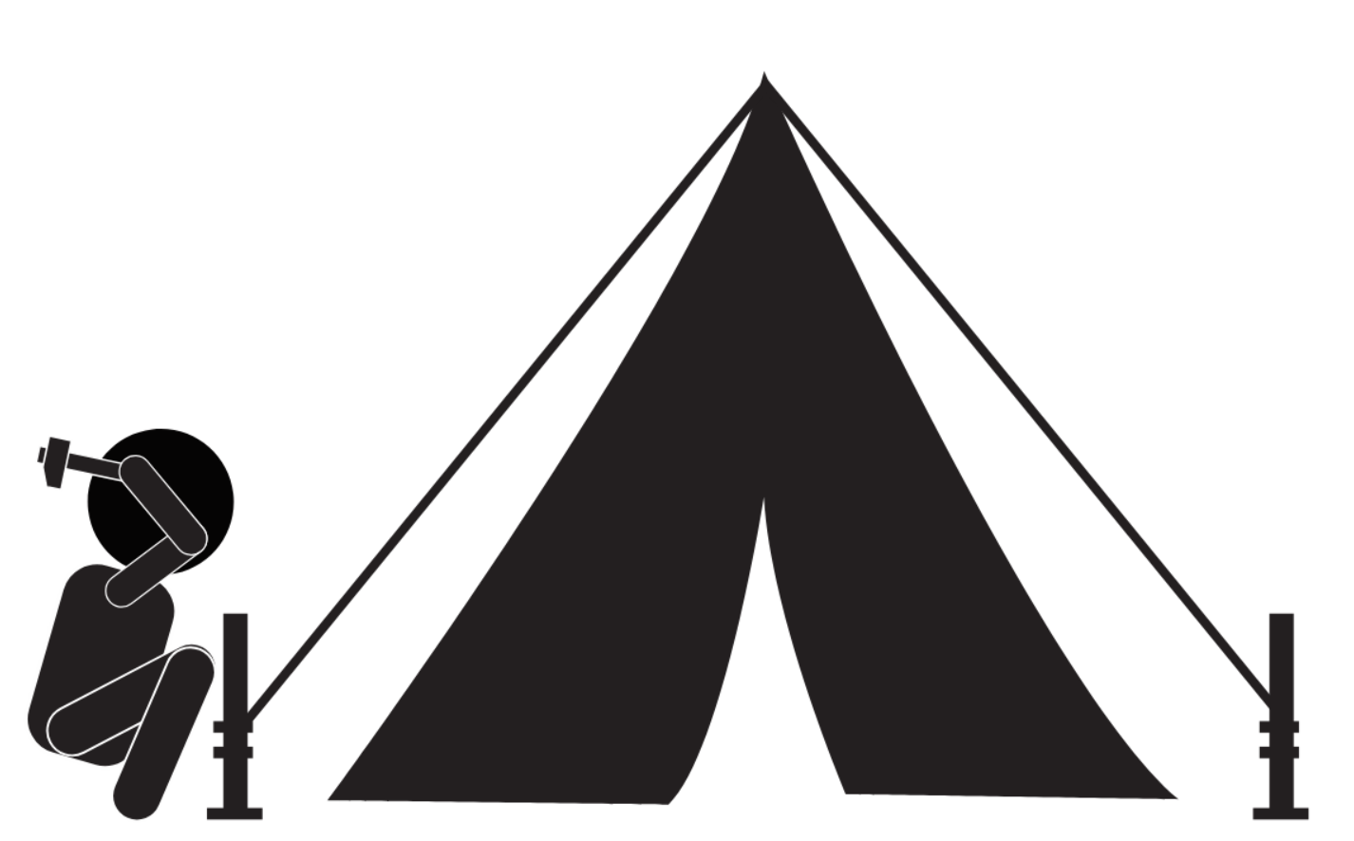
4
Listen and match.
a
b
c
d

Slide 4




5
Look, complete and read.
1
2
A: What's he doing at the campsite?
B: He's telling ________________.
A: What's she doing at the campsite?
B: She's building _______________.
a story
a campfire
3
4
doing
the campsite
A: What's he ______ at the campsite?
B: He's putting up ___________.
A: What's she doing at __________?
B: She’s __________________.
a tent
taking a photo

Slide 5
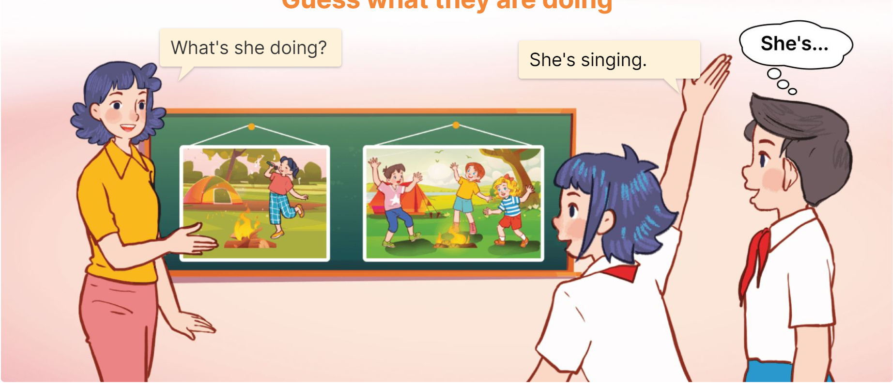
6
Let’s play.
Guess what they are doing

