Slide 1

REVIEW 3
Notes:
MADE BY FACEBOOK :TRAN THI THANH TAM

Slide 2
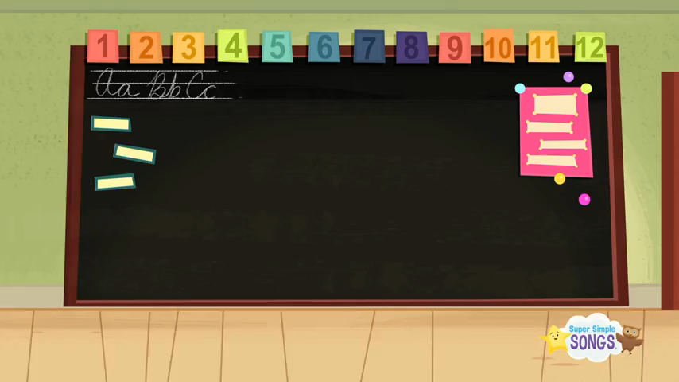
SING THE SONG: HELLO
Notes:
Made by FACEBOOK: TRAN THI THANH TAM

Slide 3

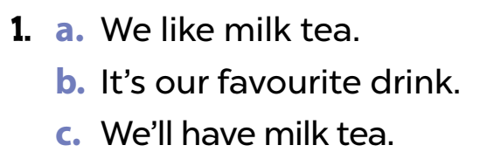
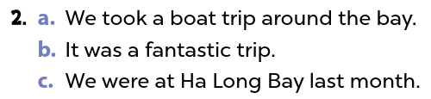
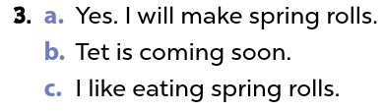
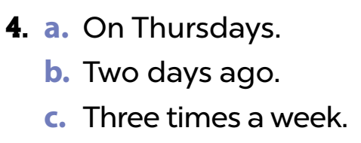
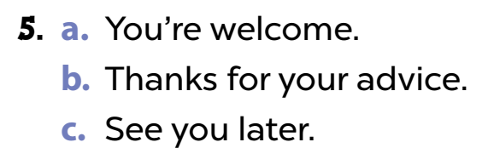
1. Listen and circle a, b or c
Notes:
MADE BY FACEBOOK :TRAN THI THANH TAM

Slide 4
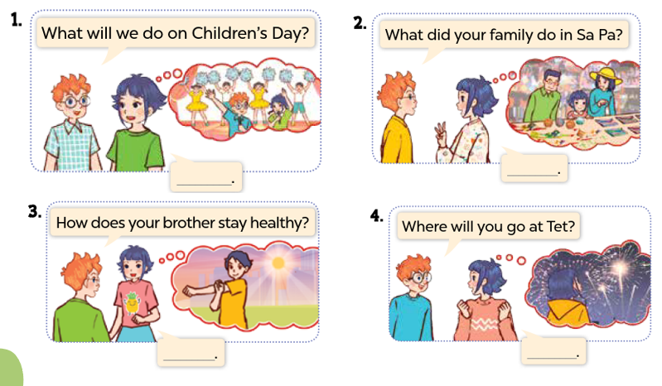
2. Ask and answer
Notes:
MADE BY FACEBOOK :TRAN THI THANH TAM

Slide 5
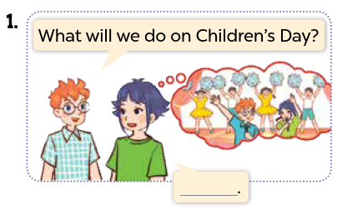
2. Ask and answer
We are going to sing and dance.
Notes:
MADE BY FACEBOOK :TRAN THI THANH TAM

Slide 6
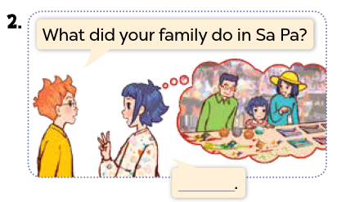
2. Ask and answer
My family bought souvenirs.
Notes:
MADE BY FACEBOOK :TRAN THI THANH TAM

Slide 7
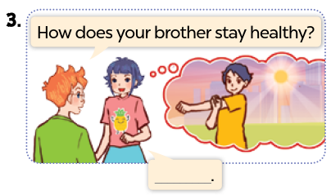
2. Ask and answer
He does morning exercise.
Notes:
MADE BY FACEBOOK :TRAN THI THANH TAM

Slide 8
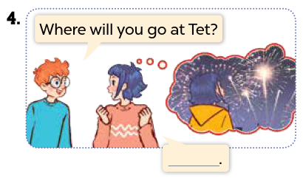
2. Ask and answer
I’ll go to a fireworks show.
Notes:
MADE BY FACEBOOK :TRAN THI THANH TAM

Slide 9
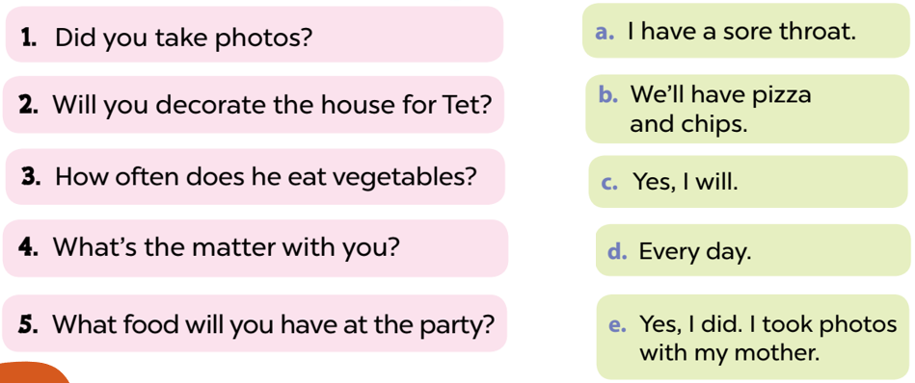
3. Read and match
Notes:
MADE BY FACEBOOK :TRAN THI THANH TAM

Slide 10
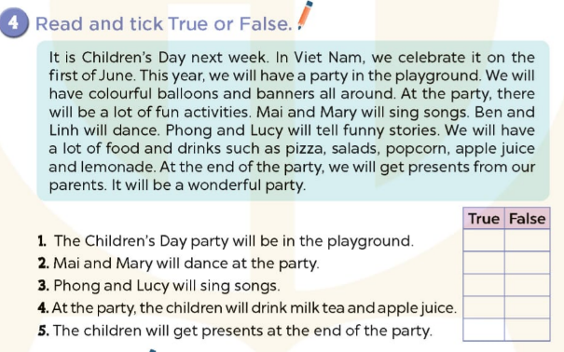


✓
✓
✓
✓
✓
Notes:
MADE BY FACEBOOK :TRAN THI THANH TAM

Slide 11
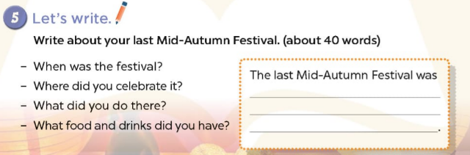
Notes:
MADE BY FACEBOOK :TRAN THI THANH TAM

Slide 12
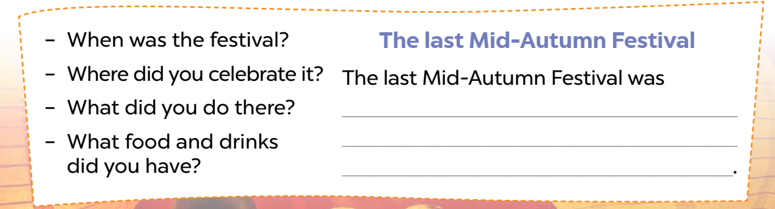
5. Let’s write
What food and drinks did you have?
The last Mid-Autumn Festival
The last Mid-Autumn Festival was in September. It was in the school playground. Lan and Hoa sang a song. Nam and Quan danced together. Huong and I played hide-and-seek.
We ate
chicken noodles and watermelon.
We drank water and apple juice
Notes:
MADE BY FACEBOOK :TRAN THI THANH TAM

