Slide 1

REVIEW 4
Notes:
MADE BY FACEBOOK :TRAN THI THANH TAM

Slide 2
PLAY GAME
Choose the best answer
Notes:
Step 2: Have groups put the posters on the desk and practice the presentation. Encourage all members in the group to present. Go around the classroom and offer help where necessary.

Slide 3

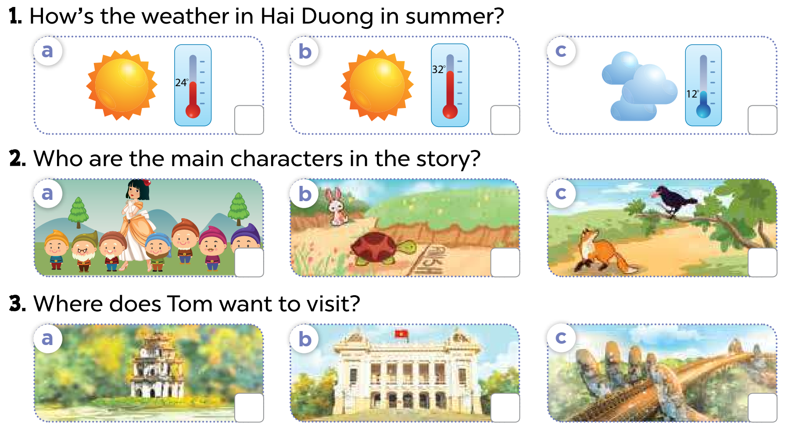

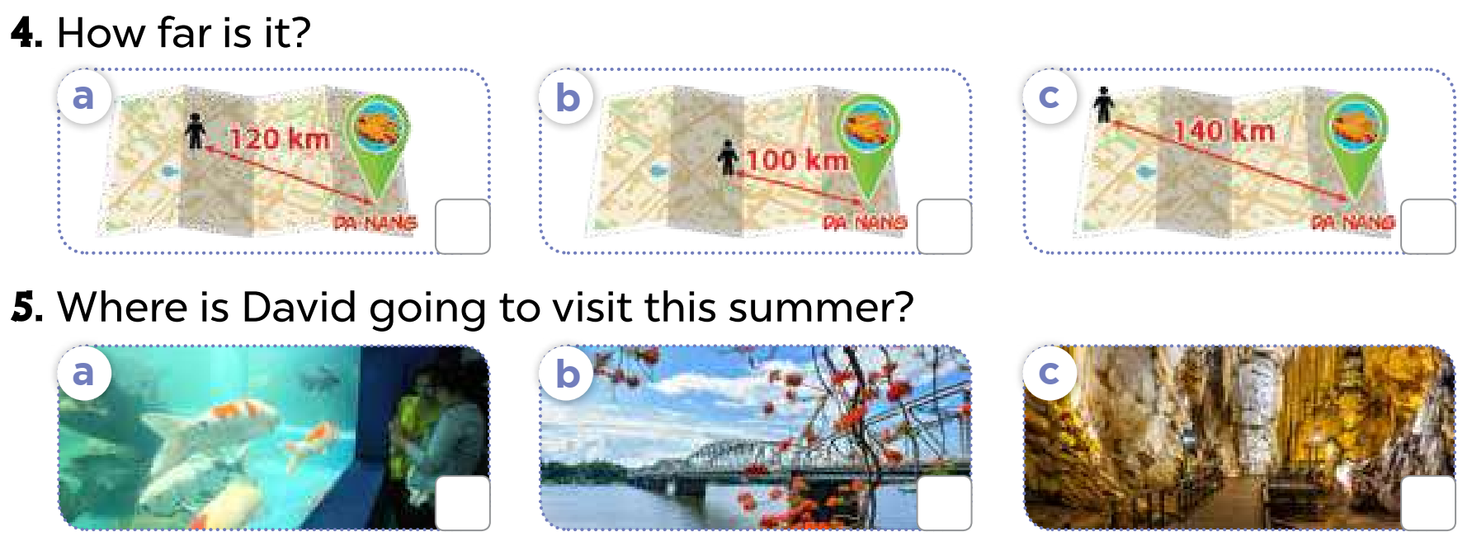
1. Listen and tick
Notes:
MADE BY FACEBOOK :TRAN THI THANH TAM

Slide 4

2. Ask and answer
Notes:
MADE BY FACEBOOK :TRAN THI THANH TAM

Slide 5
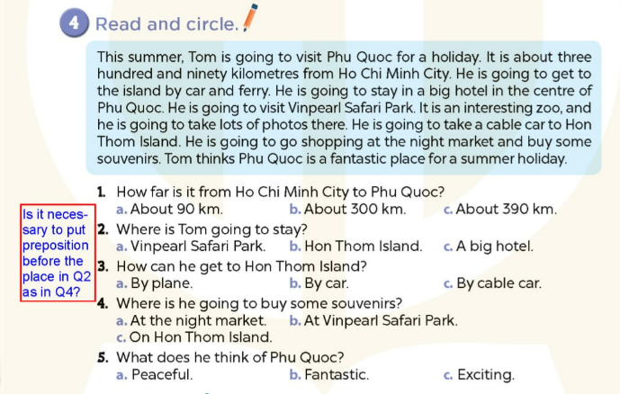
Notes:
MADE BY FACEBOOK :TRAN THI THANH TAM

Slide 6
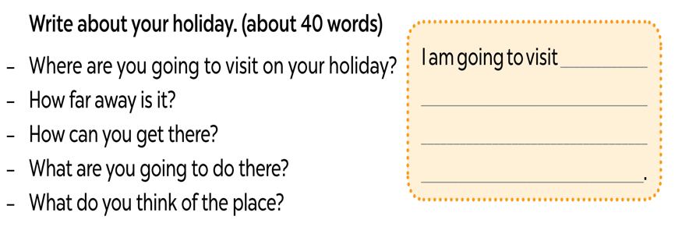
5. Let’s write
Notes:
MADE BY FACEBOOK :TRAN THI THANH TAM

Slide 7
5. Let’s write
Suggested answer.
I am going to visit Ba Na Hills in Da Nang this summer. I am going to get there by coach. It is about three hundred kilometres from Gia Lai. I am going to take the cable car to the centre of Ba Na Hills. I am going to walk on Golden Bridge. I am going to visit the old buildings and take photos there. I think Ba Na Hills is a beautiful place for a summer holiday.
Notes:
MADE BY FACEBOOK :TRAN THI THANH TAM

Slide 8





CHOOSE PRESENTS
NEXT
Notes:
MADE BY FACEBOOK :TRAN THI THANH TAM

Slide 9


Where are you going to visit
this summer?
BACK
I’m going to visit Phu Quoc island.
Notes:
MADE BY FACEBOOK :TRAN THI THANH TAM

Slide 10

BACK
Notes:
MADE BY FACEBOOK :TRAN THI THANH TAM

Slide 11

How’s the weather in Gia Lai
in summer?
BACK
It’s sunny and hot.
Notes:
MADE BY FACEBOOK :TRAN THI THANH TAM

Slide 12
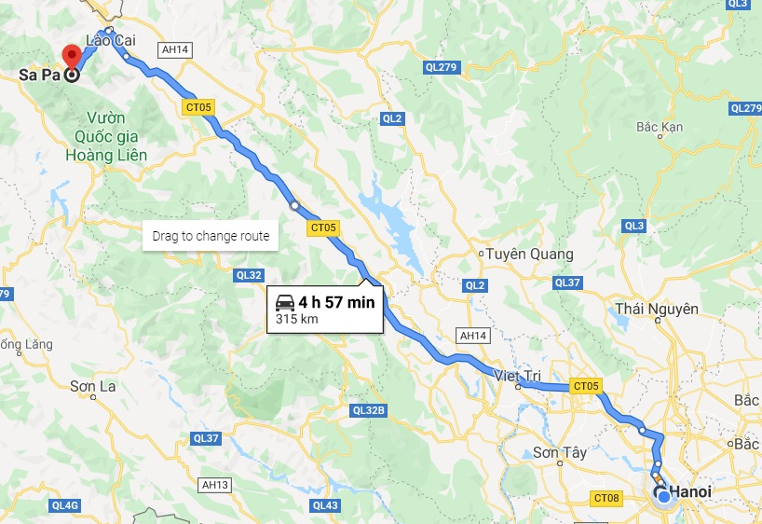
How far is it from Ha Noi
to Sa Pa?
BACK
315 km
It’s about 315 kilometres.
Notes:
MADE BY FACEBOOK :TRAN THI THANH TAM

Slide 13
BACK
Notes:
MADE BY FACEBOOK :TRAN THI THANH TAM

Slide 14
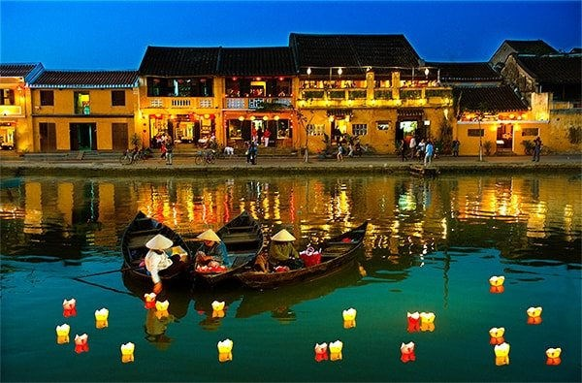
What do you think of Hoi An Old Town?
BACK
I think it’s beautiful
Notes:
MADE BY FACEBOOK :TRAN THI THANH TAM

