Slide 1

UNIT 20 :OUR SUMMER HOLIDAYS
LESSON 3 (1, 2, 3)
Notes:
MADE BY FACEBOOK :TRAN THI THANH TAM

Slide 2

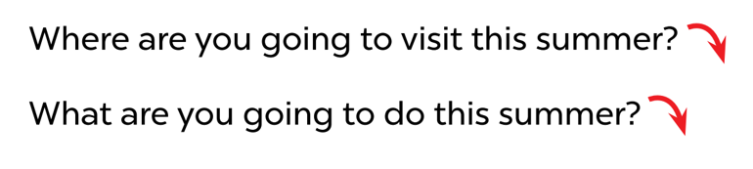
1.Listen and repeat
Notes:
MADE BY FACEBOOK :TRAN THI THANH TAM

Slide 3
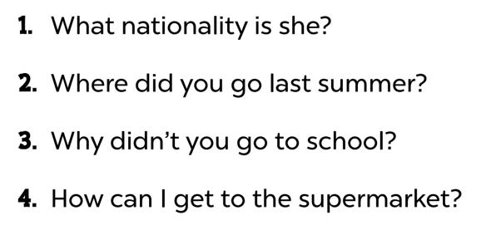

2. Listen and repeat. Pay attention to the intonation
Notes:
MADE BY FACEBOOK :TRAN THI THANH TAM

Slide 4
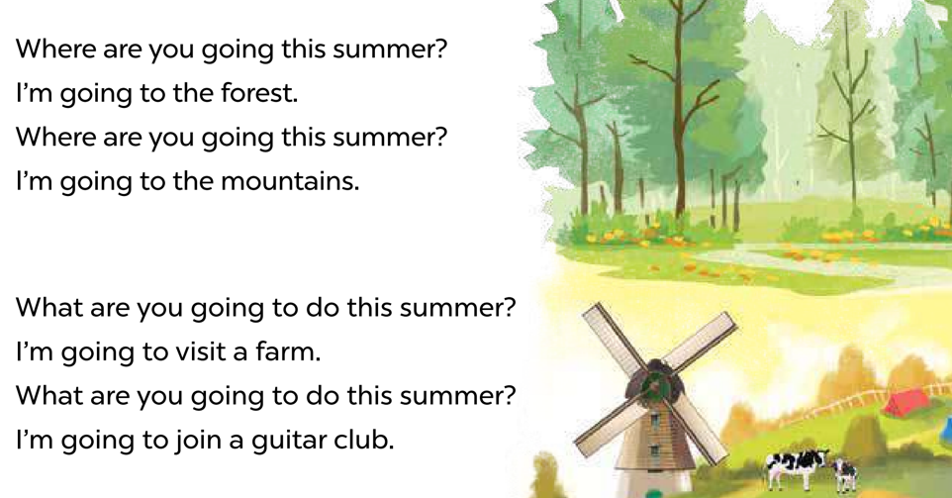
3. Let’s chant
Notes:
MADE BY FACEBOOK :TRAN THI THANH TAM

Slide 5
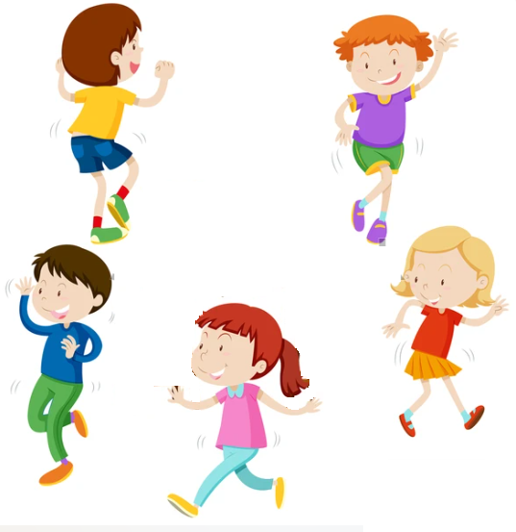
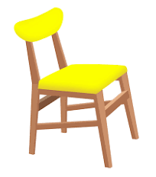
Hot seat
Game

Slide 6

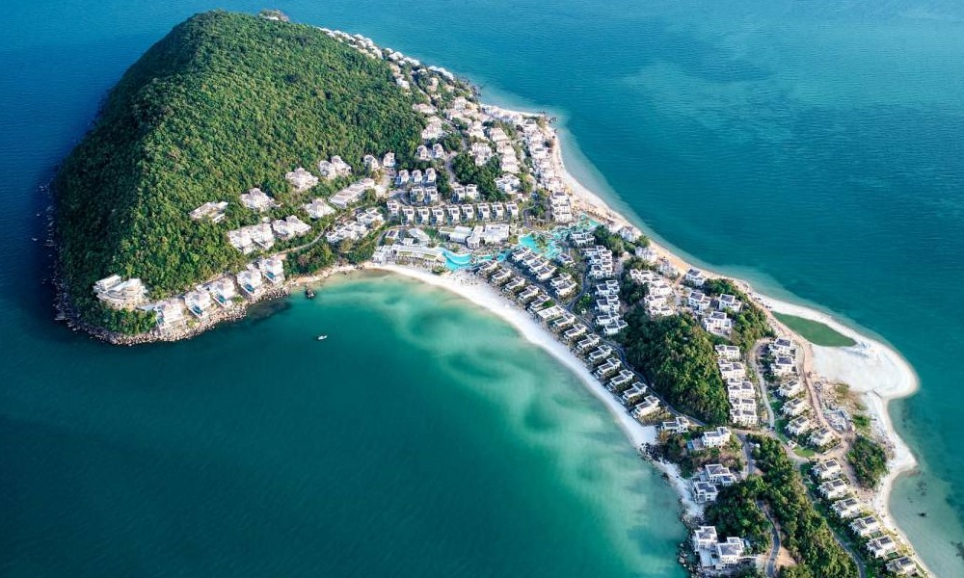
Where are you going to visit this summer?
Phu Quoc Island
I’m going to visit ……..…..................
Notes:
MADE BY FACEBOOK :TRAN THI THANH TAM

Slide 7
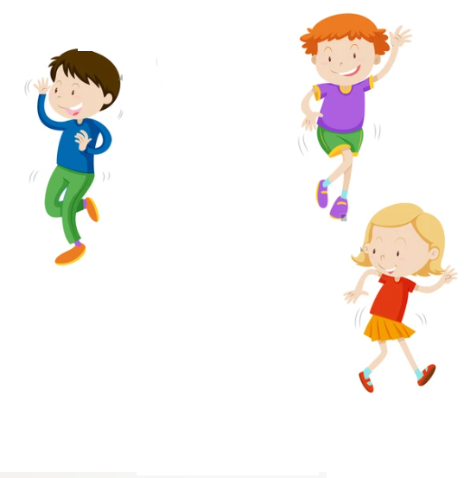
Notes:
MADE BY FACEBOOK :TRAN THI THANH TAM

Slide 8
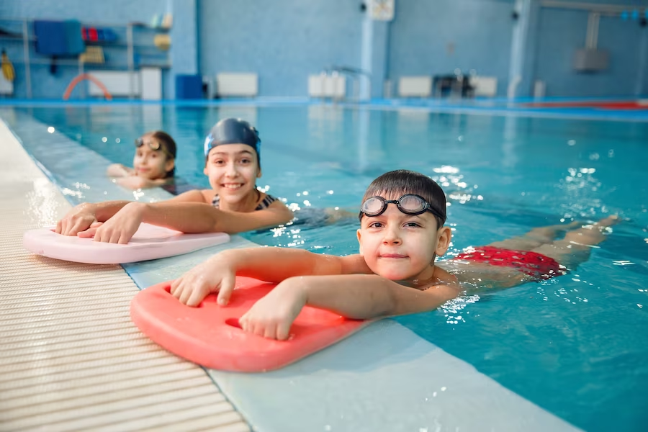
What are you going to do this summer?
practise swimming
I’m going to...……..…..................
Notes:
MADE BY FACEBOOK :TRAN THI THANH TAM

Slide 9
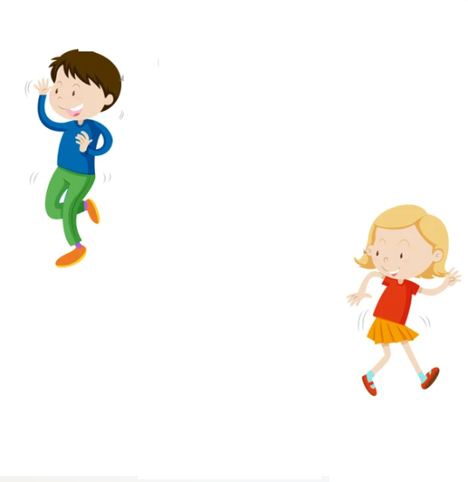
Notes:
MADE BY FACEBOOK :TRAN THI THANH TAM

Slide 10
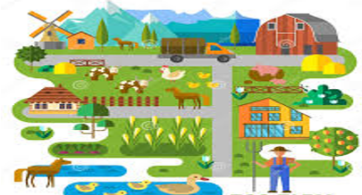
What are you going to do this summer?
visit eco-farm
I’m going to ……..…..................
Notes:
MADE BY FACEBOOK :TRAN THI THANH TAM

Slide 11
Notes:
MADE BY FACEBOOK :TRAN THI THANH TAM

Slide 12
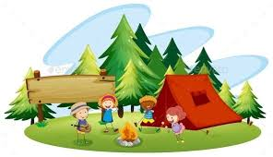
What are you going to do this summer?
go camping
I’m going to ……..…..................
Notes:
MADE BY FACEBOOK :TRAN THI THANH TAM

