Slide 1
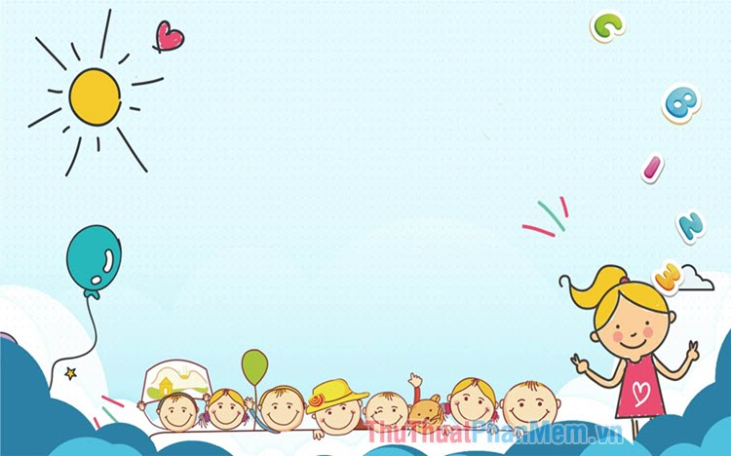

UNIT 20:OUR SUMMER HOLIDAYS
LESSON 3 ( 4, 5, 6)

Slide 2
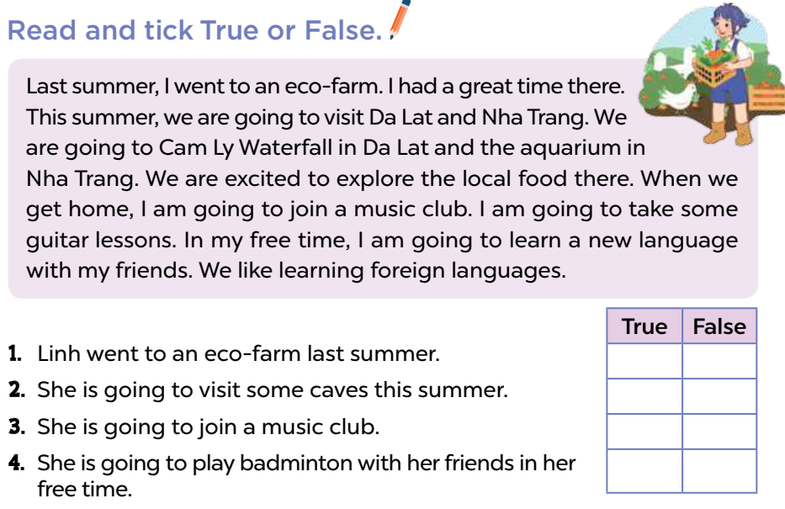



4. Read and tick true or false
4. Listen and tick true or false
Notes:
MADE BY FACEBOOK :TRAN THI THANH TAM

Slide 3
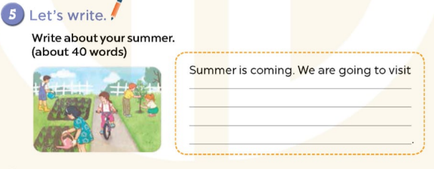
Notes:
MADE BY FACEBOOK :TRAN THI THANH TAM

Slide 4
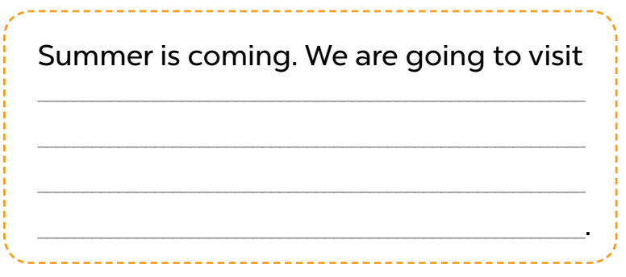
5. Let’s write
Notes:
MADE BY FACEBOOK :TRAN THI THANH TAM

Slide 5
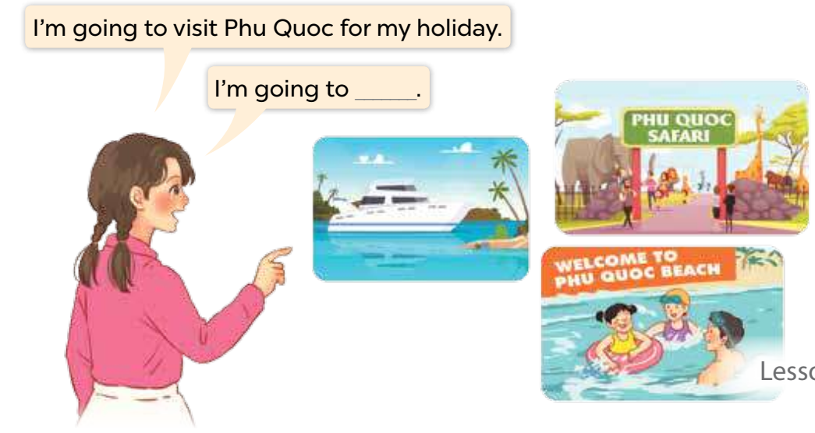
6. Project
Notes:
MADE BY FACEBOOK :TRAN THI THANH TAM

Slide 6


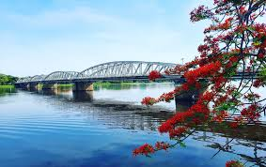
I’m going to visit Phu Quoc Island.
TRUE
FALSE

Slide 7

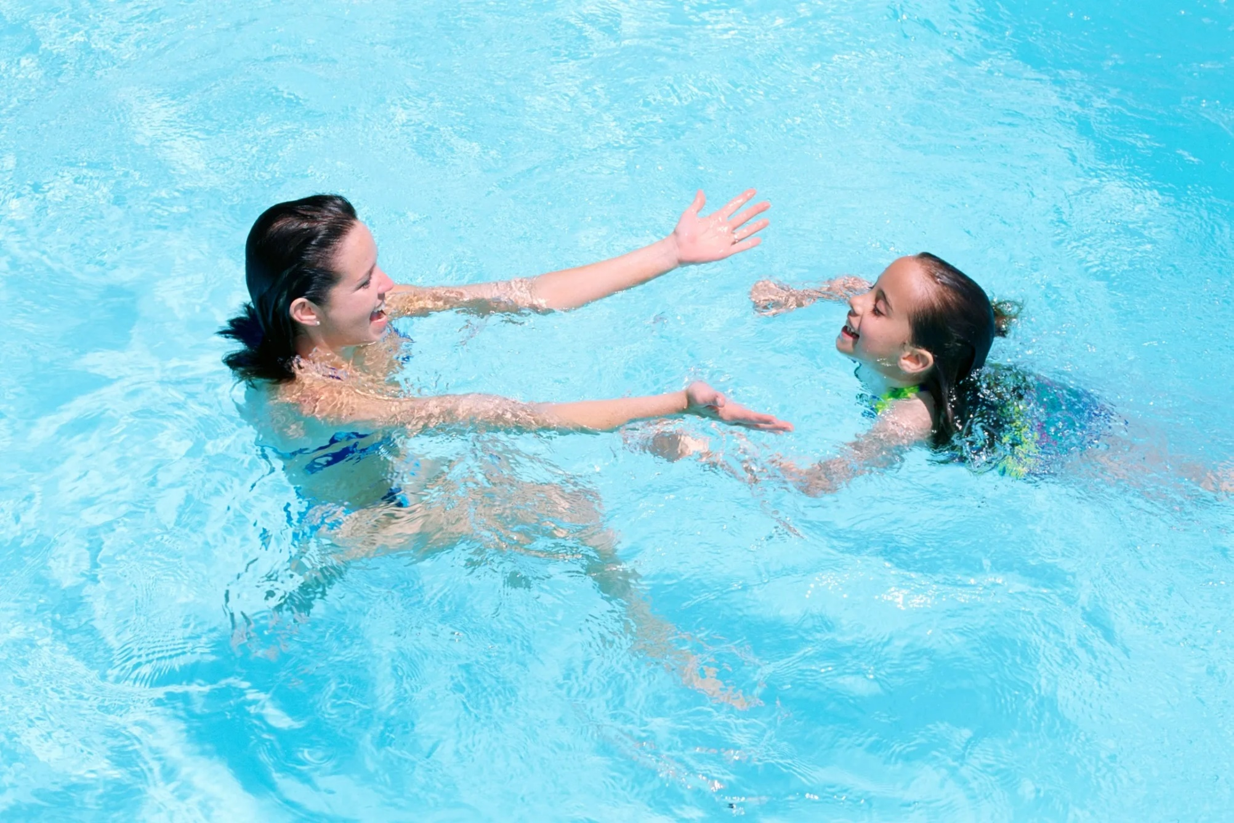
She is going to practice swimming with her mother.
TRUE
FALSE

Slide 8
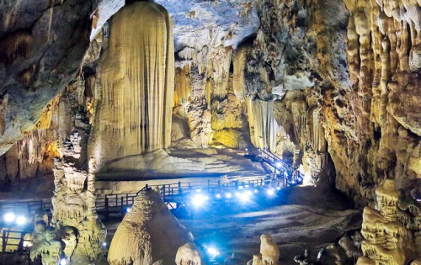
We are going to visit an aquarium.
TRUE
FALSE

Slide 9

They are going to join a music club.
TRUE
FALSE

