Slide 1
SƠ ĐỒ TƯ DUY MÔN TIẾNG ANH LỚP 4- Mindmap
Gv : Nguyễn Thị Thu Phương
Trường TH & THCS Quang Hưng

Slide 2








(Bạn đến từ đâu?)
Where are you from?
(Tớ đến từ ____)
I’m from _________.
I am = I’m
Vietnam
Australia
America
Britain

Slide 3




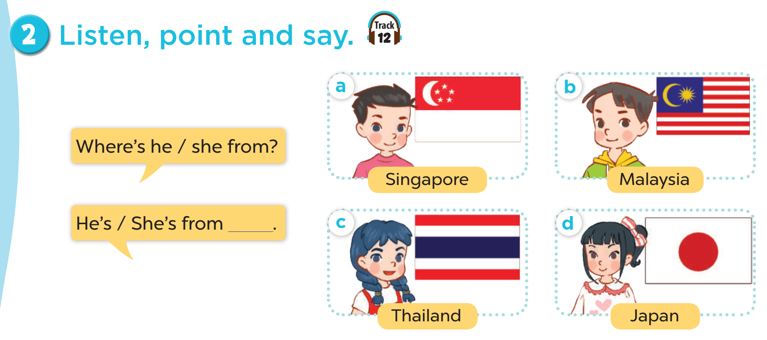



Where’s he/she from?
He’s/She’s from ________.
is = ’s
Thailand
Japan
Malaysia
Singapore

Slide 4
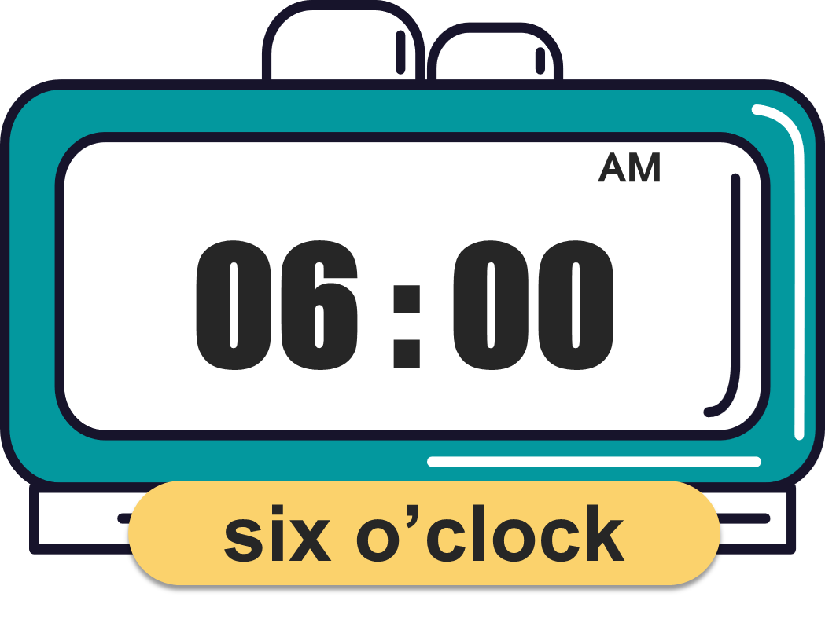
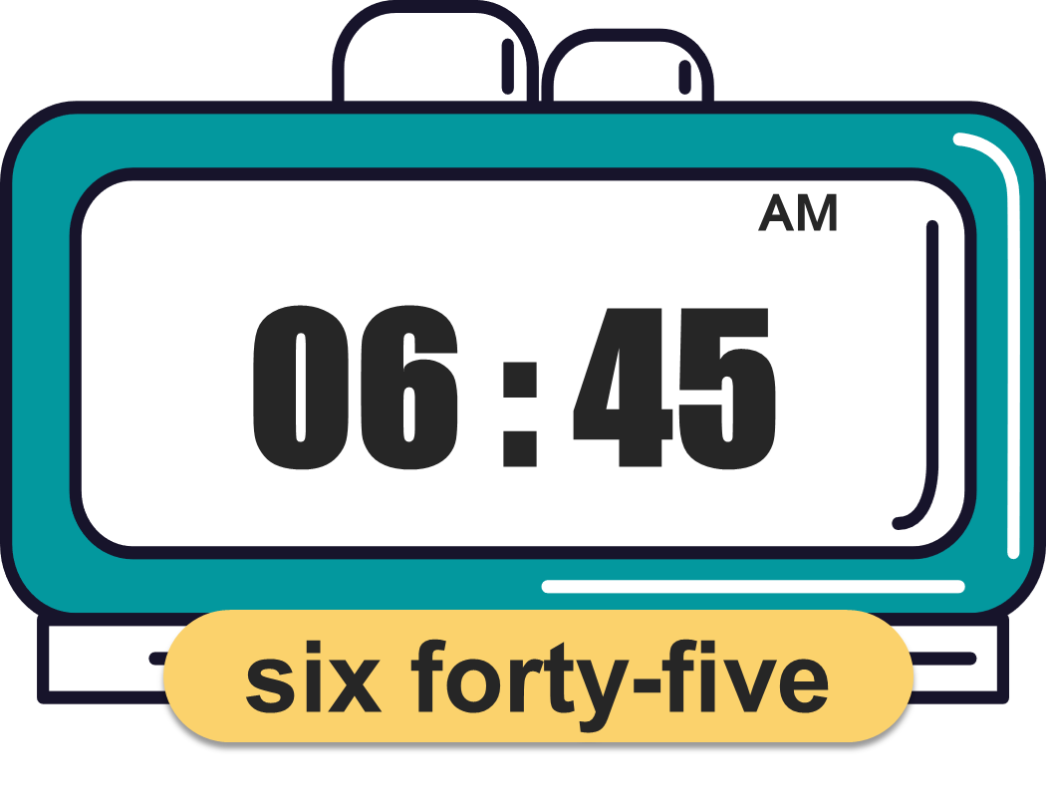
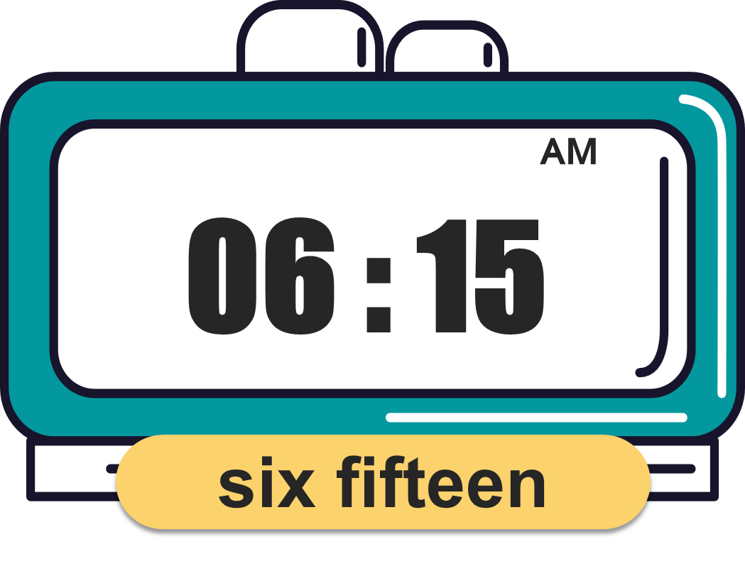
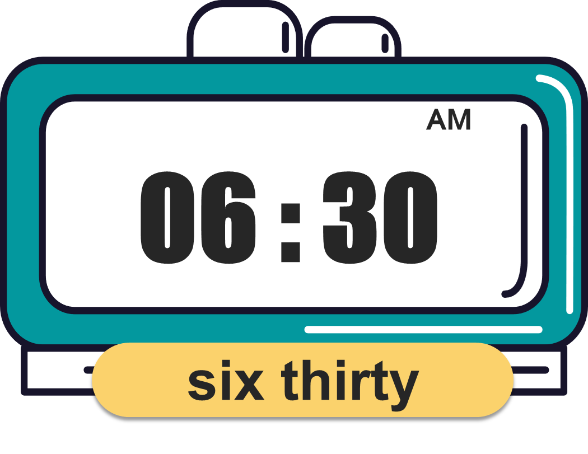
What time is it?
(Mấy giờ rồi?)
It’s _________.
(____)

Slide 5




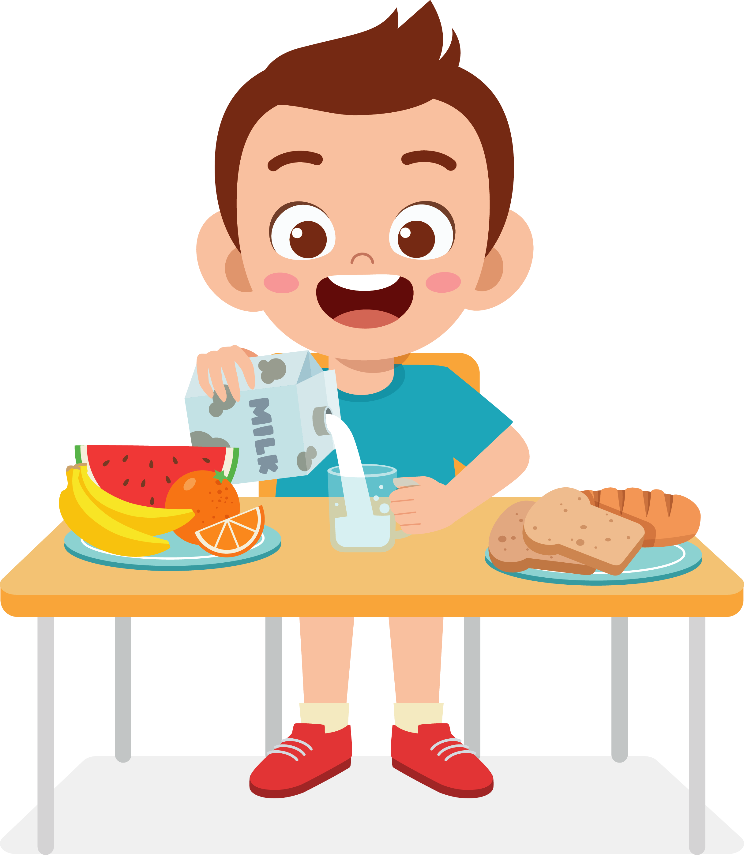




What time do you _______?
I ________ at ________.
get up
go to bed
have breakfast
go to school

Slide 6

Monday
Tuesday
Sunday
Wednesday
What day is it today?
It’s _________.
Thursday
Saturday
Friday

Slide 7


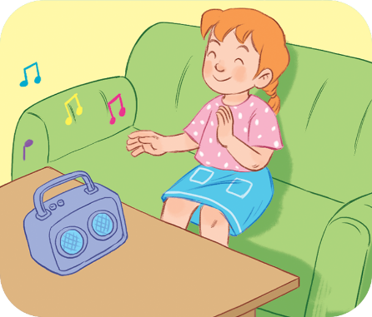


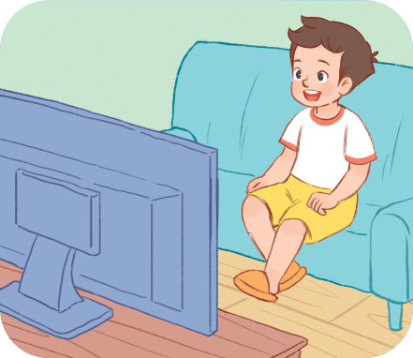
Monday
Tuesday
Sunday
Wednesday
What do you do on _____s?
I _________.
Saturday
Friday
Thursday

Slide 8








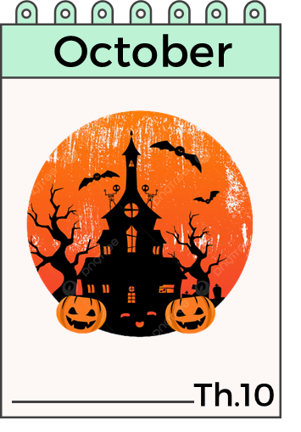
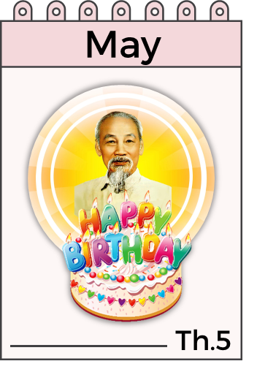
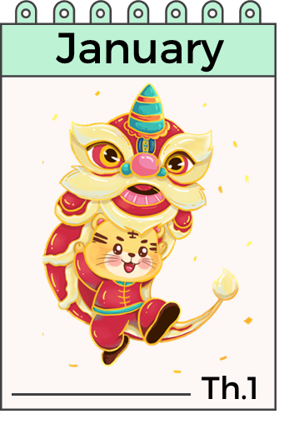
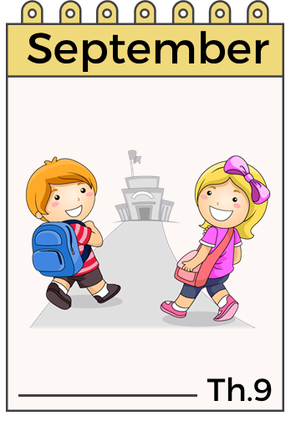
When’s your birthday?
It’s in ___________.

Slide 9

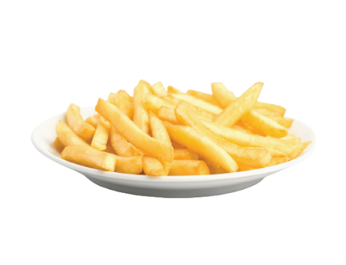




What do you want to eat/drink?
I want some _________.
chips
water
grapes
lemonade
jam
juice

Slide 10






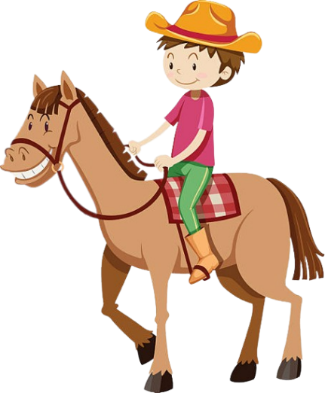
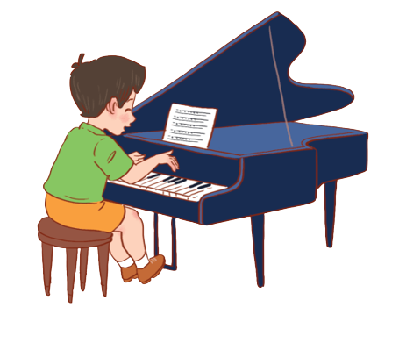

Yes, I can.
Can you + __________?
No, I can’t.
play the guitar
ride a bike
play the piano
ride a horse
skip
fly a kite

Slide 11

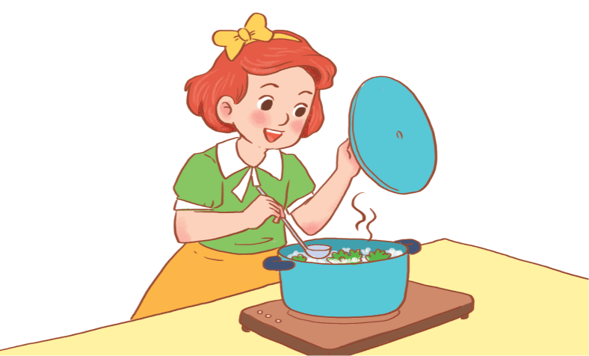
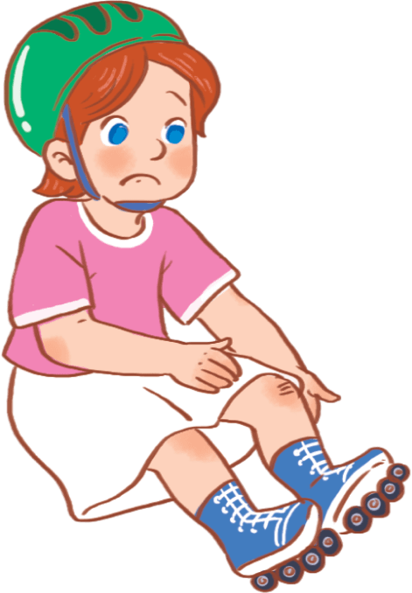



Yes, he/she can.
Can he/she + _________?
No, he/she can’t.
draw
cook
roller skate
swim
play
football
play
badminton

