Slide 1


Good morning class!!!

Slide 2
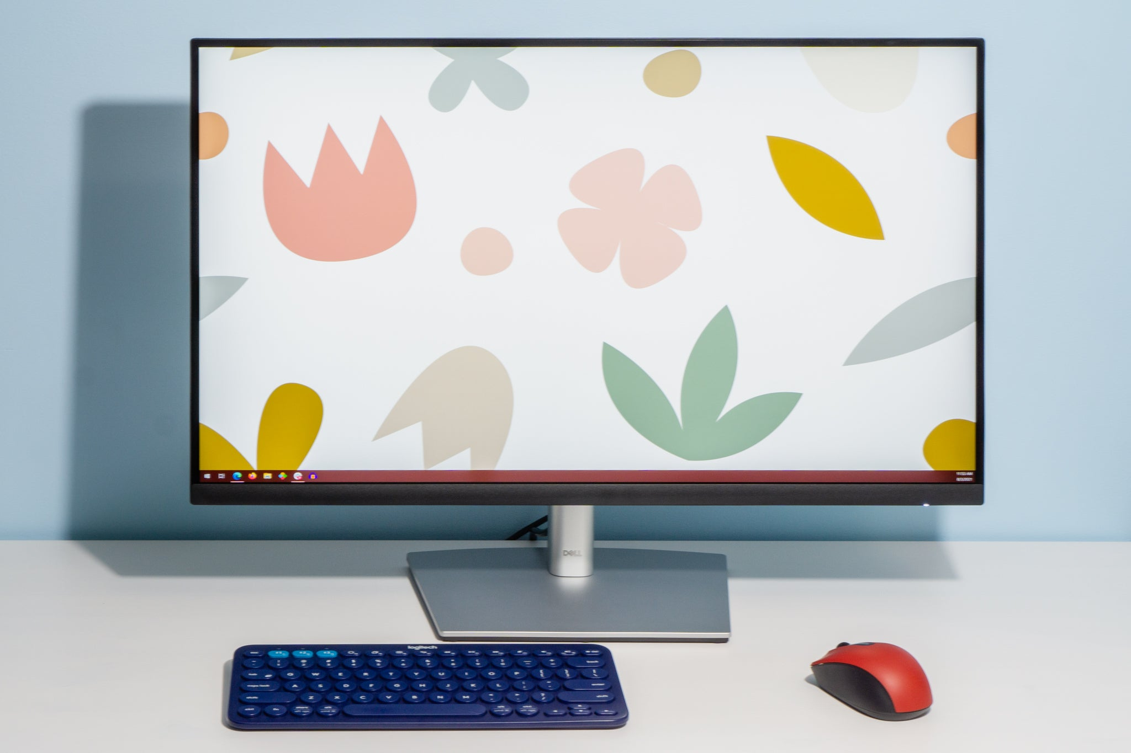



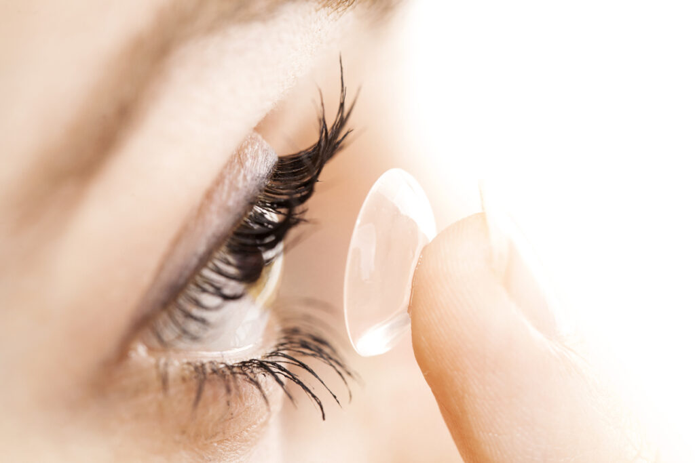

* WARM-UP
GAME: Matching
Connection
Breakout rooms
3D contact lenses
Online class
Robot teacher
Computer screen
1
2
3
4
5
6

Slide 3


Unit
11
SCIENCE AND TECHNOLOGY
LESSON 2: A closer look 1

Slide 4
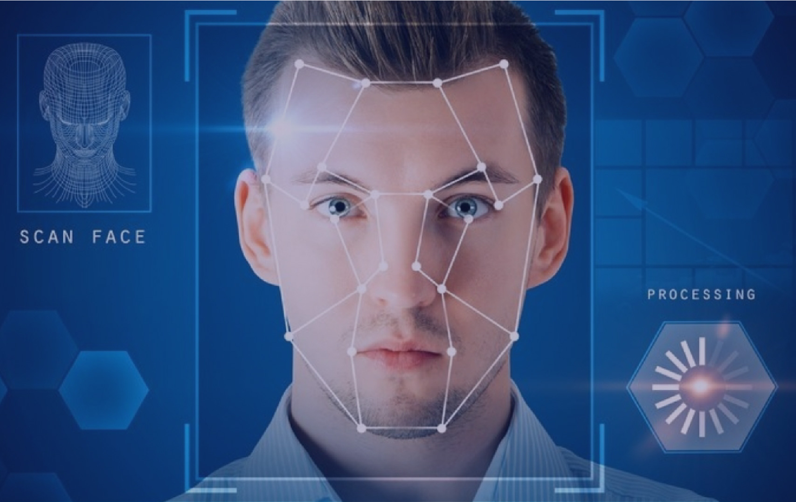

I. VOCABULARY
face recognition (n)
/feɪsˌrekəɡˈnɪʃn/
nhận diện gương mặt

Slide 5

I. VOCABULARY
experiment (n)
/ɪkˈsperɪmənt/
Thí nghiệm

Slide 6
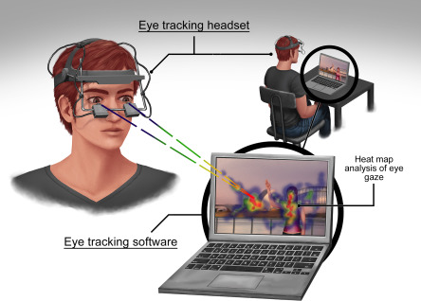
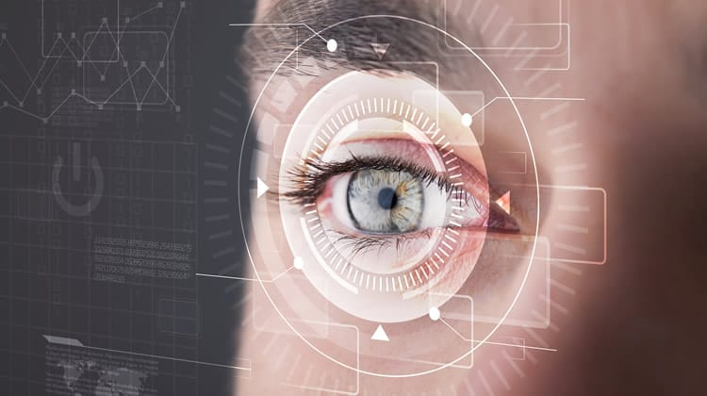
I. VOCABULARY
eye tracking (n)
/’ai ,trækɪŋ/
Theo dõi mắt

Slide 7
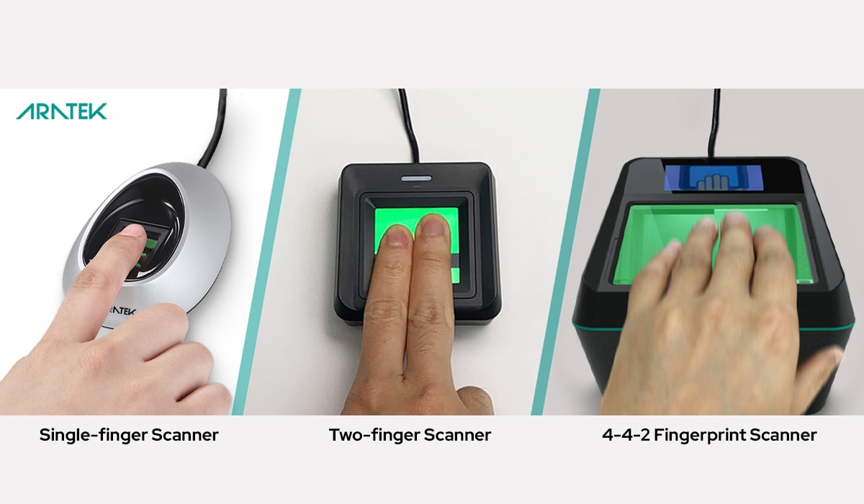
I. VOCABULARY
fingerprint scanner(n)
/ˈfɪŋɡəprɪnt ˈskænə(r)/
Máy quét vân tay

Slide 8

I. VOCABULARY
digital communication (n)
/ˈdɪdʒɪtl /kəˌmjuːnɪˈkeɪʃn/
Giao tiếp kỹ thuật số

Slide 9
* VOCABULARY
New words | Pronunciation | Meaning
1. face recognition (n) | /feɪsˌrekəɡˈnɪʃn/ | nhận diện gương mặt
2. experiment (n) | /ɪkˈsperɪmənt/ | Thí nghiệm
3. eye tracking (n) | /’ai ,trækɪŋ/ | Công nghệ dõi mắt
4. fingerprint scanner(n) | /ˈfɪŋɡəprɪnt ˈskænə(r)/ | Máy quét vân tay
5. digital (a) | /ˈdɪdʒɪtl /kəˌmjuːnɪˈkeɪʃn/ | Thuộc kỹ thuật số

Slide 10
* VOCABULARY
New words | Pronunciation | Meaning
1. face recognition (n) | /feɪsˌrekəɡˈnɪʃn/ | Công nghệ nhận diện/nhận biết gương mặt
2. experiment (n) | /ɪkˈsperɪmənt/ | Thí nghiệm
3. eye tracking (n) | /’ai ,trækɪŋ/ | Công nghệ dõi (cử động) mắt
4. fingerprint scanner(n) | /ˈfɪŋɡəprɪnt ˈskænə(r)/ | Máy quét vân tay
5. digital communication (n) | /ˈdɪdʒɪtl /kəˌmjuːnɪˈkeɪʃn/ | Giao tiếp kỹ thuật số

Slide 11

* Checking vocab
New words | Meaning
1. | Công nghệ nhận diện/nhận biết gương mặt
2. | Thí nghiệm
3. | Công nghệ dõi (cử động) mắt
4. | Máy quét vân tay
5. | Giao tiếp kỹ thuật số
face recognition (n)
experiment (n)
eye tracking (n)
fingerprint scanner(n)
digital communication (n)

Slide 12
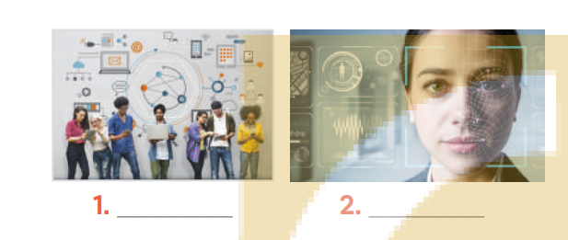
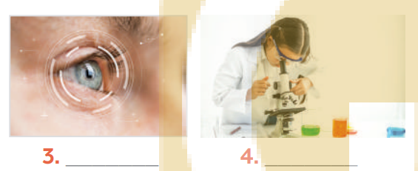
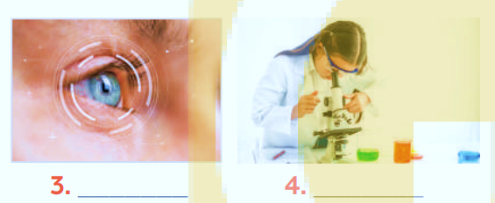
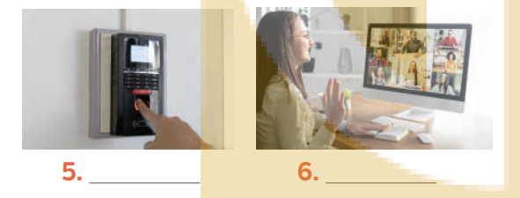
I. VOCABULARY
1
Write the words and phrases under each picture.
face recognition
experiment
video conference
eye tracking
fingerprint scanner
digital communication
1
2
3
4
5
6

Slide 13
* PRACTICE
2
Choose the option that best completes each phrase.
A. a device
1.
invent
B. a new area
A. a chemical element
B. a technology
2.
discover
A. the weather
B. a medicine
3.
create
A. a planet
B. a technology
4.
develop

Slide 14
3
Complete the sentences with the words and phrases from the box.
invented
created
experiments
discovered
fingerprint scanner
Marie Curie and Pierre Curie_____________radium and polonium.
Thomas Edison__________the light bulb in 1880.
Sarah Gilbert is the creator of a vaccine. She _________ it in 2020.
Scientists have carried out many_____________to find a cure for cancer.
Scan your finger on this _________________to check attendance, please.

Slide 15
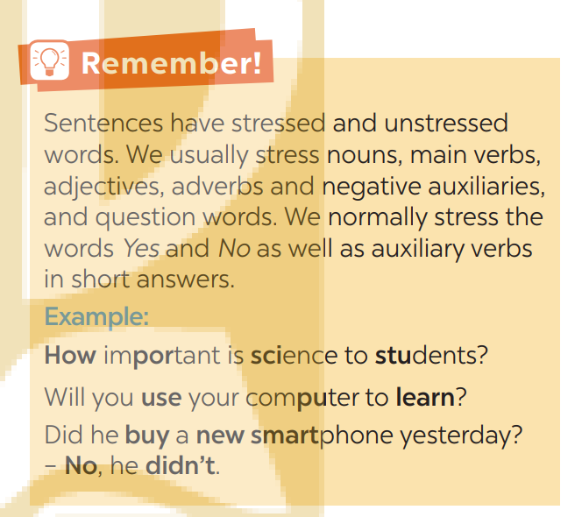
II. PRONUNCIATION: Sentence stress

Slide 16

* Some rules about stress in sentences

Slide 17
* SENTENCE STRESS – TRỌNG ÂM CÂU
Trọng âm của câu là một yếu tố rất quan trọng trong khi nói tiếng Anh, nó tạo nên ngữ điệu của câu và đôi khi còn thể hiện ẩn ý của người nói.
Trọng âm của câu thường được nhấn vào các từ khoá hay từ mang nội dung chính (content words).
E.g. We visited a famous craft village in Ha Noi.

Slide 18
Trong văn nói thì các loại từ dưới đây sẽ thường được nhấn trọng âm vào
Từ mang nội dung chính trong câu | Ví dụ
Động từ | sell, give, employ
Danh từ | car, music, table
Tính từ | red, small, beautiful
Trạng từ | quickly, never, why
Trợ từ phủ định | don’t, aren’t, can’t
Đáp án trong câu hỏi dạng đảo | yes, no

Slide 19
Không nhấn trọng âm vào các từ sau
Từ cấu trúc | Ví dụ
Đại từ | he, we, they
Giới từ | on, at, into
Mạo từ | a, an, the
Liên từ | and, but, because
Trợ động từ | do, be, have, can, must

Slide 20
* PRONUNCIATION
4
Listen and repeat the sentences. Pay attention to the bold syllables.
1. I don’t have a computer.
2. Do you call her every day? – No, I don’t.
3. They are not familiar with that new computer.
4. Did you lend her your laptop? – Yes, I did.
5. Who do you work with on Sundays?

Slide 21
5
Listen and repeat the sentences. How many stressed words are there in each sentence.
1. He is an inventor.
2. We won’t have a robot teacher next year.
3. She likes learning online.
4. Was she checking attendance when you came? - No, she wasn’t.
5. What did he invent?

Slide 22
5
Listen and repeat the sentences. How many stressed words are there in each sentence.
1. He is an inventor.
2. We won’t have a robot teacher next year.
3. She likes learning online.
4. Was she checking attendance when you came? - No, she wasn’t.
5. What did he invent?
1
5
3
6
2

Slide 23
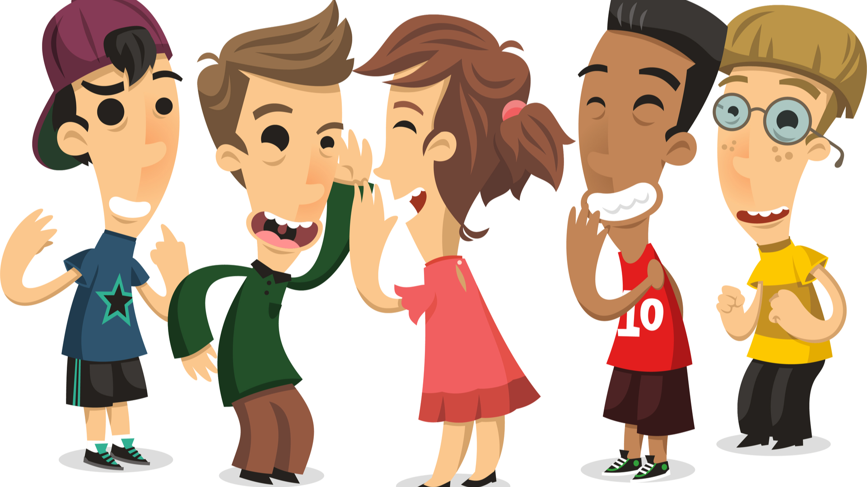
* PRODUCTION
5
GAME: BROKEN TELEPHONE
RULE:
Gather 3 or more players.
The person starting the game thinks of SENTENCE and whispers it into the next player’s ear only once, with no repeats allowed.
That listener tries to correctly repeat that SENTENCE into the next player’s ear (Paying attention to the sentence’s stress). The last person in the line or at the end of the circle repeats the SENTENCE
Allow a moment for giggles if the message is “broken” or changed. The player who started announces the correct SENTENCE
Players take turns thinking of the next SENTENCE to pass through a whisper.

Slide 24

* CONSOLIDATION
* What have we learnt in this lesson?
words and phrases related to new technologies.
new verb phrases that are used to talk about inventions, discoveries, creation, and development.
sentences stress

Slide 25

* Homework
Learn by heart words and phrases related to new technologies and new verb phrases that are used to talk about inventions, discoveries, creation, and development.
Learn by heart “REMEMBER” about sentence stress
Do Exercise ………..page ……Unit 11/Workbook

Slide 26


Thank you!
Goodbye!

Slide 27
GAME: LABELLING
WARM-UP
RULE:
Work in 2 teams
Receive the pictures of things and strips of paper with the phrases.
Stick the phrases to the right pictures.
The team with the most correct answers wins

Slide 28
