Slide 1


Good morning class!!!

Slide 2

* WARM UP
1
Look at part of the conversation in GETTING STARTED again. Then match Minh’s uncle’s direct speech with his reported speech.
Minh: …My uncle said the robots would be able to mark our work and give us feedback too.
Direct speech
1. The robots will be able to mark our work.
2. The robots will be able to give us feedback too.
Reported speech
A. My uncle said the robots would be able to give us feedback too.
B. My uncle said the robots will be able to mark our work.
1. B
2. A

Slide 3

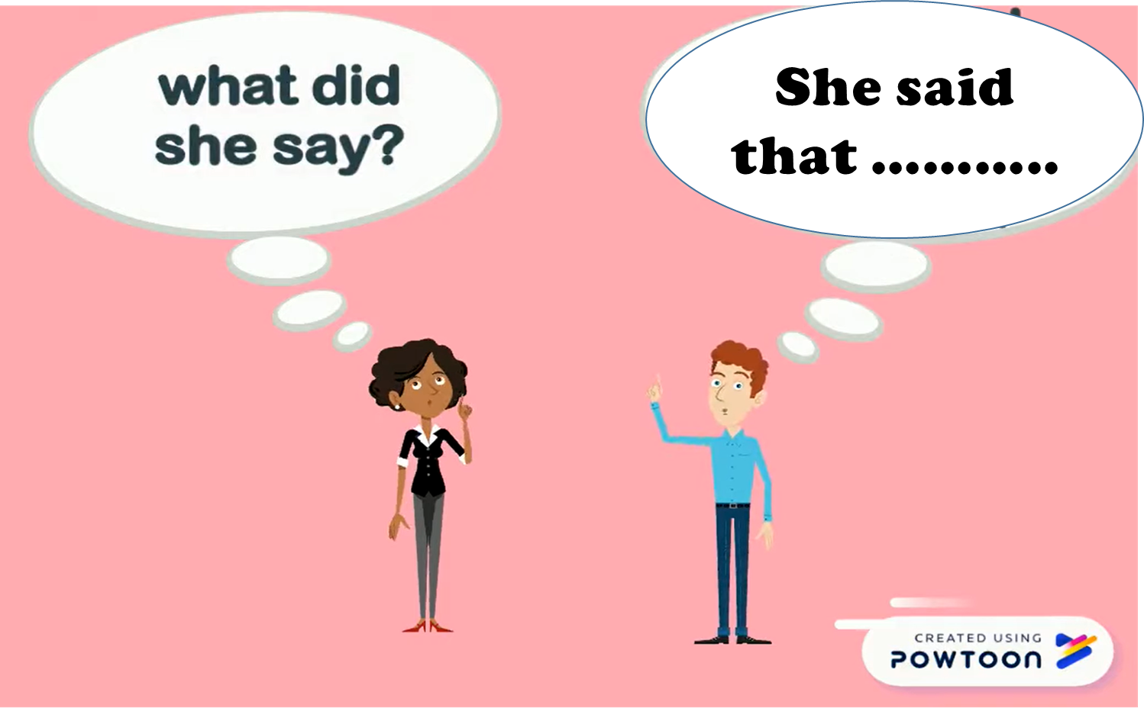
Unit
11
SCIENCE AND TECHNOLOGY
LESSON 3: A closer look 2

Slide 4
GRAMMAR
* REPORTED SPEECH (statements)
Câu tường thuật dạng câu kể
1. What is reported speech? ( Câu tường thuật là gì?)
Câu tường thuật (Reported speech) là câu thuật lại một câu nói trước đó. Câu nói trước đó được gọi là câu trực tiếp (direct speech), câu thuật lại được gọi là câu gián tiếp (indirect speech).
* Example:
Direct speech: "I want to become a scientist," Nam said.
Reported speech: Nam said that he wanted to become a scientist.

Slide 5
2. Form:
S + said (that) + S + V(lùi thì)
say
told
tell
3. Cách đổi từ câu trực tiếp sang câu tường thuật dạng câu kể
Bước 1: Chọn động từ tường thuật, chẳng hạn như said hoặc told.
Bước 2: Thay đổi thì của động từ trong câu tường thuật.
Bước 3: Thay đổi các đại từ và tính từ sở hữu.
Bước 4: Thay đổi các trạng từ chỉ nơi chốn và thời gian.

Slide 6
* REPORTED SPEECH (STATEMENTS)
REMEMBER
1. Change the verb form | Present simple | Past simple
 | Present continuous | Past continuous
 | Will | would
2. Change time and place expressions | now | Then
 | Today/ this week | That day/ that week
 | tomorrow | The following day
 | here | There
3. Change pronouns | I | He/ She
 | we | They
 | me | Him/her

Slide 7
* PRACTICE
1
Complete the second sentences using the correct verb form.
“I am a member of the IT club.”
=> Minh said that he _______ a member of the IT club.
2. “Mai will take an online course to improve her speaking.”
=> Nam said Mai________ take an online course to improve her speaking.
3. “I am talking to Phong on the phone.”
=> Tom said he ___________ to Phong on the phone.
4. “They are going to send me an email.”
=> He said they _________ to send me an email.
5. “I don’t have an iPod to listen to music.”
She said that she___________an iPod to listen to music.
was
would
was walking
were going
didn’t have

Slide 8
3
Complete the second sentences with the words and phrases from the box.
there
that year
that day
then
the next day
“I am having a science test tomorrow,” Mary said
=> Minh said she was having a science test _____________.
2. “The group is working on their project now,” Tom said
=> Tom said the group was working on their project ________.
3. “Mai is reading about Thomas Edison today,” the teacher said
=> The teacher said that Mai was reading about Thomas Edison ___________.
4. “They will invent a smart cooker this year, ” my mom said.
=> My mum said that they would invent a smart cooker____________.
5. “My teacher will park her car here,” said Mi
Mi said her teacher would park her car________.

Slide 9
4
Complete the second sentence in each pair so that it means the same as the first one.
1. “We will live much longer in the future,” said the scientist.
=> Our scientist said that _________________________________________________
2. “Our school is going to have a new laboratory here, ”said our teacher.
=> Our teacher said that _________________________________________________
3. “They are developing technology to monitor students better,” my dad said.
=> My dad said that _____________________________________________________
4. “There are no classes tomorrow because our teacher is ill,” Tom said.
=> Tom said that ________________________________________________________
5. “We want some students to join the science club next semester,” the teacher said.
=> The teacher said that__________________________________________________
we would live much longer in the future.
our school was going to have a new laboratory there.
they were developing technology to monitor students better.
there were no classes the next day because their teacher was ill.
they wanted some students to join the science club the next semester.

Slide 10
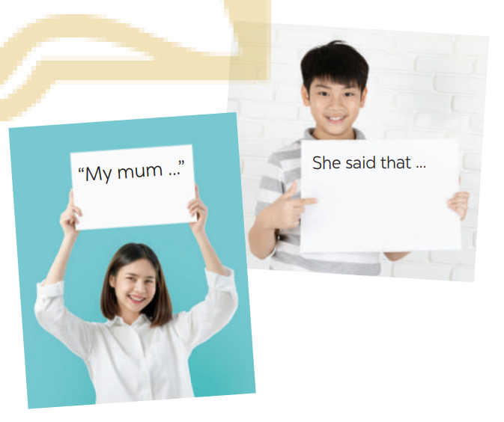
* PRODUCTION:
REPORTED SPEECH (STATEMENTS)
5
GAME: He/ She said that…
Work in pairs. One student says a sentence and the other changes that sentence into reported speech. Then swap roles.

Slide 11
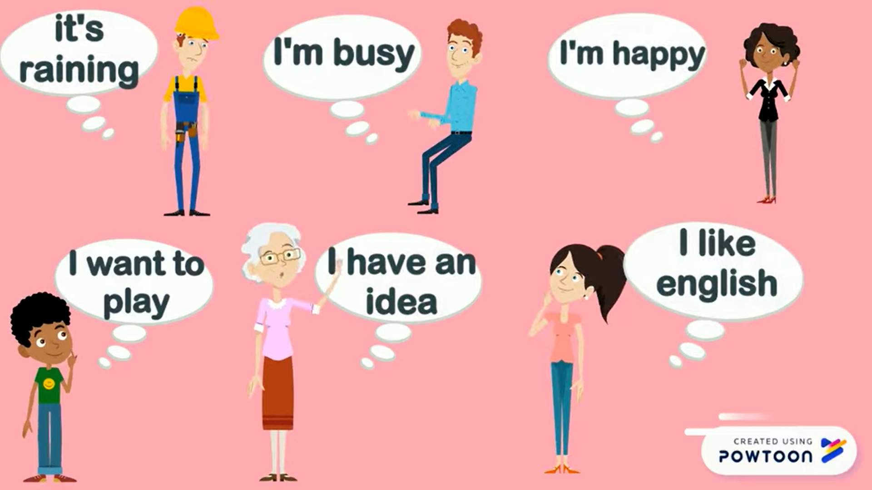
5
* PRODUCTION:
GAME: MEMORIZING
David
Peter
Linda
Ms. Brown
Sarah
Tom

Slide 12
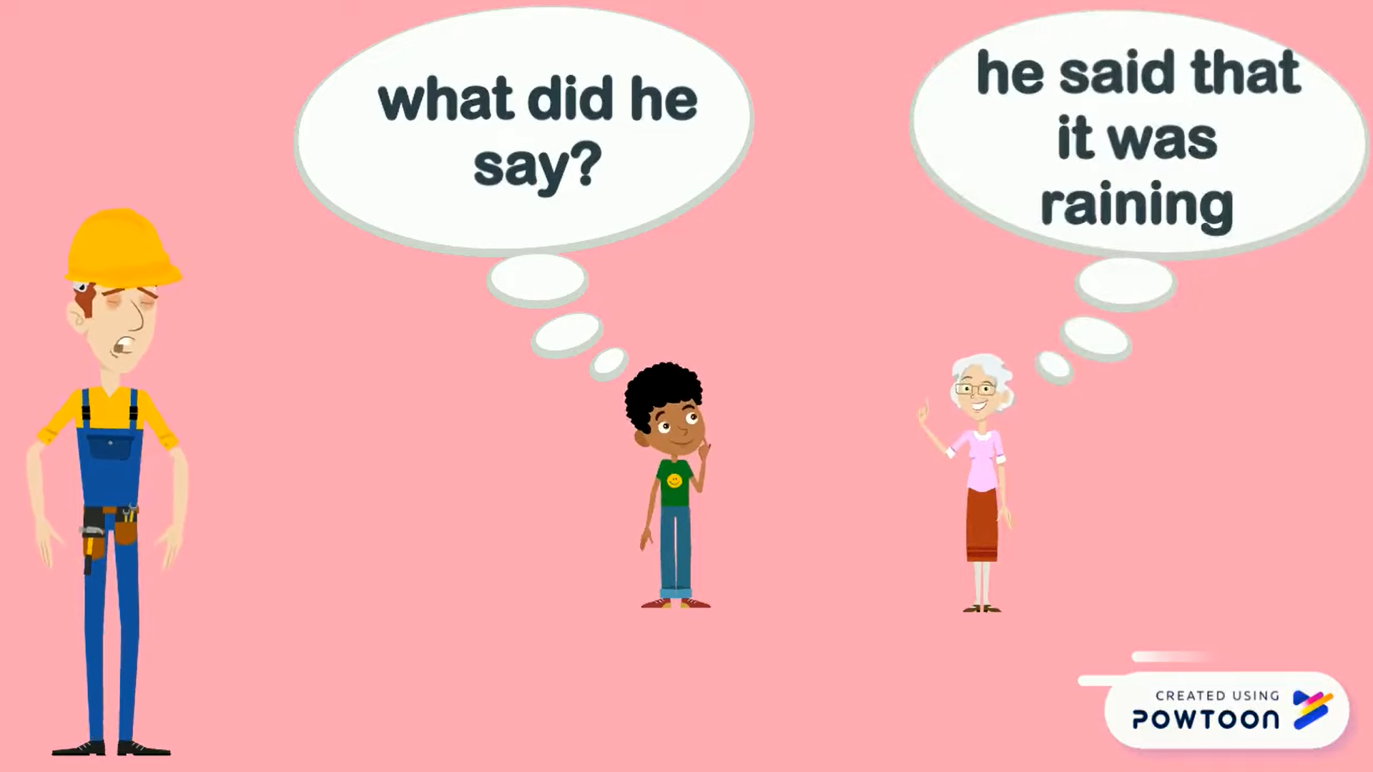
5
GAME: He/ She said that…
David

Slide 13
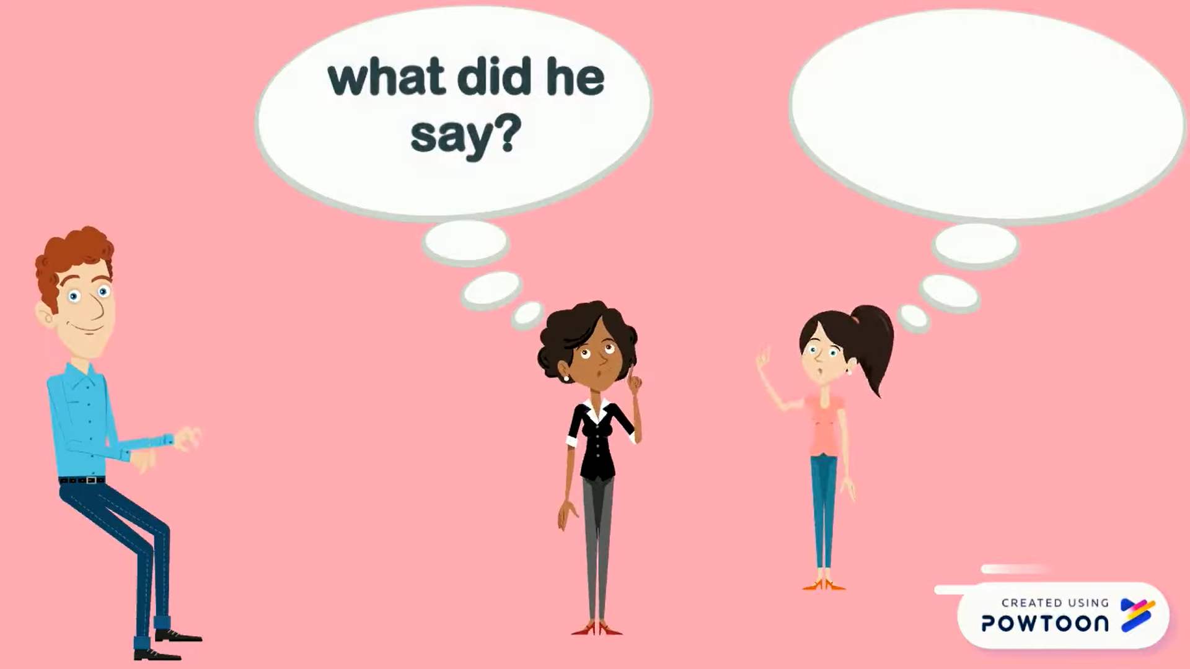
5
GAME: He/ She said that…
Peter

Slide 14
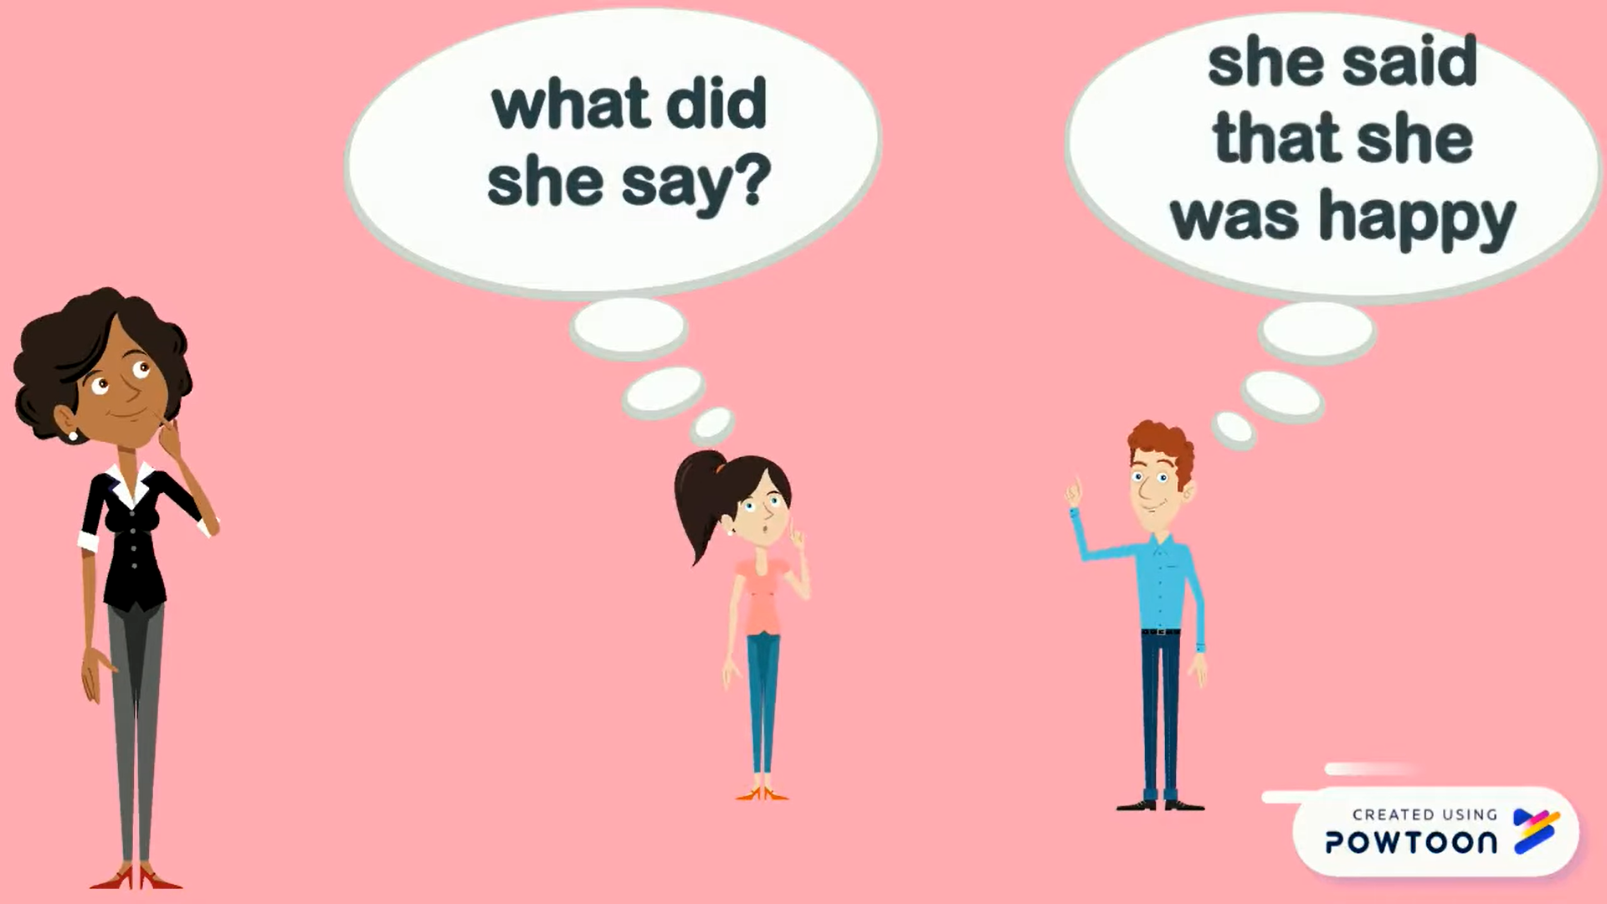
5
GAME: He/ She said that…
Linda

Slide 15
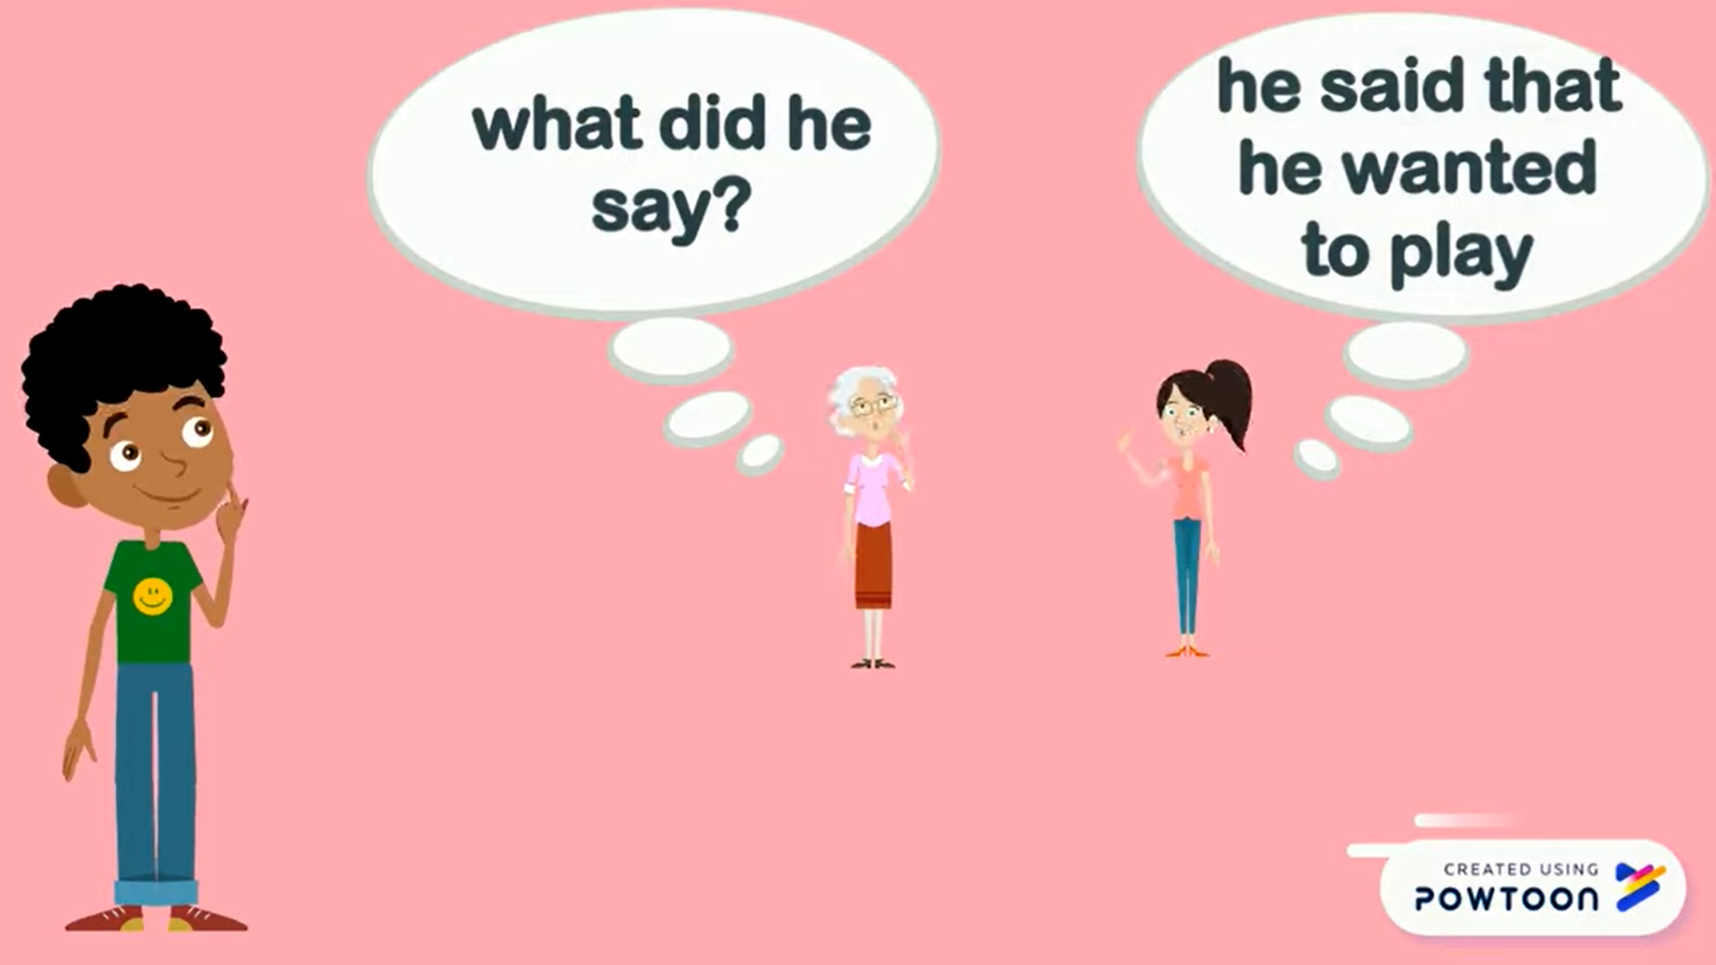
5
GAME: He/ She said that…
Tom

Slide 16
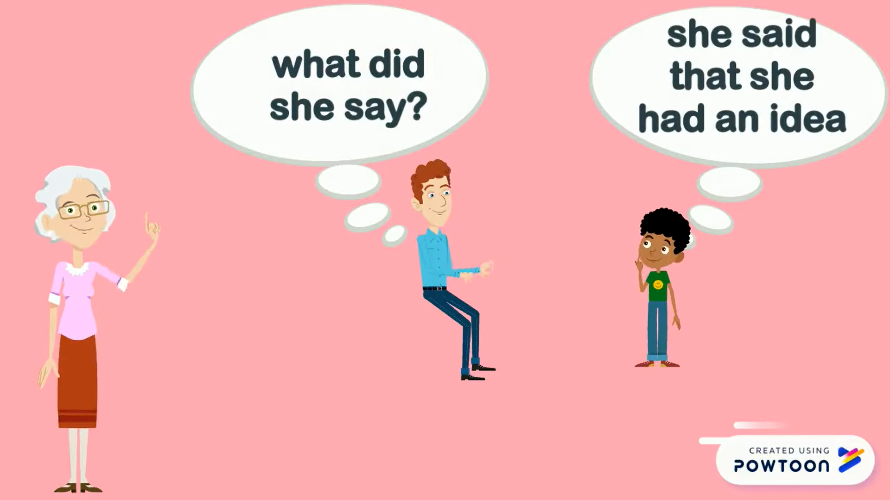
5
GAME: He/ She said that…
Ms. Brown

Slide 17
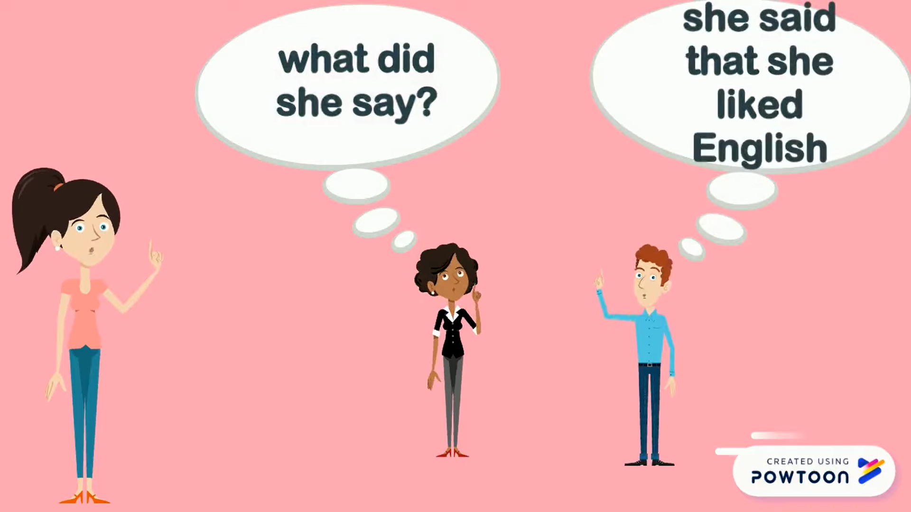
5
GAME: He/ She said that…
Sarah

Slide 18

* CONSOLIDATION
? What have we learnt in this lesson?
What direct speech and reported speech are
Rules of changing direct speech to reported speech.

Slide 19

. Homework
Learn the rules of changing direct speech into reported speech by heart.
Do Exercises in the Workbook

Slide 20



Slide 22
WARM-UP
GAME: MEMORIZING
RULE:
Work in 4 groups
Look at the pictures in 30 seconds and try to remember what each people said.
Write down on the posters what each of the people in the picture said.
The group with the most correct answers is the winner.

