Slide 1

ENGLISH 8
Hello everyone !!!

Slide 2
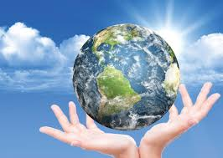
* WARM-UP
Answer the questions:
1. What one word would you use to describe the Earth?
The one-word game
Love, round, colourful, living, blue, beautiful....

Slide 3
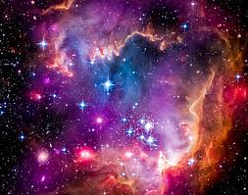
* WARM-UP
Answer the questions:
2. What one word would you use to describe the space?
The one-word game
limitless, magical, immense, vast, dangerous...
bao la

Slide 4
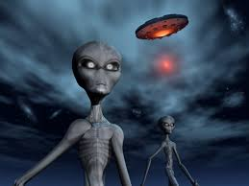
* WARM-UP
Answer the questions:
3. What one word would you use to describe the alien?
The one-word game
Unreal, mysterious, exotic, friendly, threatening.
Kì lạ

Slide 5

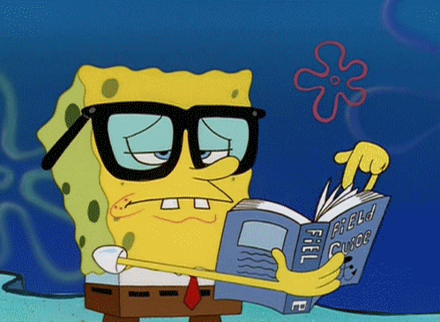
Unit
12
LIFE ON OTHER PLANETS
LESSON 1: GETTING STARTED
A thrilling science fiction novel

Slide 6
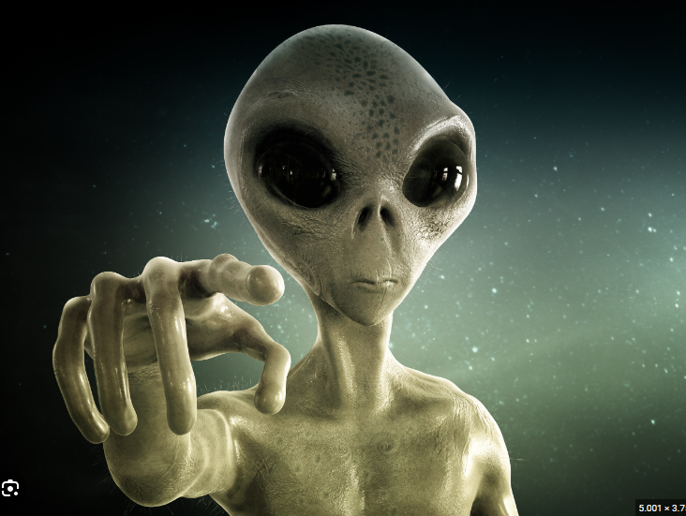

* VOCABULARY
alien (n)
/ˈeɪliən/
người ngoài hành tinh

Slide 7
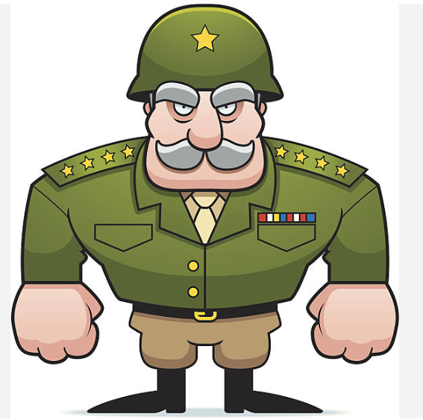

* VOCABULARY
commander (n)
/kəˈmɑːndə/
người chỉ huy, người cầm đầu

Slide 8
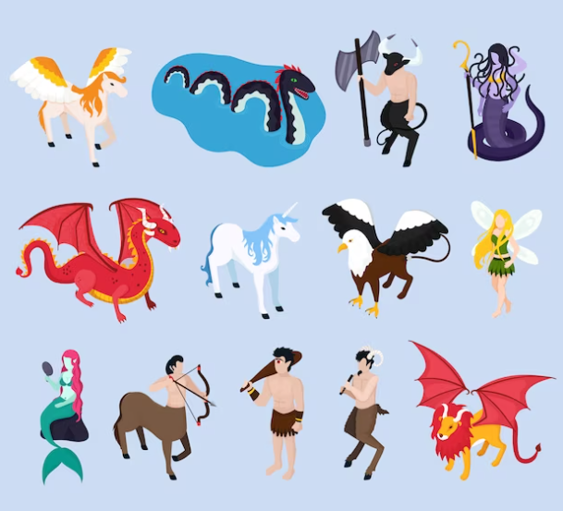
* VOCABULARY
creature (n)
/ˈkriːtʃə/
sinh vật

Slide 9
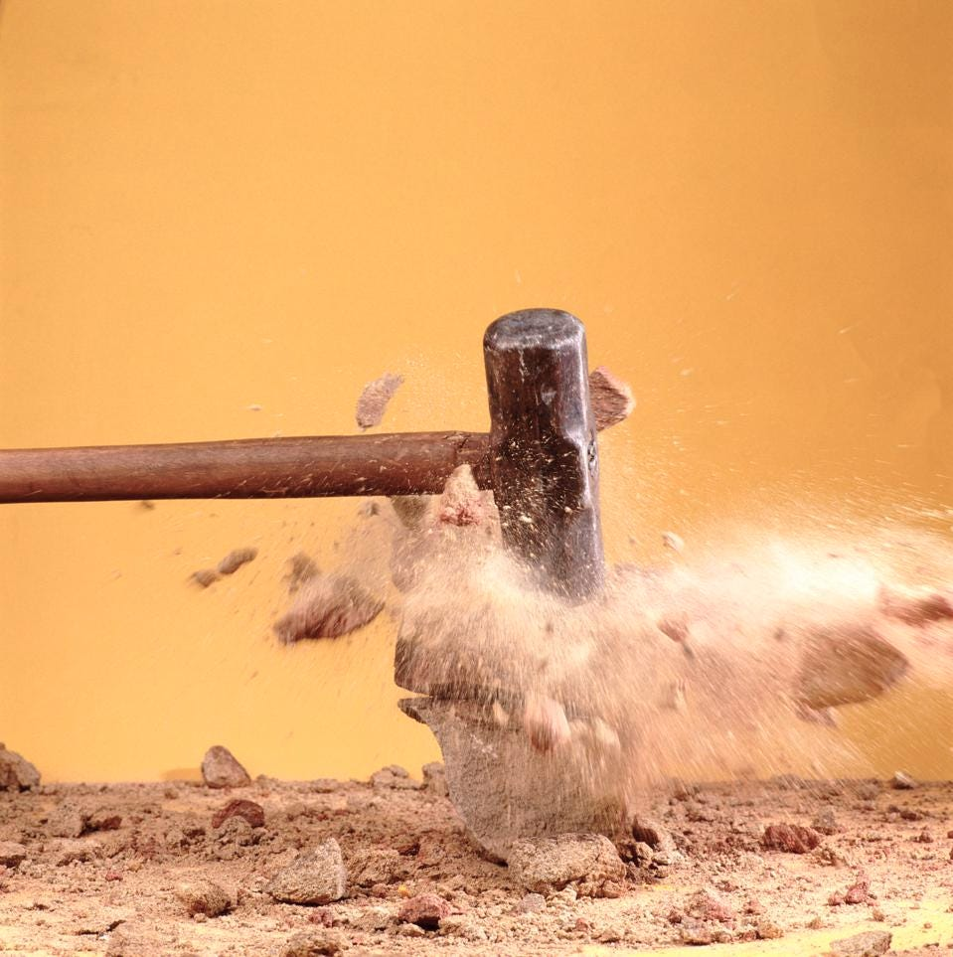
* VOCABULARY
destroy (v)
/dɪˈstrɔɪ/
hủy diệt/ tàn phá

Slide 10
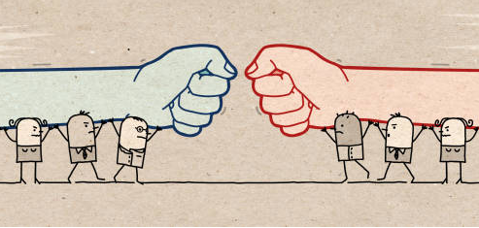
* VOCABULARY
oppose (v)
/əˈpəʊz/
chiến đấu, đánh lại ai

Slide 11
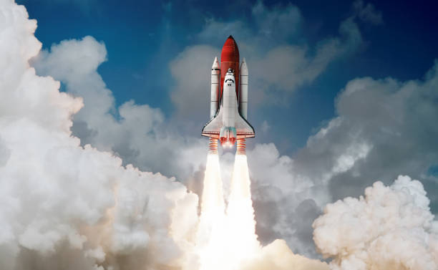
* VOCABULARY
spaceship (n)
/ˈspeɪsʃɪp/
phi thuyền

Slide 12
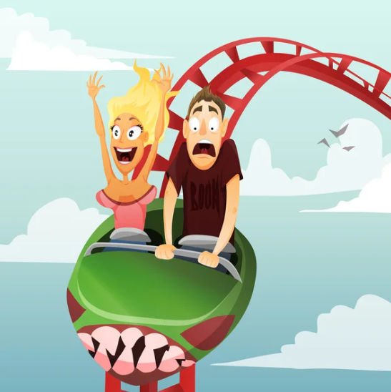
* VOCABULARY
thrilling (adj)
/ˈθrɪlɪŋ/
kịch tính

Slide 13
* VOCABULARY
New words | Pronunciation | Meaning
1. alien (n) | /ˈeɪliən/ | người ngoài hành tinh
2. commander (n) | /kəˈmɑːndə/ | người chỉ huy, người cầm đầu
3. creature (n) | /ˈkriːtʃə/ | sinh vật
4. destroy (v) | /dɪˈstrɔɪ/ | hủy diệt/ tàn phá
5. oppose (v) | /əˈpəʊz/ | chiến đấu, đánh lại ai
6. spaceship (n) | /ˈspeɪsʃɪp/ | phi thuyền
7. thrilling (adj) | /ˈθrɪlɪŋ/ | kịch tính

Slide 14
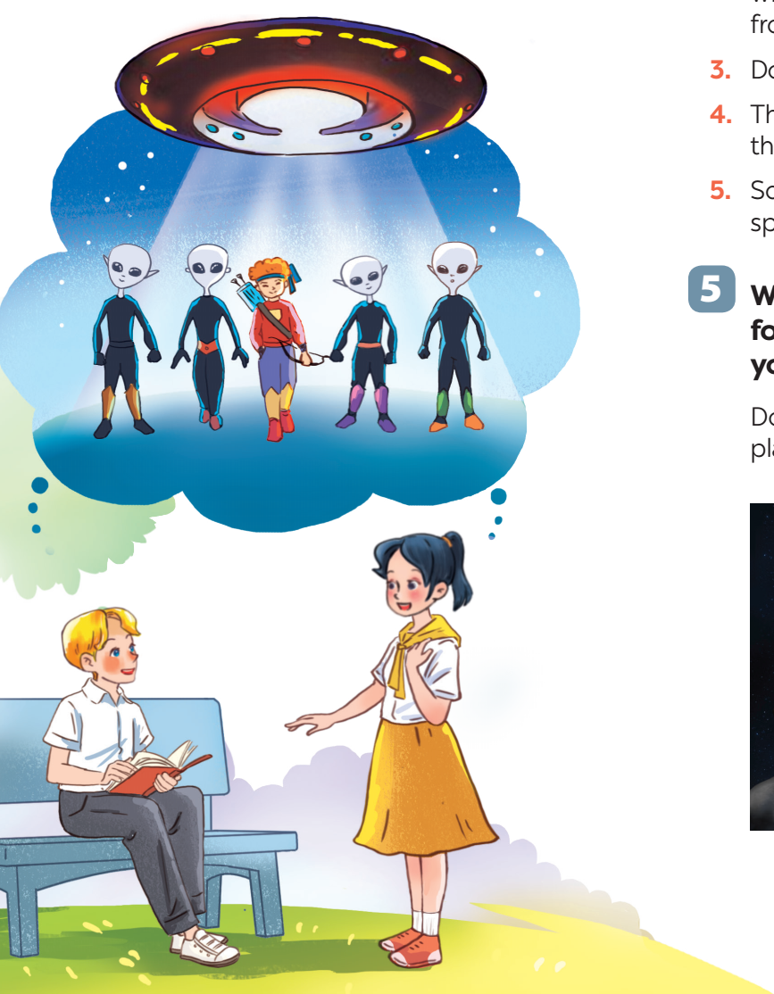

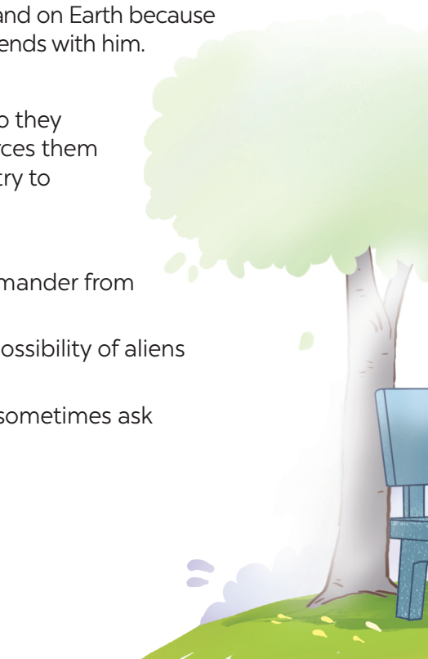
1
1
Listen and read.
1. What are Nick and Mai talking about?
2. Who do you think the men in black are?
3. Where do you think the men in black are from?
4. Where do you think the boy standing between the four men is from?
5. What do you think the object above the men is?

Slide 15
1
Listen and read.
Mai: What book are you reading, Nick?
Nick: A journey back to Soduka. I’m on the last page.
Mai: That’s a science fiction book, isn’t it? What’s it about?
Nick: Yes, it is. It’s about four creatures Titu, Kaku, Hub, and Barb. They’re travelling back to Soduka, a planet like Earth. Along the way they have to land on Earth because their spaceship breaks down. They meet Tommy and become friends with him.
Mai: What happens next?
Nick: Tommy helps the four creatures repair their spaceship, so they can travel back to their home planet. But their commander forces them to return to Earth to destroy it. Tommy and the four creatures try to oppose the commander.
Mai: Sounds thrilling!
Nick: Tommy and the four creatures manage to stop the commander from destroying Earth.
Mai: So it has a happy ending! What do you think about the possibility of aliens attacking Earth?
Nick: I’m not sure about it. But I’m starting to think about it. I sometimes ask myself what we would do if aliens took over our planet.

Slide 16
1
Listen and read.
Mai: What book are you reading, Nick?
Nick: A journey back to Soduka. I’m on the last page.
Mai: That’s a science fiction book, isn’t it? What’s it about?
Nick: Yes, it is. It’s about four creatures Titu, Kaku, Hub, and Barb. They’re travelling back to Soduka, a planet like Earth. Along the way they have to land on Earth because their spaceship breaks down. They meet Tommy and become friends with him.
Mai: What happens next?
Nick: Tommy helps the four creatures repair their spaceship, so they can travel back to their home planet. But their commander forces them to return to Earth to destroy it. Tommy and the four creatures try to oppose the commander.
Mai: Sounds thrilling!
Nick: Tommy and the four creatures manage to stop the commander from destroying Earth.
Mai: So it has a happy ending! What do you think about the possibility of aliens attacking Earth?
Nick: I’m not sure about it. But I’m starting to think about it. I sometimes ask myself what we would do if aliens took over our planet.

Slide 17
Task 1: Listen and read.
1. What are Nick and Mai talking about?
2. Who do you think the men in black are?
3. Where do you think the men in black are from?
They are talking about aliens creatures from another planet.
They are aliens / creatures from another planet.
Another planet.

Slide 18
4. Where do you think the boy standing between the four men is from?
5. What do you think the object above the men is?
He is from Earth.
It is a spaceship / flying saucer / UFO.

Slide 19

2
Read the conversation again and tick T (True) or F (False).
Statements | T | F
1. Soduka is a planet that is very diﬀerent from Earth.
2. Titu, Kaku, Hub, and Barb have to land on Earth because their spaceship breaks down.
3. Tommy helps the four creatures make a new spaceship so that they can return to Soduka.
4. The four creatures travel to Earth again to visit Tommy.
5. The novel makes Nick and Mai think about the possibility that Earth might be attacked by aliens.

Slide 20
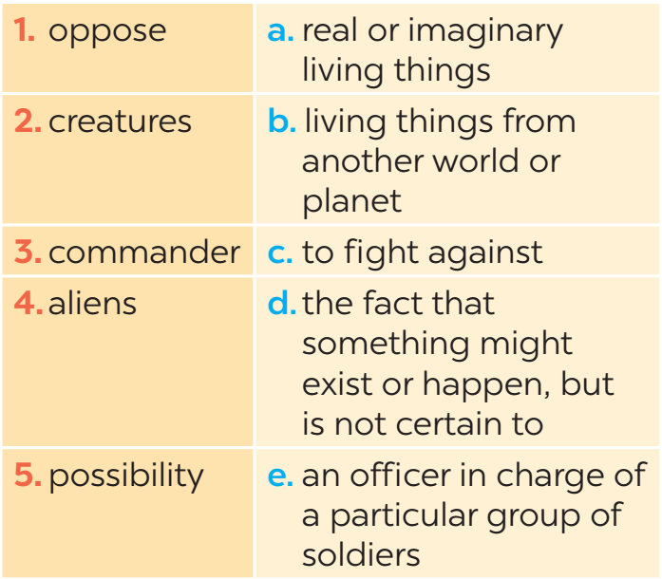
3
Match the words (1 - 5) with their definitions (a - e).

Slide 21
4
Complete the sentences with the words in task 3.
1. There is a _________ that we might visit Mars in the near future.
2. The main character in the film is a boy who makes friends with some _____ from a planet.
3. Dogs are more social ________ than cats.
4. These soldiers were punished because they didn’t obey their __________.
5. Some people _______ sending spaceships to explore other planets.
possibility
aliens
creatures
commander
oppose

Slide 22
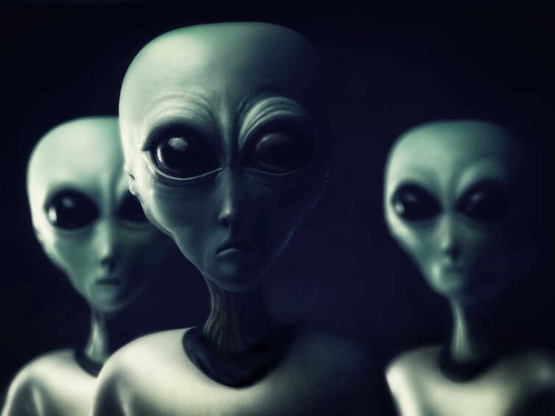
5
Work in groups. Discuss the following questions. Then report your group’s answers to the class.
Do you believe that there is life on other planets? Why / Why not?
A: What do you think about the possibility of life on other planets?
B: I think there might be. The universe is so vast.
A: Yeah, you're right. I guess until we have proof, it's just a mystery.
B: Exactly. But I hope that one day we'll discover something new.
A: Me too, it would be amazing to know we're not alone in the universe.

Slide 23
5
Work in groups. Discuss the following questions. Then report your group’s answers to the class.
Do you believe that there is life on other planets? Why / Why not?
In our discussion, we talked about whether there might be life on other planets. We all believe there could be life beyond Earth due to the vastness of the universe. But we know there is no evidence to prove this so it is still a mystery. We hope that in the future, we might discover evidence of life on other planets.

Slide 25

* CONSOLIDATION
* What have we learnt in this lesson?
identify the topic of the unit
use lexical items related to outer space
identify the language features that are covered in the unit

Slide 26

* Homework
- Learn the new words by heart.
- Make sentences with new words.
- Start preparing for the Project of the unit.

Slide 27
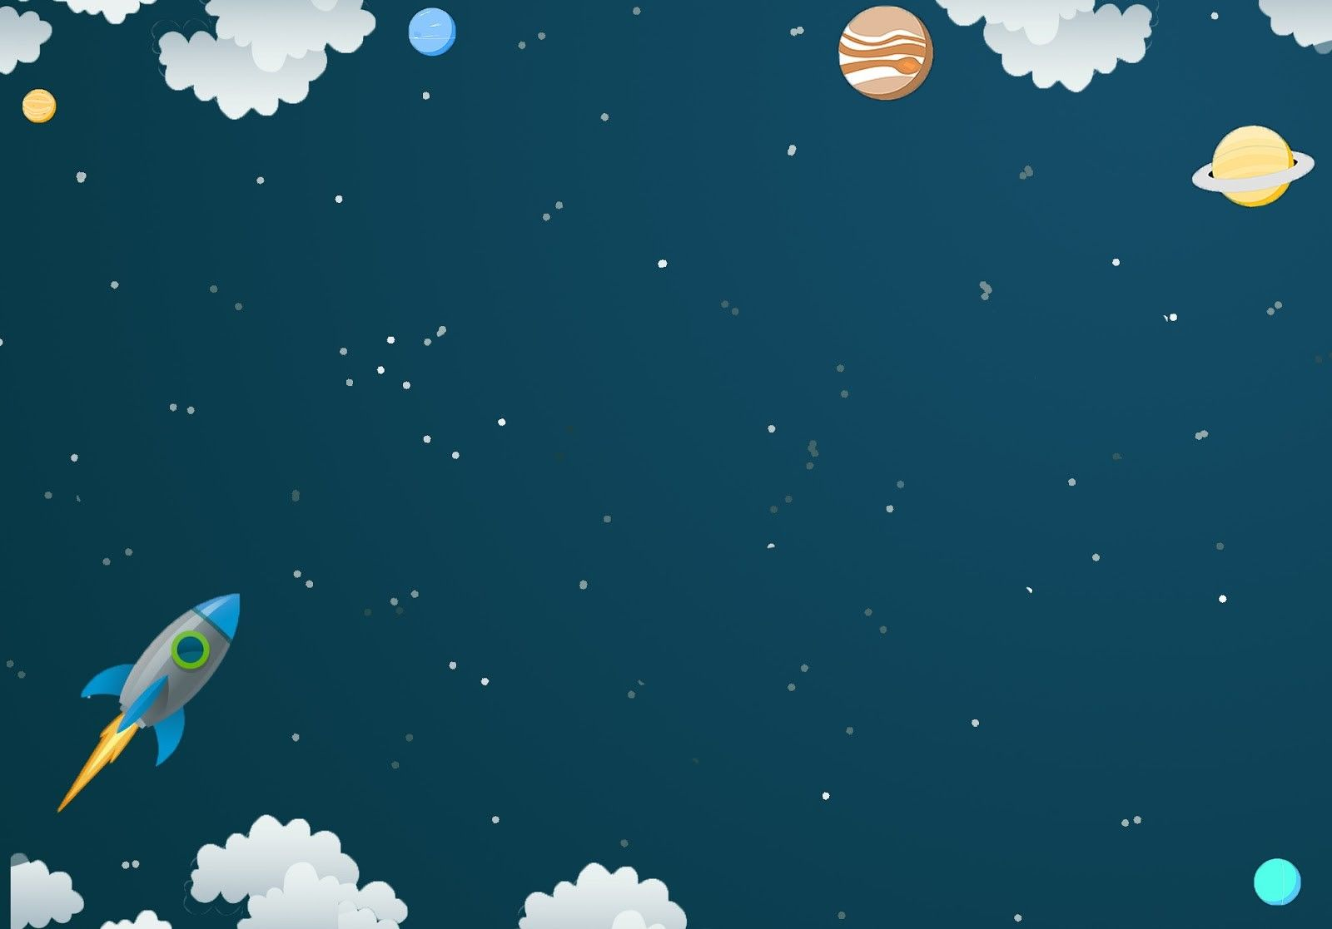
Goodbye.
See you again.

Slide 28
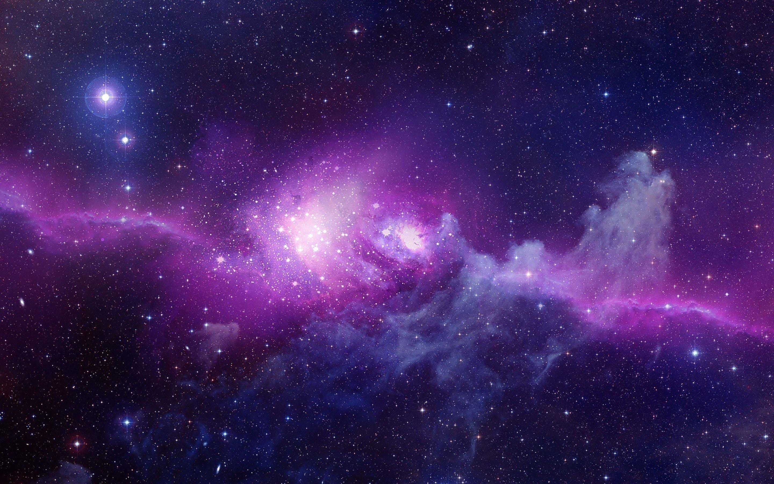
WARM-UP
OPTION 1
Science and Technology
Write on the board the list of future technology you expect to see in the future in 2 minutes.

Slide 29
WARM-UP
OPTION 1
Answer the questions:
1. Where and how fast do you think we can travel with those new technologies?
2. Can we travel to other planets with those technologies?
LIFE ON OTHER PLANETS

