Slide 1


UBND QUẬN DƯƠNG KINH
TRƯỜNG TIỂU HỌC ANH DŨNG
WELCOME
To Our Class

Slide 2

REVIEW 4
Period 1

Slide 3

Table of contents
01
02
Warm-up and Review
Activity 1.
Listen and repeat.
03
04
Activity 2.
Look and circle.
Fun corner and Wrap-up

Slide 4


01
Warm-up and Review

Slide 5

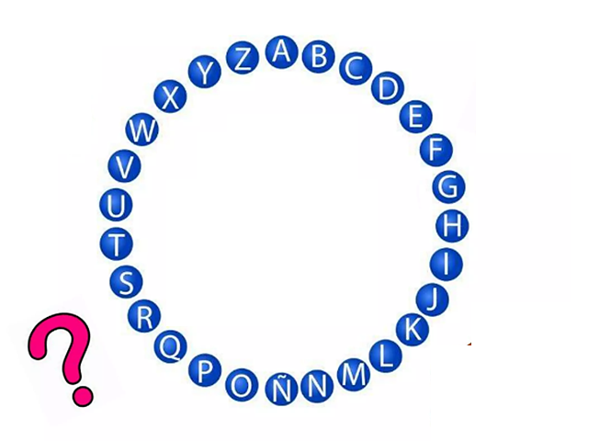

Pass
the
Word
Notes:
Phát nhạc khi học sinh chơi

Slide 6


Very Good!

Slide 7
02
Activity 1. Listen and repeat.

Slide 8


Listen and repeat.

Slide 9

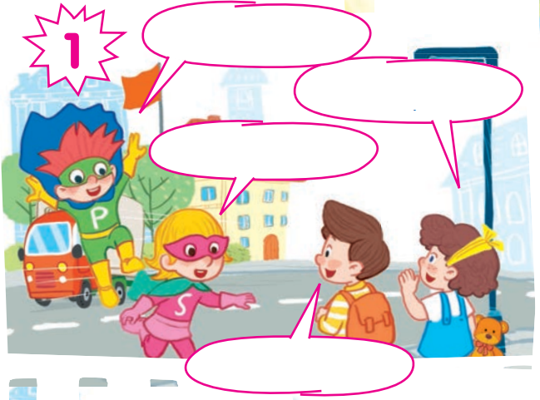
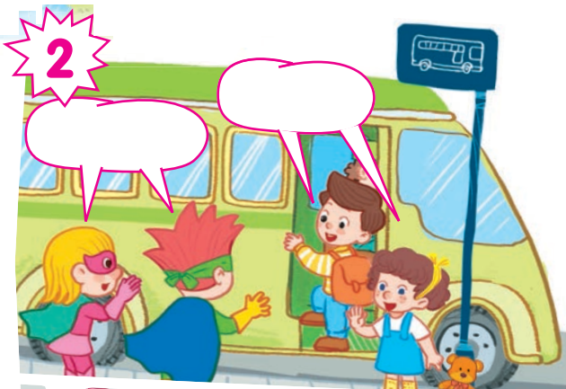
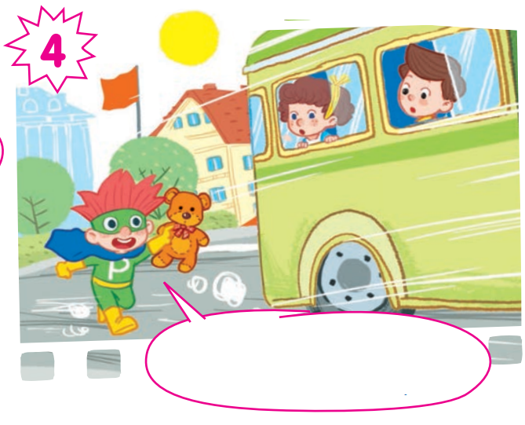
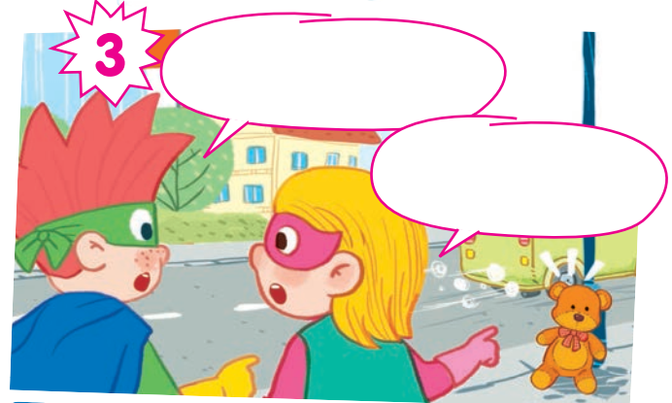

Slide 10

Listen and repeat.
Hi, Lucky!
Hello, Phil!
Hi, Nam!
Hello, Sue!

Slide 11
Listen and repeat.
Bye!
Goodbye!

Slide 12
Listen and repeat.
Look! I can see a teddy bear.
It’s Lucy’s teddy bear!

Slide 13
Listen and repeat.
Stop! Lucy! Your teddy bear!

Slide 14
Hi, Lucky!
Hello, Phil!
Bye!
Goodbye!
Hi, Nam!
Hello, Sue!
Look! I can see a teddy bear.
It’s Lucy’s teddy bear!
Stop! Lucy! Your teddy bear!

Slide 15
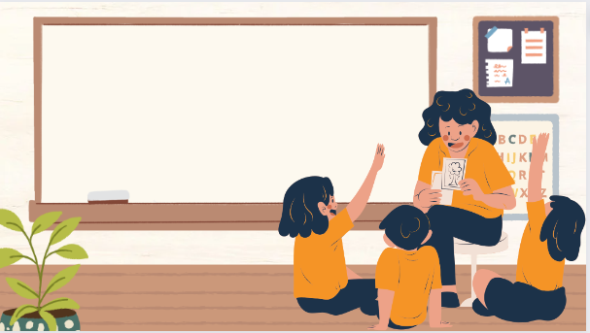
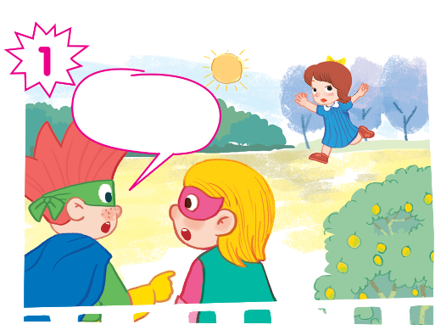
Play as a character

Slide 16
Hi, Lucky!
Hello, Phil!
Bye!
Goodbye!
Hi, Nam!
Hello, Sue!
Look! I can see a teddy bear.
It’s Lucy’s teddy bear!
Stop! Lucy! Your teddy bear!

Slide 17
03
Activity 2. Look and circle.

Slide 18

Look and circle.
face hands foot teddy bear
bus tiger turtle windows

Slide 19
Look and circle.
face hands foot teddy bear
bus tiger turtle windows

Slide 20

Look and circle.
face hands foot teddy bear
bus tiger turtle windows

Slide 21

Look and circle.
face hands foot teddy bear
bus tiger turtle windows

Slide 22



Look and circle.
face hands foot teddy bear
bus tiger turtle windows

Slide 23
teddy bear
foot
windows
face

Slide 24
04
Fun corner and Wrap-up

Slide 25

GUESSING
GAME

Slide 26
Fill in the blanks.
Hi, ______!
Lucky
Hello
_____, Phil!
Hi
______, Nam!
Sue
Hello, ____!

Slide 27
Bye
_____!
Goodbye
_________!

Slide 28
Look
____! I can see a _________.
teddy bear
It’s Lucy’s
________ teddy bear!

Slide 29
Stop
____! Lucy! _____ teddy bear!
Your

Slide 30
Very Good!

