Slide 1


UBND QUẬN DƯƠNG KINH
TRƯỜNG TIỂU HỌC ANH DŨNG
WELCOME
To Our Class

Slide 2

REVIEW 4
Period 2

Slide 3

Table of contents
01
Warm-up and Review
02
Activity 1. Listen and tick.
03
Activity 2. Listen and circle.
04
Activity 3. Listen and tick or cross.
05
Fun corner and Wrap-up

Slide 4


01
Warm-up and Review

Slide 5

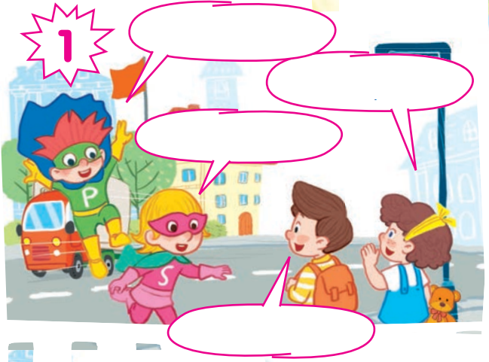
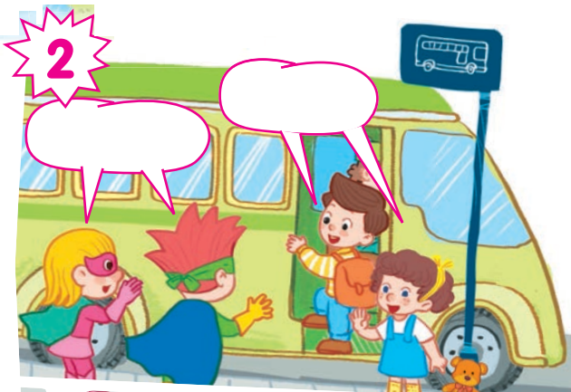
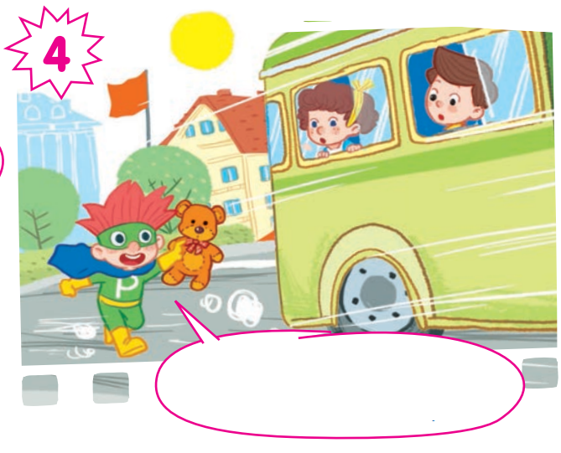
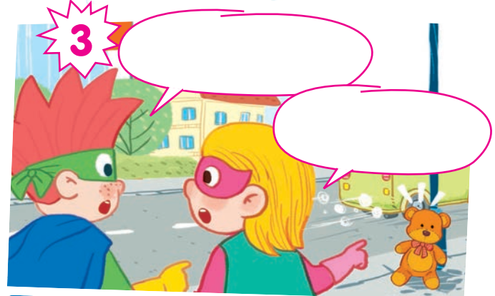

Slide 6
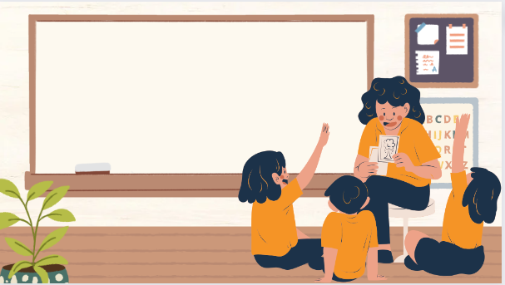
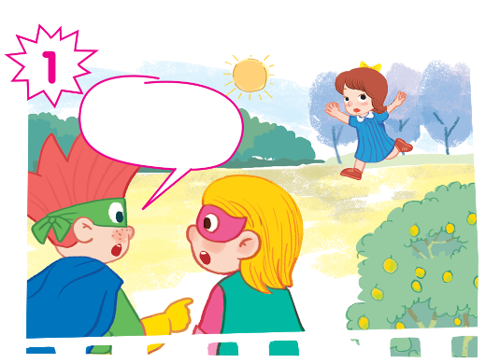
Play as a character

Slide 7
Hi, Lucky!
Hello, Phil!
Bye!
Goodbye!
Hi, Nam!
Hello, Sue!
Look! I can see a teddy bear.
It’s Lucy’s teddy bear!
Stop! Lucy! Your teddy bear!

Slide 8
02
Activity 1. Listen and tick.

Slide 9

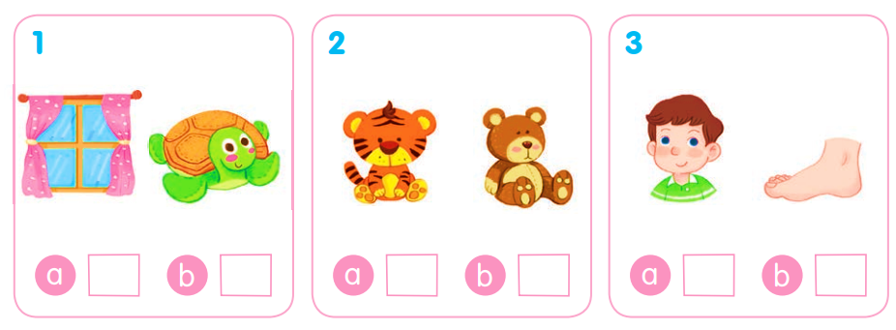
Listen and tick.

Slide 10
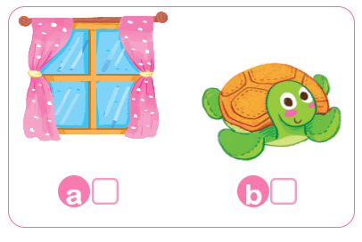
Listen and tick.
✓

Slide 11
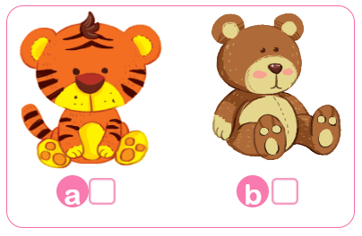
Listen and tick.
✓

Slide 12
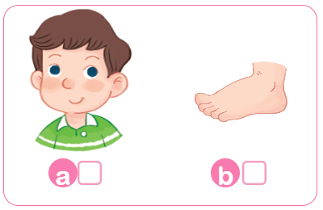
Listen and tick.
✓

Slide 13
Listen and tick.
✓
✓
✓

Slide 14
03
Activity 2. Listen and circle.

Slide 15

Listen and circle.
1 o w 2 l n
3 f b 4 d t

Slide 16
Listen and circle.
1 o w

Slide 17
Listen and circle.
2 l n

Slide 18
Listen and circle.
3 f b

Slide 19
Listen and circle.
4 d t

Slide 20
Listen and circle.
1 o w 2 l n
3 f b 4 d t

Slide 21
04
Activity 3.
Listen and tick or cross.

Slide 22
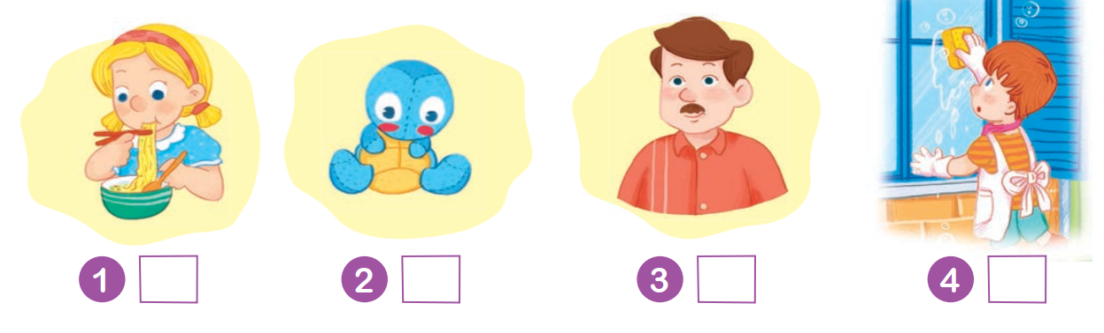
Listen and tick or cross.

Slide 23
Listen and tick or cross.
✓

Slide 24
Listen and tick or cross.
✗

Slide 25
Listen and tick or cross.
✓

Slide 26
Listen and tick or cross.
✗

Slide 27
Listen and tick or cross.
✓
✗
✓
✗

Slide 28

She’s having ___.
Point to___.
He’s___.
How many ___ can you see?

Slide 29
05
Fun corner and Wrap-up

Slide 30


Mystery bag

Slide 31


f

Slide 32
w

Slide 33
o

Slide 34
m

Slide 35
u

Slide 36
n

Slide 37
l

Slide 38

Very Good!

Slide 39
THANK YOU!

