Slide 1

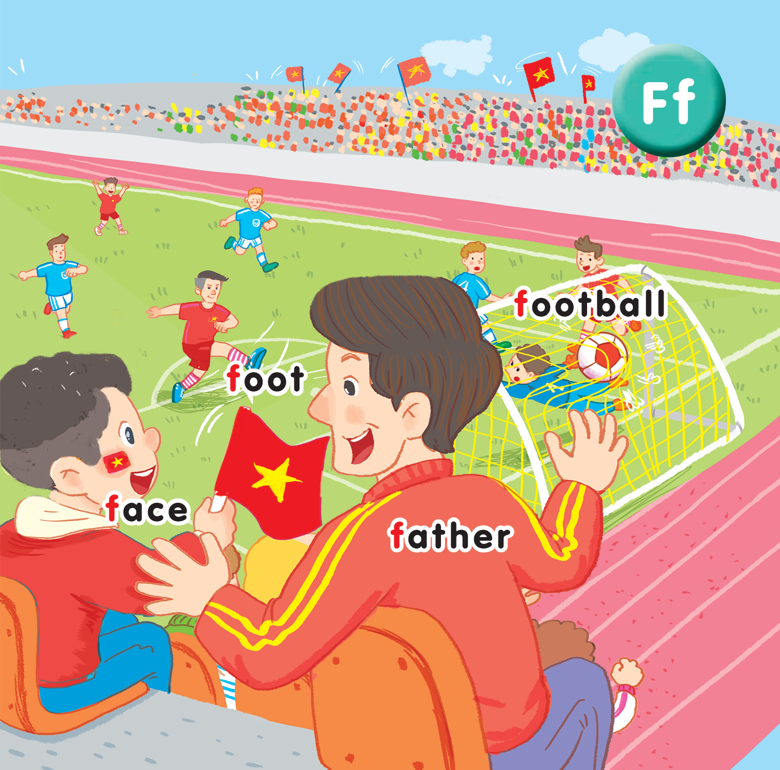
Unit 15 At the football match Lesson 2
UBND QUẬN DƯƠNG KINH
TRƯỜNG TIỂU HỌC ANH DŨNG

Slide 2






A
B
C
D
E
F
G
H
I
J
K
L
M
O
P
Q
R
S
T
U
tekhnologic
Notes:
Divide the class into groups. Each group takes turns to choose a letter and say a word which starts with the chosen letter.

Slide 3

Listen and chant

Slide 4
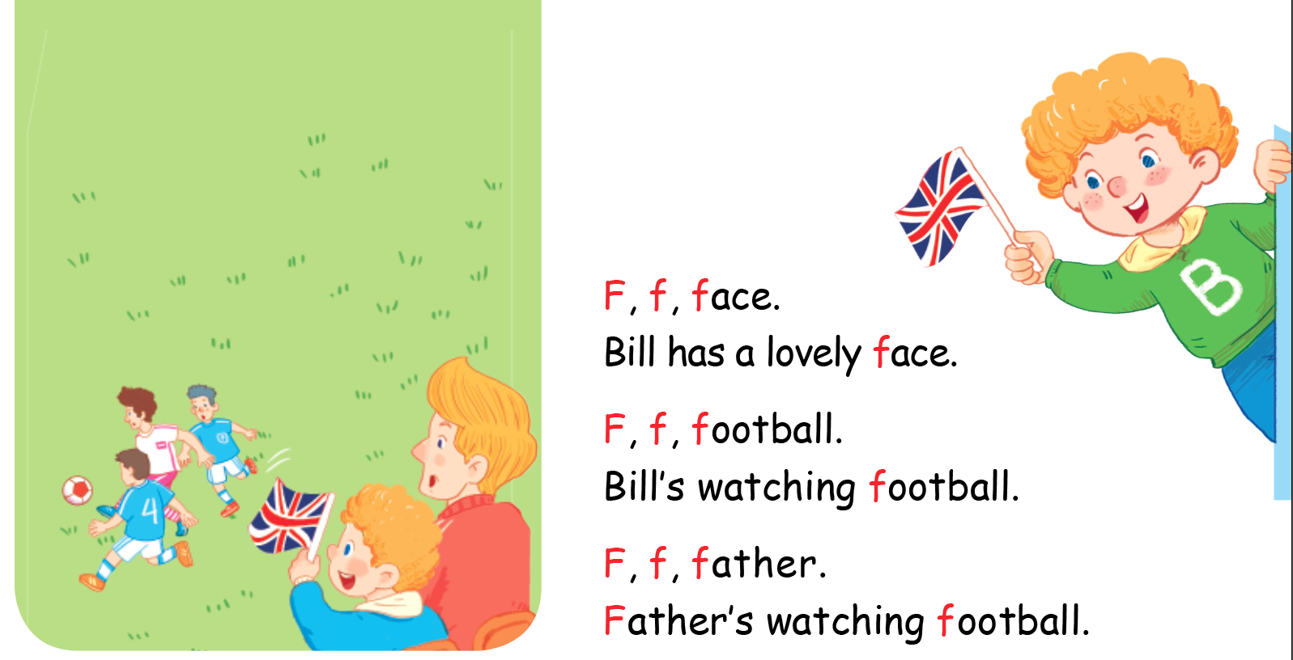

Listen and chant

Slide 5


Listen and tick

Slide 6
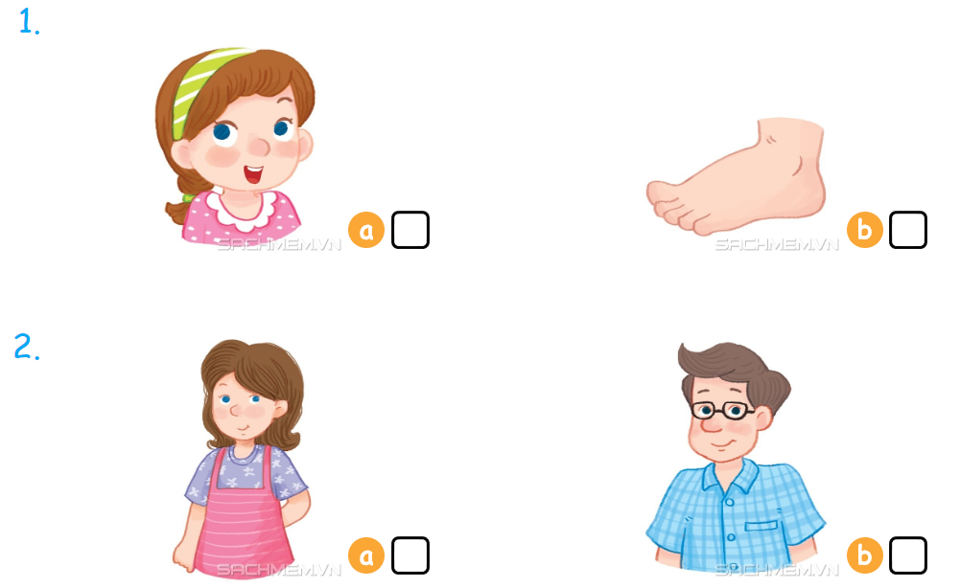

Listen and tick

Slide 7



Look, trace and write

Slide 8
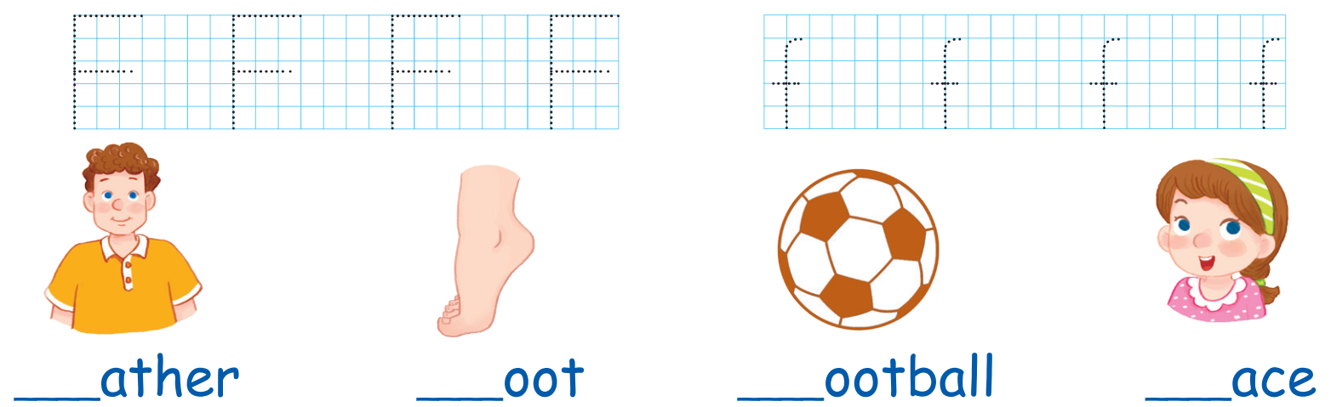

Slide 9
Game
Notes:
Goal: Revise the words learnt
Time: 5 minutes
Game: Score a goal
Have pupils to play the game in groups.
Each group takes turn to choose word to shoot into the net.
Correct shoot will give score to the group.

Slide 10
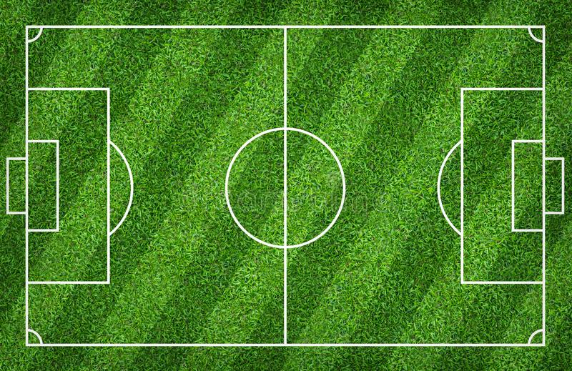

TEAM 1
TEAM 2

Slide 11
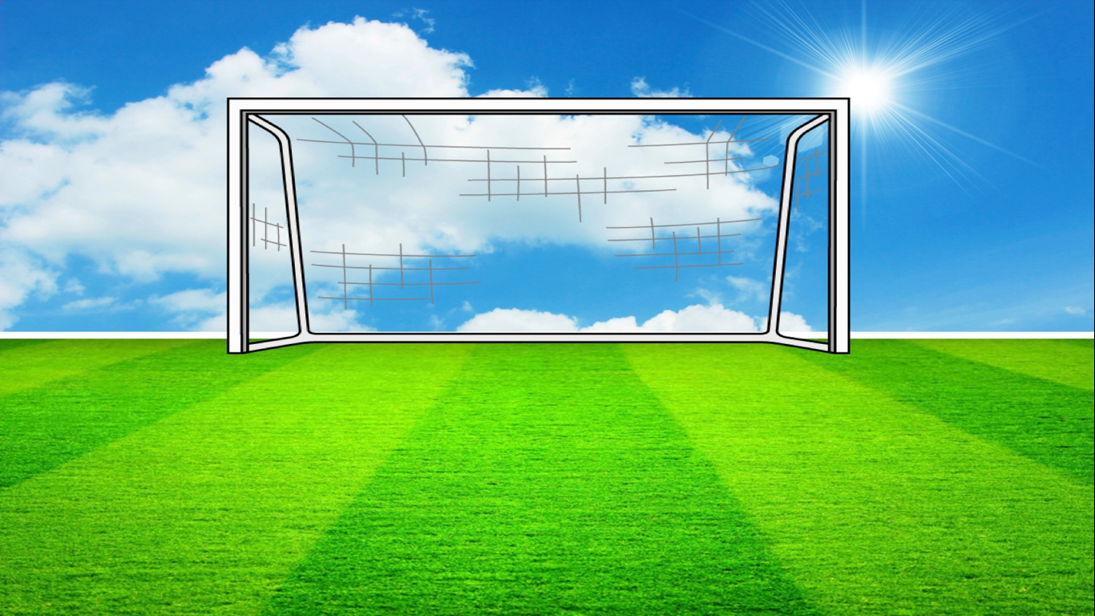
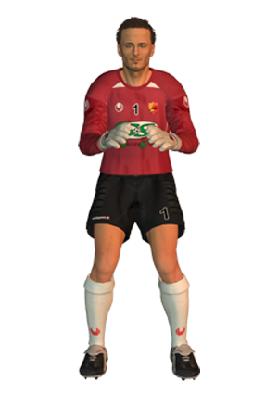




Q1.
frog
GOAL!!
SAVED…
MISSED..

Slide 12

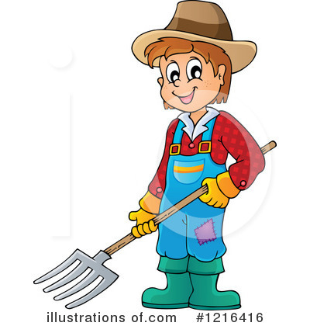

Q2.
Farmer
GOAL!!
SAVED…
MISSED..

Slide 13

Q3.
fish
GOAL!!
SAVED…
MISSED..

Slide 14
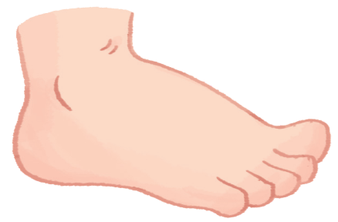
Q4.
face
GOAL!!
SAVED…
MISSED..

Slide 15
Q5.
foot
GOAL!!
SAVED…
MISSED..

Slide 16
Q6.
family
GOAL!!
SAVED…
MISSED..

Slide 17
Q7.
father
GOAL!!
SAVED…
MISSED..

Slide 18
Q8.
fire truck
GOAL!!
SAVED…
MISSED..

Slide 19
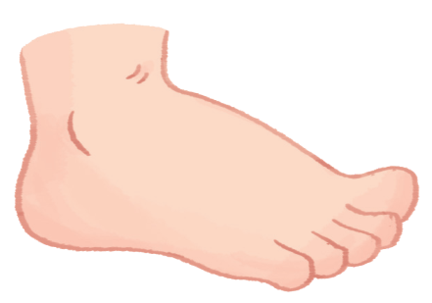
Goodbye
foot
Notes:
Teacher shows the vocabulary of the lesson on slide.
Pupils say goodbye.

Slide 20

Goodbye
face

Slide 21

Goodbye
football

Slide 22
Goodbye
father

