Slide 2
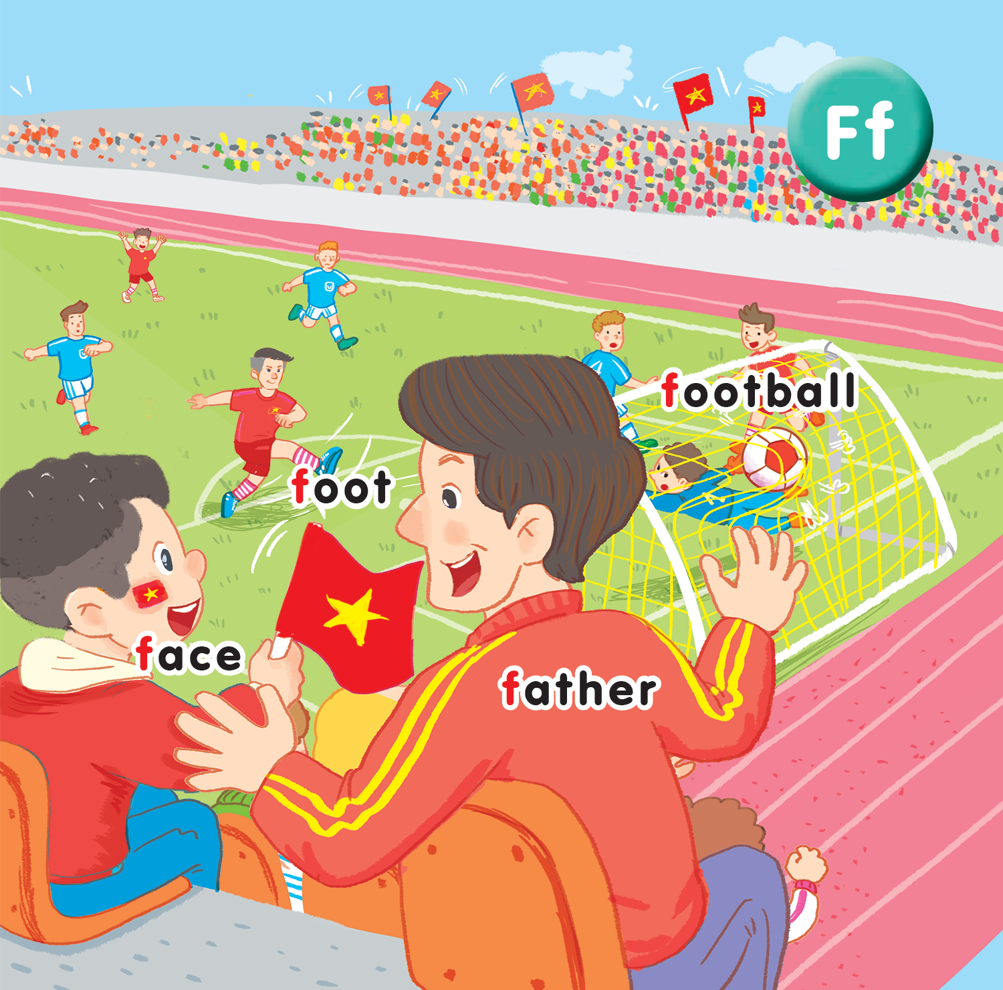
Unit 15
At the football match
Lesson 1

Slide 3

Warm-up
Notes:
Game: Pass the ball!
- Divide the class into teams of 3.
- Play the music, pupils in each team take turns to pass the ball. When the music ends, 3 pupils holding the ball stand up and say the words have sound T/t.

Slide 4




Slide 5
Tranh baif 15 lesson 1

Slide 6

foot football
F f
face father

Slide 7


face

Slide 8

father

Slide 9
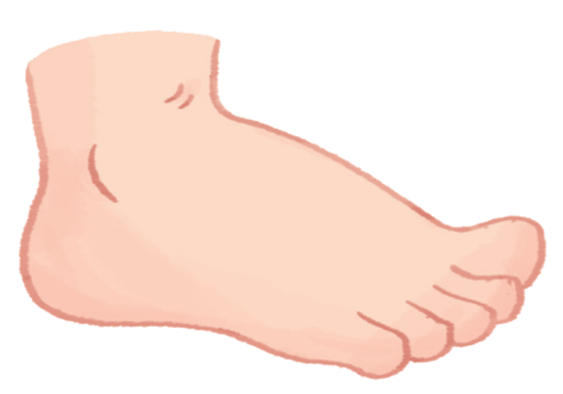
foot

Slide 10

football

Slide 11




Slide 12
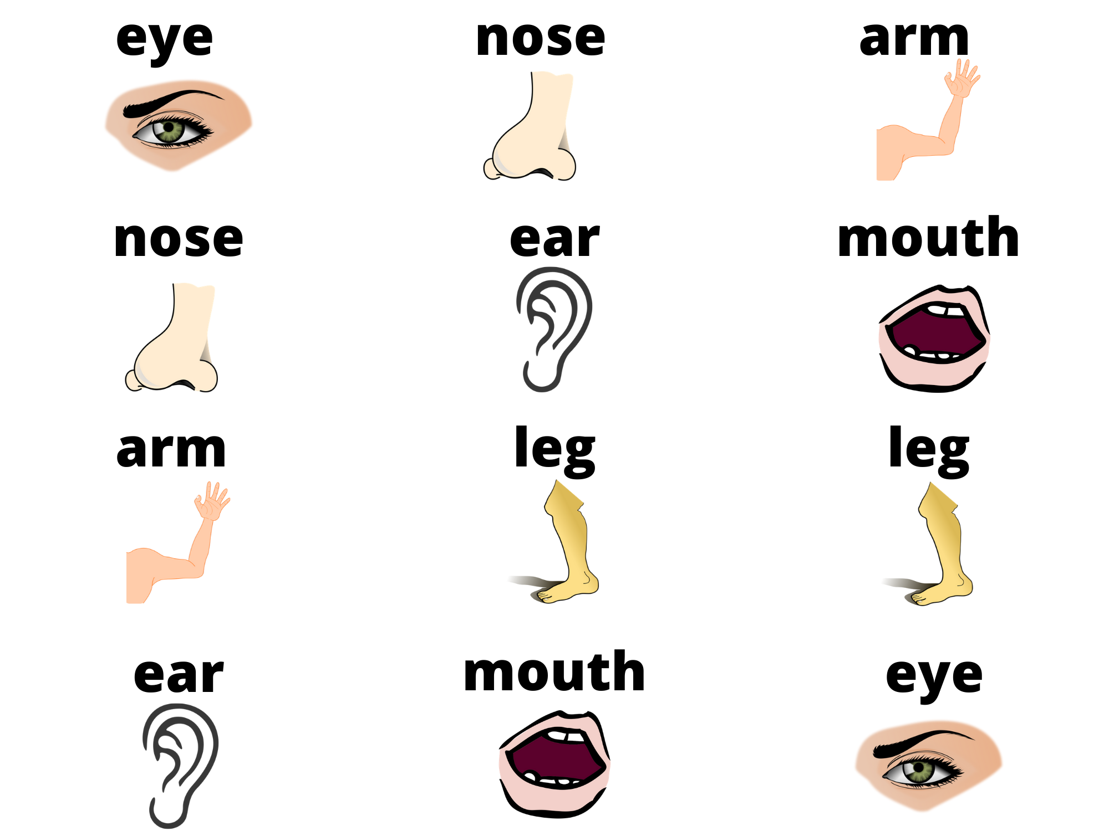
1
2
3
4
5
6
7
8
9
10
11
12
Notes:
Game: Matching pictures
- Divide the class into two teams. Each team then takes turns in choosing TWO squares.
- If the two squares are the same word / picture, then the team gets a point.
- If the two squares are different, then click on the red circle to hide the picture again.
- Pupils have to try to remember where the matching pairs of words are.

Slide 13
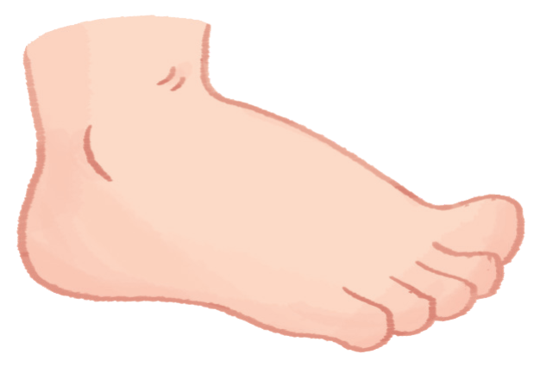
Goodbye
foot

Slide 14

Goodbye
face

Slide 15

Goodbye
football

Slide 16

Goodbye
father

Slide 17
Website: hoclieu.vn
Fanpage: facebook.com/tienganhglobalsuccess.vn

