Slide 1

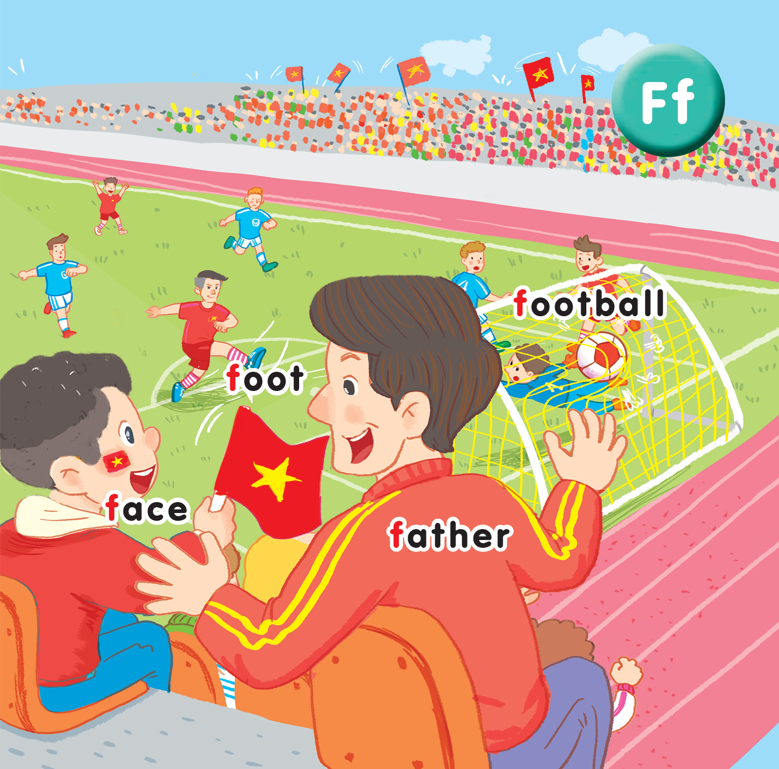
Unit 15
At the football match
Lesson 3
UBND QUẬN DƯƠNG KINH
TRƯỜNG TIỂU HỌC ANH DŨNG
Notes:
By the end of the lesson, pupils will be able to:
- introduce a thing with the structure He’s having_________.
- sing along the unit song.

Slide 2

Warm-up
Notes:
Option 2: I spy…
- Have pupils play the game in groups.
- Have pupils look at the screen and guess what it is, using the structure I spy with my little eyes, I can see a …
- Quick and correct answer will get point for the group.
- Have pupils repeat the words.

Slide 3

a kite

Slide 4


Slide 5
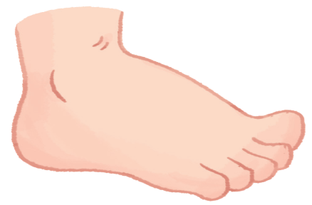

Slide 6


Slide 7


Slide 8


Slide 9


Slide 10


Slide 11


Listen and repeat
Notes:
Listen and repeat is divided in to 2 steps.

Slide 12
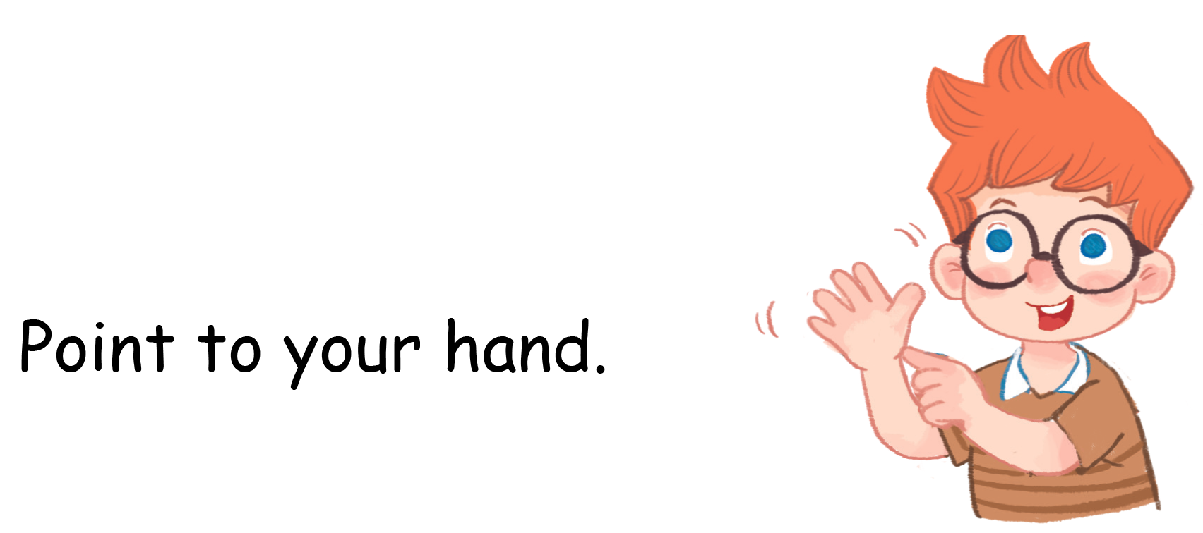


Slide 13


Let’s talk

Slide 14
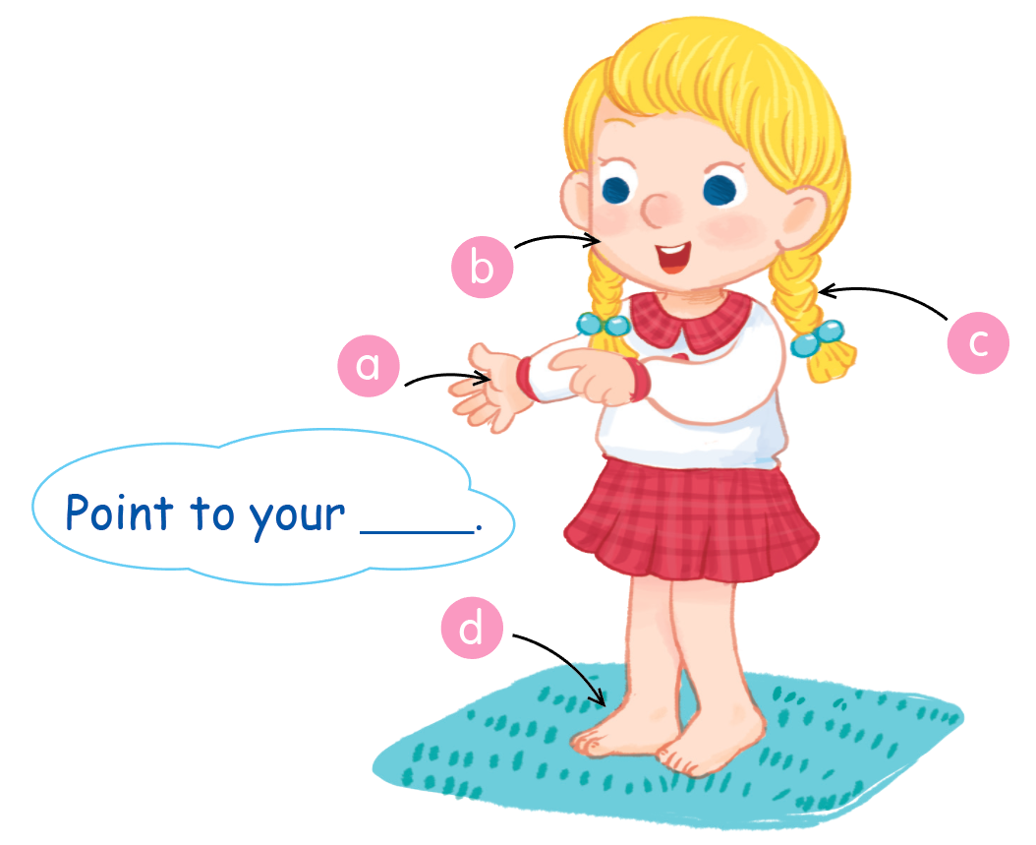

Slide 15
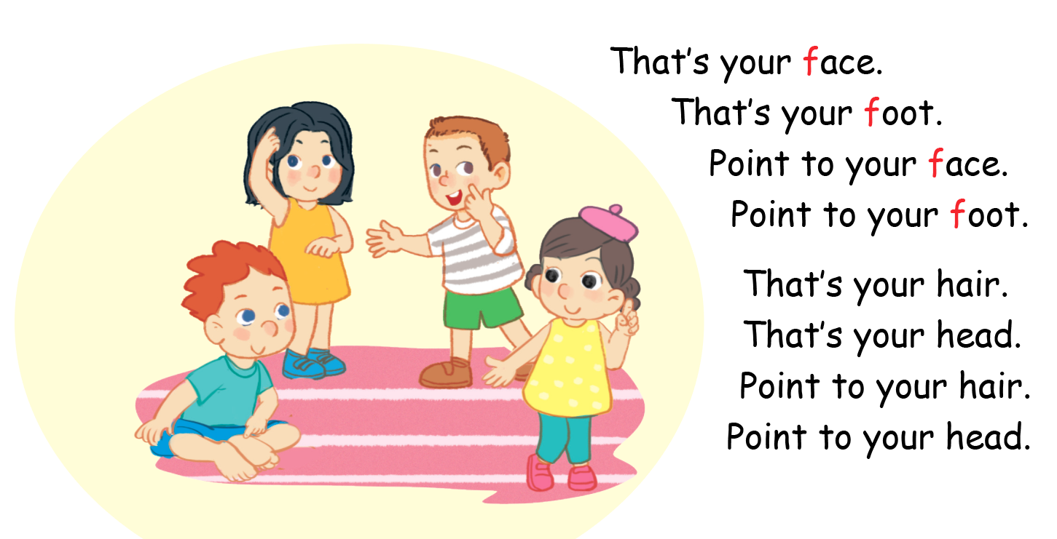
Listen and sing

Slide 16
Game
Notes:
Game: https://www.freddiesville.com/games/body-parts-word-search-puzzle-online/
Click on the link and have pupils look at the table of letters.
Group will get star if they can find the meaningful word.

Slide 17
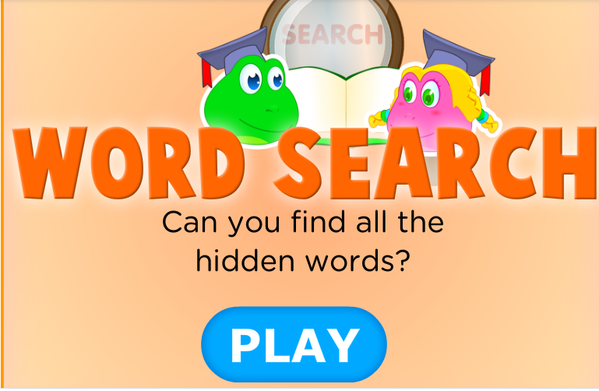

Slide 18
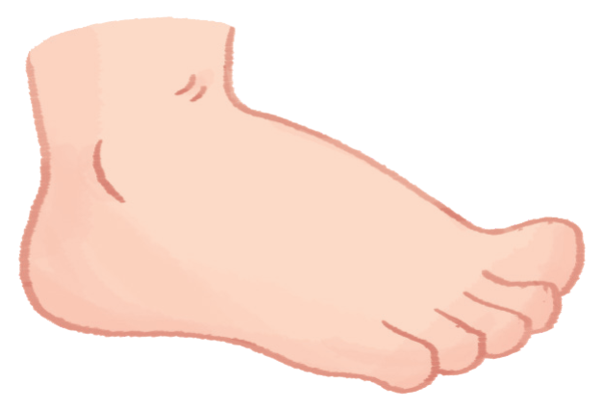
Goodbye
foot
Notes:
Teacher shows the vocabulary of the lesson on slide.
Pupils say goodbye.

Slide 19

Goodbye
face

Slide 20

Goodbye
football

Slide 21
Goodbye
father

