Slide 1


UBND QUẬN DƯƠNG KINH
TRƯỜNG TIỂU HỌC ANH DŨNG
WELCOME
To Our Class

Slide 2
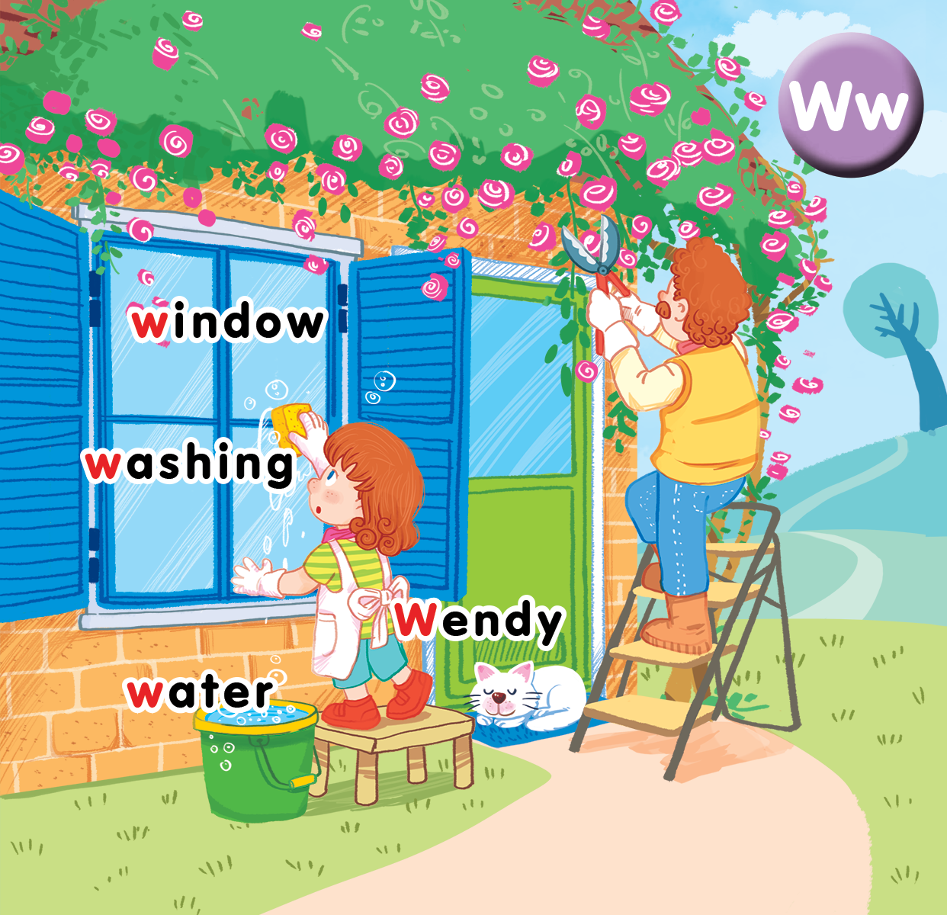
Unit 16 At home Lesson 1

Slide 3

Warm-up

Slide 4


Pass the ball!
Bài hat trang 67

Slide 5




Slide 7

washing

Slide 8

window

Slide 9

water

Slide 10

Wendy

Slide 11




Slide 13
Word build challenge
Notes:
Have pupils play word build, close all the books, guess the letter to make words.
For wrong guessing, 1 part of the UFO will be built.
Pupils will lose the game if the UFO is completed.

Slide 14



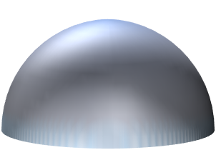


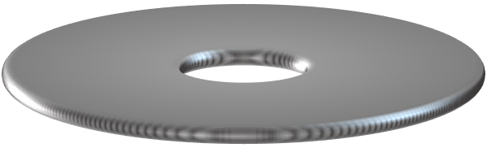

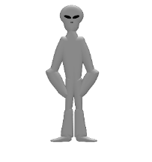



A
B
C
D
E
F
G
H
I
J
K
L
M
N
O
P
Q
R
S
T
U
V
W
X
W
e
n
d
y
Y
Z
BUILD
Notes:
Nguồn : internet

Slide 15
A
B
C
D
E
F
G
H
I
J
K
L
M
N
O
P
Q
R
S
T
U
V
W
X
w
a
s
h
i
n
g
Y
Z
BUILD

Slide 16
A
B
C
D
E
F
G
H
I
J
K
L
M
N
O
P
Q
R
S
T
U
V
W
X
w
i
n
d
o
w
Y
Z
BUILD

Slide 17
A
B
C
D
E
F
G
H
I
J
K
L
M
N
O
P
Q
R
S
T
U
V
W
X
n
o
o
d
l
e
s
Y
Z
BUILD
Notes:
Write the answer here

Slide 18
A
B
C
D
E
F
G
H
I
J
K
L
M
N
O
P
Q
R
S
T
U
V
W
X
w
a
t
e
r
Y
Z
BUILD

Slide 19
A
B
C
D
E
F
G
H
I
J
K
L
M
N
O
P
Q
R
S
T
U
V
W
X
f
o
o
t
b
a
l
l
Y
Z
BUILD
Notes:
Write the answer here

Slide 20
A
B
C
D
E
F
G
H
I
J
K
L
M
N
O
P
Q
R
S
T
U
V
W
X
t
i
g
e
r
Y
Z
BUILD
Notes:
Write the answer here

Slide 21
Goodbye
water
Notes:
Teacher shows the vocabulary of the lesson on slide.
Pupils say goodbye.

Slide 22
Goodbye
Wendy

Slide 23
Goodbye
window

Slide 24

Goodbye
washing

Slide 25
Website: hoclieu.vn
Fanpage: facebook.com/tienganhglobalsuccess.vn

