Slide 1


UBND QUẬN DƯƠNG KINH
TRƯỜNG TIỂU HỌC ANH DŨNG
WELCOME
To Our Class

Slide 2
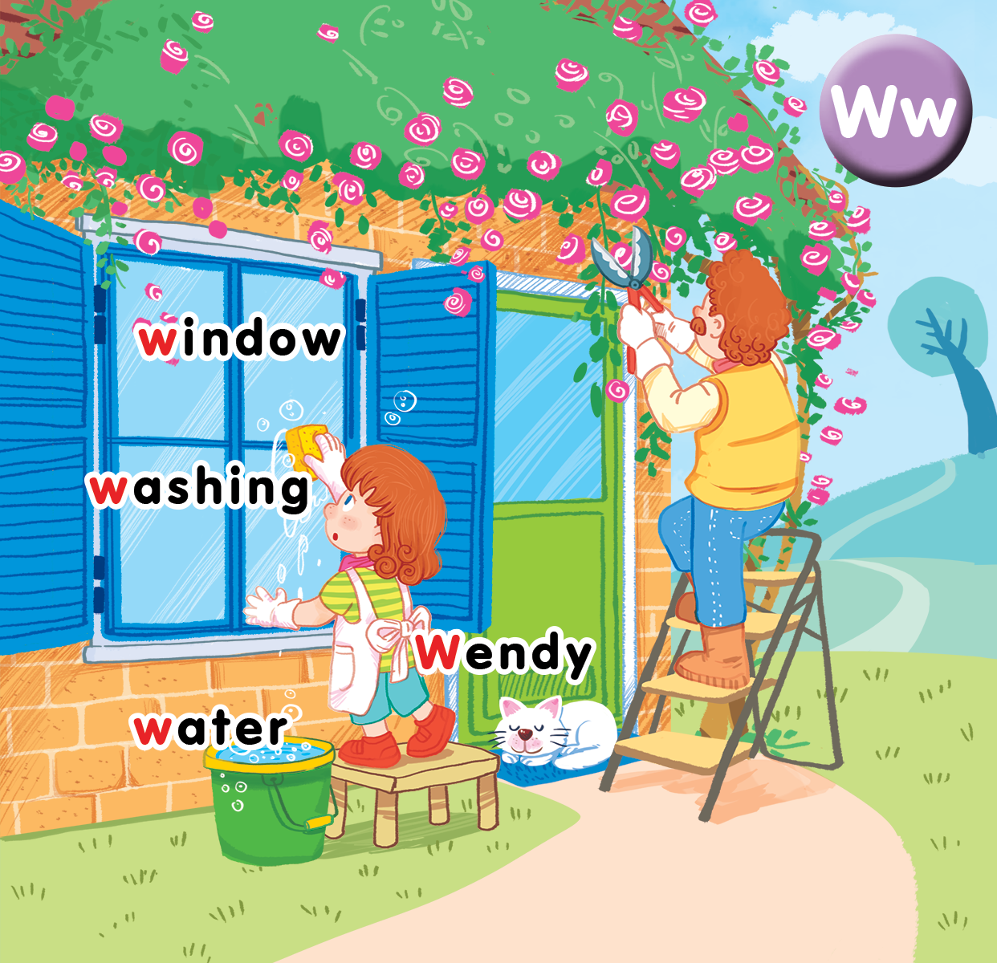
Unit 16
At home
Lesson 2

Slide 3

Hidden pictures
Notes:
- Prepare flashcards of several words. Use a sheet of paper to hide a part of the card.
- Encourage pupils to guess what the word is.

Slide 4


Listen and chant

Slide 5

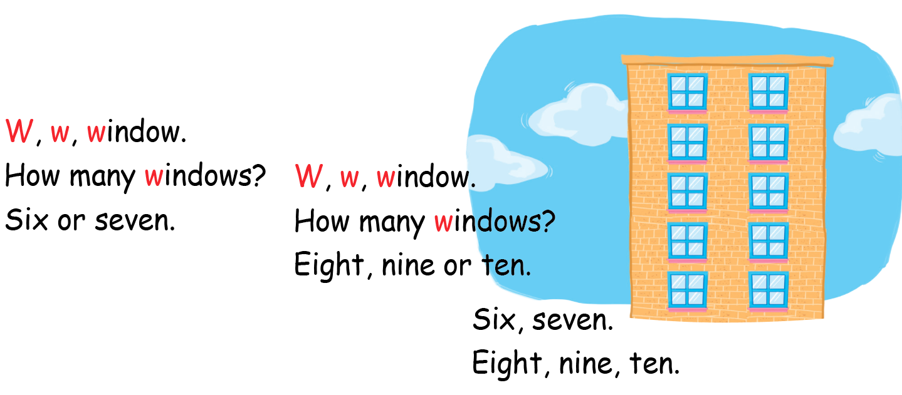
Listen and chant

Slide 6

Listen and tick

Slide 7
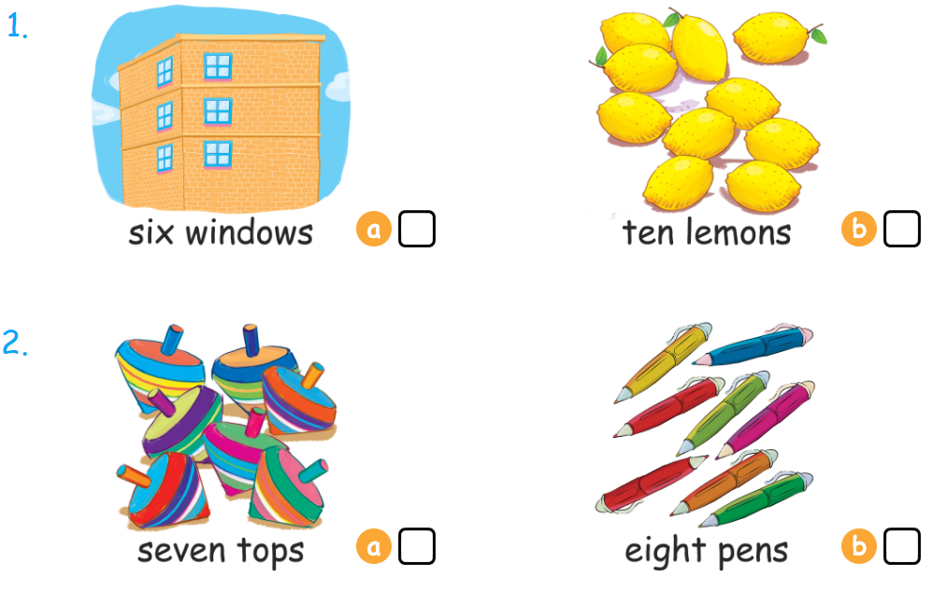

Listen and tick

Slide 8



Look, trace and write

Slide 9
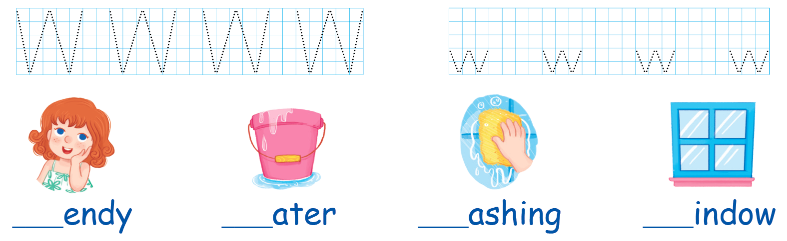
Look , trace and write

Slide 10
How many …?
Notes:
Divide the class into 3 teams.
Call 1 pupil from each team to choose a number and answer the question How many… in that number to get points.
Click on the flower to move to the next activity.

Slide 11





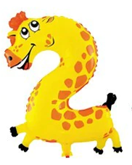




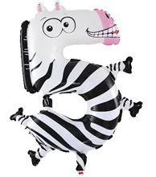

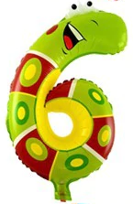




Slide 12
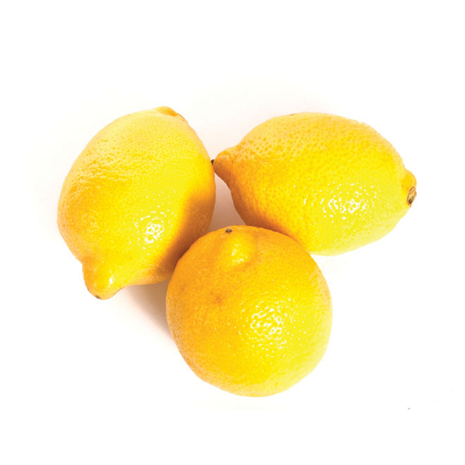

How many lemons?
three lemons

Slide 13

How many balls?
ten balls

Slide 14
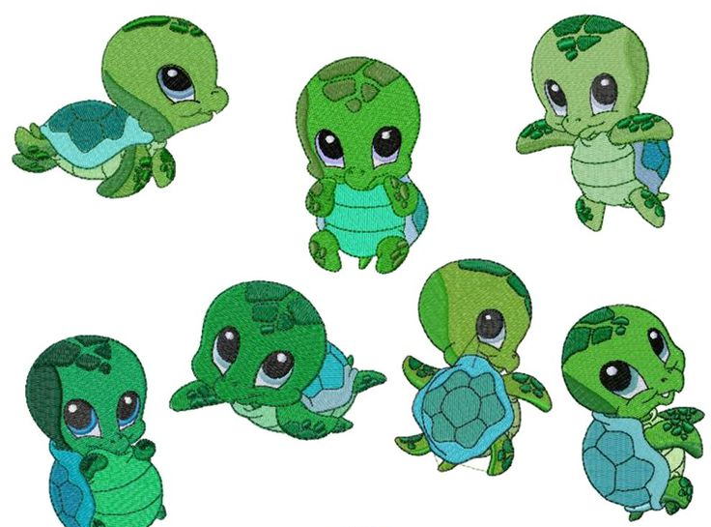
How many turtles?
seven turtles

Slide 15
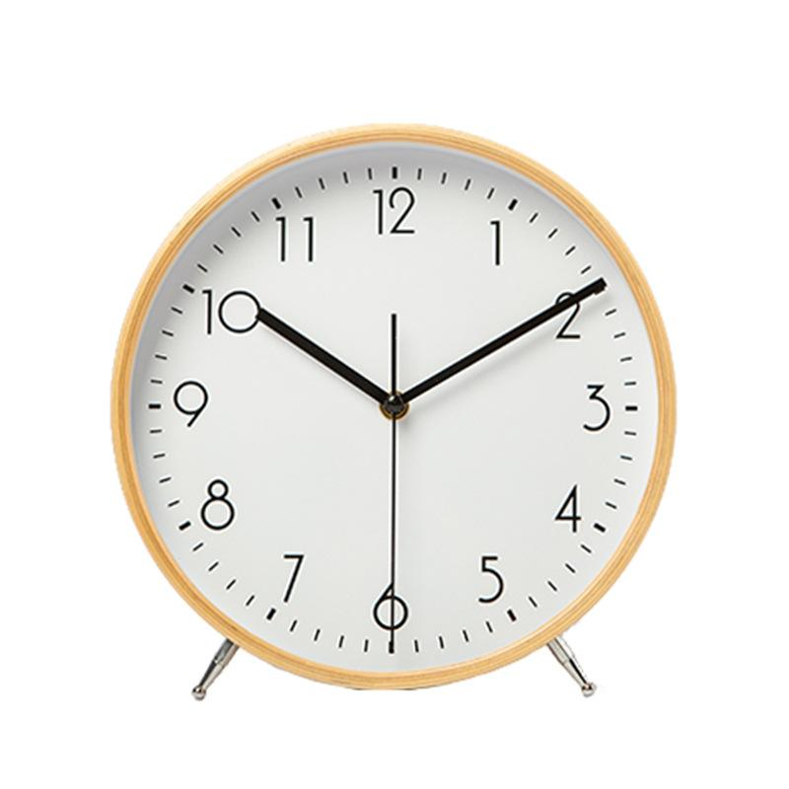
How many clocks?
one clock

Slide 16
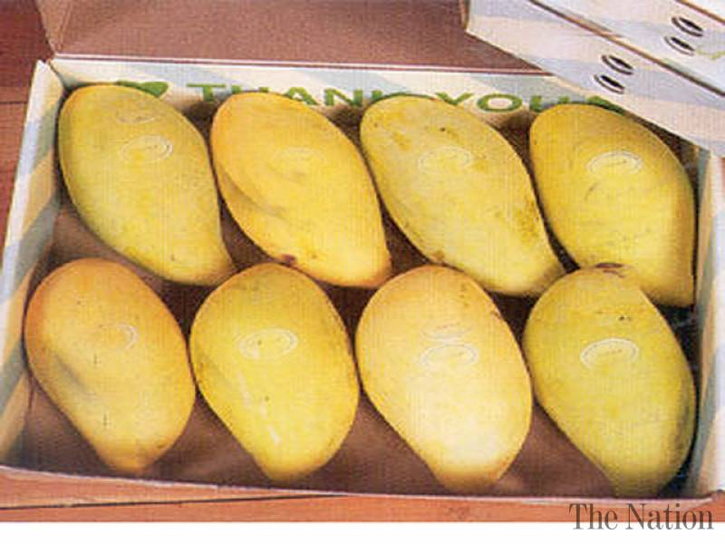
How many mangoes?
eight mangoes

Slide 17
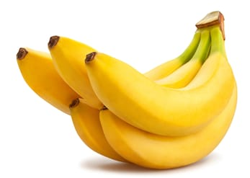
How many bananas?
five bananas

Slide 18

How many pens?
three pens

Slide 19

How many windows?
six windows.

Slide 20

How many pencils?
eight pencils

Slide 21
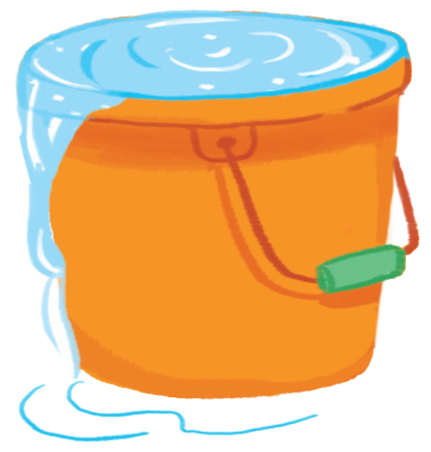
Goodbye
water
Notes:
Teacher shows the vocabulary of the lesson on slide.
Pupils say goodbye.

Slide 22

Goodbye
Wendy

Slide 23

Goodbye
window

Slide 24
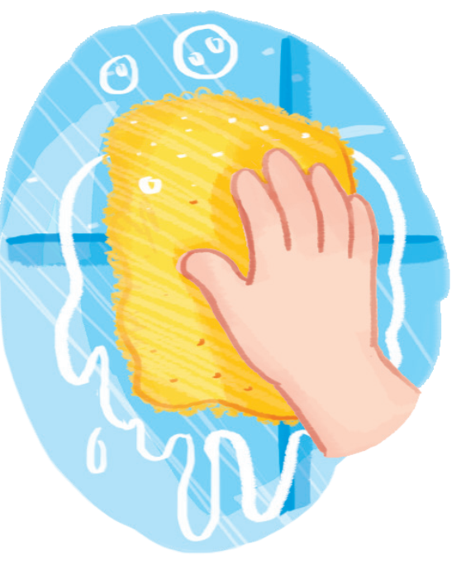
Goodbye
washing

