Slide 1
UNBD QUẬN DƯƠNG KINH TRƯỜNG TIỂU HỌC ANH DŨNG
HELLO AND WELCOME TO MY ENGLISH CLASS

Slide 2

FUN TIME 4
Period 1

Slide 3

Table of contents
01
Warm-up and Review
02
Activity 1.Trace and colour. Then say.
03
Activity 2. Let’s play.
04
Fun corner and Wrap-up

Slide 4


01
Warm-up and Review

Slide 5


HIDDEN PICTURES
GAME

Slide 6


What’s this picture?
tiger

Slide 7
What’s this picture?
top

Slide 8

What’s this picture?
turtle

Slide 9

What’s this picture?
teddy bear

Slide 10


Very Good!

Slide 11
02
Activity 1.
Trace and colour. Then say.

Slide 12

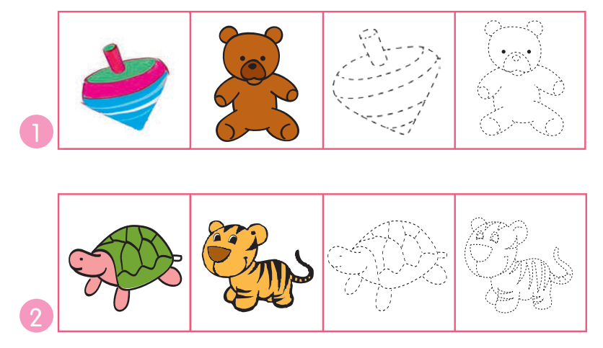
Trace and colour. Then say.

Slide 13
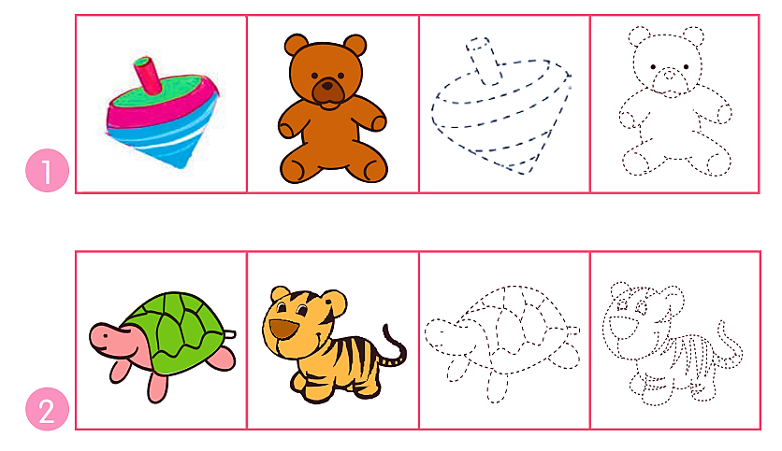


Trace and colour. Then say.
top

Slide 14















































Trace and colour. Then say.
teddy bear

Slide 15



























Trace and colour. Then say.
turtle

Slide 16


























Trace and colour. Then say.
tiger

Slide 17


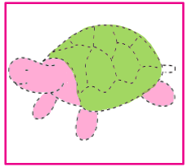

Trace and colour. Then say.
top
teddy bear
turtle
tiger

Slide 18
03
Activity 2. Let’s play.

Slide 19

Let’s play.
Mystery bag

Slide 20



Mystery bag
Team turtle
Team Tiger

Slide 21


Mystery bag
?
T

Slide 22
Mystery bag
?
N

Slide 23
Mystery bag
?
n

Slide 24
Mystery bag
?
t

Slide 25
Mystery bag
?
m

Slide 26
Mystery bag
?
o

Slide 27
Mystery bag
?
O

Slide 28
Mystery bag
?
M

Slide 29
Mystery bag
?
b

Slide 30
Mystery bag
?
B

Slide 31
Mystery bag
?
C

Slide 32
Mystery bag
?
c

Slide 33

Win!

Slide 34
04
Fun corner and wrap-up

Slide 35


Slide 36
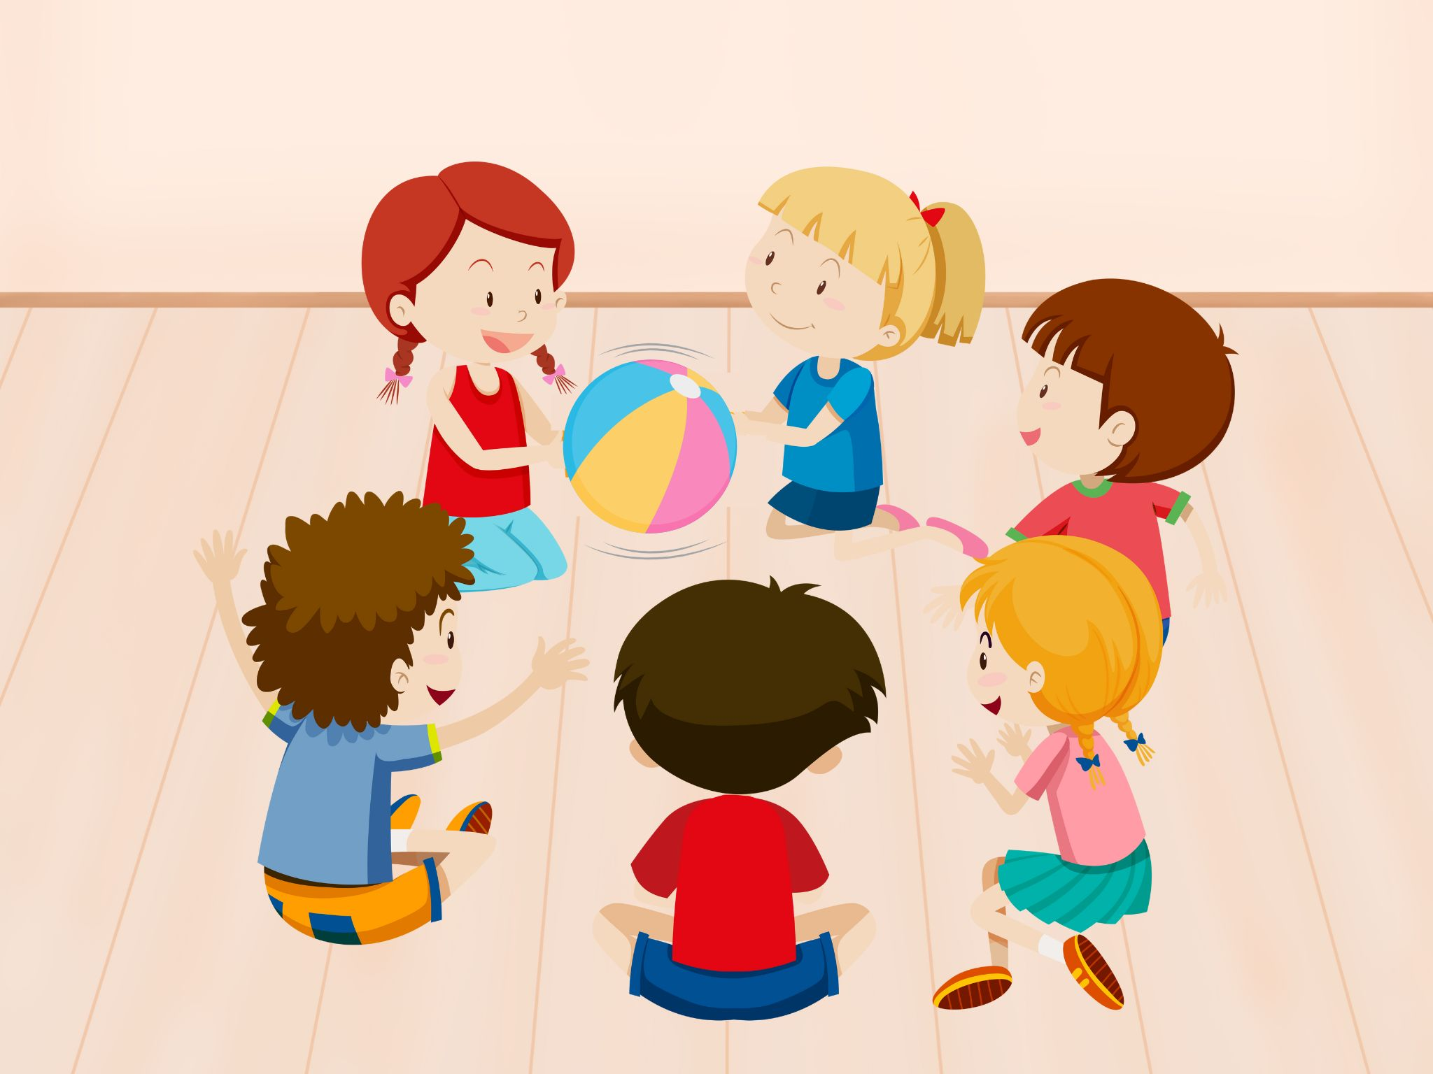
Pass the ball.
I can see __.
I can see __.

Slide 37
THANK FOR YOUR LISTENING

