Slide 1




UBND QUẬN DƯƠNG KINH
TRƯỜNG TIỂU HỌC ANH DŨNG
HELLO AND WELCOME TO MY ENGLISH CLASS

Slide 2

Unit 13 In the school canteen Lesson 2

Slide 3

Labelling

Slide 4


Listen and chant

Slide 5
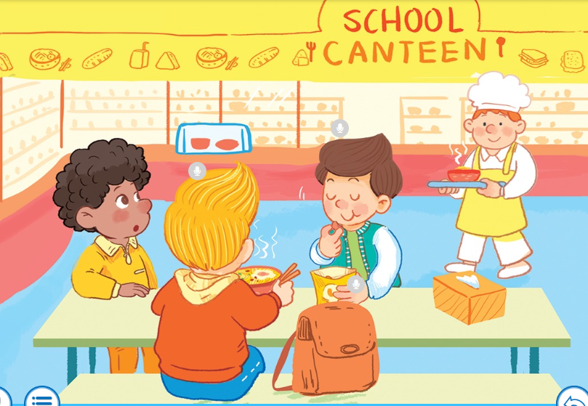

Slide 6
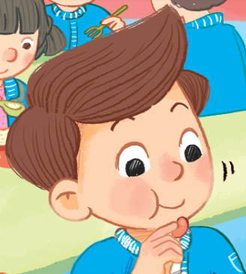

Nam’s having nuts.

Slide 7


Nick’s having noodles.

Slide 8


Listen and chant

Slide 9

Listen and tick

Slide 10
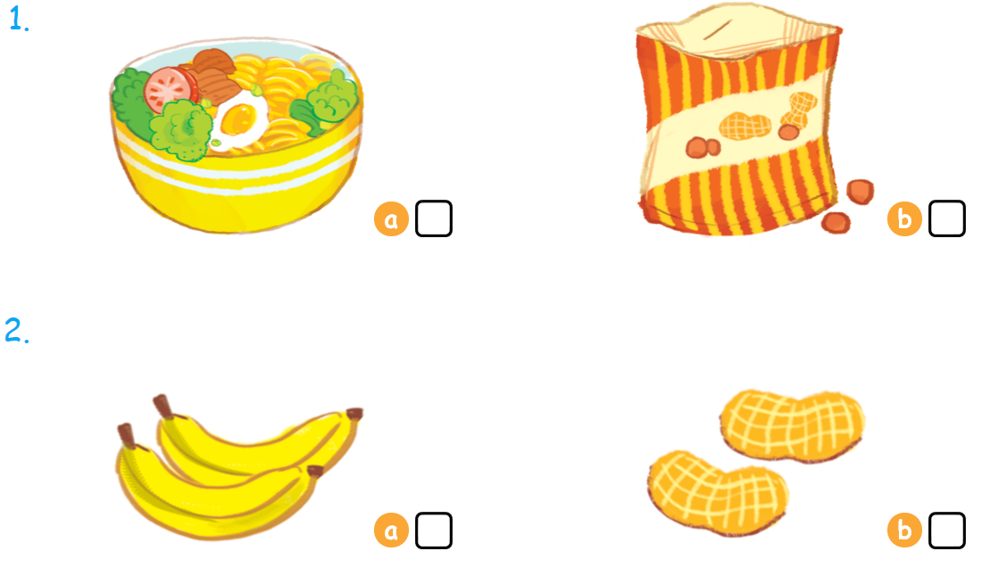

Listen and tick

Slide 11



Look, trace and write

Slide 12
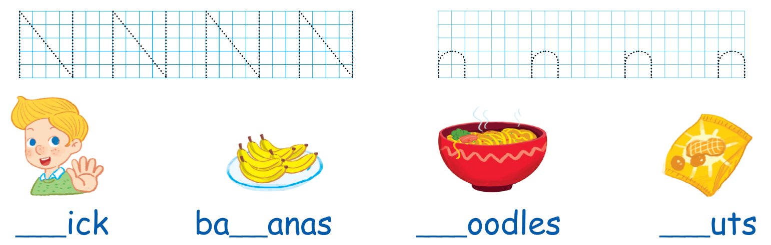
Look and trace
Chờ Xuân gửi file sách giáo khoa để add

Slide 13
What’s missing?
Notes:
- Show the slide.
- At the 2nd time showing, there’s something missing in the picture.
- Encourage pupils to guess what is missing.
- The fastest pupil who can find out what the missing picture is and say out loud the word gets points for his/her team.

Slide 14






Slide 15


Slide 16


Slide 19
Goodbye
Notes:
Goodbye
Time: 2 minutes
Teacher and pupils say goodbye to the words.

Slide 20

Goodbye

Slide 21
Goodbye

Slide 22
Goodbye

Slide 23







THANK YOU FOR LISTENING!

