Slide 1




UBND QUẬN DƯƠNG KINH
TRƯỜNG TIỂU HỌC ANH DŨNG
HELLO AND WELCOME TO MY ENGLISH CLASS

Slide 2
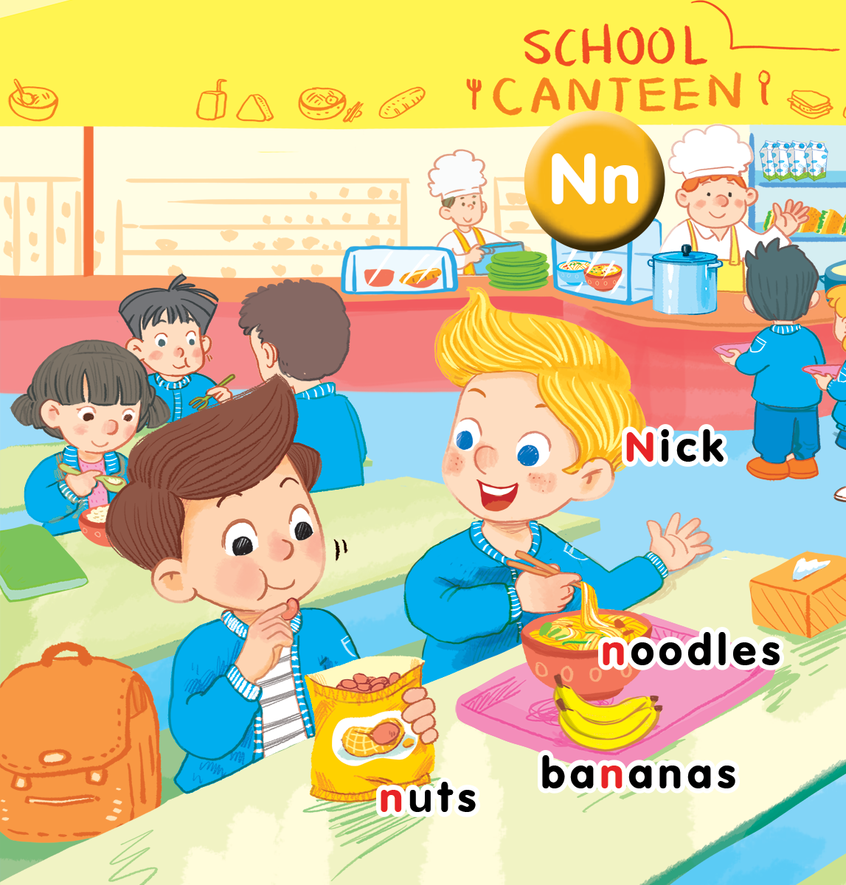
Unit 13 In the school canteen Lesson 3

Slide 3

Who’s faster?
Notes:
- Show the slide of food or fruit.
- Have pupils say the word.
- Give marks for the group that has a member say the word correctly and quickly.

Slide 4


Slide 5


Slide 6


Slide 7


Slide 8


Slide 9


Slide 10


Slide 11


Slide 12


Slide 13


Listen and repeat

Slide 14

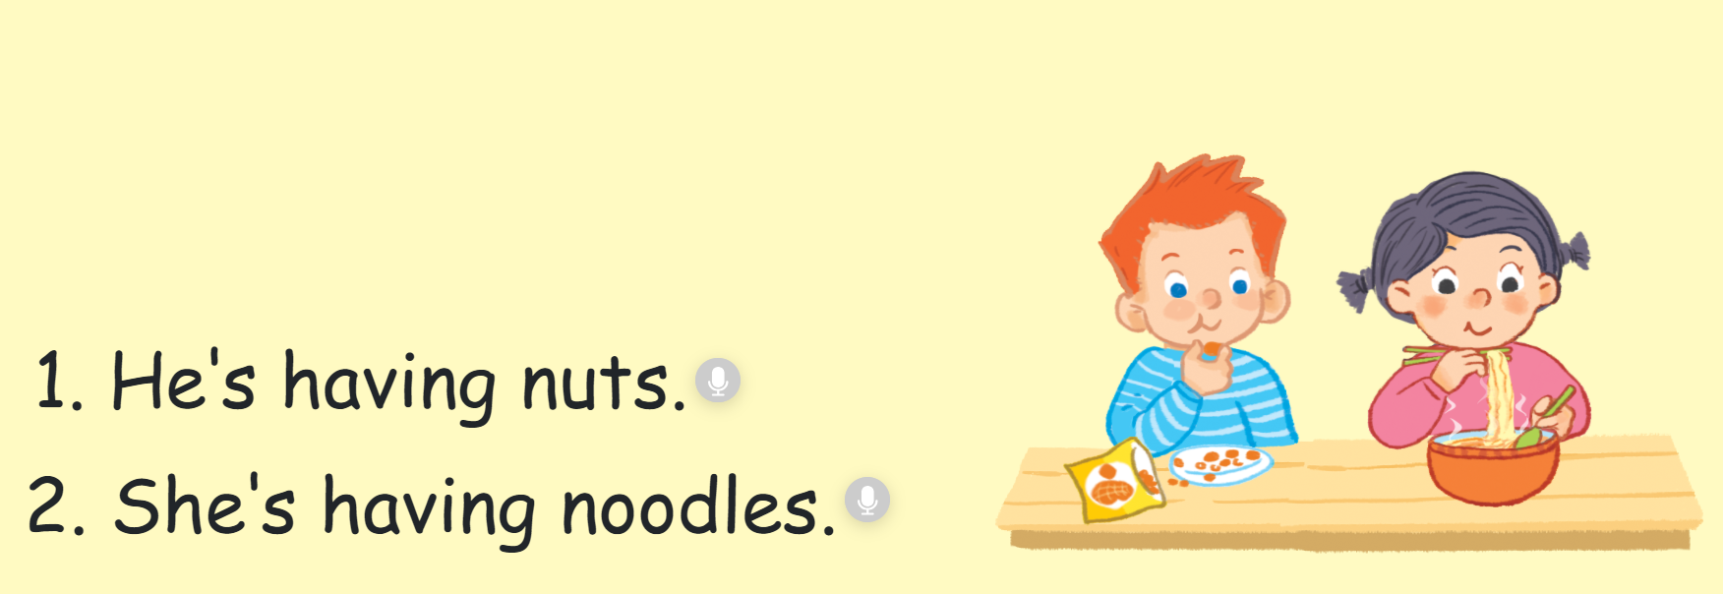

Slide 15


Let’s talk
Notes:
Let’s talk is divided into 2 steps.

Slide 16
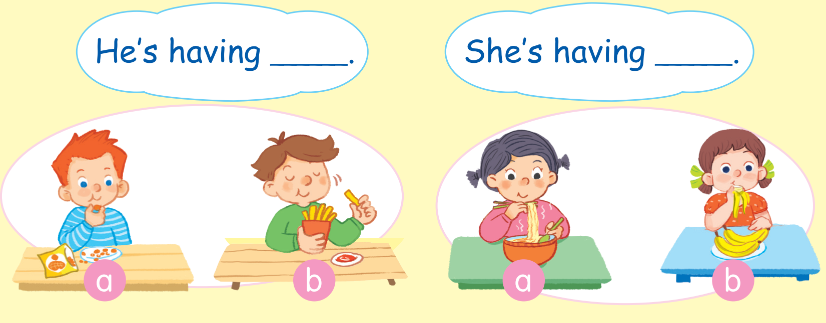

Slide 17


Slide 18



Rules:
= 1 point
= lose 3 points
= 5 points

Slide 19










TEAM 1:
TEAM 2:
TEAM 3:
TEAM 4:
Notes:
Giáo viên click vào số bất kỳ, sẽ link sang câu hỏi.
Giáo viên cho Hs nhìn hình để đặt câu,
Giáo viên click để ra đáp án
Giáo viên click lần nữa để ra điểm.
Muốn quay trở lại slide này, Giáo viên click vào hình bông hoa màu tím ở góc dưới bên phải màn hình.
Giáo viên sửa điểm cho mỗi đội ngay trên slide powerpoint này trong khi đang trình chiếu

Slide 20
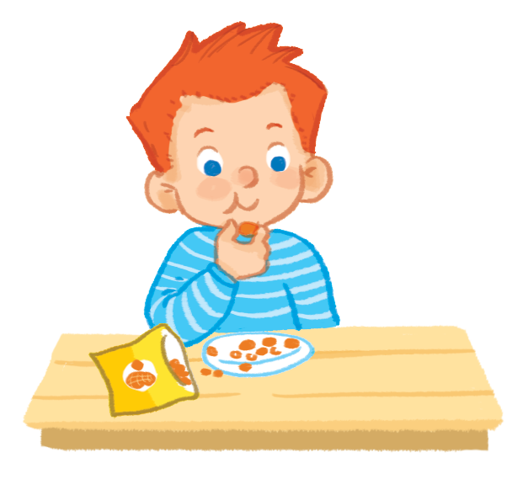

He’s having nuts..

Slide 21

He’s having chips..

Slide 22
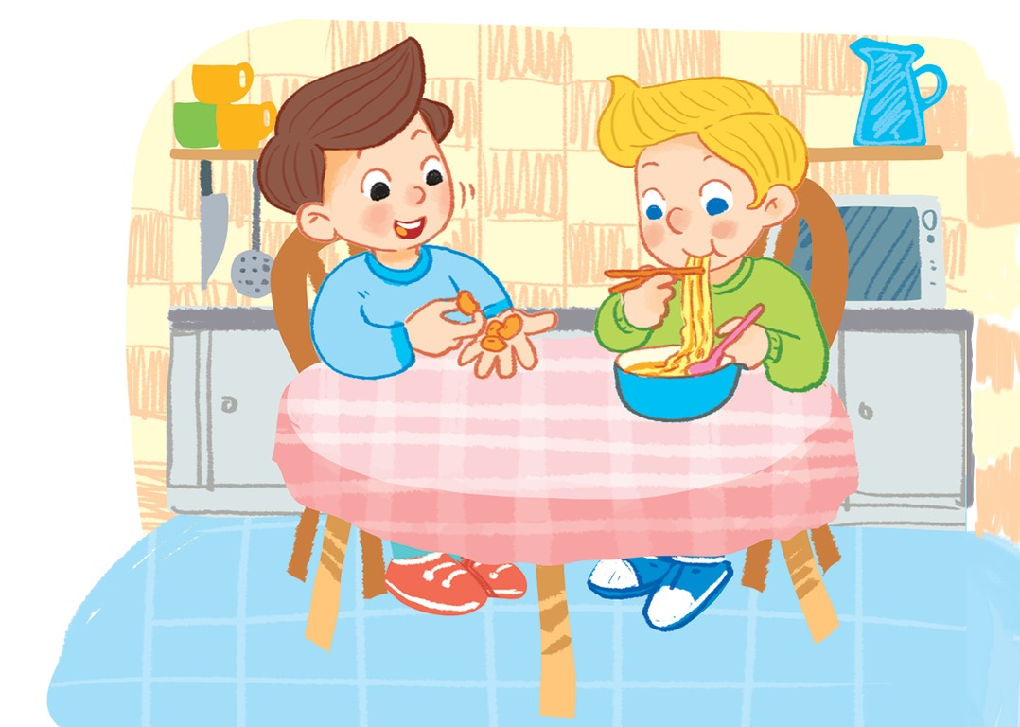
He’s having nuts..

Slide 23
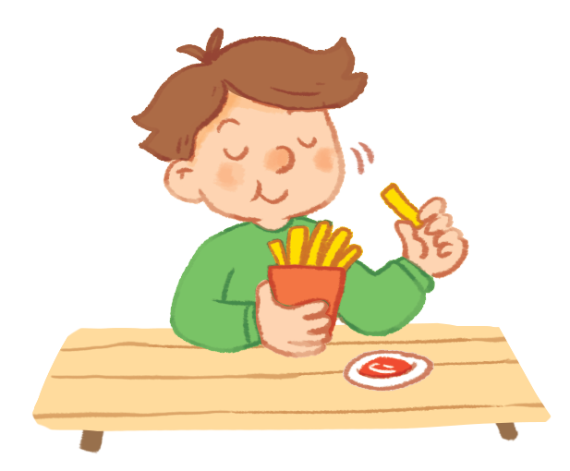
He’s having chips..

Slide 24
He’s having noodles..

Slide 25

She’s having an apple..

Slide 26

She’s having fish and chips..

Slide 27

She’s having noodles..

Slide 28

She’s having a cake..

Slide 29

He’s having chicken..

Slide 30

She’s having fish and chips..

Slide 31

He’s having an apple..

Slide 32


Let’s sing
Notes:
Let’s sing is divided into 3 steps.
Step 1
Goal: Pupils will be able to read the song lyrics.
Time: 3 minutes
Have pupils read the song lyrics in chorus then in groups.
Step 2:
Goal: Pupils will be able to sing a long the song with TPR.
Have pupils listen and sing a long the song in chorus then in groups.
Have groups create their own TPR for the song then present.
Finish the song with the TRP for High five and fist bump.

Slide 33
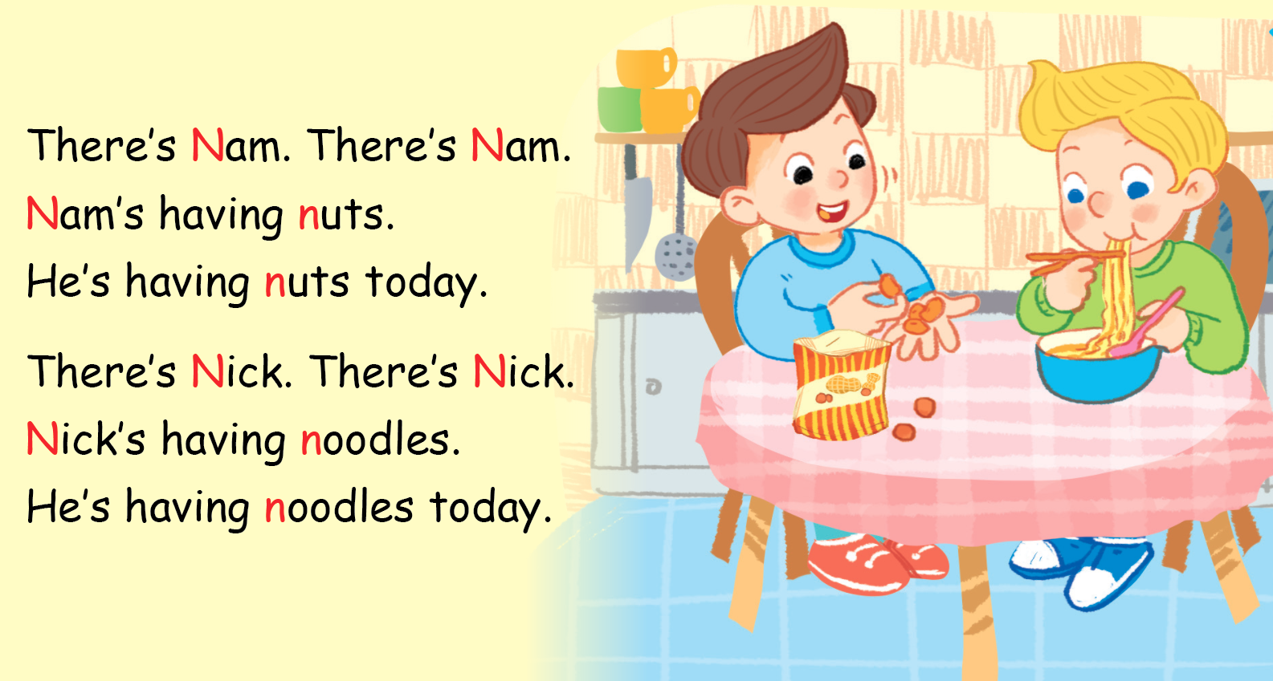
Let’s sing

Slide 34

Notes:
Ask pupils to look at the board.
Some of the words will disappear when teacher press any buttons.
Have pupils work in pairs to create a new version by replace some words to the missing places.
Give pupils 1-2 mins to prepare.
Call some pairs to the front to sing, give points to the team.

Slide 35
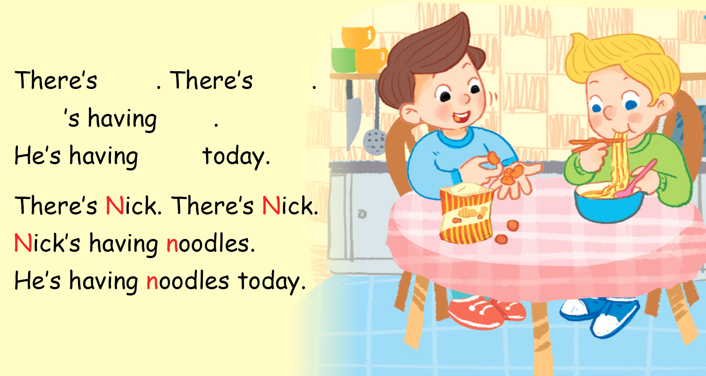

Slide 36
Game
Notes:
Hidden picture
* Teacher presses any buttons, some blocks will disappear, the fastest pupil with the correct answer will get points for their team.

Slide 37
SHOW
www.Games4esl.com

Slide 38
SHOW
www.Games4esl.com

Slide 39
SHOW
www.Games4esl.com

Slide 40

SHOW
www.Games4esl.com

Slide 41

SHOW
www.Games4esl.com

Slide 42
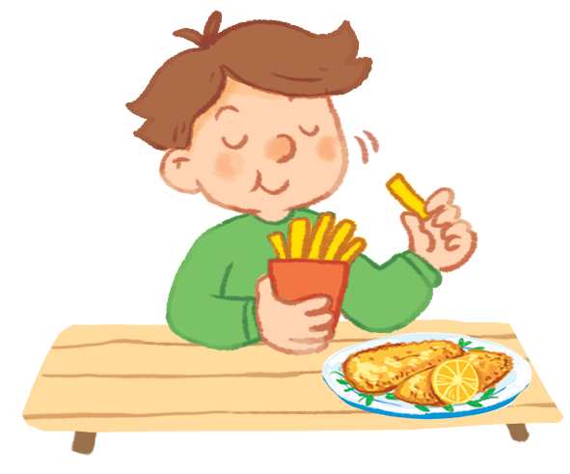
SHOW
www.Games4esl.com

Slide 43

Goodbye
Notes:
Teacher and pupils say goodbye to the words.

Slide 44
Goodbye

Slide 45

Goodbye

Slide 46
Goodbye

Slide 47







THANK YOU FOR LISTENING!

