Slide 1




UBND QUẬN DƯƠNG KINH
TRƯỜNG TIỂU HỌC ANH DŨNG
HELLO AND WELCOME TO MY ENGLISH CLASS

Slide 2
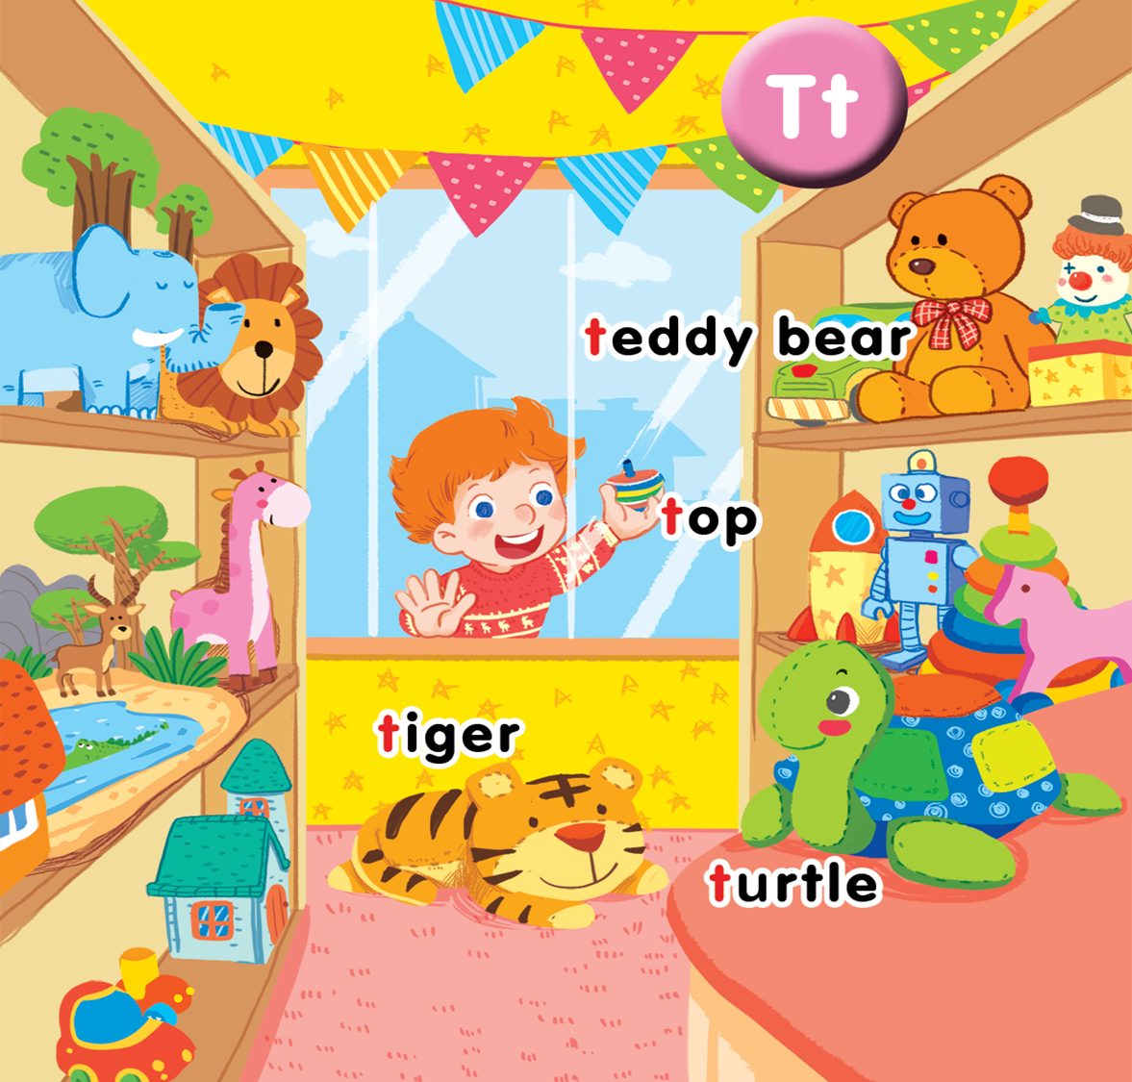
Unit 14 In the toyshop Lesson 3

Slide 3

What’s this?
Notes:
- Have pupils look at the slide and guess what it is.
- First correct answer will earn a star.
- Have pupils say out loud the word after each slide.

Slide 4

Tony

Slide 5
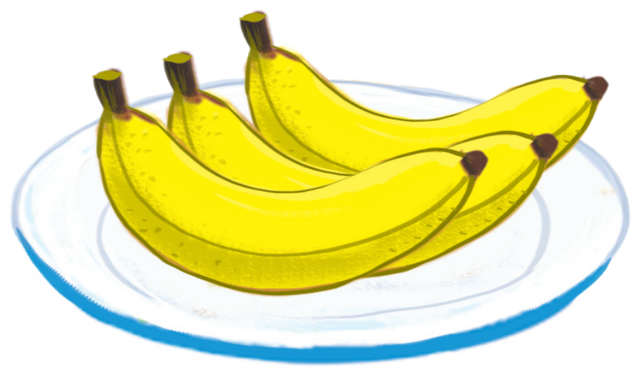
bananas

Slide 6

teddy bear

Slide 7

tiger

Slide 8

top

Slide 9

noodles

Slide 10

turtle

Slide 11

nuts

Slide 12


Listen and repeat
Notes:
Listen and repeat is divided in to 2 steps.
Step 1
Goal: Introduce the sound and the meaning of the structure I can see_____?
Time: 3 minutes
Point to a flashcard for tiger and say I can see a tiger. Use TPR to demonstrate the meaning of “see”.
Repeat the sentence many times and ask pupils to repeat once.
Ask pupils if they understand the sentence and explain in mother tongue if it is needed.
Step 2
Goal: Pupils will be able to repeat the structure I can see a tiger.
Time: 3 minutes.
Have pupils open the book, listen and repeat in chorus, groups and in pairs with different voice for fun.

Slide 13

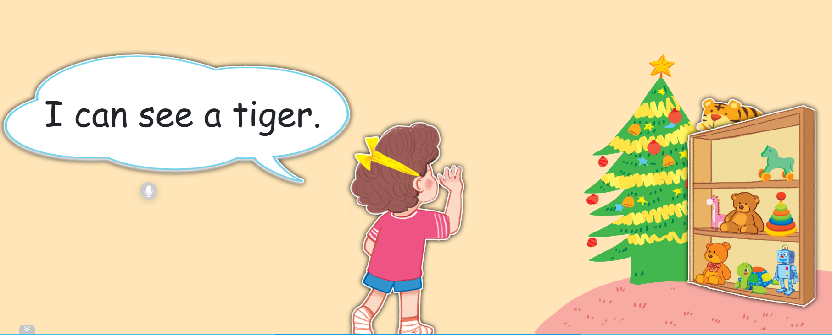

Slide 14


Let’s talk
Notes:
Let’s talk is divided into 2 steps.

Slide 15
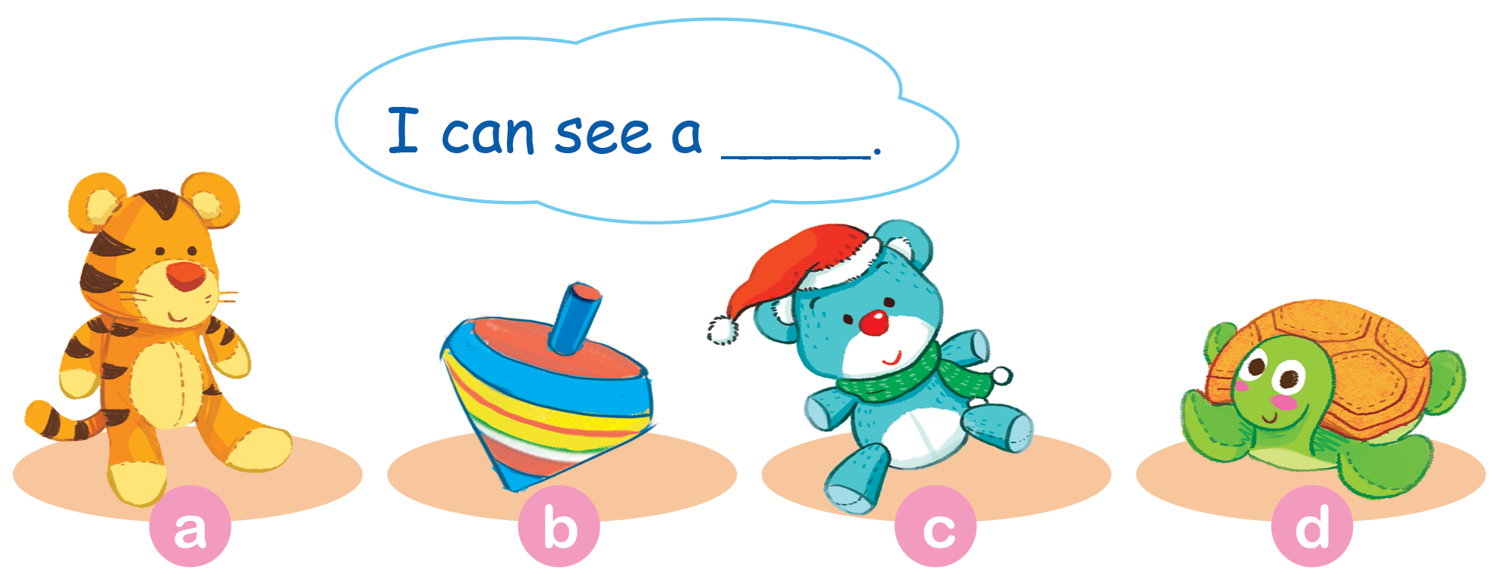

Slide 16

top

Slide 17
teddy bear

Slide 18
Tony

Slide 19
turtle

Slide 20


Let’s sing

Slide 21
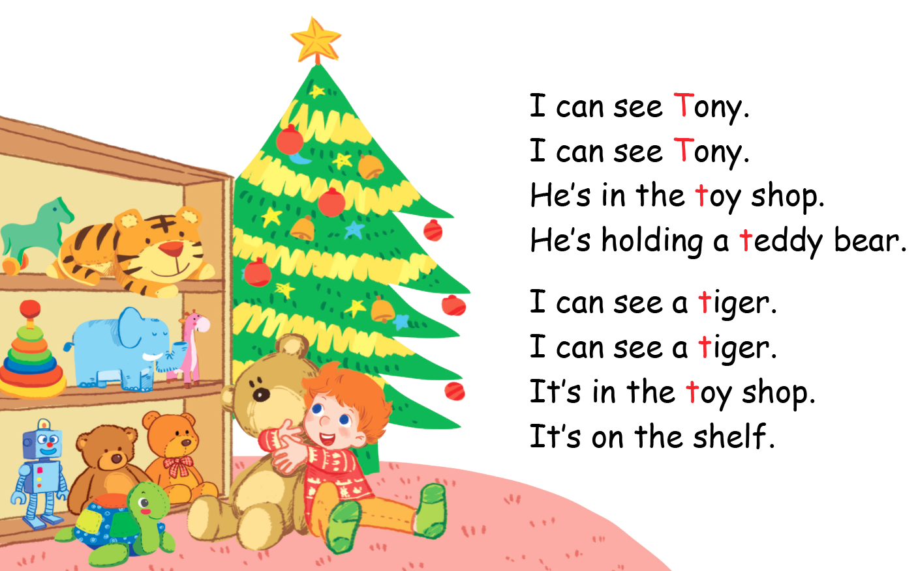
Let’s sing

Slide 22
Goodbye
Notes:
Goodbye
Time: 2 minutes
Teacher and pupils say goodbye to the words.

Slide 23
Goodbye

Slide 24

Goodbye

Slide 25
Goodbye

Slide 26







THANK YOU FOR LISTENING!

