Slide 1




UBND QUẬN DƯƠNG KINH
TRƯỜNG TIỂU HỌC ANH DŨNG
HELLO AND WELCOME TO MY ENGLISH CLASS

Slide 2
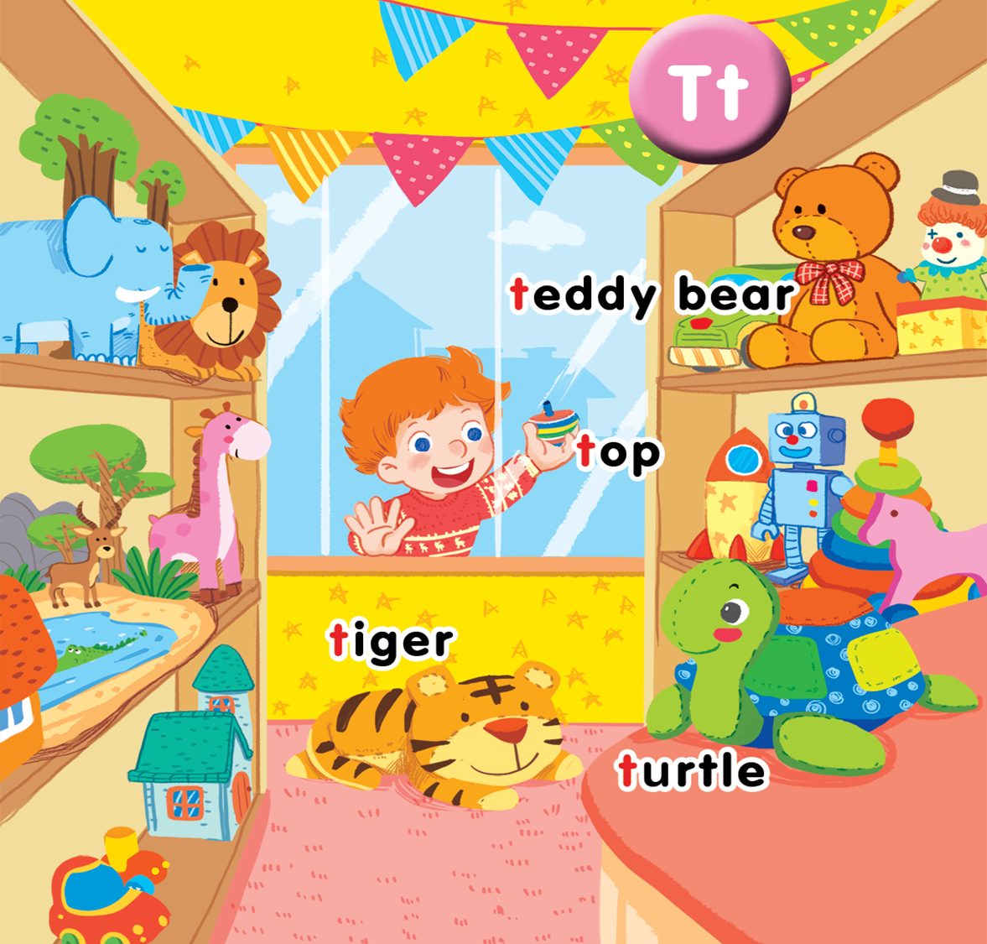
Unit 14 In the toy shop Lesson 1

Slide 3

Warm-up
Notes:
Link: https://www.youtube.com/watch?v=BoJBeGUHGv8
- Have pupils listen to the song twice.
- Ask: What can you see in the song? What is the song about? (Vietnamese is accepted).
- Point out the topic of the song: TOY.
- Write the word TOY on the board and have pupils repeat the word 3 times.
- Have pupils sing along to the song.

Slide 4




Slide 5



Slide 6

teddy bear

Slide 7

tiger

Slide 8

top

Slide 9

turtle

Slide 10




Slide 11
Game
Notes:
Hidden picture
- Show the screen with colourful blocks.
- Have pupils take turns to choose one block to reveal a picture. Pupils have to say aloud the word for that picture.
- Praise for each correct answer.

Slide 12

SHOW
www.Games4esl.com

Slide 13

SHOW
www.Games4esl.com

Slide 14
SHOW
www.Games4esl.com

Slide 15

SHOW
www.Games4esl.com

Slide 16
Goodbye

Slide 17
Goodbye

Slide 18
Goodbye

Slide 19
Goodbye

Slide 20







THANK YOU FOR LISTENING!

