Slide 1




UBND QUẬN DƯƠNG KINH
TRƯỜNG TIỂU HỌC ANH DŨNG
HELLO AND WELCOME TO MY ENGLISH CLASS

Slide 2
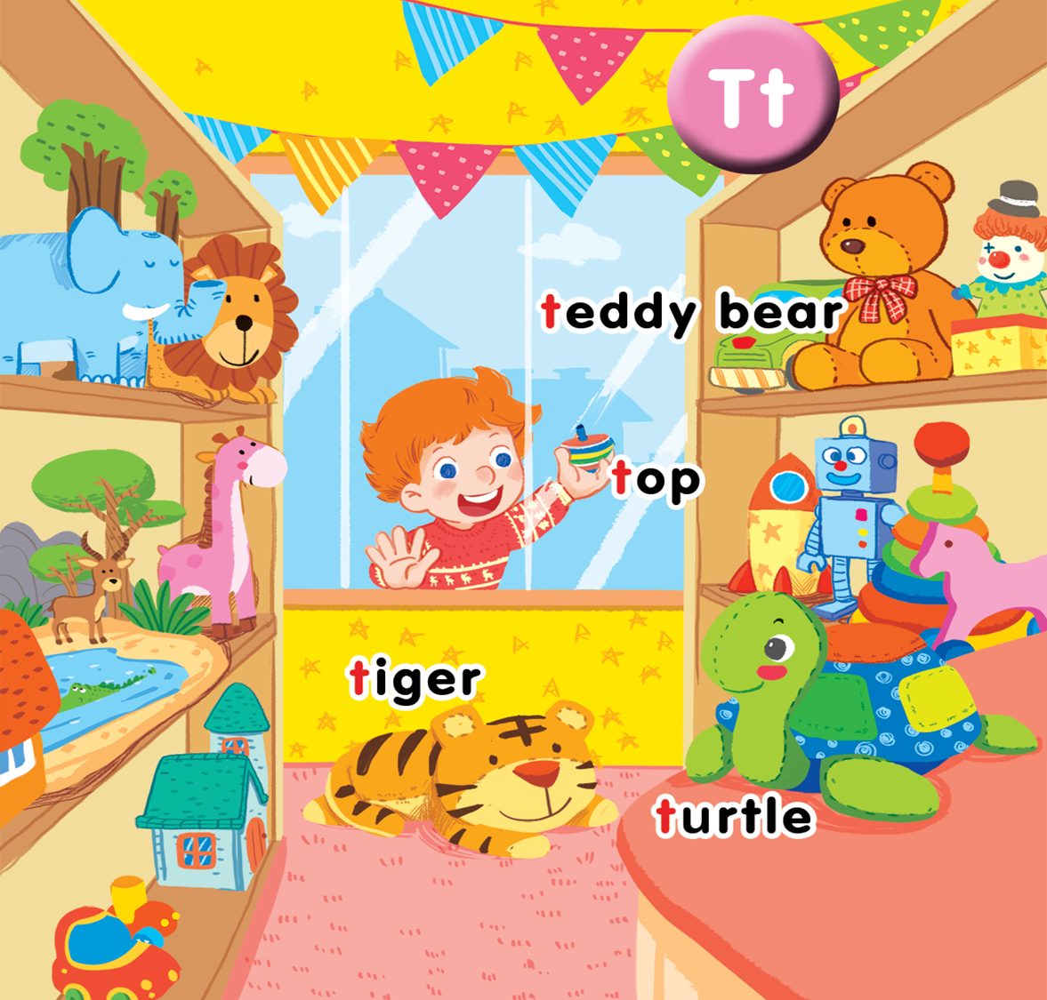
Unit 14 In the toy shop Lesson 2

Slide 3

Notes:
Game: Hidden pictures
Use the flashcards of teddy bear, top, tiger, turtle
Hide a part of card and have pupils guess the word
Praise for each correct answer.

Slide 4


Listen and chant

Slide 5

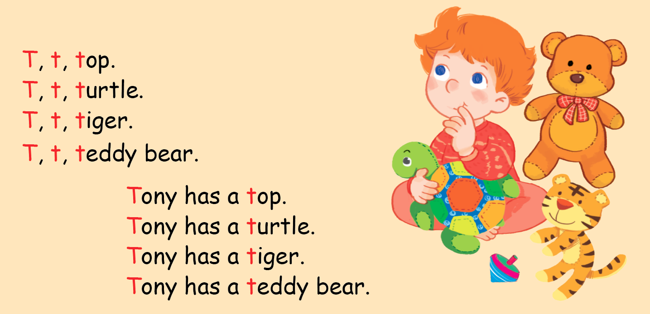
Listen and chant

Slide 6

Listen and tick

Slide 7
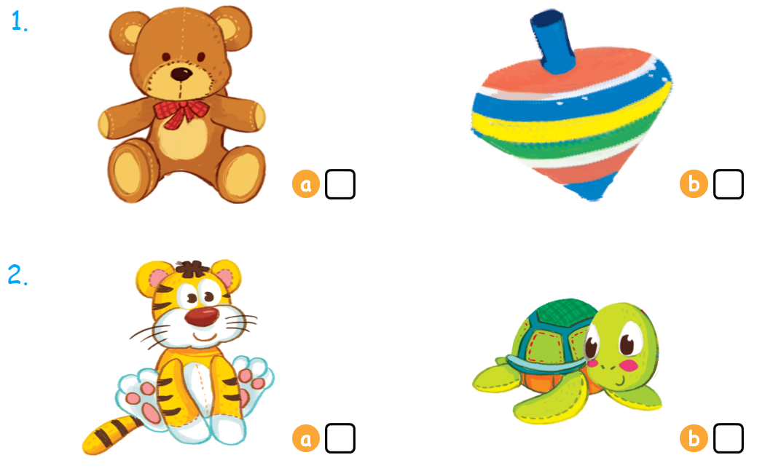

Listen and tick

Slide 8



Look, trace and write

Slide 9
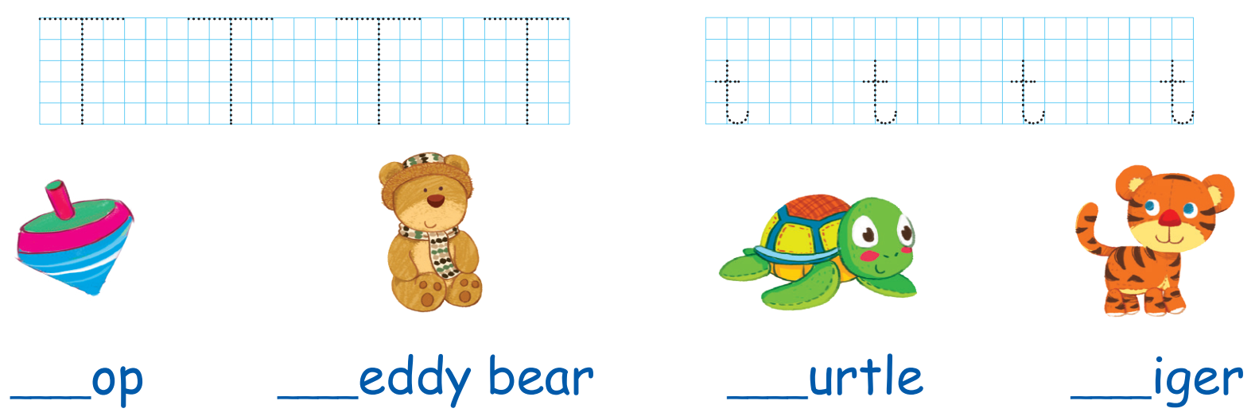

Slide 10
Who’s the fastest?
Notes:
* Game: Who’s the fastest?
- Divide the class into 4 teams.
- Each team has to say the chant in activity 3: each pupil says one sentence. Which team finishes the chant first will be the winner.

Slide 11

Goodbye

Slide 12
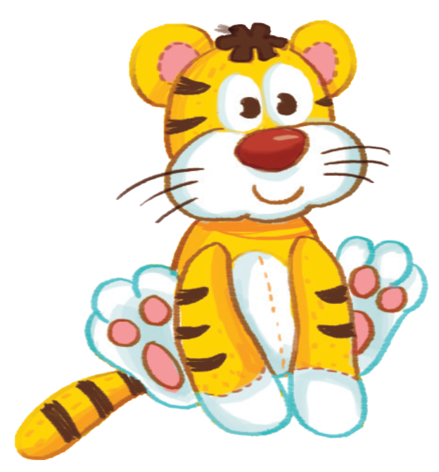
Goodbye

Slide 13

Goodbye

Slide 14

Goodbye

Slide 15

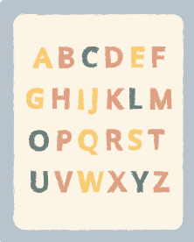





THANK YOU FOR LISTENING!

