Slide 1






UBND QUẬN DƯƠNG KINH
TRƯỜNG TIỂU HỌC ANH DŨNG
REVIEW 3
Period 1 – Phil and Sue

Slide 2


Warm-up
and review.
1

Slide 3
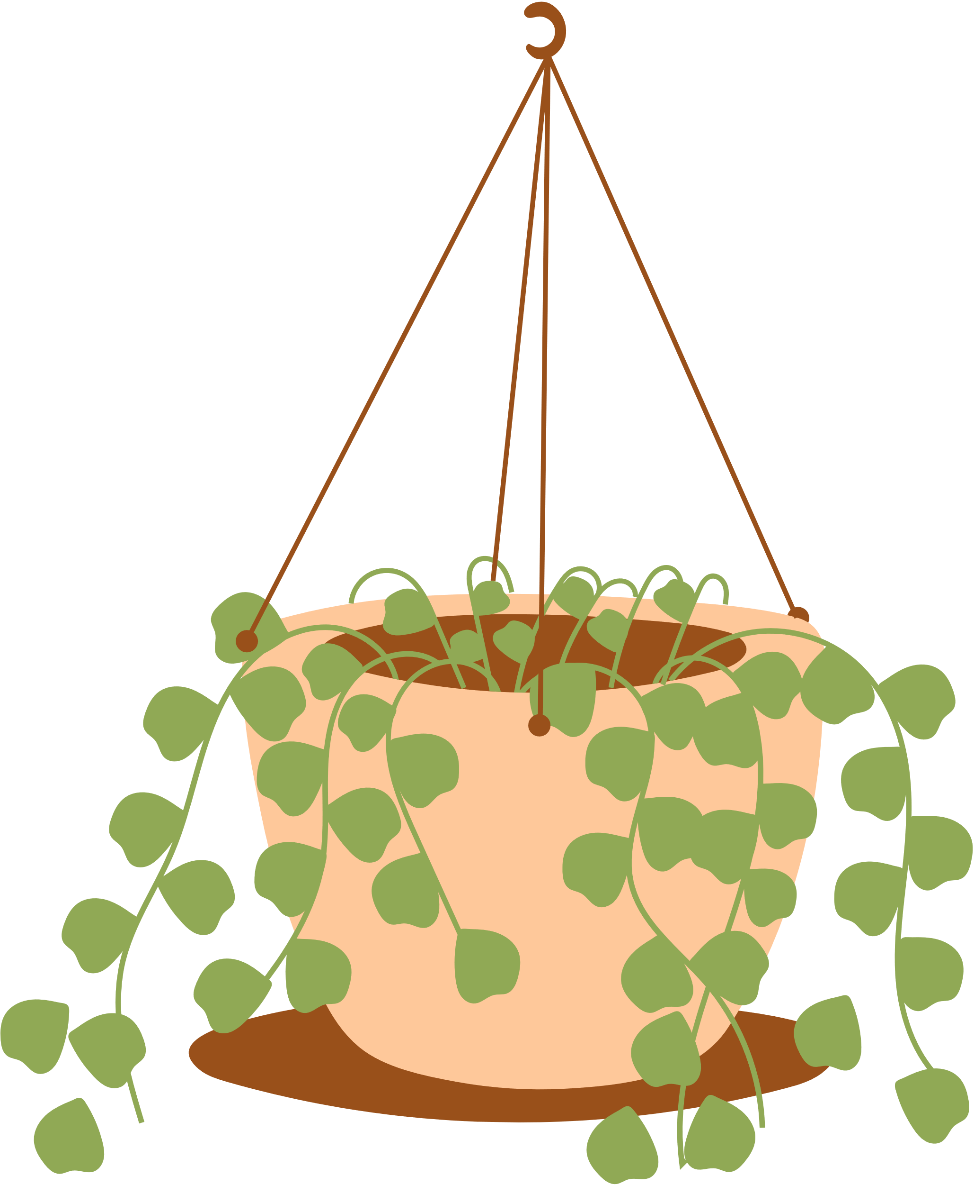










LUCKY FLOWERS
Notes:
Click the flowers to link to the Question slides.
Click the tree to end the game.

Slide 4







grapes
Notes:
Click the red flower to back to the Flower slide.

Slide 5

cake
Notes:
Click the red flower to back to the Flower slide.

Slide 6
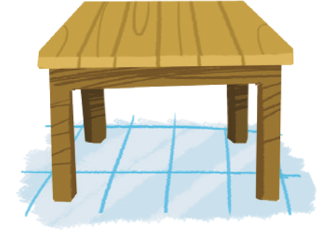
table
Notes:
Click the red flower to back to the Flower slide.

Slide 7
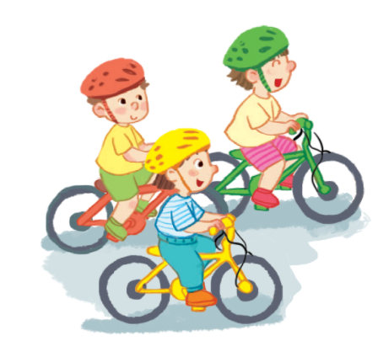
riding
Notes:
Click the red flower to back to the Flower slide.

Slide 8

Notes:
Click the red flower to back to the Flower slide.

Slide 9
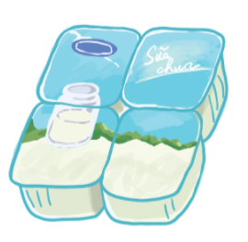
yogurt
Notes:
Click the red flower to back to the Flower slide.

Slide 10

yo-yos
Notes:
Click the red flower to back to the Flower slide.

Slide 11





Thank you
for playing!

Slide 12

2
Listen
and repeat.

Slide 13





LOOK and ANSWER.

Slide 14
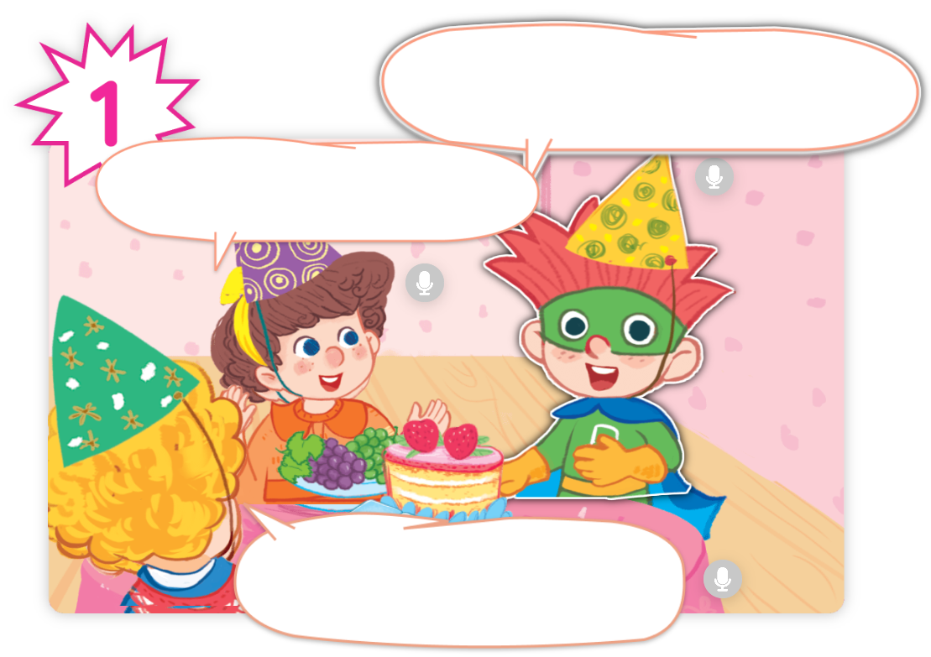
LOOK and ANSWER.

Slide 15
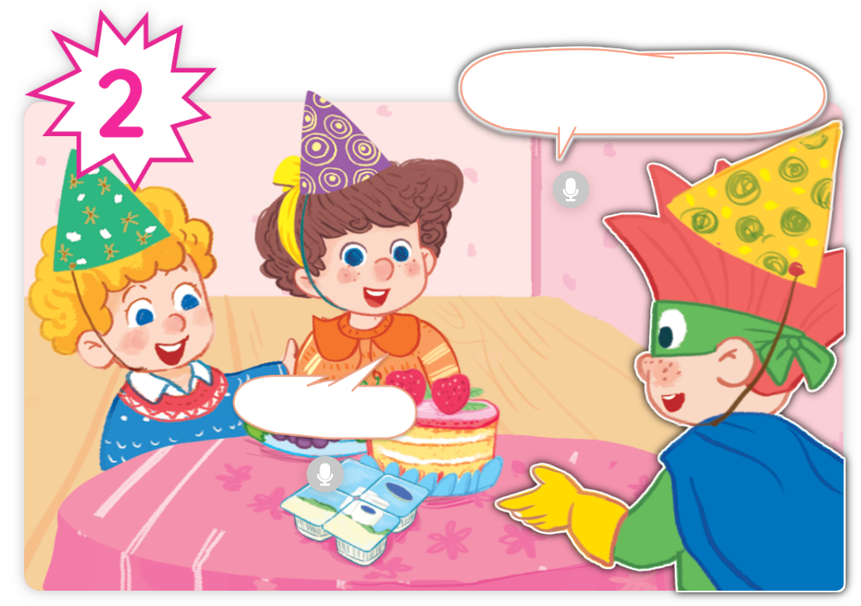
LOOK and ANSWER.

Slide 16
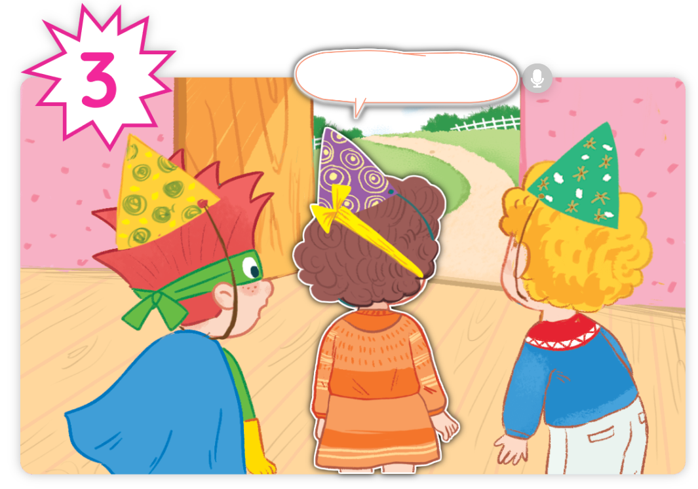
LOOK and ANSWER.

Slide 17
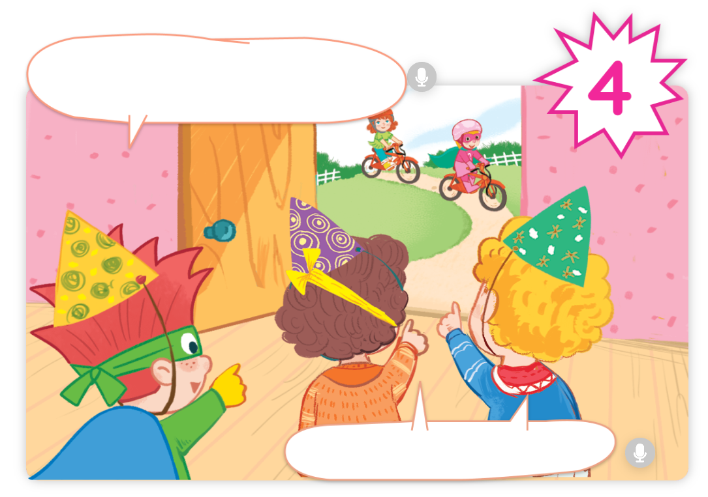
LOOK and ANSWER.

Slide 18


LISTEN and REPEAT.

Slide 19


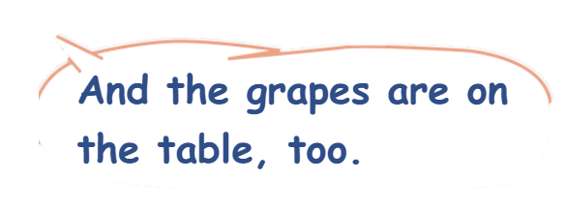
LISTEN and REPEAT.

Slide 20


LISTEN and REPEAT.

Slide 21

LISTEN and REPEAT.

Slide 22


LISTEN and REPEAT.

Slide 23
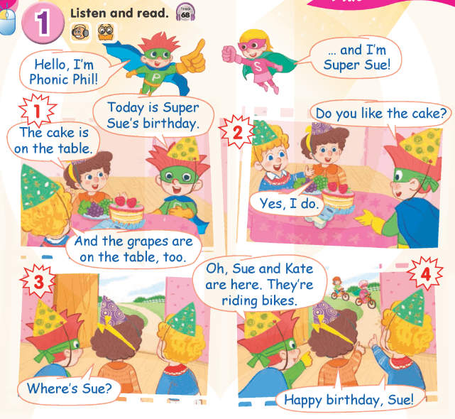

Work in pairs.

Slide 24

Good Job!

Slide 25
3
Look again
and circle.

Slide 26
Point and say.
grapes

Slide 27
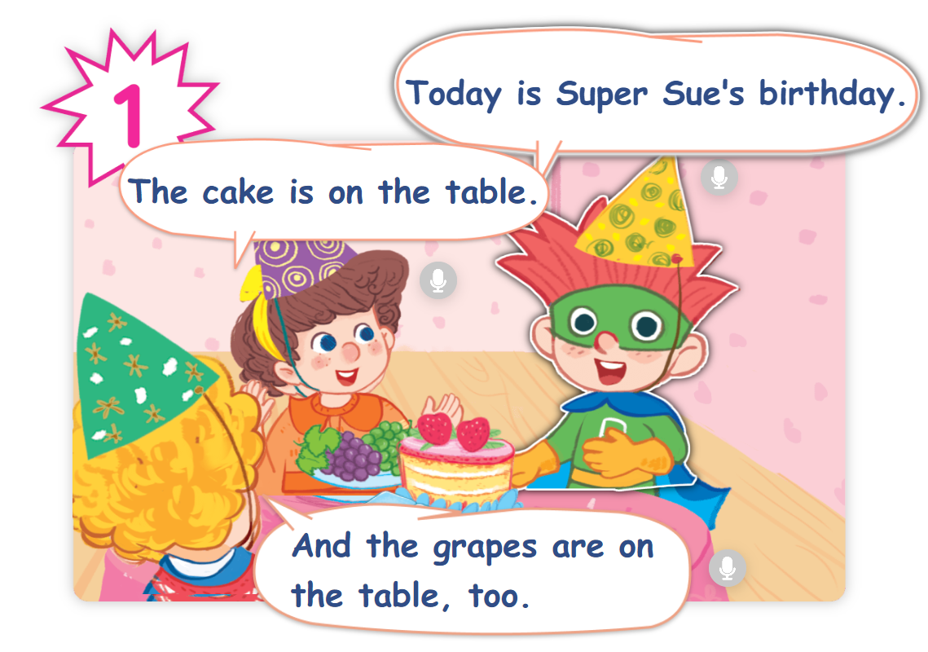
Find “grapes” in the story.

Slide 28
Point and say.
yogurt

Slide 29
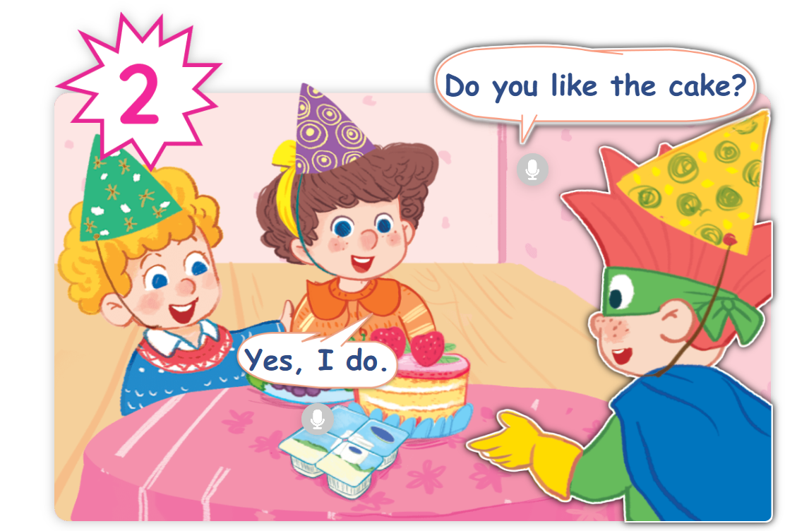
Find “yogurt” in the story.

Slide 30
Point and say.
cake

Slide 31
Find “cake” in the story.

Slide 32
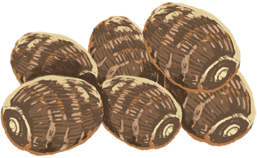
Point and say.
yams

Slide 33
Find “yams” in the story.
✗

Slide 34
Point and say.
riding

Slide 35
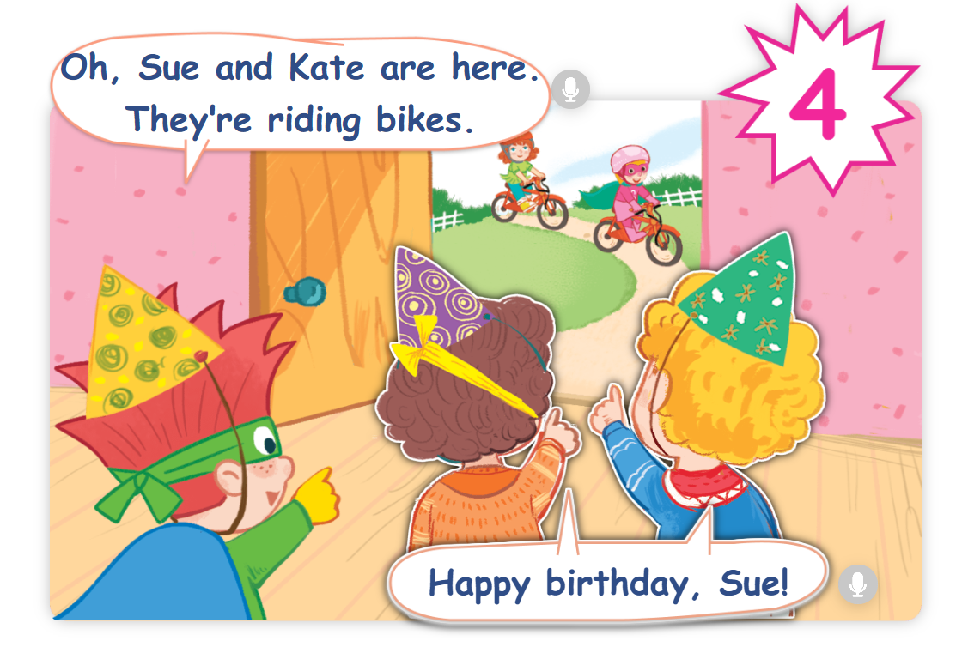
Find “riding” in the story.

Slide 36
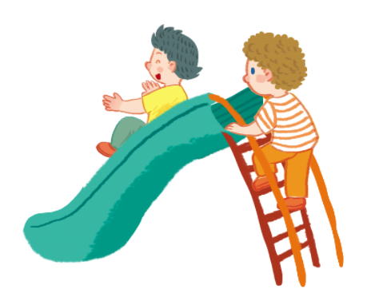
Point and say.
sliding

Slide 37
Find “sliding” in the story.
✗

Slide 38
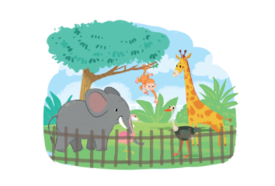
Point and say.
zoo

Slide 39
Find “zoo” in the story.
✗

Slide 40
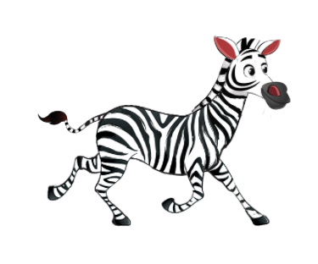
Point and say.
zebra

Slide 41
Find “zebra” in the story.
✗

Slide 42
Good Job!

Slide 43
4
Fun corner
and wrap-up.

Slide 44




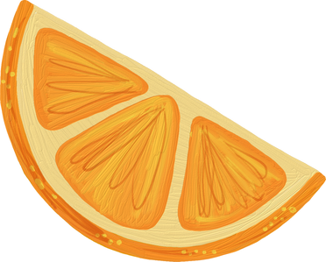


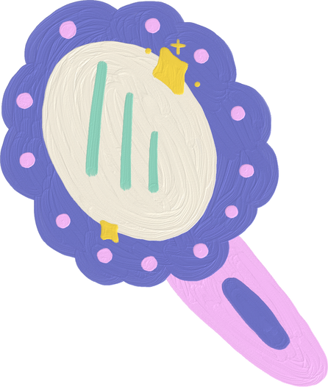
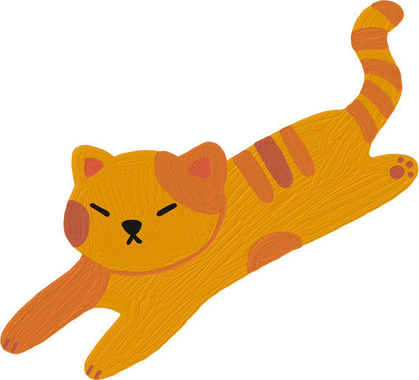

Spell it!
Game

Slide 45

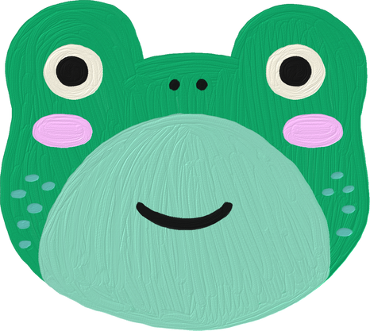
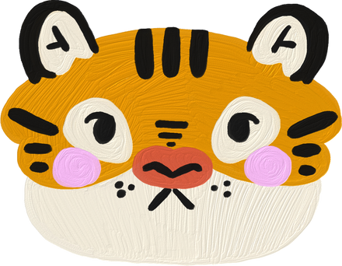
Are You
Ready?

Slide 46

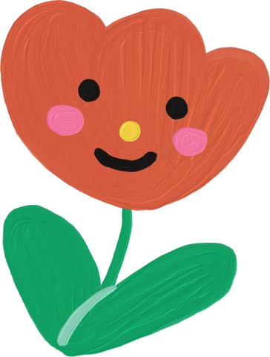
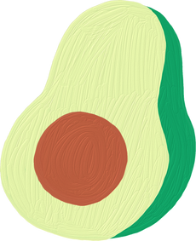
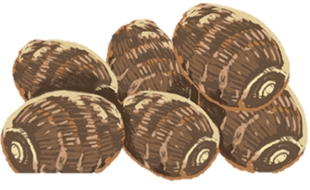
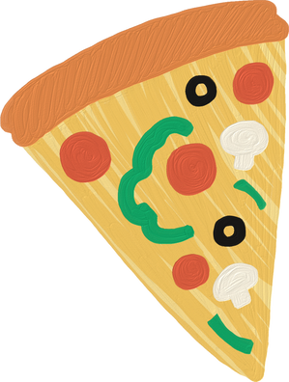
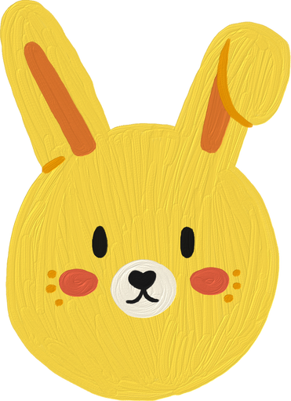
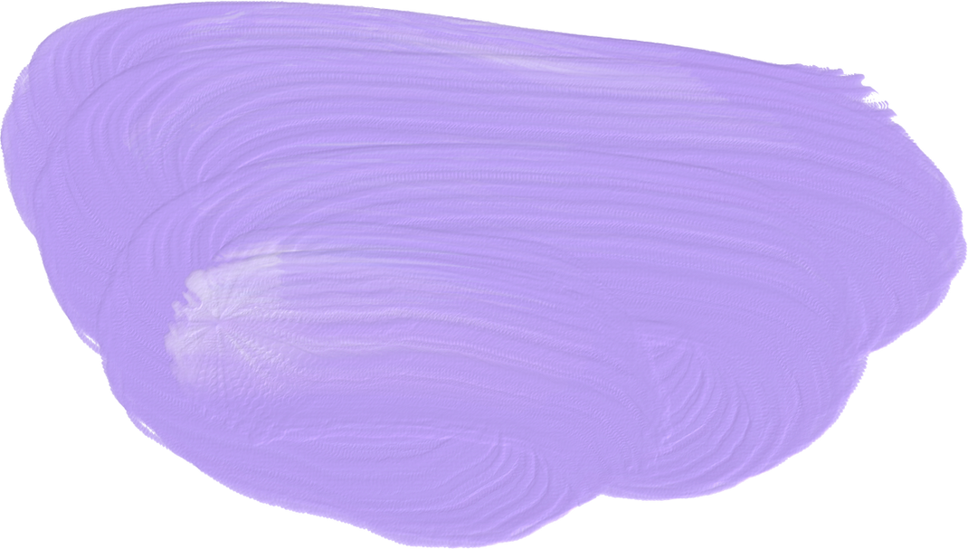
Question 1
A
Y
M
S

Slide 47
Answer
yams

Slide 48
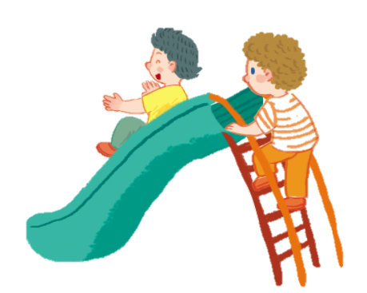
Question 2
D
l
N
S
L
I
G

Slide 49
Answer
sliding

Slide 50
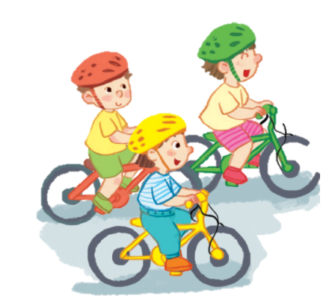
Question 3
D
I
G
R
I
N

Slide 51
Answer
riding

Slide 52
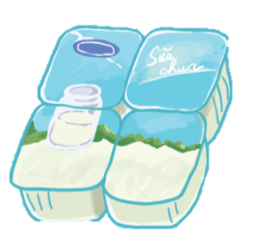
Question 4
G
O
U
Y
R
T

Slide 53
Answer
yogurt

Slide 54
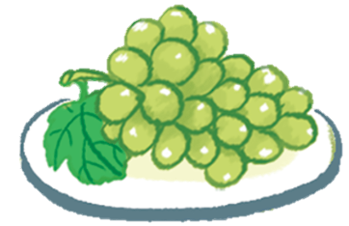
Question 5
E
P
G
R
A
S

Slide 55
Answer
grapes

Slide 56

Question 6
A
K
E
C

Slide 57
Answer
cake

Slide 58
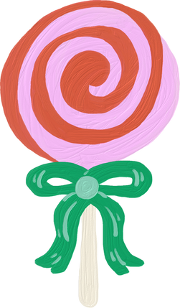

Thank you
for Playing!

