Slide 1






UBND QUẬN DƯƠNG KINH
TRƯỜNG TIỂU HỌC ANH DŨNG
REVIEW 3
Period 2 – Self-check

Slide 2


Warm-up
and review.
1

Slide 3



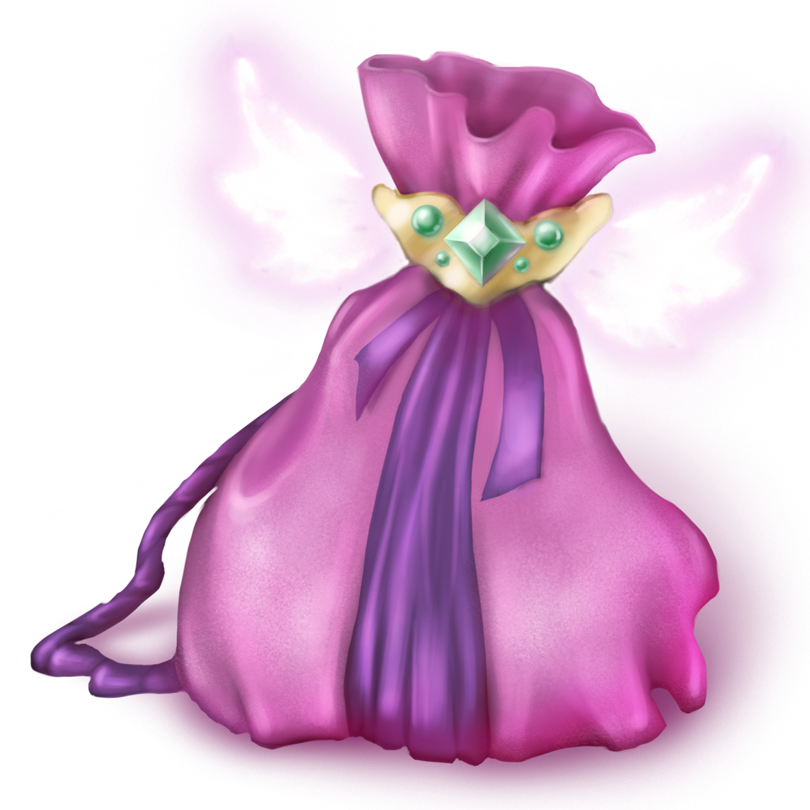
Magic bag
Notes:
Click to play the music. After a while, the music will stop and the picture will appear.

Slide 4


Game: MAGIC BAG
g
r
a
p
e
s

Slide 5
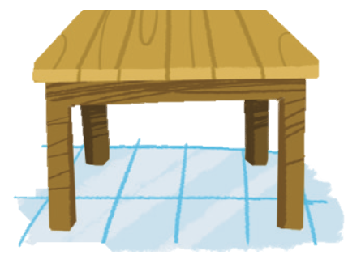
Game: MAGIC BAG
t
a
b
l
e

Slide 6
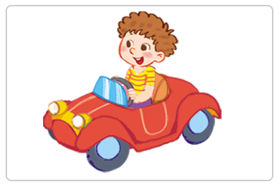
Game: MAGIC BAG
d
r
i
v
i
n
g

Slide 7
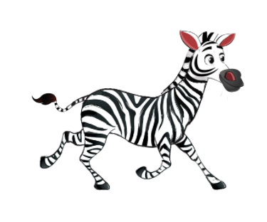
Game: MAGIC BAG
z
e
b
r
a

Slide 8
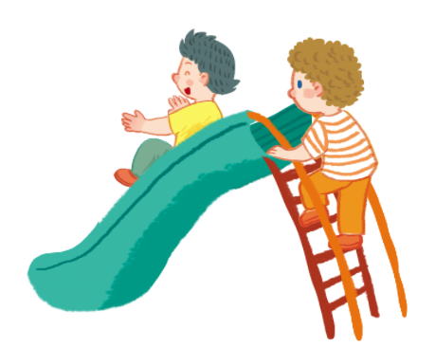
Game: MAGIC BAG
s
l
i
d
i
n
g

Slide 9

Game: MAGIC BAG
y
o
y
o
s

Slide 10

Thank
you!

Slide 11

2
Listen and tick or cross.

Slide 12


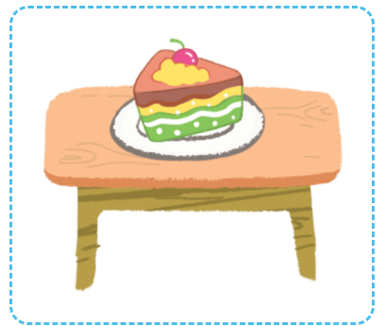
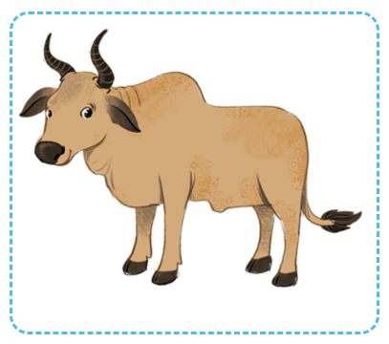
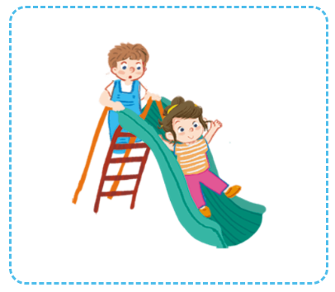


POINT and SAY.

Slide 13
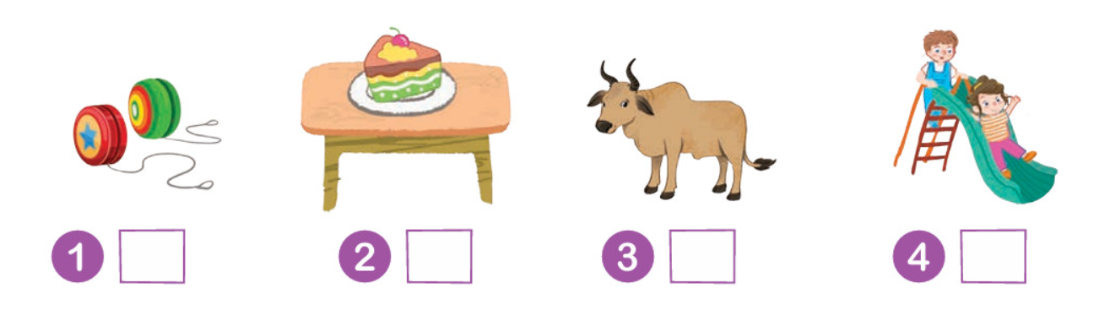
LISTEN and TICK or CROSS.

Slide 14
LISTEN again.

Slide 15







Let’s check.
Work in pairs.

Slide 16
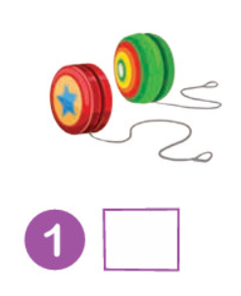
Let’s CHECK.
✓

Slide 17
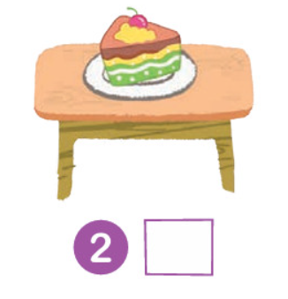
Let’s CHECK.
✓

Slide 18
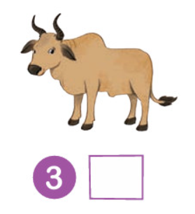
Let’s CHECK.
✗

Slide 19
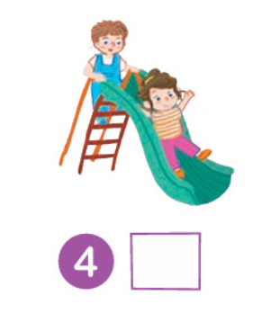
Let’s CHECK.
✗

Slide 20

Good Job!

Slide 21
3
Look
and circle.

Slide 22

Point and say.
a
i

Slide 23

Point and say.
y
a

Slide 24

Point and say.
y
z

Slide 25

Point and say.
i
z

Slide 26
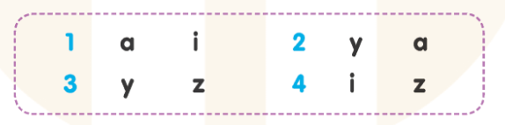
LISTEN and CIRCLE.

Slide 27
LISTEN again.

Slide 28
Let’s check.
Work in pairs.

Slide 29
Let’s CHECK.
a
i

Slide 30
Let’s CHECK.
y
a

Slide 31
Let’s CHECK.
y
z

Slide 32
Let’s CHECK.
i
z

Slide 33
Good Job!

Slide 34
4
Write
and say.

Slide 35
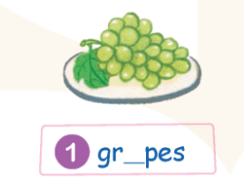
Point and say.

Slide 36
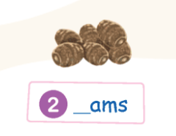
Point and say.

Slide 37
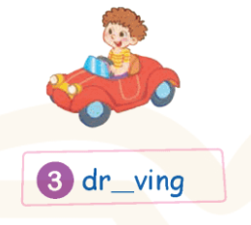
Point and say.

Slide 38
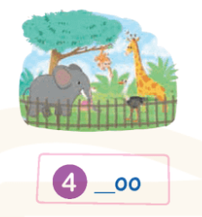
Point and say.

Slide 39
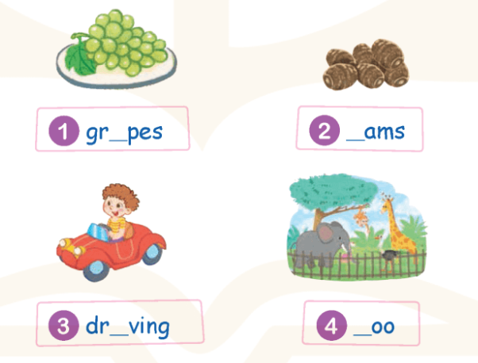
LOOK and WRITE.

Slide 40
Let’s check.
Work in pairs.

Slide 41
WRITE and SAY.
gr_ pes
a

Slide 42
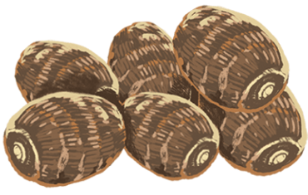
WRITE and SAY.
y
_ams

Slide 43
WRITE and SAY.
dr_ving
i

Slide 44
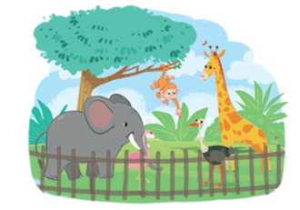
WRITE and SAY.
_oo
z

Slide 45
Good Job!

Slide 46
5
Fun corner
and wrap-up.

Slide 47









GAME

Slide 48





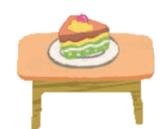
What can you see?
The cake is on the table.

Slide 49

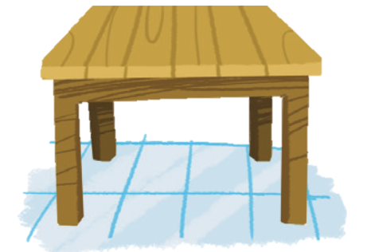
What can you see?
The grapes are on the table.

Slide 50

What can you see?
The bananas are on the table.

Slide 51

What can you see?
The apple is on the table.

Slide 52


Slide 53
Good Job!

