Slide 1




UBND QUẬN DƯƠNG KINH
TRƯỜNG TIỂU HỌC ANH DŨNG
HELLO AND WELCOME TO MY ENGLISH CLASS

Slide 2






Unit 13:
In the maths class
Lesson 2

Slide 3

Warm-up and Review.

Slide 4




MATHS QUIZ

Slide 5





+
?
=
A
B
✗
C
✗
✓
ten
nine
eight

Slide 6

+
=
?
A
✗
B
✗
C
✓
fifteen
fourteen
eleven

Slide 7





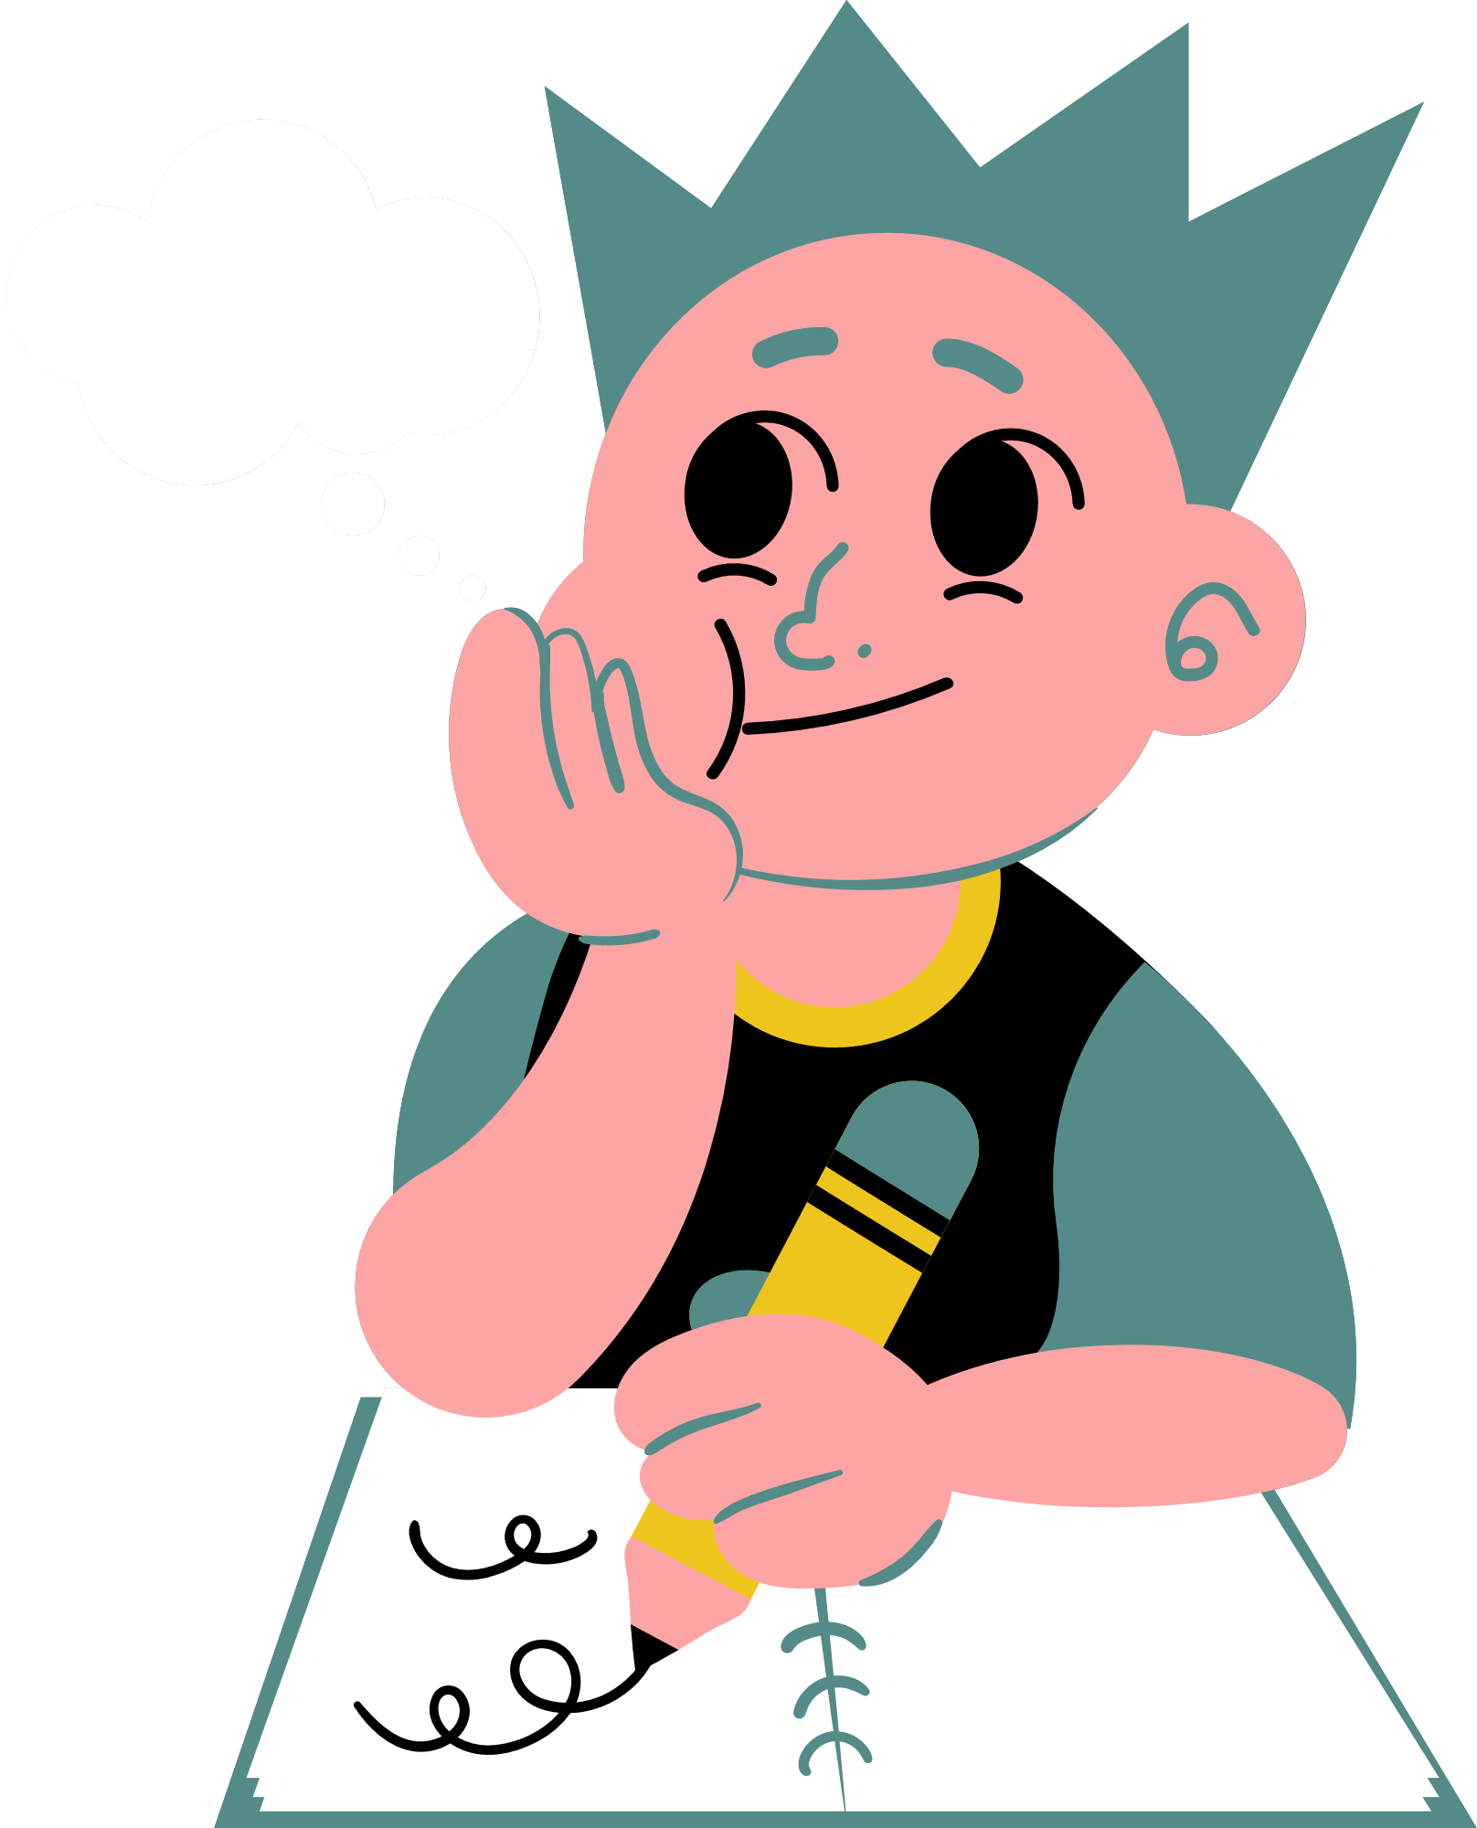
+
=
?
A
B
✗
C
✗
✓
fifteen
fourteen
thirteen

Slide 8



+
?
=
A
✗
B
✗
C
✓
fourteen
eleven
thirteen

Slide 9



+
?
=
A
✗
B
C
✗
✓
thirteen
fourteen
fifteen

Slide 10

Thank you for Playing!

Slide 11

Listen and chant.

Slide 12
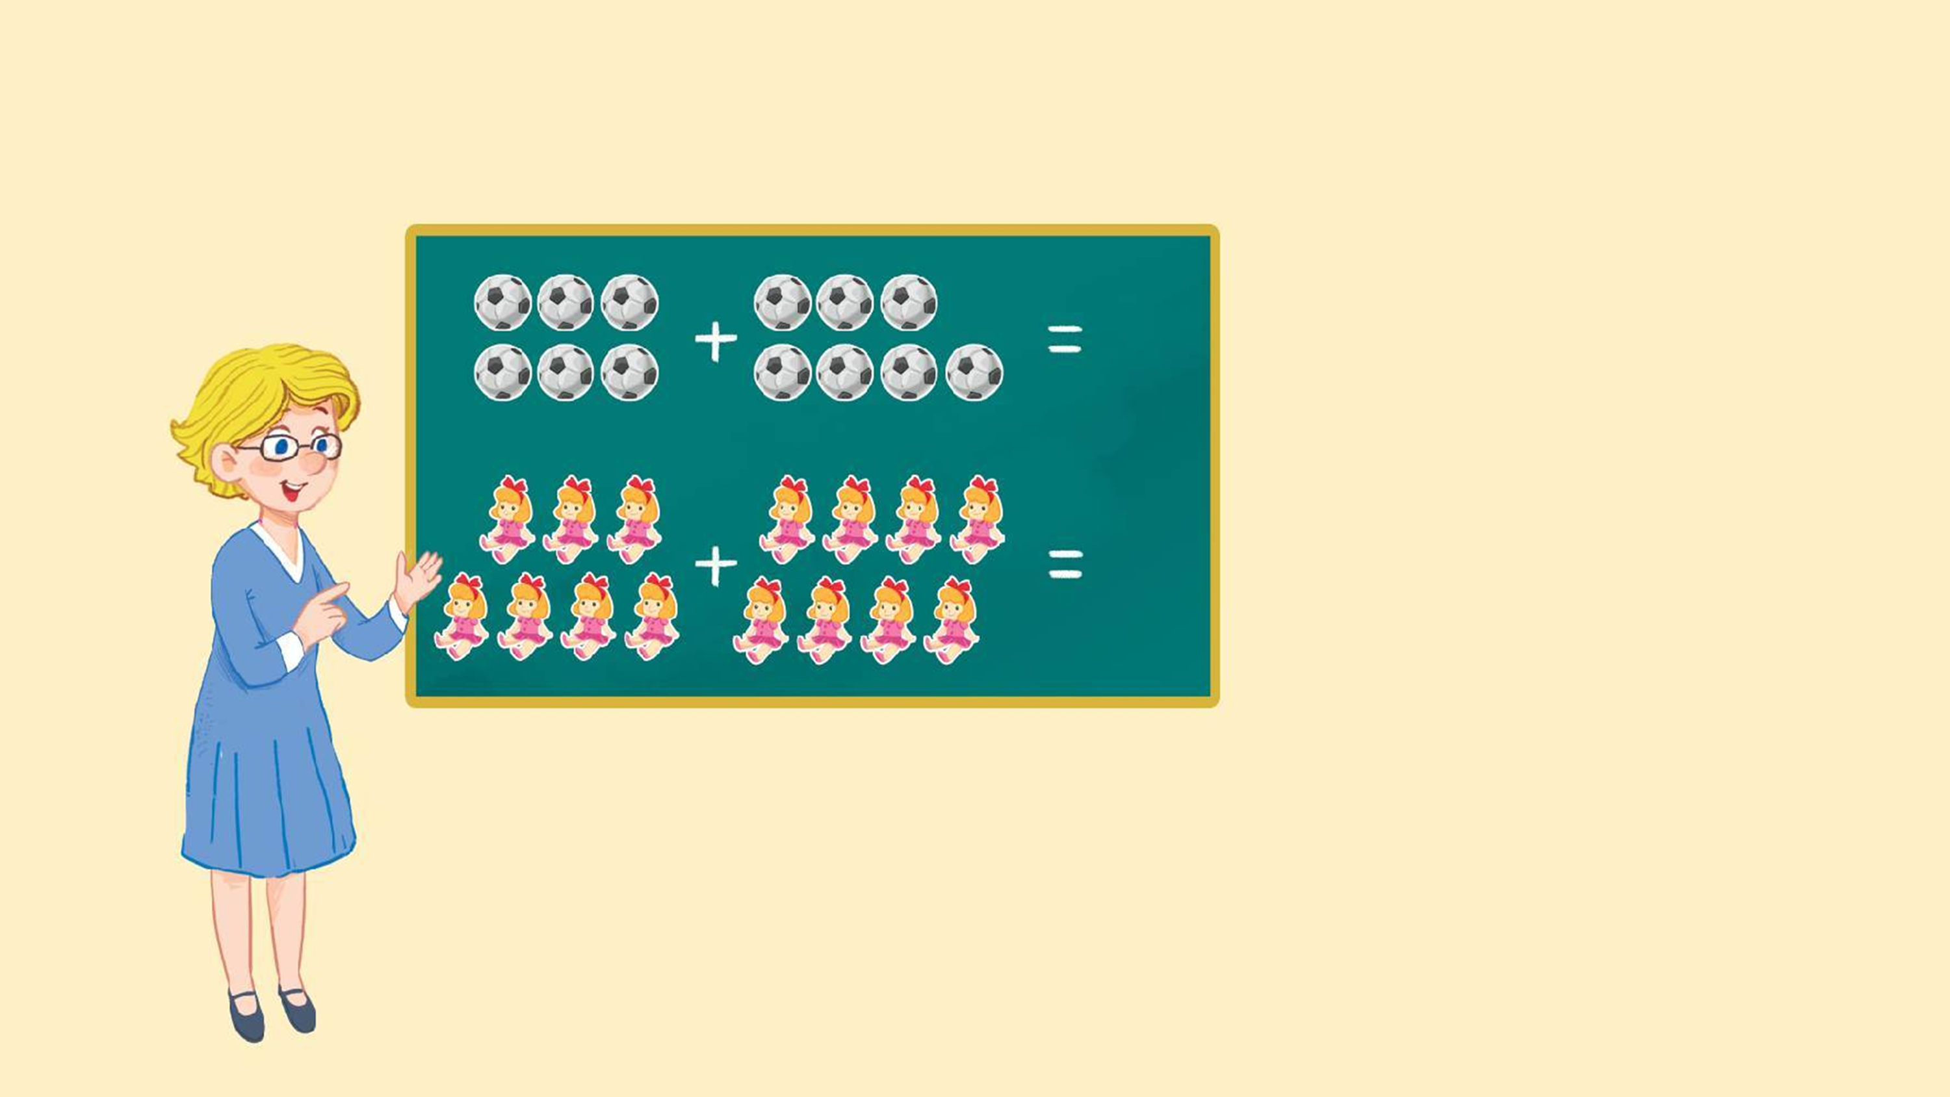
Look and say.
13
thirteen
15
fifteen

Slide 13


Watch a video.

Slide 14

3.Listen and chant.
N, n, eleven.
N, n, eleven.
N, n, eleven.
N, n, eleven.
N, n, thirteen.
N, n, thirteen.
N, n, thirteen.
N, n, thirteen.
How many balls?
How many balls?
How many balls?
How many balls?
Eleven or thirteen.
Eleven or thirteen.
Eleven or thirteen.
Eleven or thirteen.
N, n, fourteen.
N, n, fourteen.
N, n, fourteen.
N, n, fourteen.
N, n, fifteen.
N, n, fifteen.
N, n, fifteen.
N, n, fifteen.
How many dolls?
How many dolls?
How many dolls?
How many dolls?
Fourteen or fifteen.
Fourteen or fifteen.
Fourteen or fifteen.
Fourteen or fifteen.

Slide 15
Work in teams.
N, n, eleven.
N, n, thirteen.
How many balls?
Eleven or thirteen.
N, n, fourteen.
N, n, fifteen.
How many dolls?
Fourteen or fifteen.

Slide 16

Listen and tick.

Slide 17

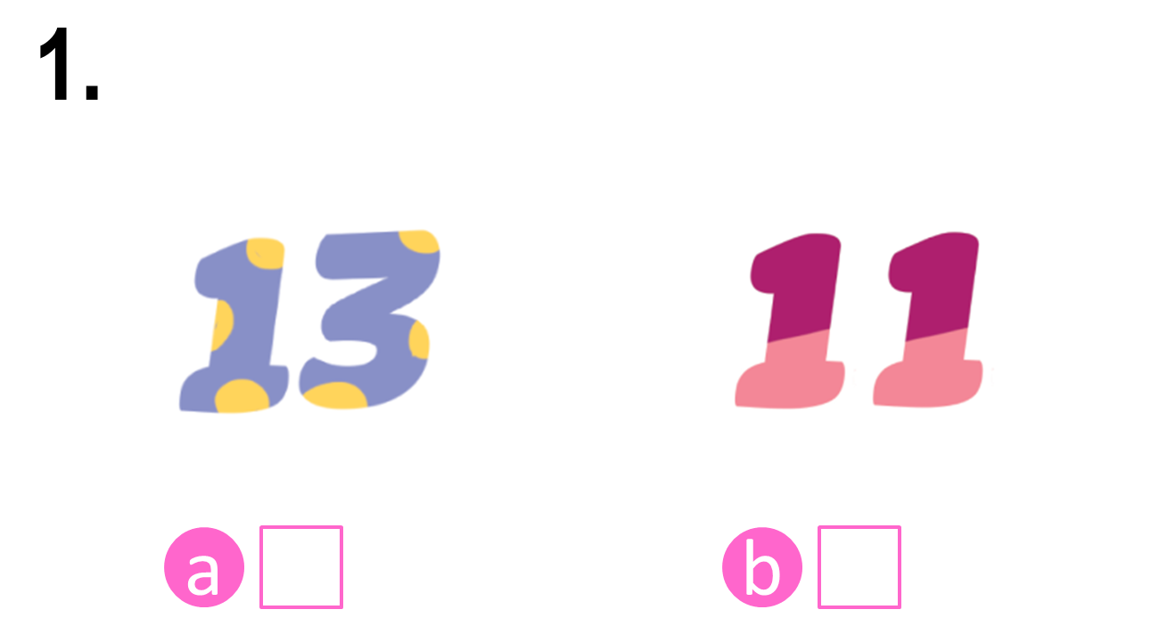
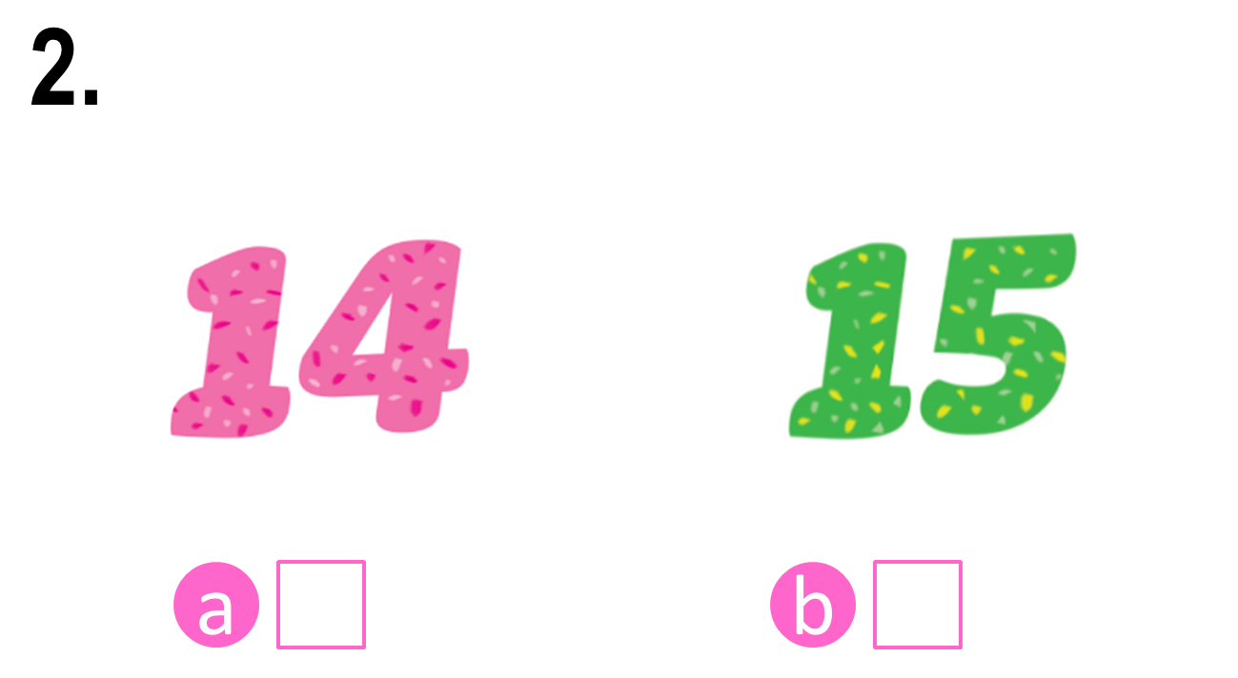


Look and say.

Slide 18
4. Listen and tick.

Slide 19
Check the answers.

Notes:
Step 3: Check the answers by asking “a or b?” When pupils answer correctly, confirm by saying “1a. Can you see the number thirteen?”/ “2b. Can you see the number fifteen?” and encourage them to repeat.

Slide 20
Check the answers.


Slide 21

Write and say.

Slide 22







Look and say.
eleve__
thirtee__
fourtee__
fiftee__

Slide 23
5. Write and say.
eleve__
thirtee__
fourtee__
fiftee__

Slide 24
Check the answers.
n
n
n
n
eleve__
thirtee__
fourtee__
fiftee__

Slide 25
Say the words.
n
n
n
n
eleve__
thirtee__
fourtee__
fiftee__

Slide 26

Fun corner and wrap-up.

Slide 27



Matching Game

Slide 28
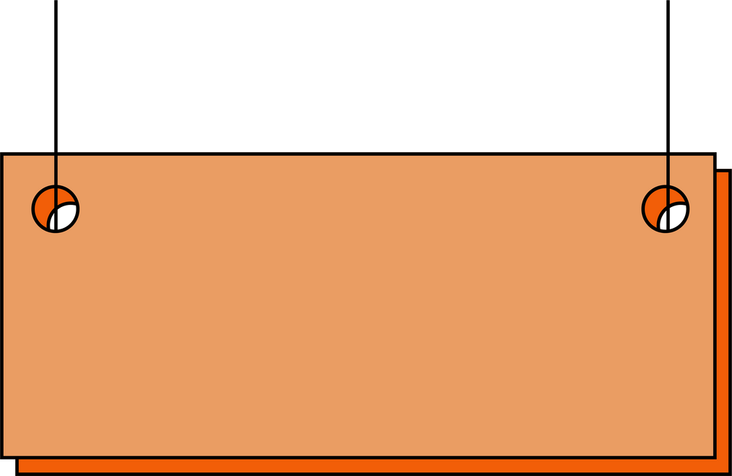





1
2
3
4
eleven
fourteen
fifteen
thirteen
A
B
C
D

Slide 29

Thank you
for
playing!

