Slide 1






UBND QUẬN DƯƠNG KINH
TRƯỜNG TIỂU HỌC ANH DŨNG
REVIEW 4
Period 1 – Phil and Sue

Slide 2


TABLE OF CONTENTS
1.
Warm-up and review.
2.
Listen and repeat.
3.
Look again and circle.
4.
Fun corner and wrap-up.

Slide 3


Warm-up
and review.
1

Slide 4





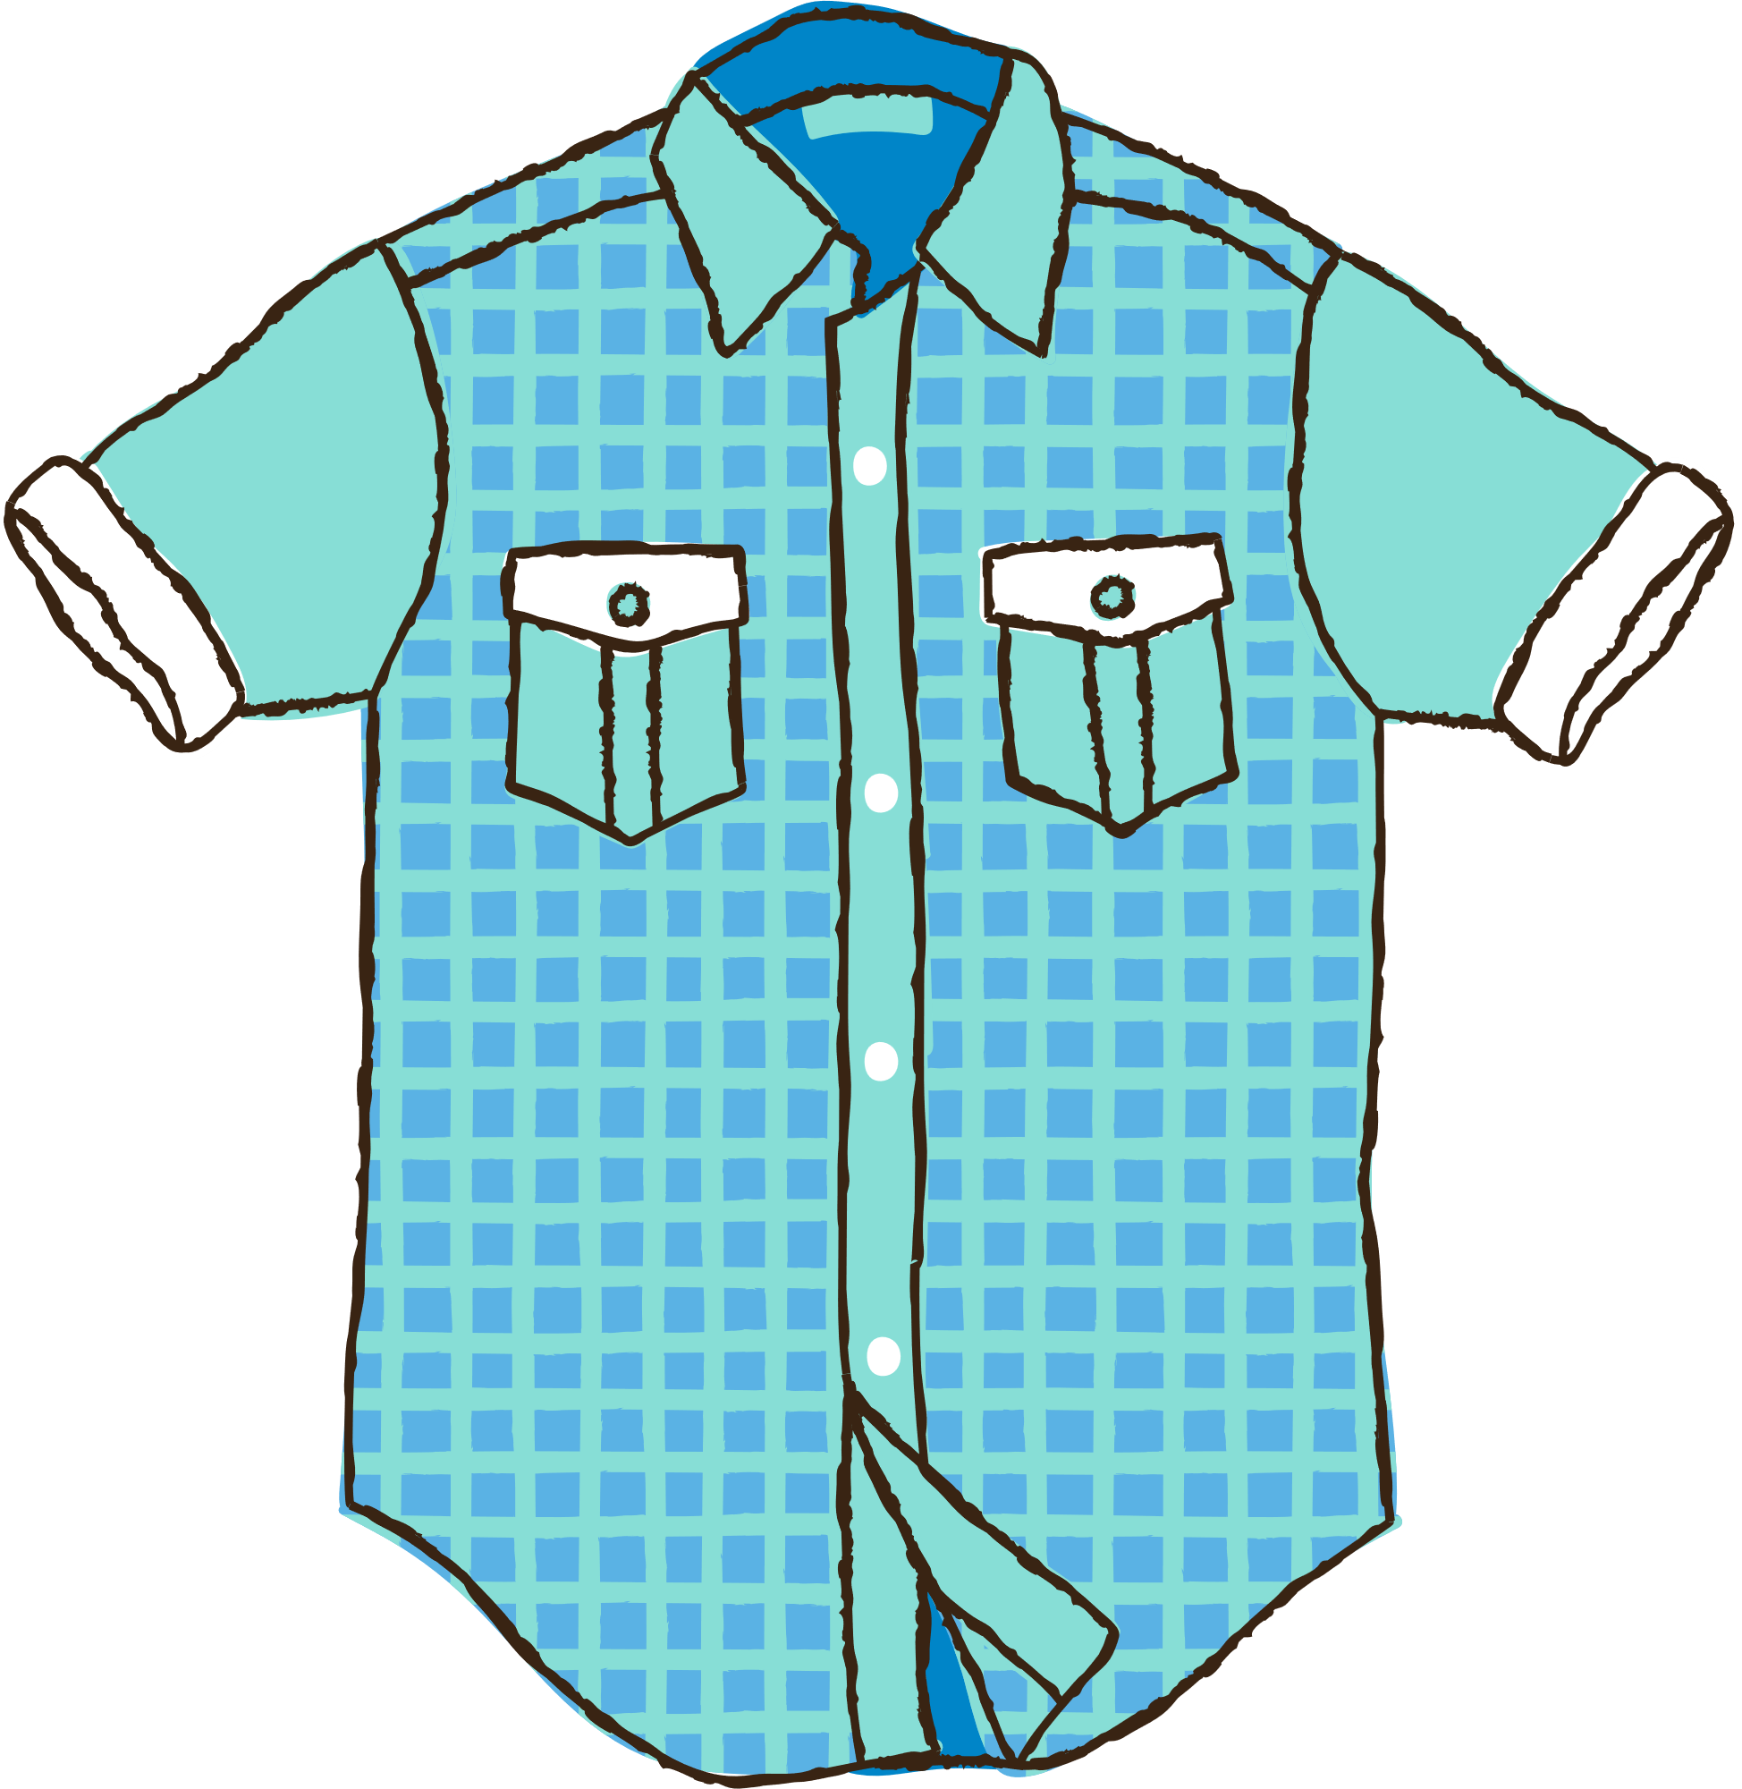

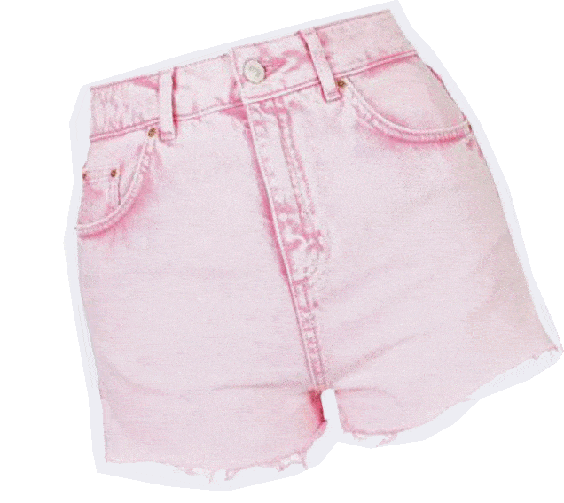

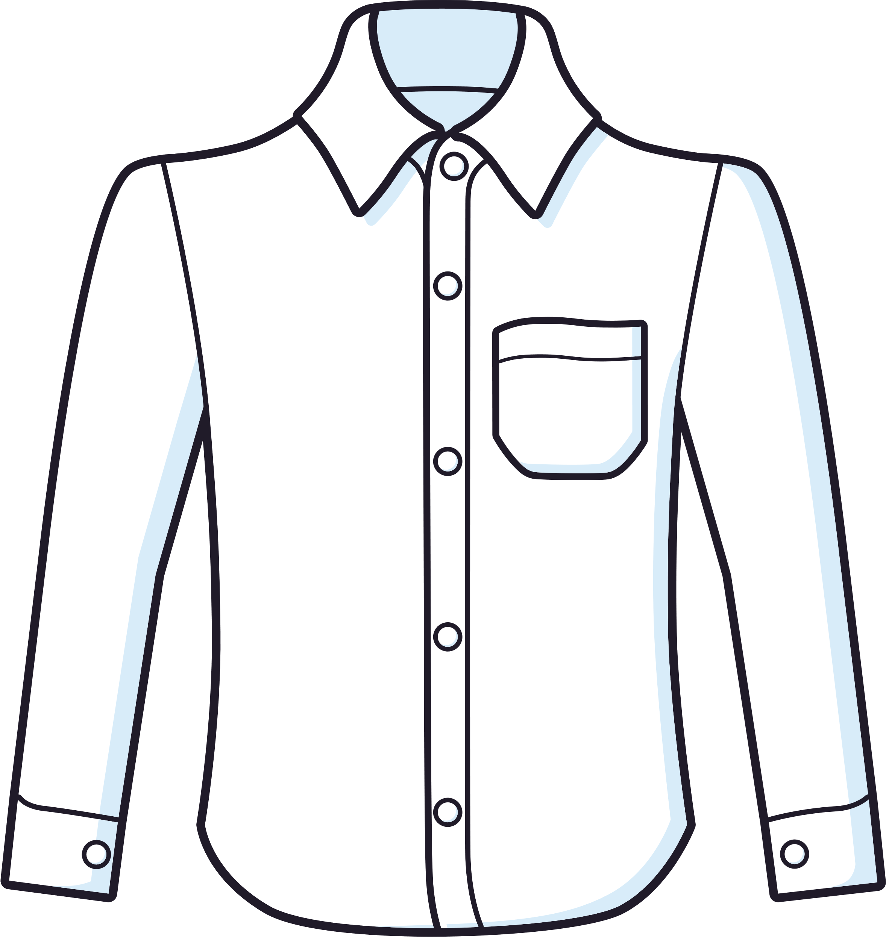




Look and say.
shirts
shoes
shorts
teapot
tent
blanket

Slide 5








Secret Boxes
Notes:
Click the number on each gift to move to the Question slide.
Click the girl to end the game.

Slide 6



Look and choose A, B or C.
shorts
A
shirts
shirts
B
B
shoes
C
Notes:
Click to show the answer key.
Click the pink flower to back to the Gift slide.

Slide 7
Look and choose A, B or C.
tent
A
teapot
B
blanket
blanket
C
C

Slide 8
Look and choose A, B or C.
shorts
A
shoes
shoes
B
B
shirts
C

Slide 9
Look and choose A, B or C.
teapot
teapot
A
A
tent
B
blanket
C

Slide 10
Look and choose A, B or C.
blanket
A
teapot
B
tent
tent
C
C

Slide 11
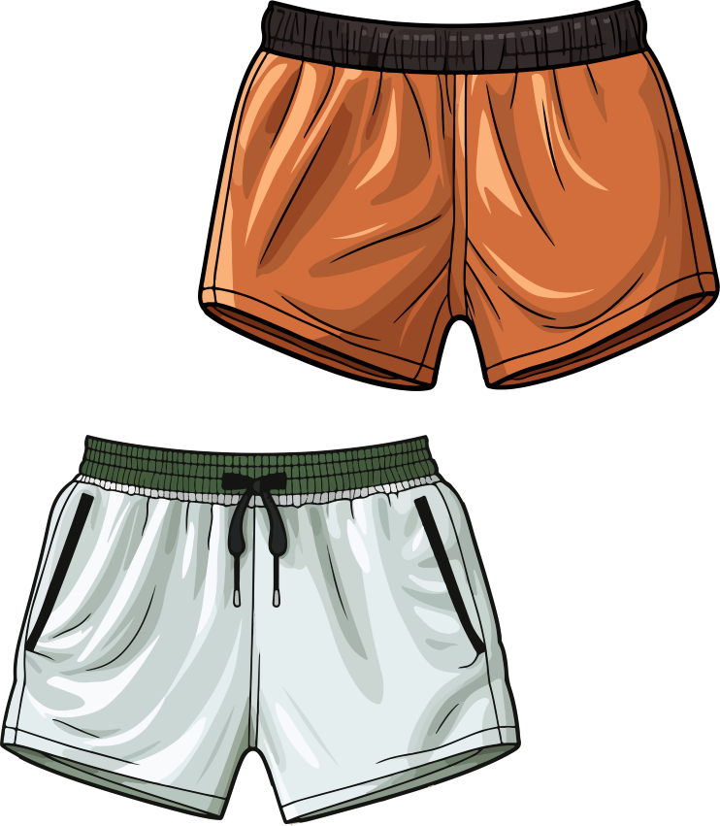
Look and choose A, B or C.
shoes
A
shirts
B
shorts
shorts
C
C

Slide 12


Thank you!

Slide 13

2
Listen
and repeat.

Slide 14




LOOK and ANSWER.

Slide 15
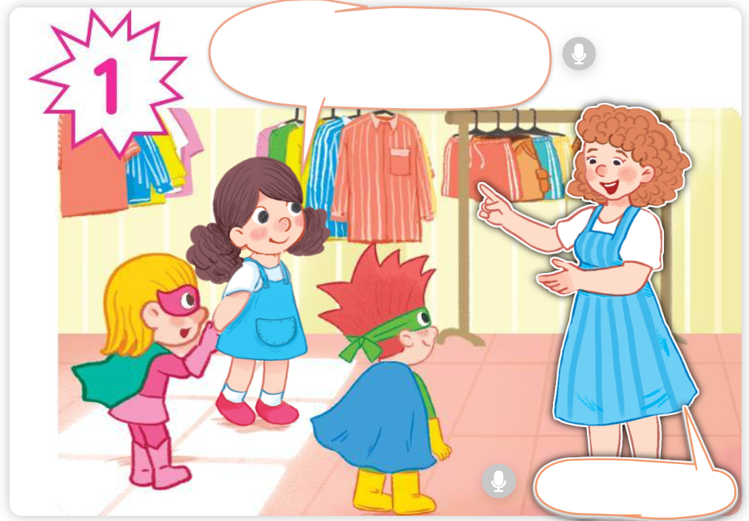
LOOK and ANSWER.

Slide 16
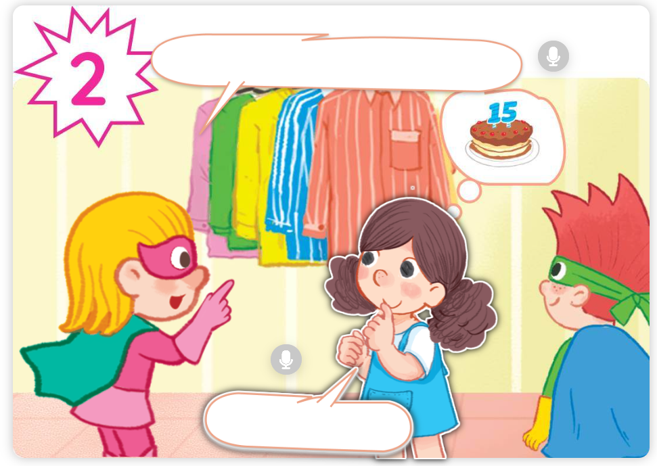
LOOK and ANSWER.

Slide 17
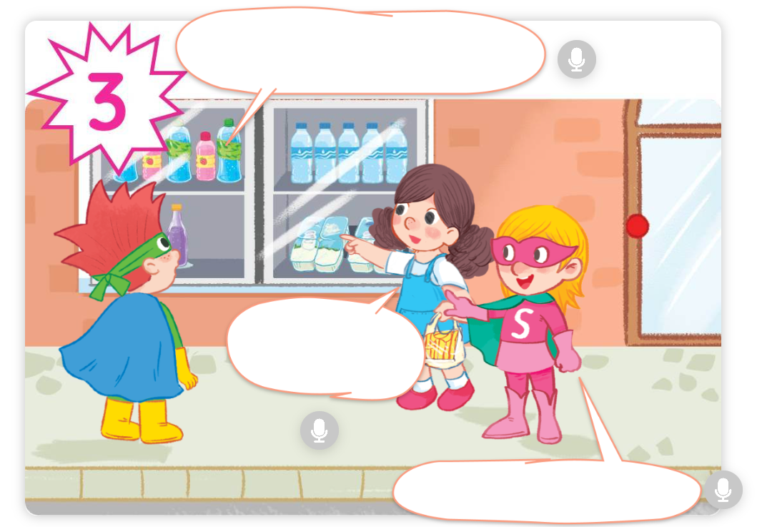
LOOK and ANSWER.

Slide 18
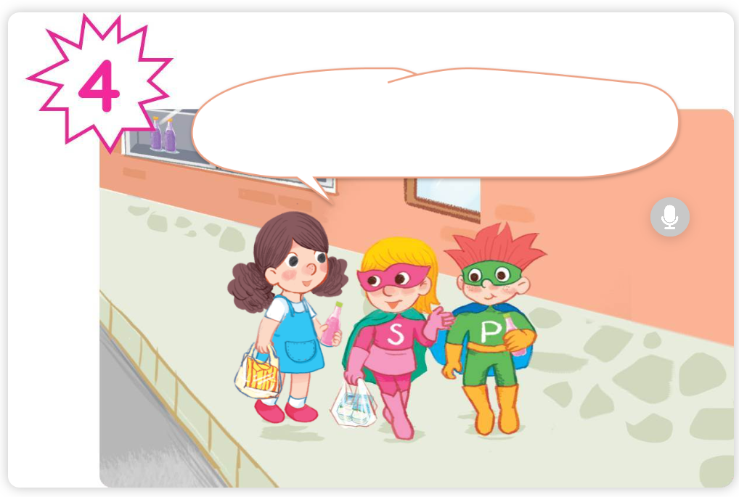
LOOK and ANSWER.

Slide 19
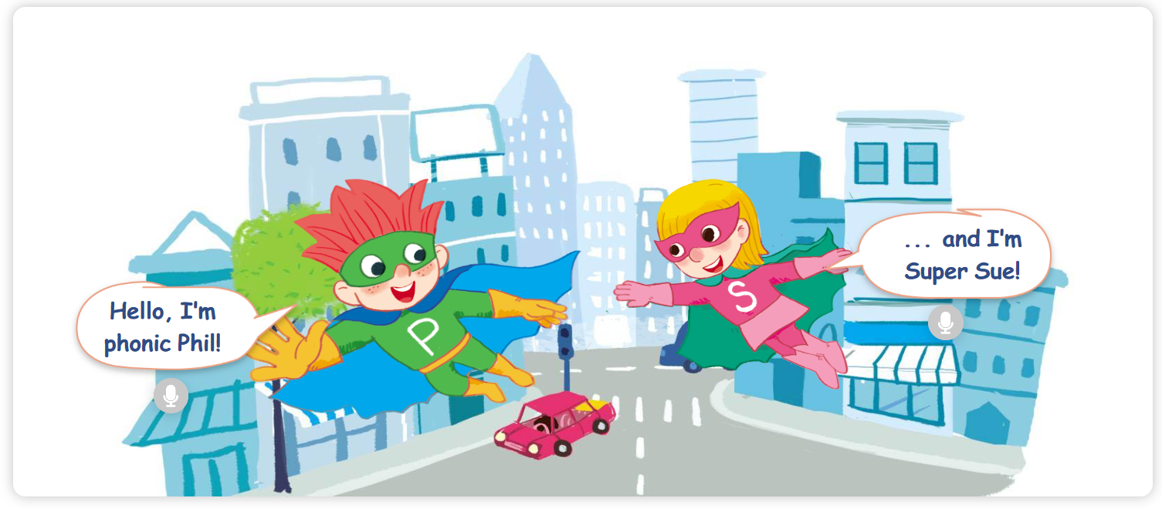


LISTEN and REPEAT.
Notes:
Click the speech bubble to hear the recording.

Slide 20
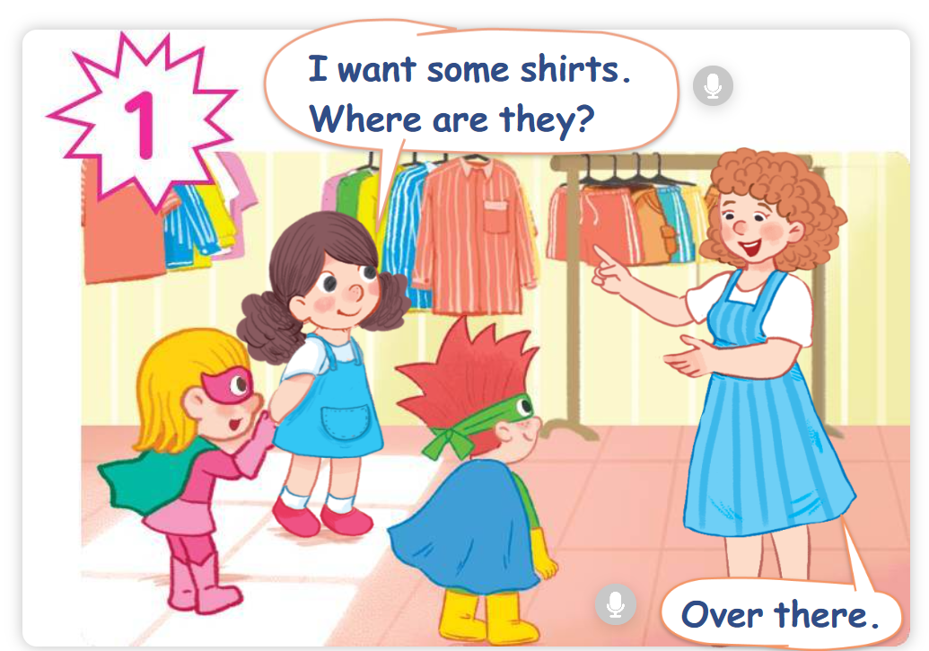


LISTEN and REPEAT.
Notes:
Click the speech bubble to hear the recording.

Slide 21
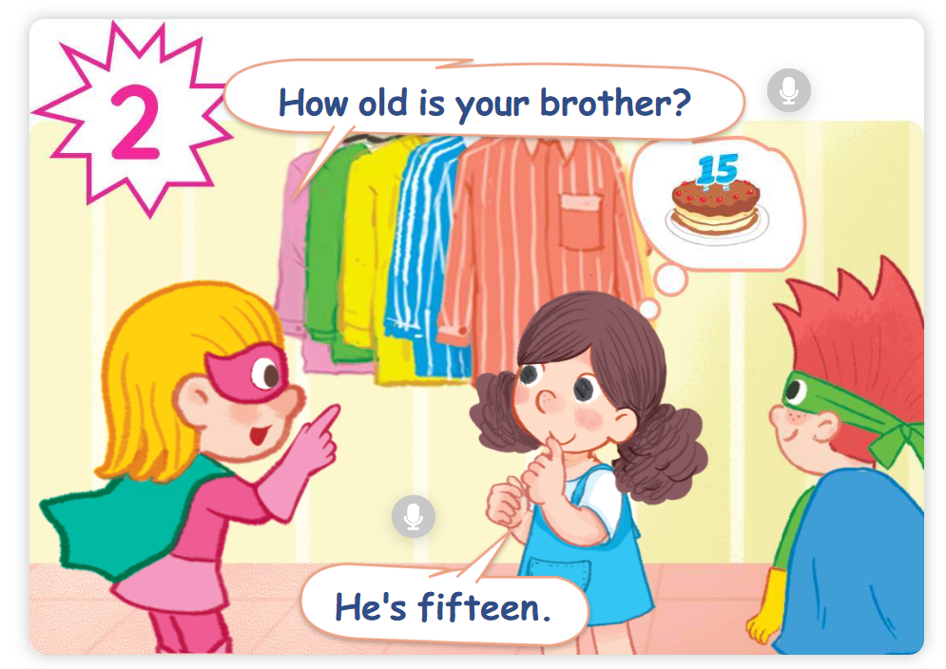


LISTEN and REPEAT.
Notes:
Click the speech bubble to hear the recording.

Slide 22

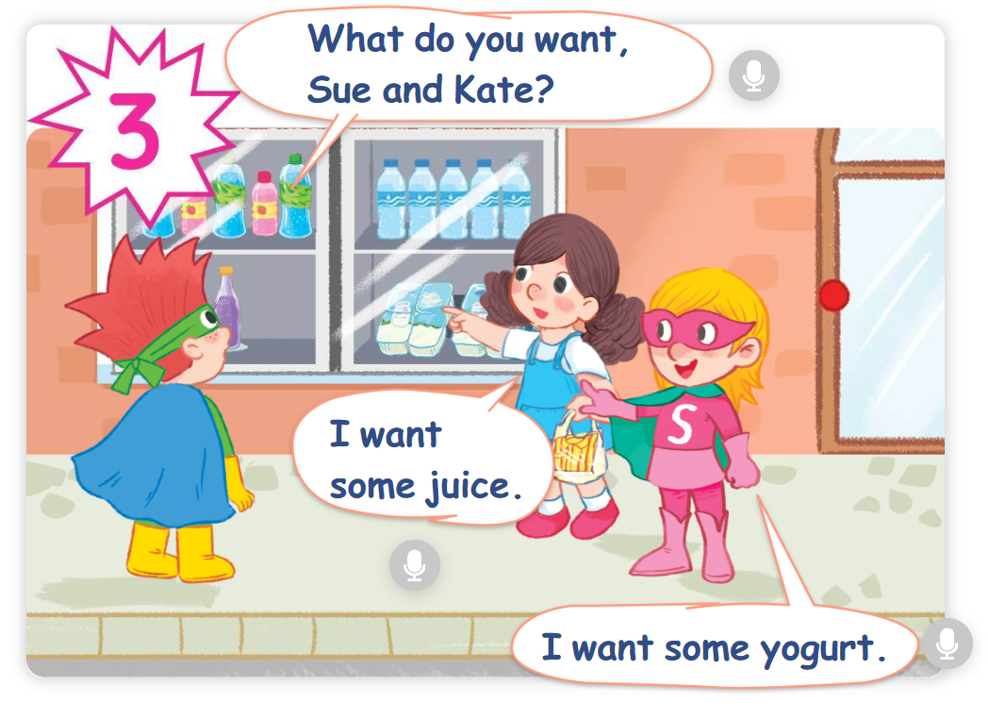


LISTEN and REPEAT.
Notes:
Click the speech bubble to hear the recording.

Slide 23
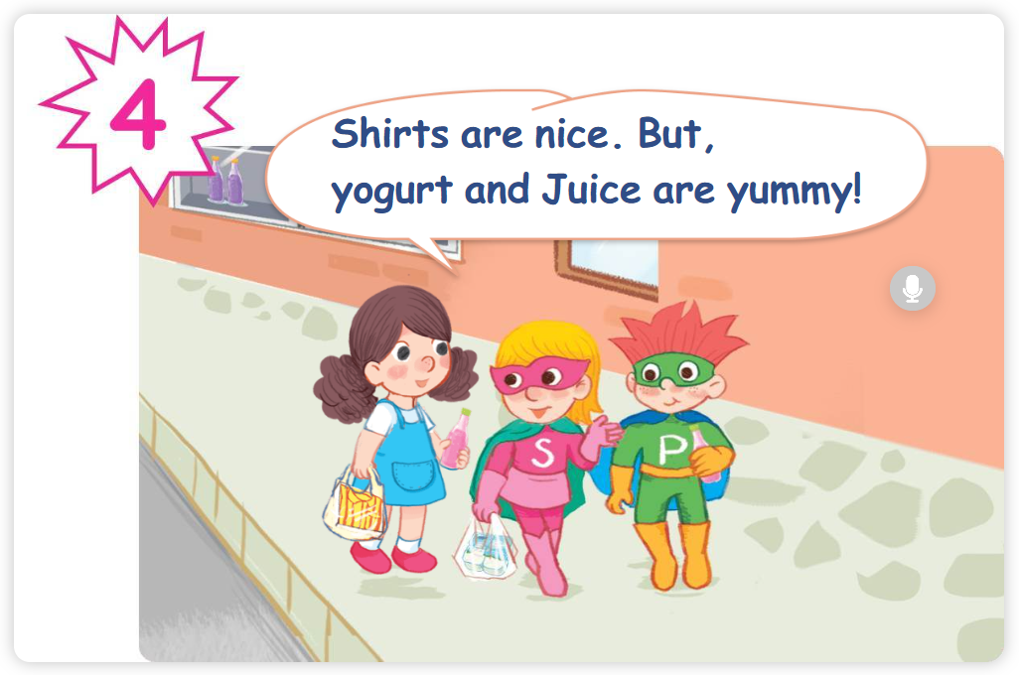

LISTEN and REPEAT.
Notes:
Click the speech bubble to hear the recording.

Slide 24
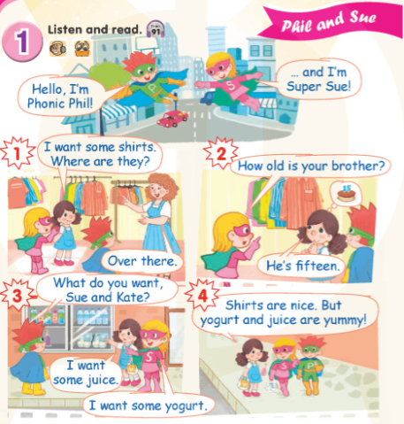

Work in pairs.

Slide 25
Good Job!

Slide 26
3
Look again
and circle.

Slide 27
Point and say.
16
sixteen

Slide 28
Find “sixteen” in the story.
✗

Slide 29
Point and say.
15
fifteen

Slide 30
Find “fifteen” in the story.

Slide 31
Point and say.
blanket

Slide 32
Find “blanket” in the story.
✗

Slide 33

Point and say.
brother

Slide 34
Find “brother” in the story.

Slide 35
Good Job!

Slide 36
4
Fun corner
and wrap-up.

Slide 37







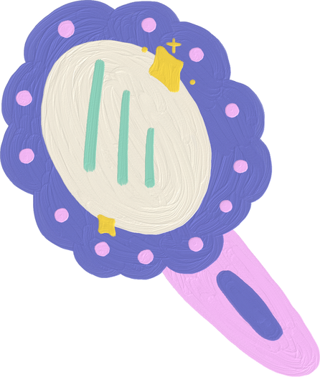
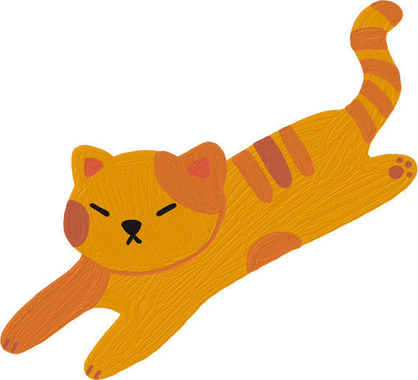

Word
Game

Slide 38



Are You
Ready?

Slide 39






Question 1
b
l
a
n
k
e
t

Slide 40
Question 2
t
e
n
t

Slide 41
Question 3
t
e
a
p
o
t

Slide 42
Question 4
s
h
i
r
t
s

Slide 43
Question 5
s
h
o
r
t
s

Slide 44
Question 6
s
h
o
e
s

Slide 45
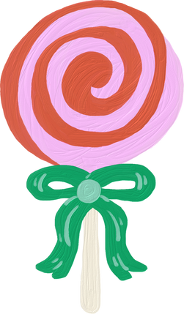

Thank you
for Playing!

