Slide 1
UNBD QUẬN DƯƠNG KINH
TRƯỜNG TIỂU HỌC ANH DŨNG
HELLO AND WELCOME TO MY ENGLISH CLASS

Slide 2

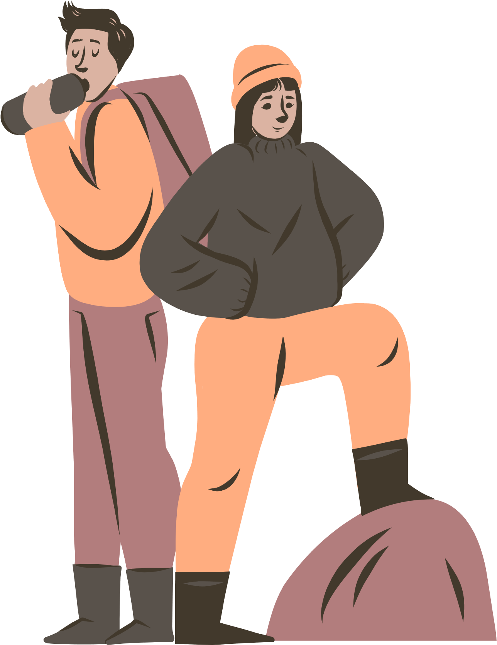




UNIT 16
AT THE CAMPSITE
Lesson 1

Slide 3





TABLE OF CONTENTS
1
Warm-up and review.
2
Listen and repeat.
3
Point and say.
4
Fun corner and wrap-up.

Slide 4





1
Warm-up
and review.

Slide 5









Jumbled Letters!
FISH THEME

Slide 6




ARE YOU READY?
Let's get started!

Slide 7



QUESTION 1
s
o
h
e
s

Slide 8



The answer is...
shoes

Slide 9







QUESTION 2
t
s
o
h
r
s

Slide 10



The answer is...
shorts

Slide 11

QUESTION 3
s
s
i
t
r
h

Slide 12
The answer is...
shirts

Slide 13

THANK YOU
FOR PLAYING!

Slide 14
2
Listen
and repeat.

Slide 15


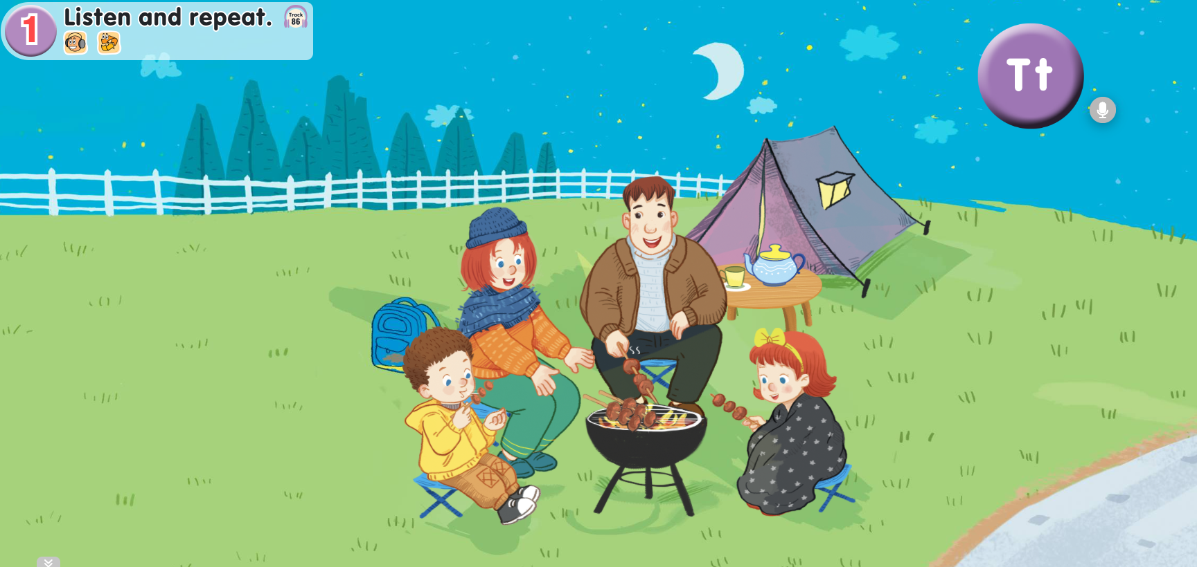

Look and answer.
Notes:
- Click on the purple circle which has Tt to hear the recording “Tt”.

Slide 16
Listen and repeat.
Notes:
- Click on the purple circle which has Tt to hear the recording “Tt”.

Slide 17
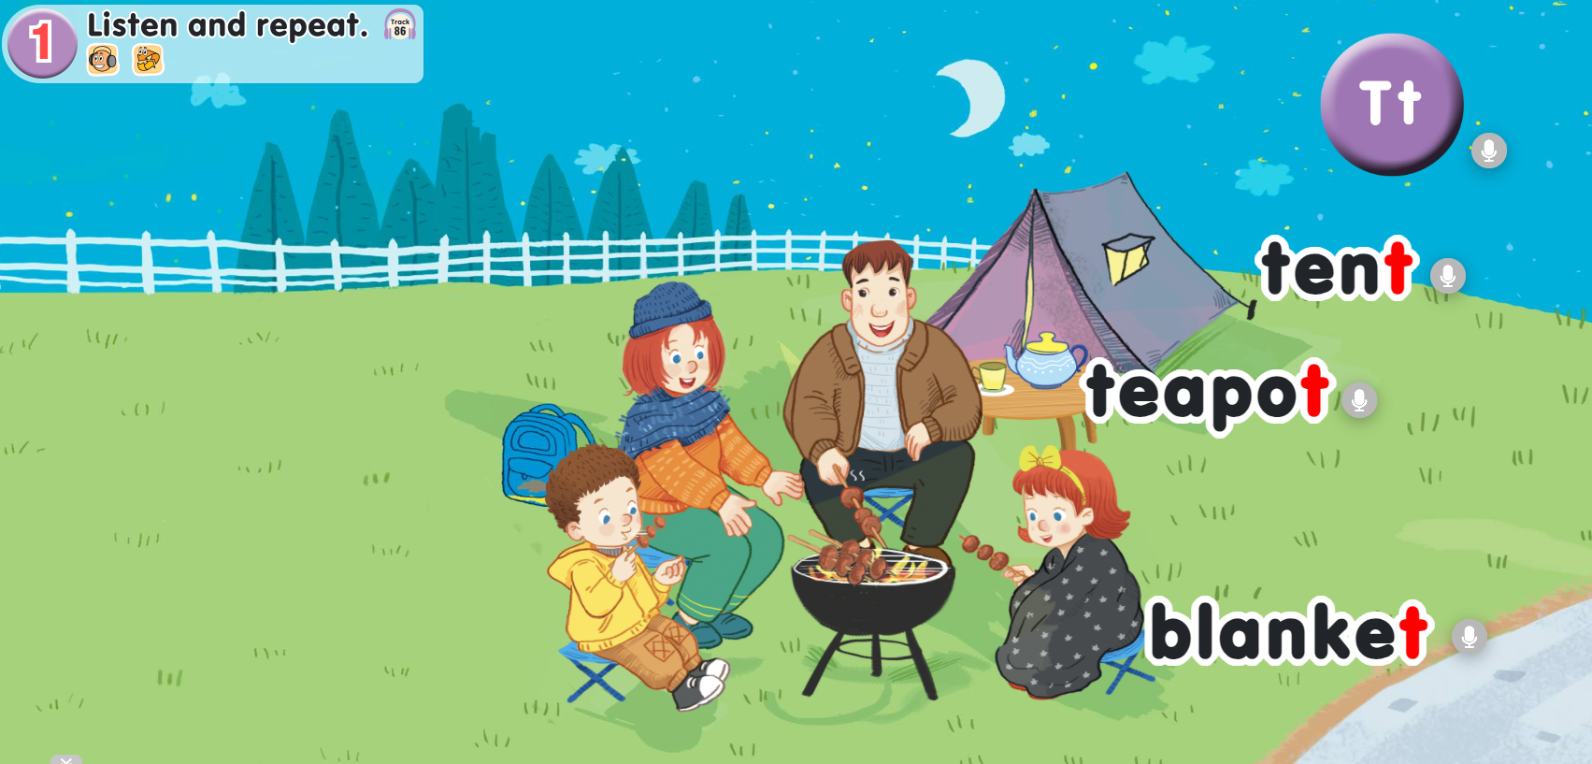


Listen and repeat.
Notes:
Click on the purple circle which has Tt.
Click “tent” to listen to the recording of tent.

Slide 18







Listen and repeat.
tent

Slide 19

Listen and repeat.
Notes:
Click on the purple circle which has Tt.
Click “teapot” to listen to the recording of teapot.

Slide 20

Listen and repeat.
teapot

Slide 21

Listen and repeat.
Notes:
Click on the purple circle which has Tt.
Click “blanket” to listen to the recording of blanket.

Slide 22

Listen and repeat.
blanket

Slide 23
Listen and repeat.
Notes:
- Click on the purple circle which has Tt to hear the full recording of track 86.

Slide 24







GOOD JOB!

Slide 25
3
Point
and say.

Slide 26
Point and say.

Slide 27
Point and say.

Slide 28







Point and say.
Work in pairs.

Slide 29
GOOD JOB!

Slide 30
4
Fun corner
and wrap-up.

Slide 31
MATCHING GAME

Slide 32

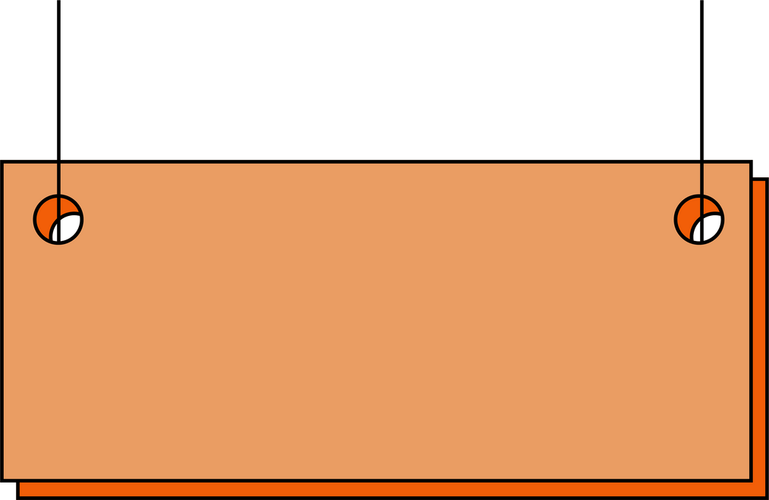




1
2
3
4
teapot
table
blanket
tent
A
B
C
D

Slide 33



Thank you
for
playing!

