Slide 1

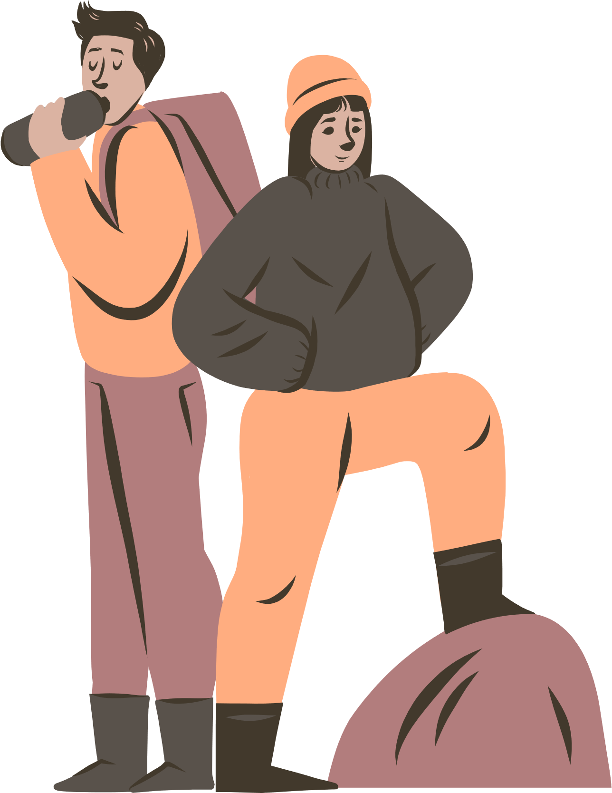




UBND QUẬN DƯƠNG KINH
TRƯỜNG TIỂU HỌC ANH DŨNG
UNIT 16
AT THE CAMPSITE
Lesson 2

Slide 2





TABLE OF CONTENTS
1
Warm-up and review.
2
Listen and chant.
3
Listen and circle.
4
Write and say.
5
Fun corner and wrap-up.

Slide 3





1
Warm-up
and review.

Slide 4







Let's play!
The Memory Game!

Slide 5









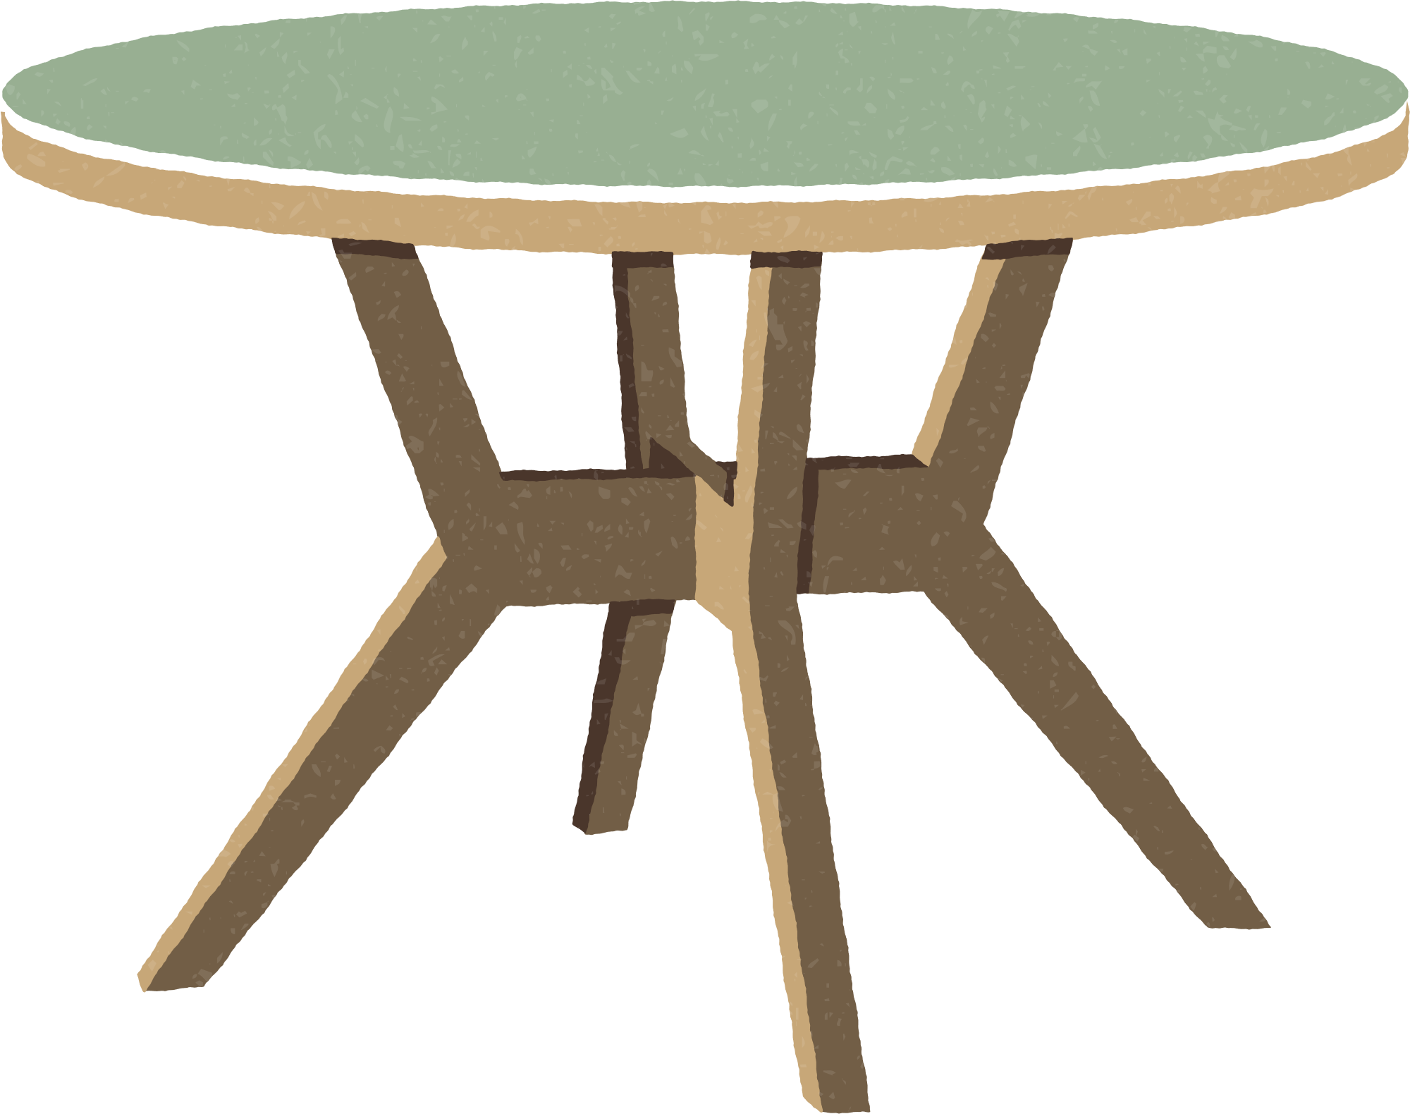


d
1
2
3
4
table
teapot
tent
blanket

Slide 6

Thank You
For Playing!

Slide 7
2
Listen
and chant.

Slide 8


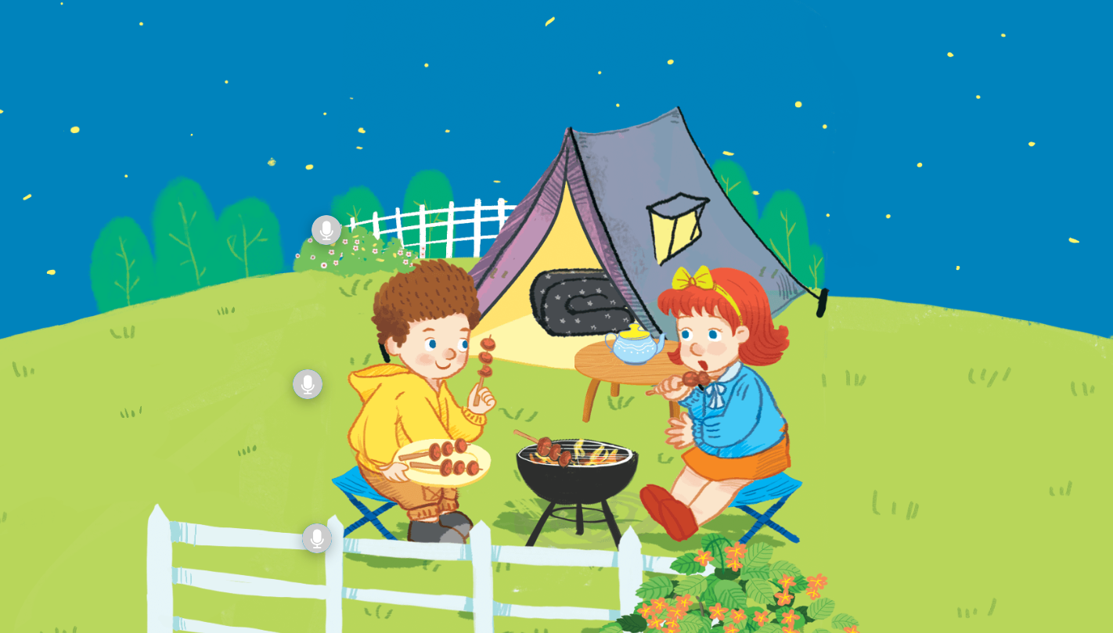
Look and answer.

Slide 9






Watch a video.
Notes:
- Click on the purple circle which has Tt to hear the recording “Tt”.

Slide 10
Listen and chant.
T, t, tent.
T, t, tent.
T, t, tent.
T, t, tent.
The tent is near the fence.
The tent is near the fence.
The tent is near the fence.
The tent is near the fence.
T, t, blanket.
T, t, blanket.
T, t, blanket.
T, t, blanket.
The blanket is in the tent.
The blanket is in the tent.
The blanket is in the tent.
The blanket is in the tent.
T, t, teapot.
T, t, teapot.
T, t, teapot.
T, t, teapot.
The teapot is on the table.
The teapot is on the table.
The teapot is on the table.
The teapot is on the table.
Notes:
Click on the purple circle which has Tt.
Click “tent” to listen to the recording of tent.

Slide 11
Chant in groups.
T, t, tent.
T, t, tent.
T, t, tent.
T, t, tent.
The tent is near the fence.
The tent is near the fence.
The tent is near the fence.
The tent is near the fence.
T, t, blanket.
T, t, blanket.
T, t, blanket.
T, t, blanket.
The blanket is in the tent.
The blanket is in the tent.
The blanket is in the tent.
The blanket is in the tent.
T, t, teapot.
T, t, teapot.
T, t, teapot.
T, t, teapot.
The teapot is on the table.
The teapot is on the table.
The teapot is on the table.
The teapot is on the table.

Slide 12







GOOD JOB!

Slide 13
3
Listen
and circle.

Slide 14

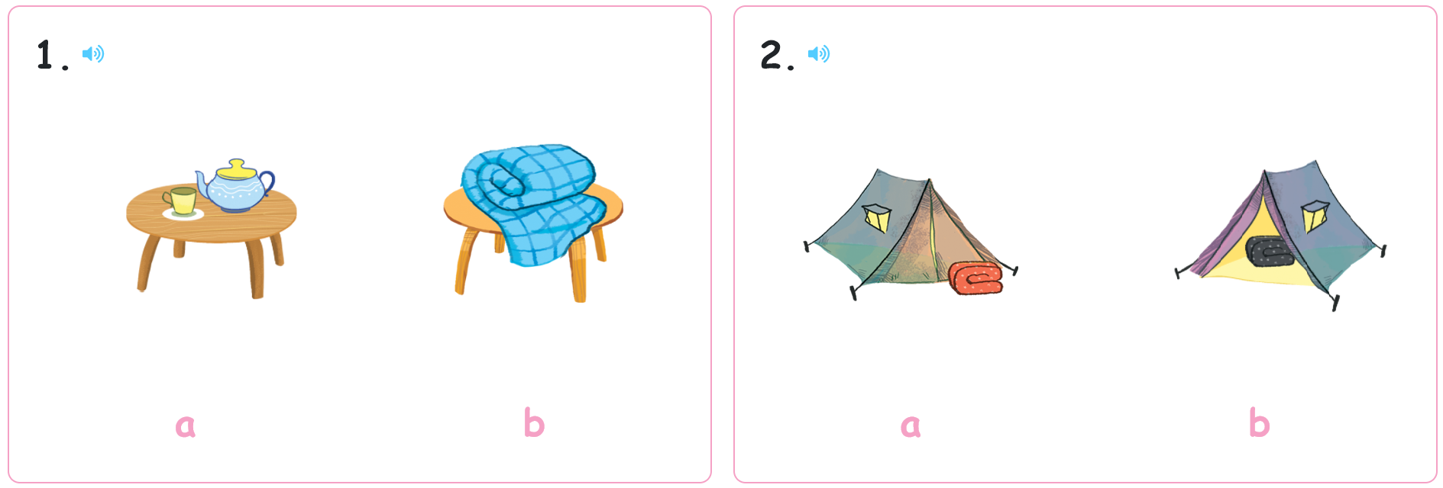




Point and say.
Notes:
The teacher says, “The teapot is on the table.” and pupils point to the picture 1a.
Do the same way with blanket, blanket next to the tent and blanket in the tent.
The blanket is on the table. – 1b
The blanket is next to the tent. – 2a
The blanket is in the tent. – 2b

Slide 15
Listen and circle.

Slide 16



Let’s check.
Work in pairs.

Slide 17
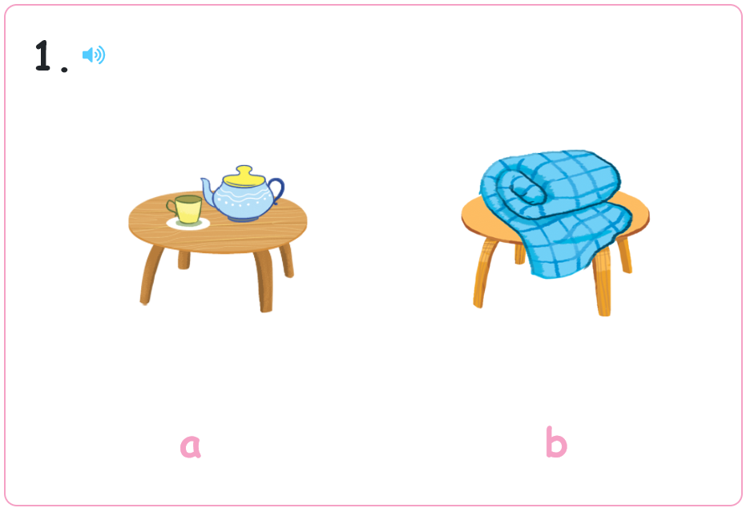
Let’s check.

Slide 18
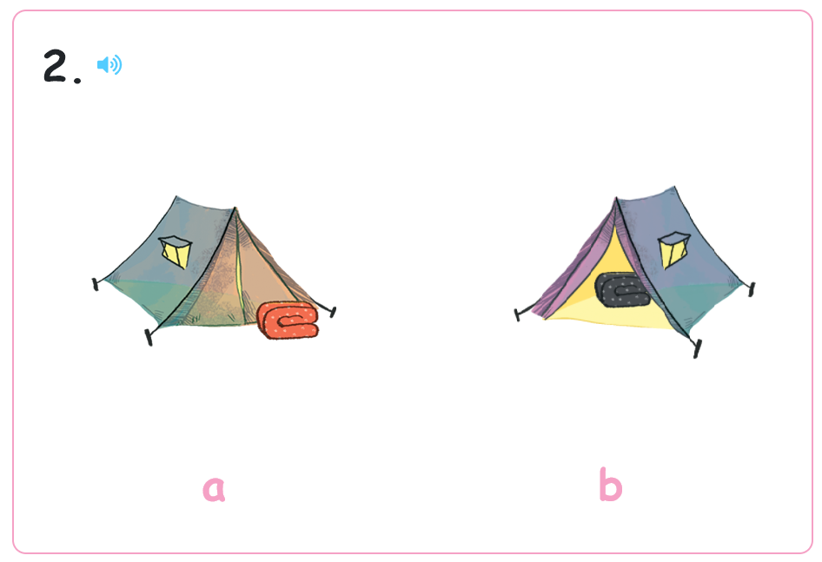
Let’s check.

Slide 19
GOOD JOB!

Slide 20
4
Write
and say.

Slide 21
Look and listen.
t

Slide 22
Look and write.
t

Slide 23
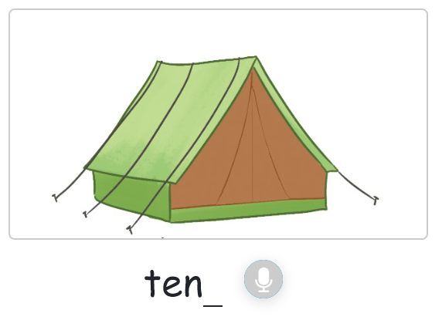

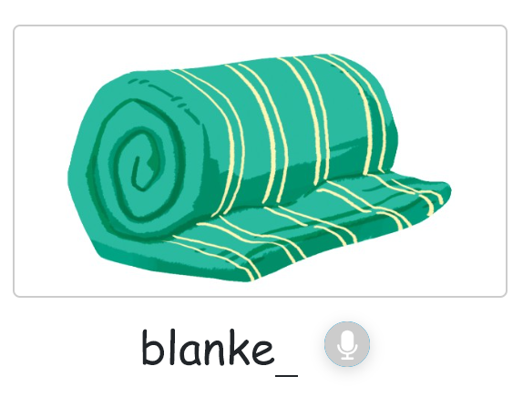
Look and say.

Slide 24
Let’s write.

Slide 25
Let’s check.
t

Slide 26
Let’s check.
t

Slide 27
Let’s check.
t

Slide 28
GOOD JOB!

Slide 29
5
Fun corner
and wrap-up.

Slide 30





Game: BALL CIRCLE

Slide 31
Game: BALL CIRCLE

Slide 32
Game: BALL CIRCLE

Slide 33
GOOD JOB!

Slide 34
THANK YOU

