Slide 1

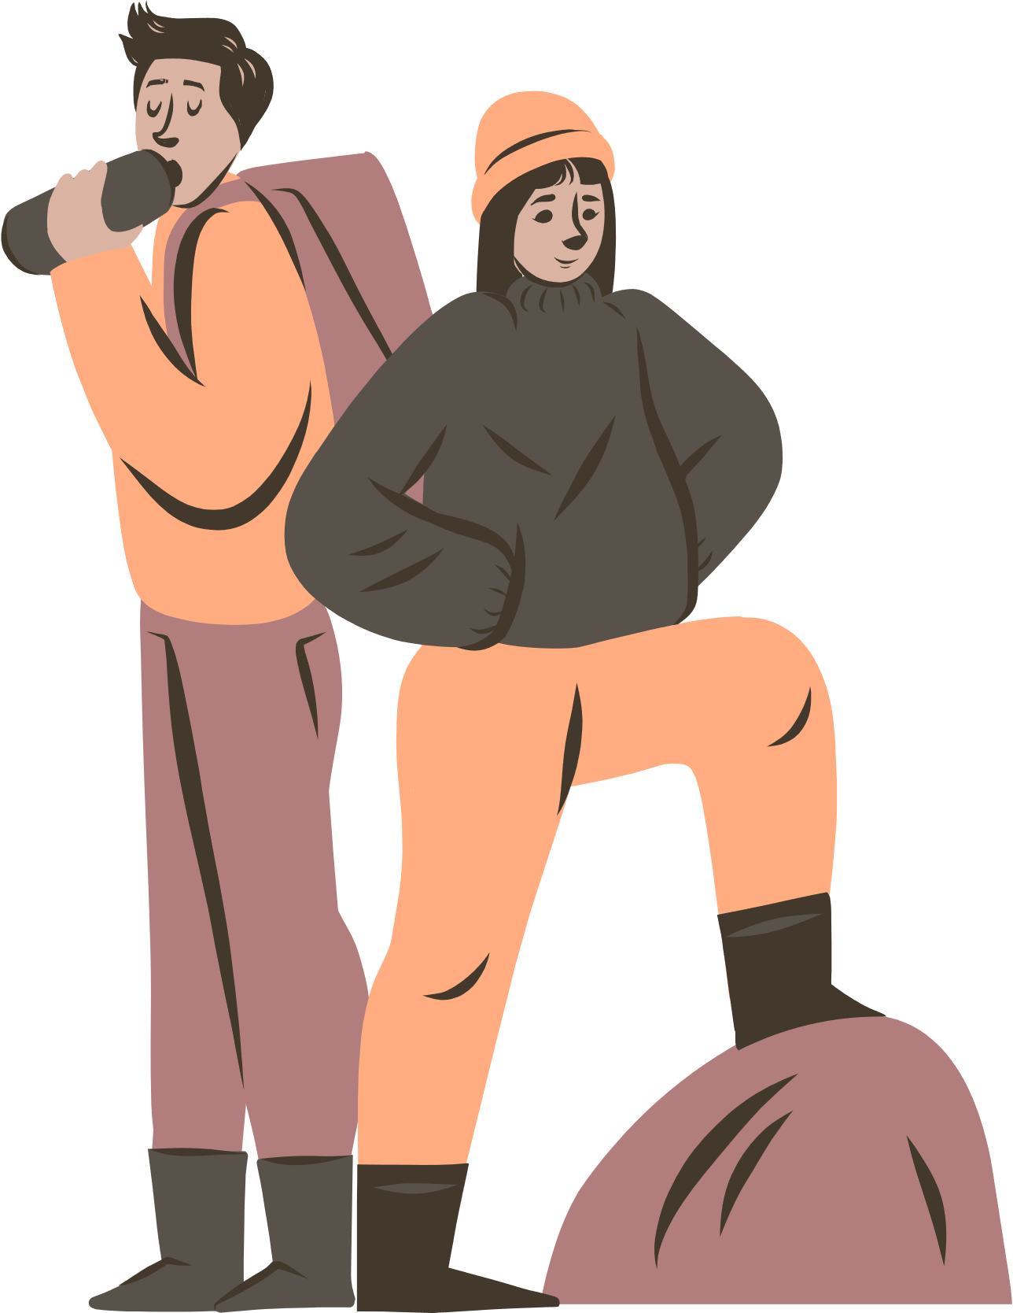




UBND QUẬN DƯƠNG KINH
TRƯỜNG TIỂU HỌC ANH DŨNG
HELLO AND WELLCOME TO MY ENGLISH CLASS

Slide 2
UNIT 16
AT THE CAMPSITE
Lesson 3

Slide 3




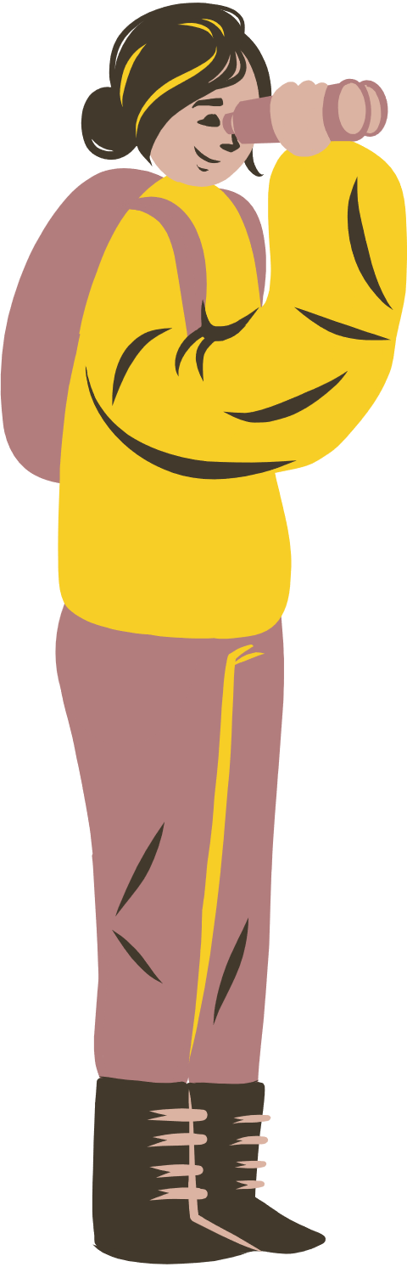
TABLE OF CONTENTS
1
Warm-up and review.
2
Listen and repeat.
3
Let’s talk.
4
Let’s sing.
5
Fun corner and wrap-up.

Slide 4





1
Warm-up
and review.

Slide 5







Let's play!
Look and Write!

Slide 6


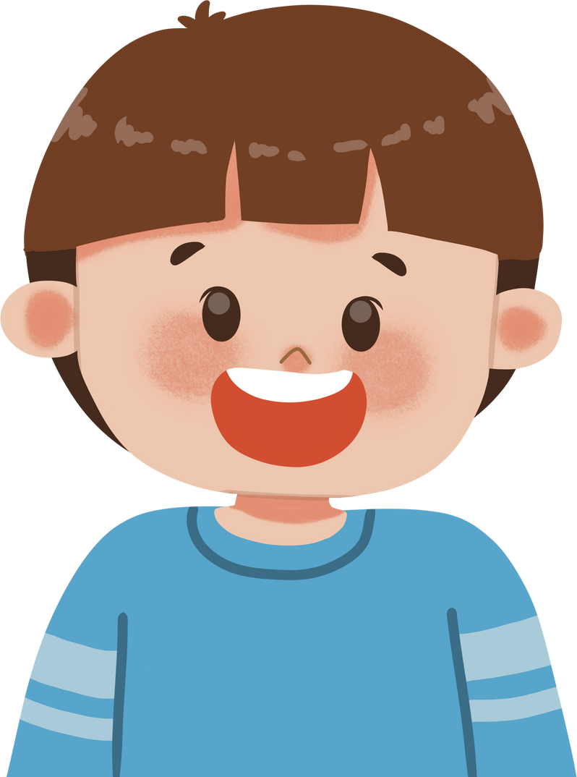




brother
grapes
teapot
zebu

Slide 7


brother
cake
yogurt
zebu

Slide 8
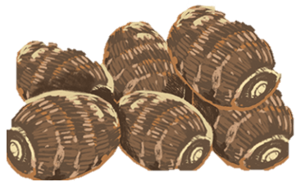
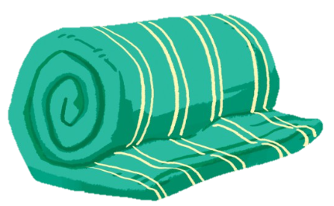
yams
blanket
grapes
cake

Slide 9
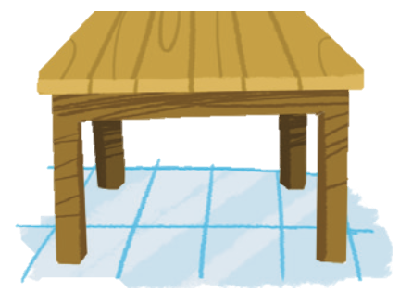
zebu
table
brother
cake

Slide 10

Thank you
for Playing!

Slide 11
2
Listen
and repeat.

Slide 12


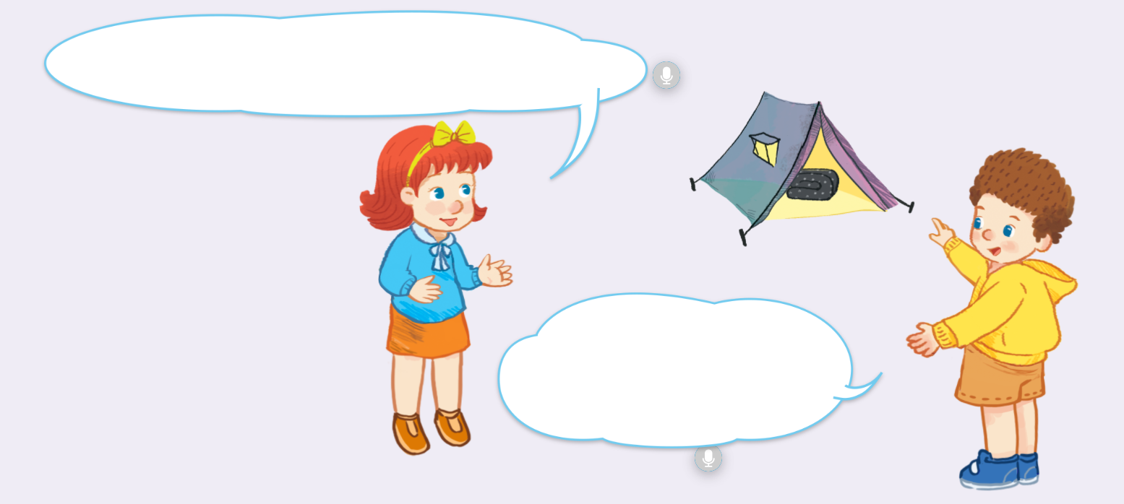
Look and say.

Slide 13

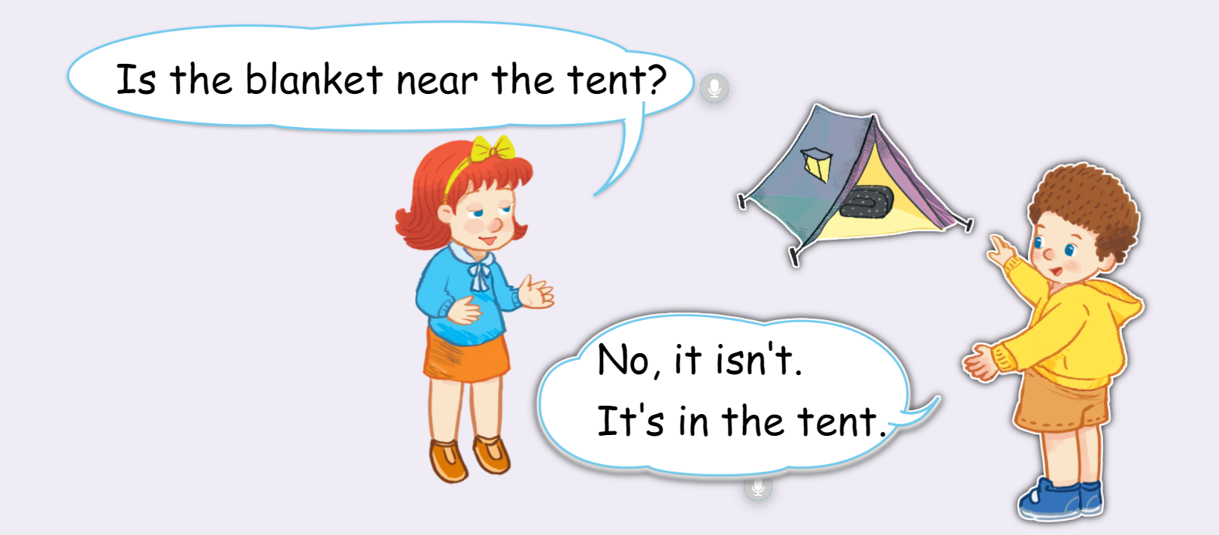




Listen and point.

Slide 14
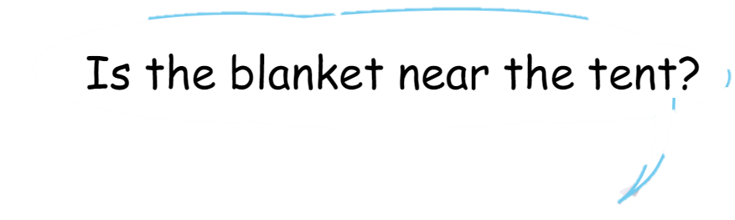
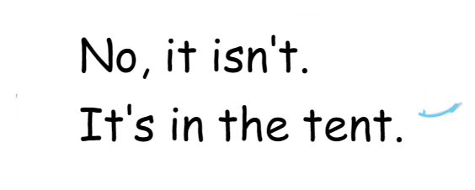
Listen and repeat.
Notes:
- Click each speech bubble to hear the recording.

Slide 15


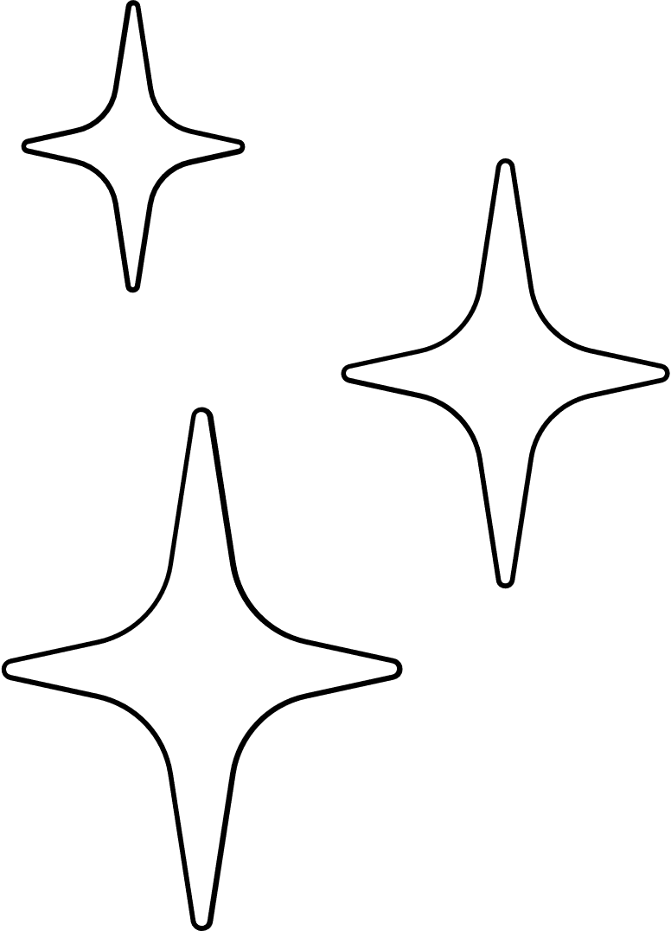


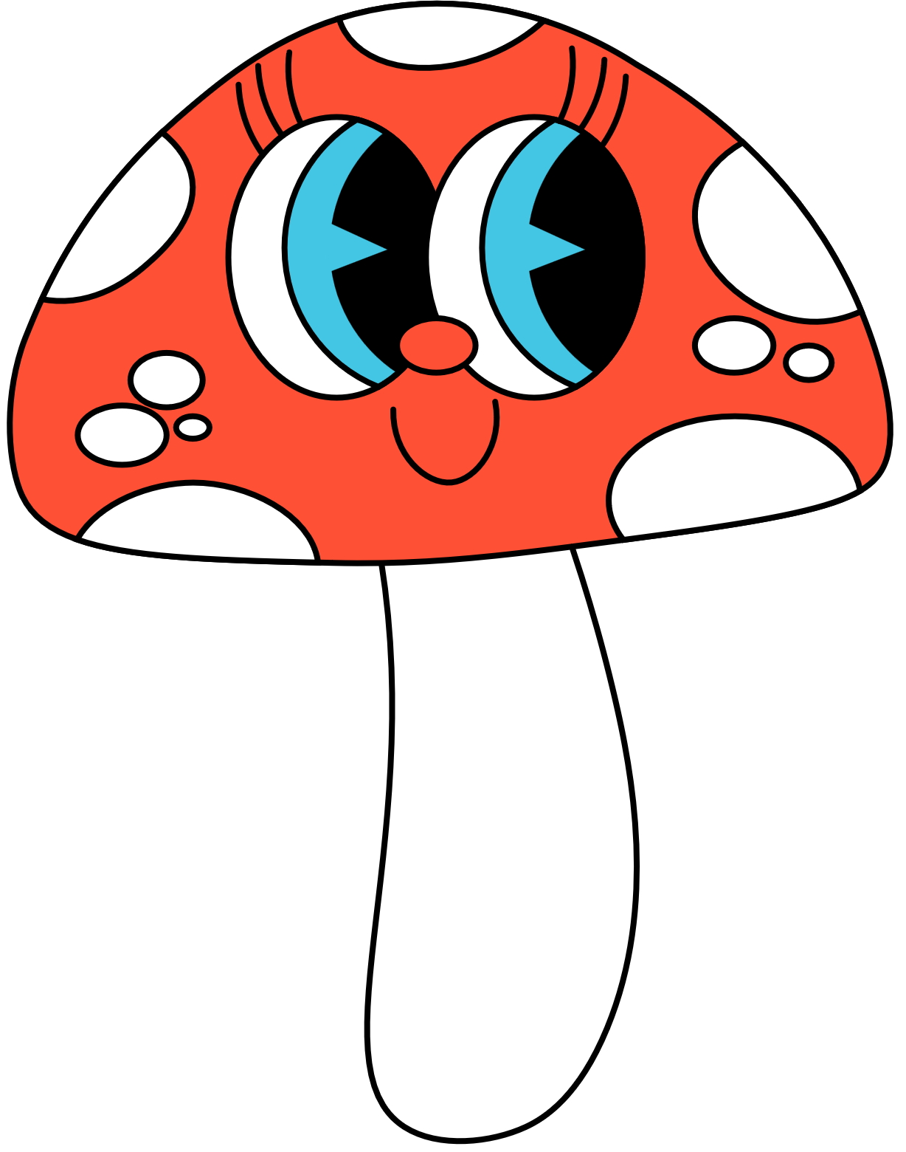

GOOD JOB!

Slide 16
3
Let’s talk.

Slide 17

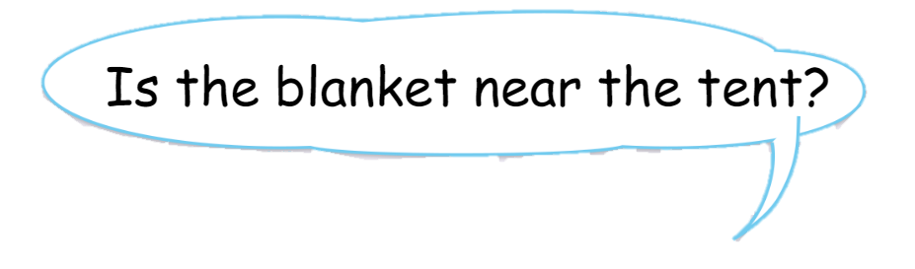
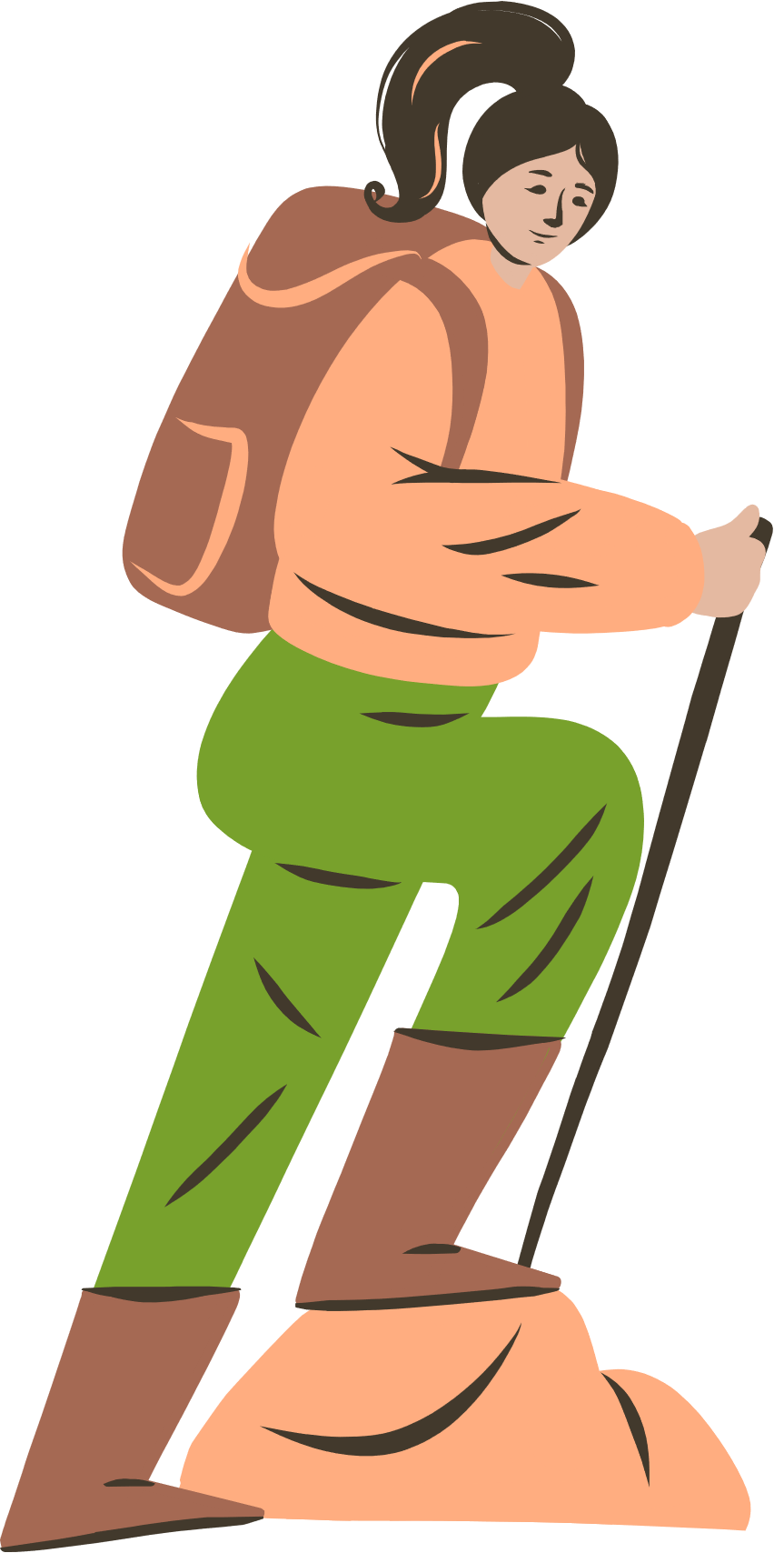


Look and say.

Slide 18
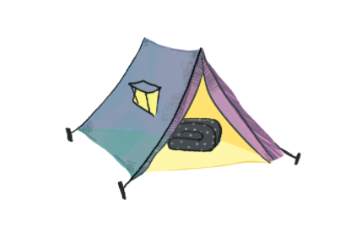
Listen and answer.

Slide 19
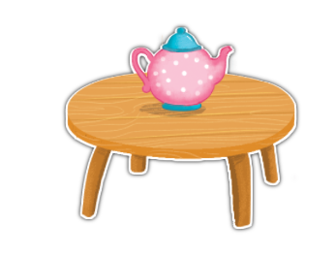
Ask and answer.
Is the …….....near ………..……?
teapot
the table
No, …………. .It’s …………………..
it isn’t
on the table

Slide 20
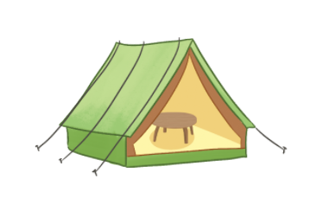
Ask and answer.
Is the …….....near ………..……?
table
the tent
No, …………. .It’s …………………..
it isn’t
in the tent

Slide 21



Ask and answer.
Work in pairs.

Slide 22
GOOD JOB!

Slide 23
4
Let’s sing.

Slide 24
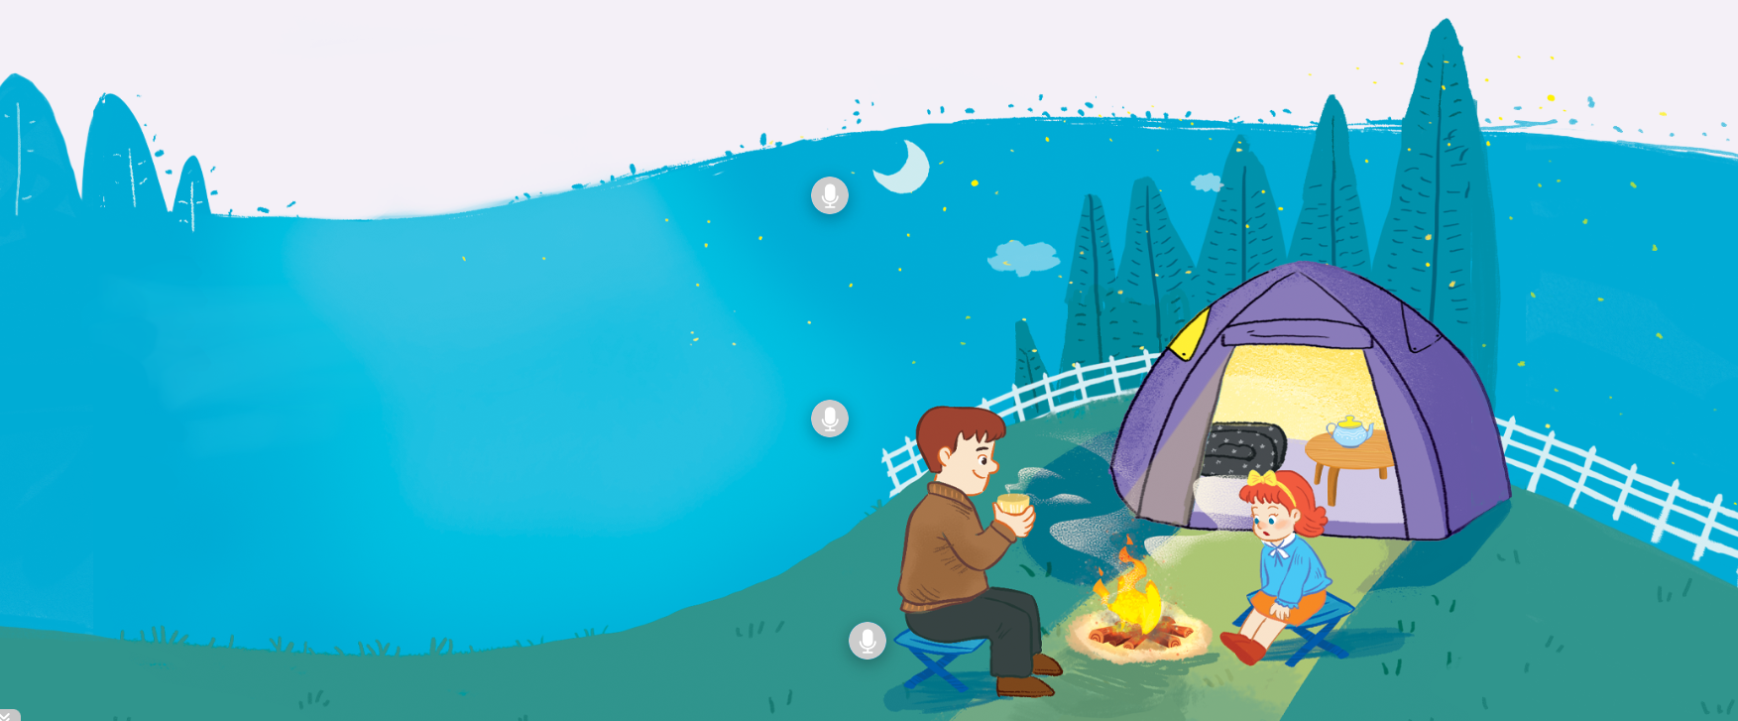
Look, listen and answer.

Slide 25

Watch a video.

Slide 26
Listen and repeat.
Is the blanket near the tent?
Is the blanket near the tent?
Is the blanket near the tent?
Is the blanket near the tent?
No, it isn’t. It’s in the tent.
No, it isn’t. It’s in the tent.
No, it isn’t. It’s in the tent.
No, it isn’t. It’s in the tent.
Is the table near the tent?
Is the table near the tent?
Is the table near the tent?
Is the table near the tent?
No, it isn’t. It’s in the tent.
No, it isn’t. It’s in the tent.
No, it isn’t. It’s in the tent.
No, it isn’t. It’s in the tent.
Is the teapot near the table?
Is the teapot near the table?
Is the teapot near the table?
Is the teapot near the table?
No, it isn’t. It’s on the table.
No, it isn’t. It’s on the table.
No, it isn’t. It’s on the table.
No, it isn’t. It’s on the table.

Slide 27
Listen and sing.
Is the blanket near the tent?
Is the blanket near the tent?
Is the blanket near the tent?
Is the blanket near the tent?
No, it isn’t. It’s in the tent.
No, it isn’t. It’s in the tent.
No, it isn’t. It’s in the tent.
No, it isn’t. It’s in the tent.
Is the table near the tent?
Is the table near the tent?
Is the table near the tent?
Is the table near the tent?
No, it isn’t. It’s in the tent.
No, it isn’t. It’s in the tent.
No, it isn’t. It’s in the tent.
No, it isn’t. It’s in the tent.
Is the teapot near the table?
Is the teapot near the table?
Is the teapot near the table?
Is the teapot near the table?
No, it isn’t. It’s on the table.
No, it isn’t. It’s on the table.
No, it isn’t. It’s on the table.
No, it isn’t. It’s on the table.

Slide 28
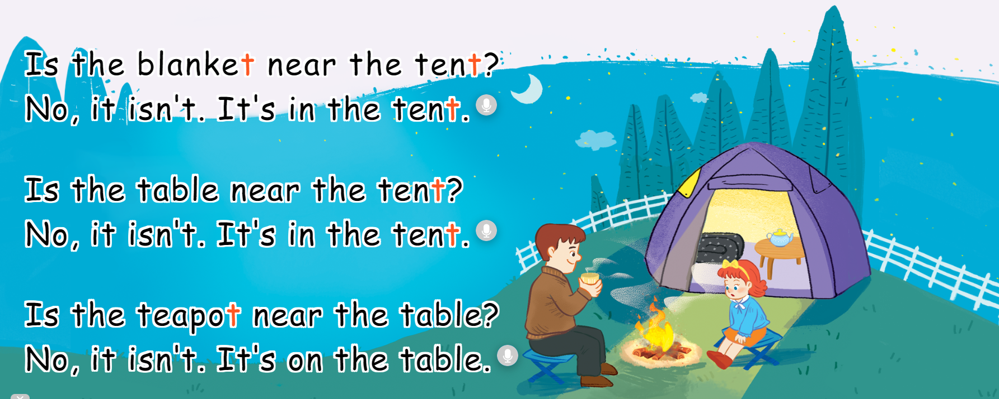
Make up actions.
T, t, tent.
The tent is near the fence.
T, t, blanket.
The blanket is in the tent.
T, t, teapot.
The teapot is on the table.

Slide 29

Perform the song.
T, t, tent.
The tent is near the fence.
T, t, blanket.
The blanket is in the tent.
T, t, teapot.
The teapot is on the table.

Slide 30
GOOD JOB!

Slide 31
5
Fun corner
and wrap-up.

Slide 32


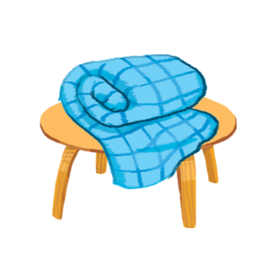
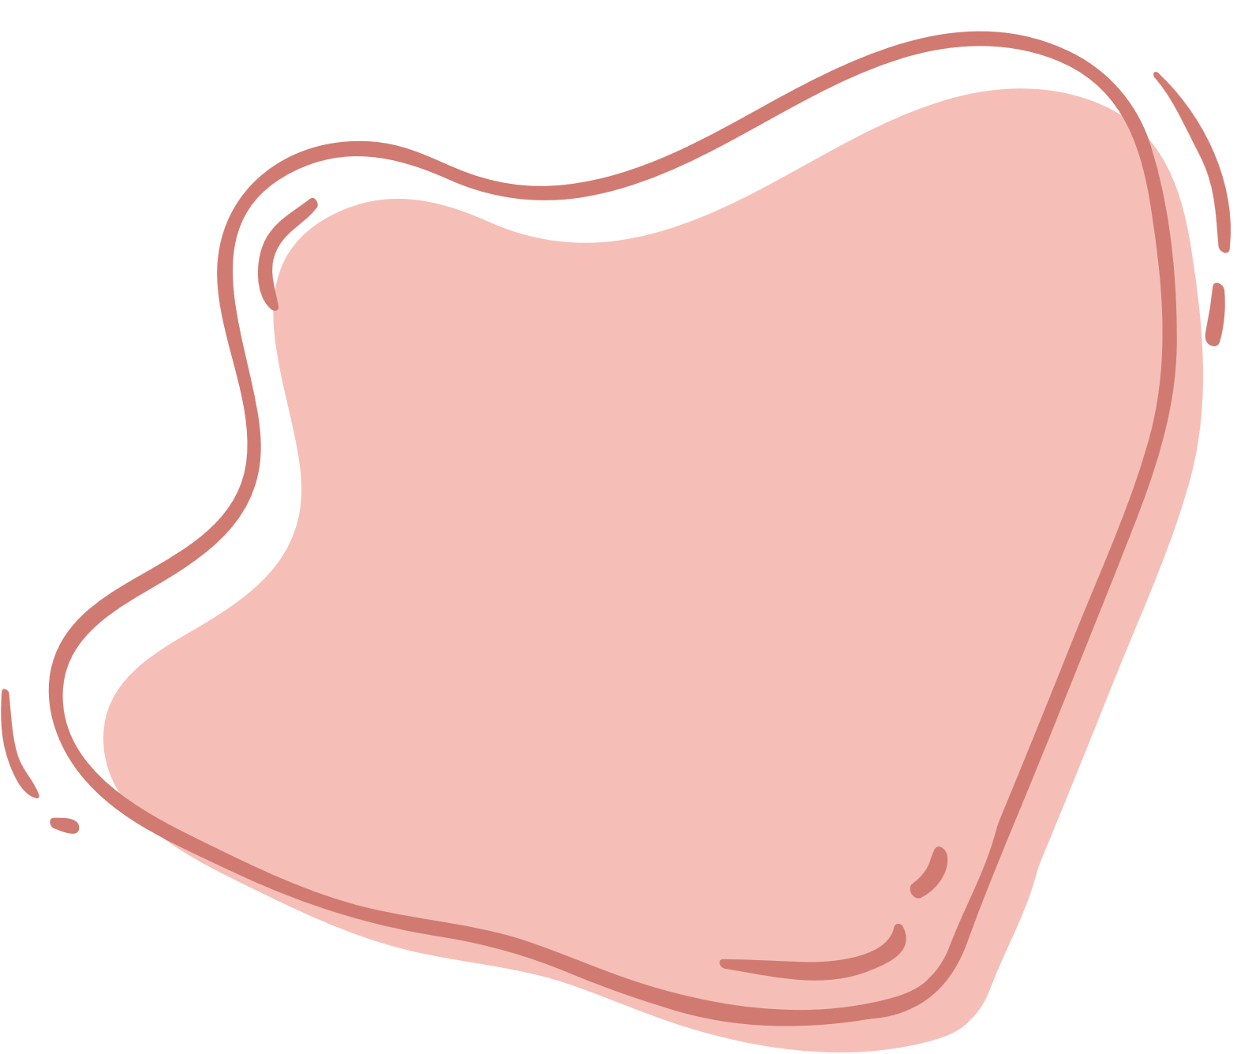

Game: MUSICAL CARDS

Slide 33
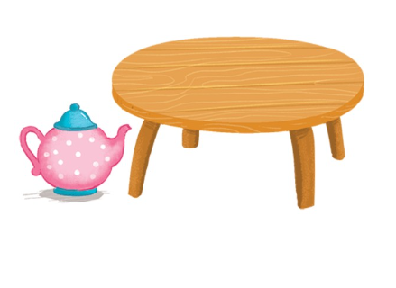
Game: MUSICAL CARDS

Slide 34
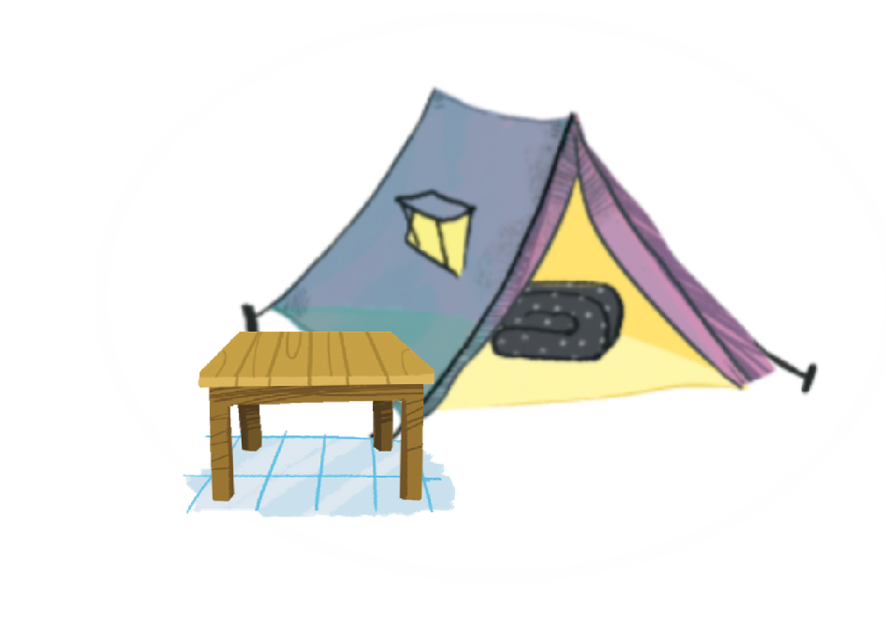
Game: MUSICAL CARDS

Slide 35
GOOD JOB!

Slide 36
THANK YOU!

