Slide 1






















Unit 1: At my birthday party
Lesson 1 – Period 1

Slide 2
WELCOME
TO OUR CLASS!

Slide 3


Slide 4
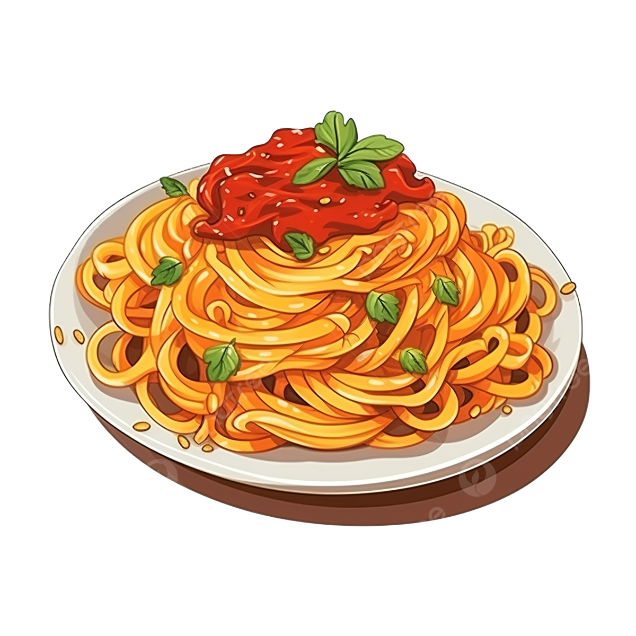


Pizza
Pasta
Popcorn

Slide 5
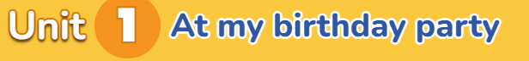
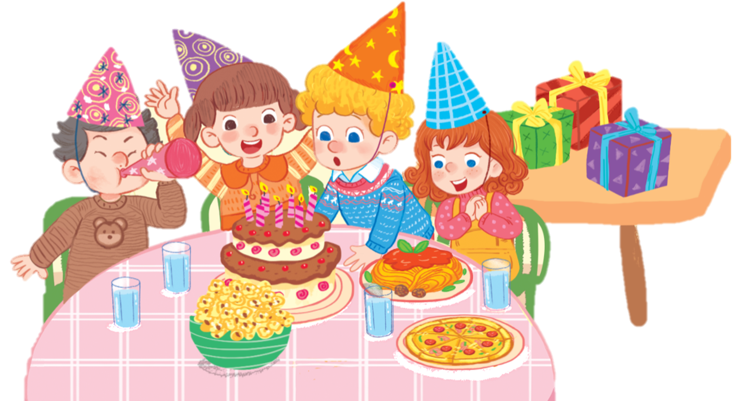

Pp

Slide 6
Pp
pasta

Slide 7
Pp
pasta
pizza

Slide 8

1. Listen and repeat.
Pp
pasta
popcorn
pizza

Slide 9
Pp
pasta
popcorn
pizza

Slide 10






Look and say aloud
popcorn

Slide 11
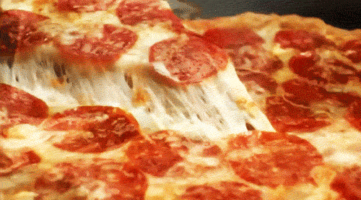
Look and say aloud.
pizza

Slide 12
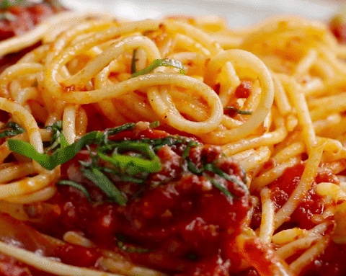
Look and say aloud.
pasta

Slide 13
KIM’S GAME

Slide 14


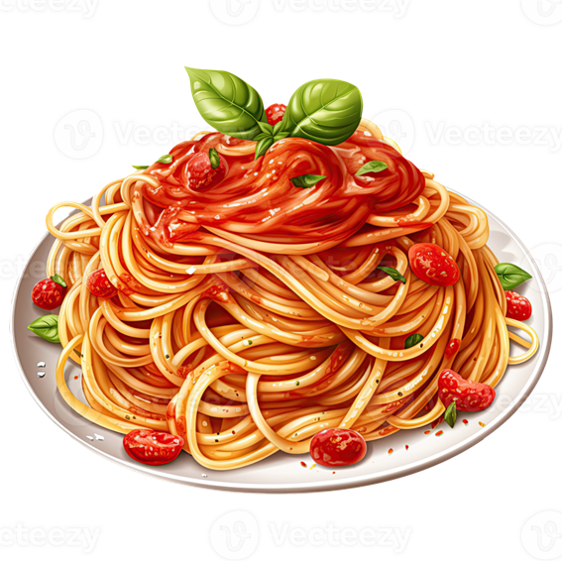
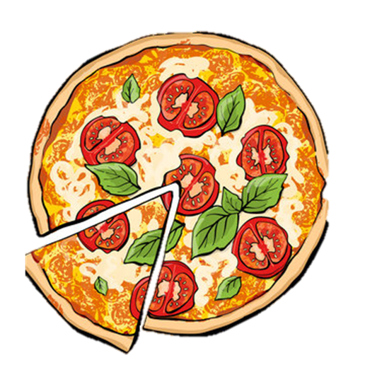
KIM’S GAME
(Turn 1)
Time’s up!

Slide 15



KIM’S GAME
(Turn 1)
pizza
popcorn
pasta

Slide 16

KIM’S GAME
(Turn 2)
Time’s up!

Slide 17



KIM’S GAME
(Turn 2)
popcorn
pasta
pizza

Slide 18

KIM’S GAME
(Turn 3)
popcorn
pizza
pasta
Time’s up!

Slide 19



KIM’S GAME
(Turn 3)
pizza
pasta
popcorn

Slide 20
Goodbye
Notes:
https://www.youtube.com/watch?v=E7BRrNU25lE

