Slide 1
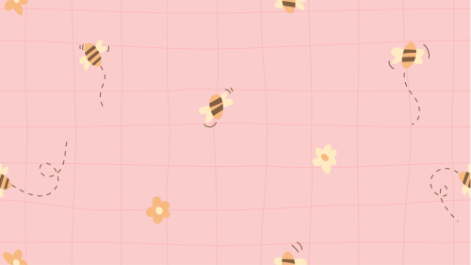

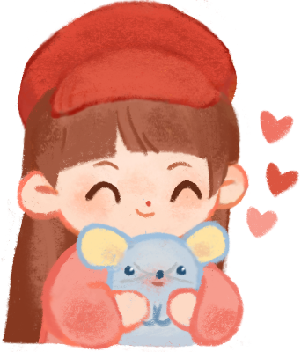
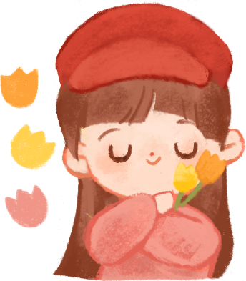
UNIT 1 - LESSON 2
AT MY BIRTHDAY PARTY

Slide 2
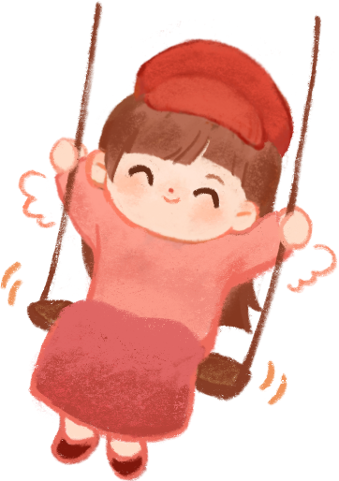

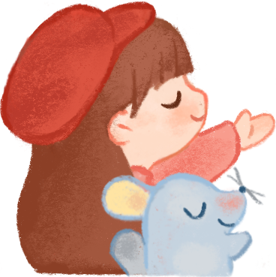
Hello and Welcome To My English Class

Slide 3

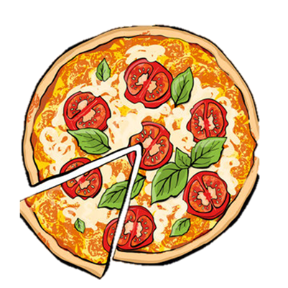
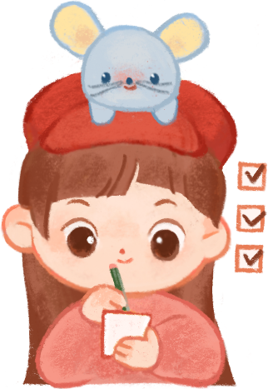
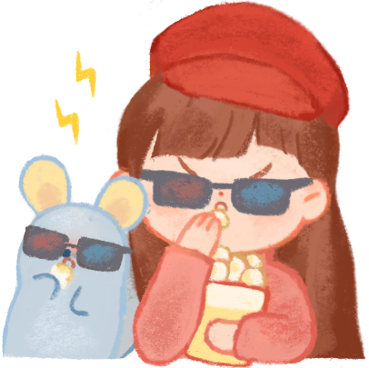


Guess the picture
1
2
3
4
Pizza

Slide 4

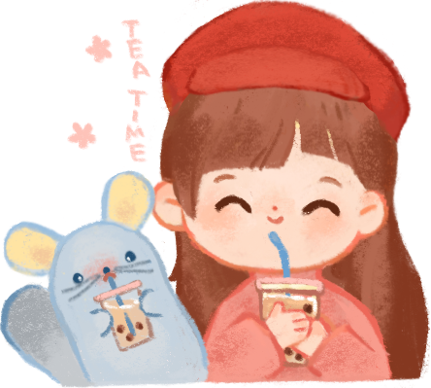

Guess the picture
1
2
3
4
Popcorn

Slide 5
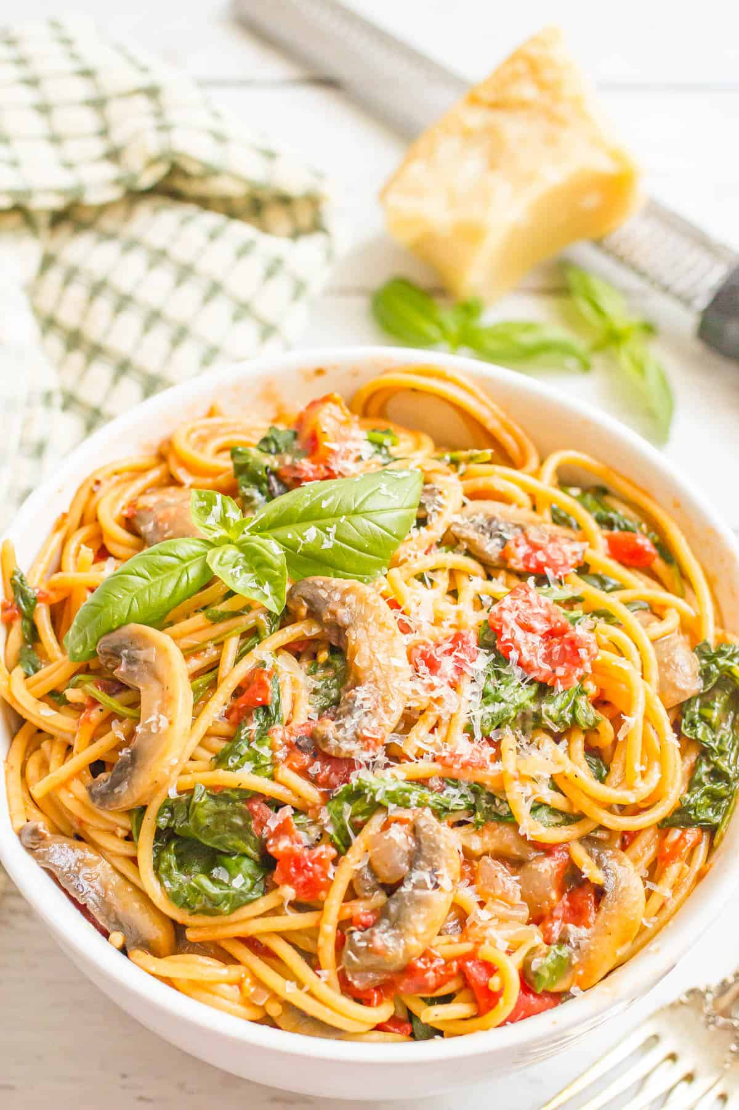
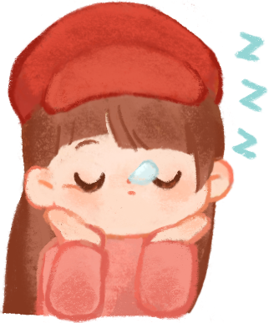
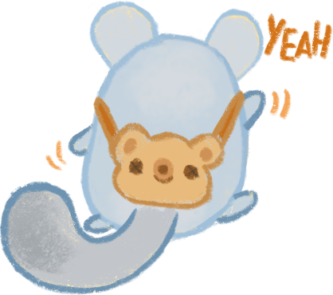
Guess the picture
1
2
3
4
Pasta

Slide 6

Let’s chant.

Slide 7


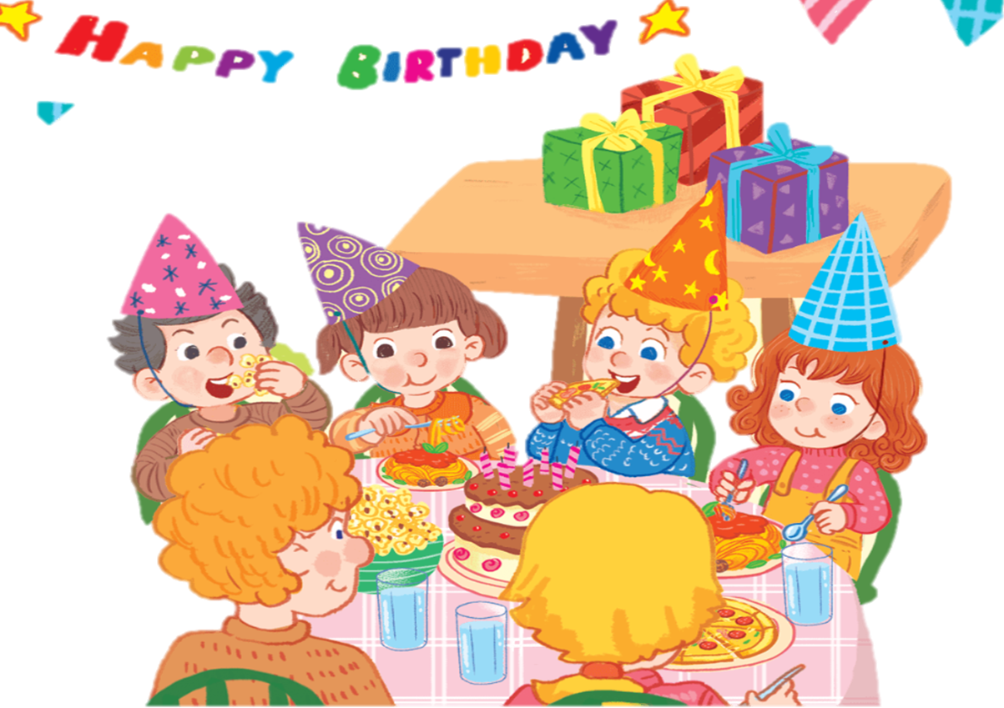
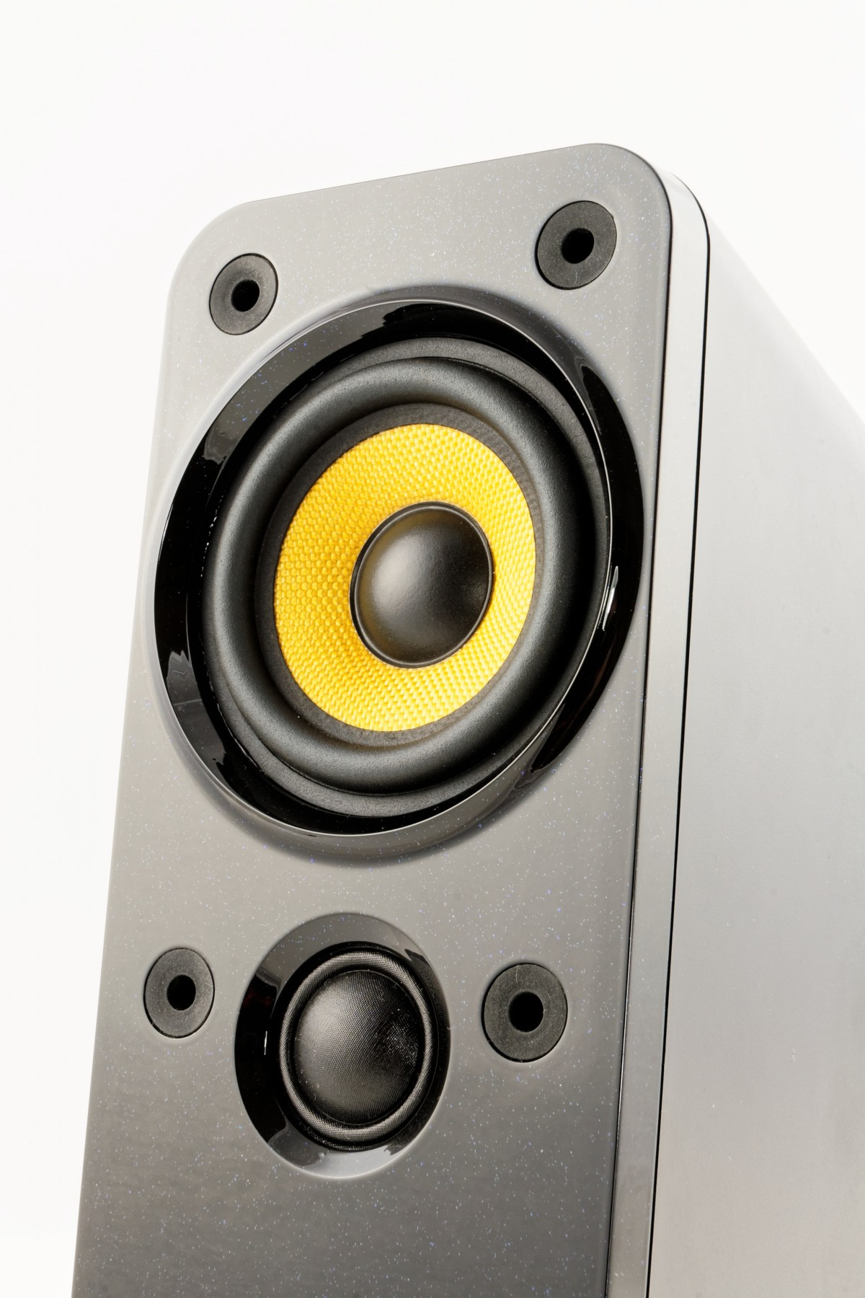
P, p, pasta.
P, p, pizza.
P, p, popcorn.
I like pasta.
I like pizza.
I like popcorn.
Yummy, yummy, yummy.
Notes:
Click to see each line
Click each line to hear the sound
Click the speaker to hear the whole chant

Slide 8

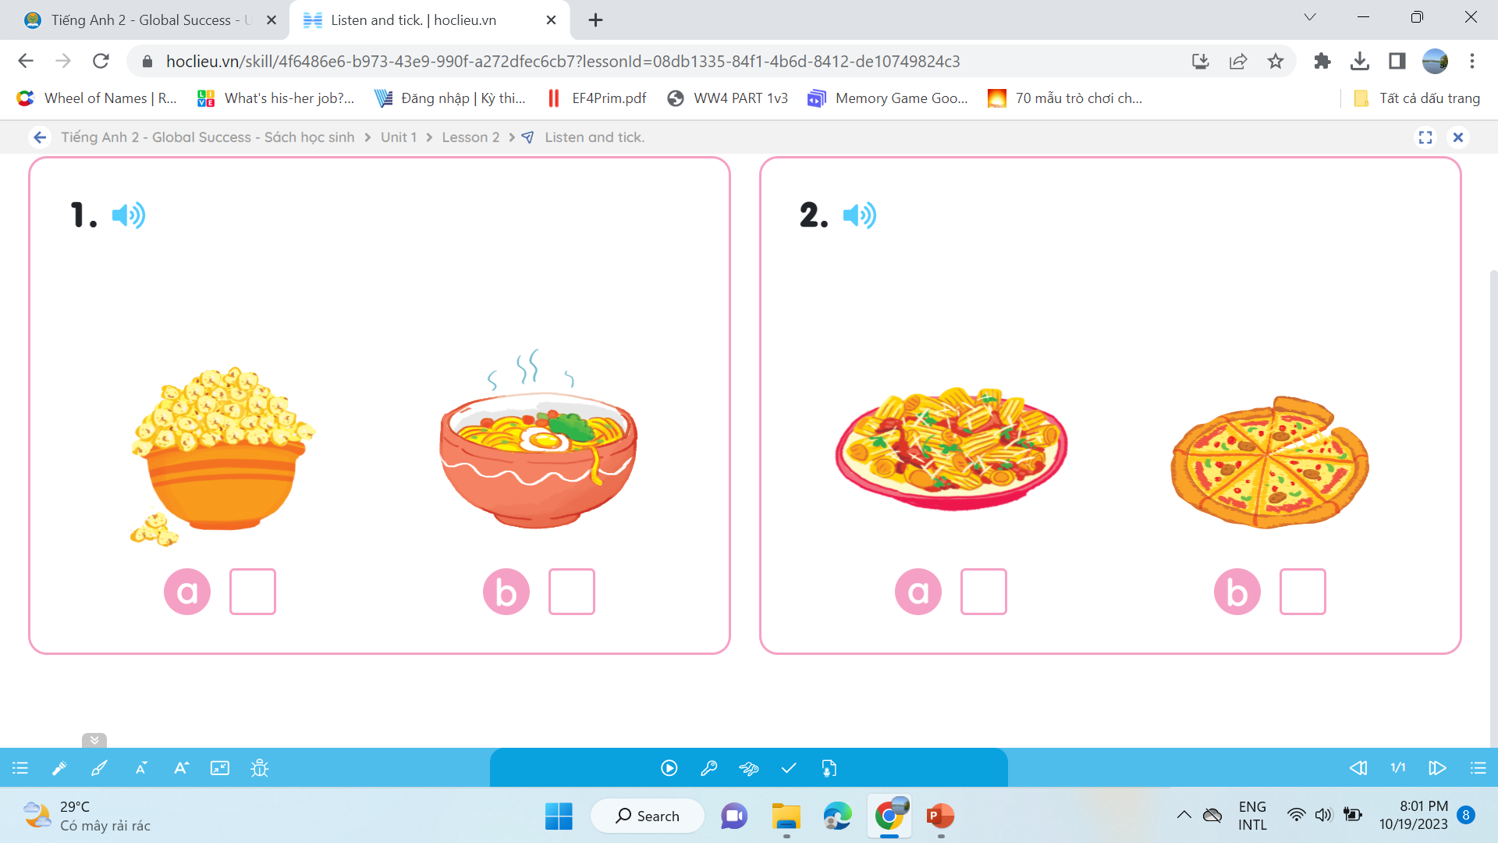
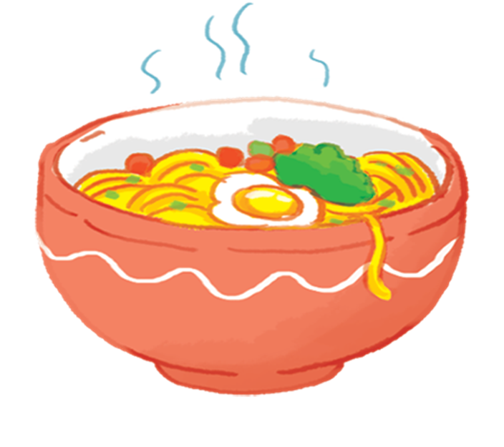
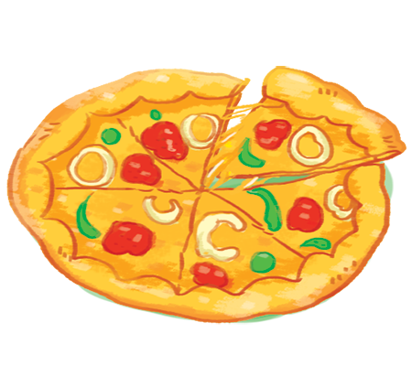

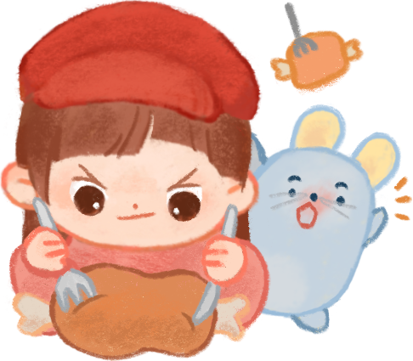
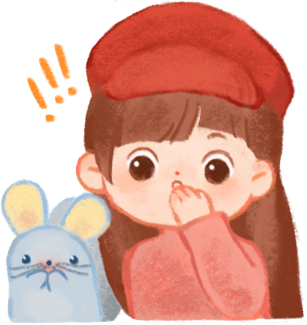
1.
Listen and tick
2.
a
b
a
b

Slide 9

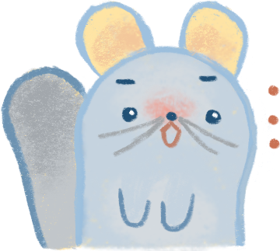
Look and write

Slide 10

Look and write

Slide 11

GAME

Slide 12



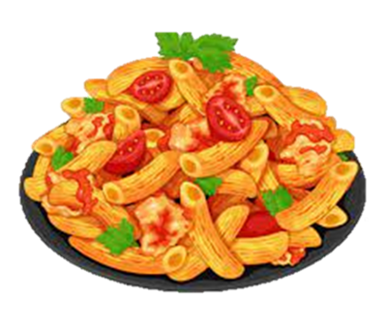

Notes:
Listen to the audio first then click the pictures.

Slide 13



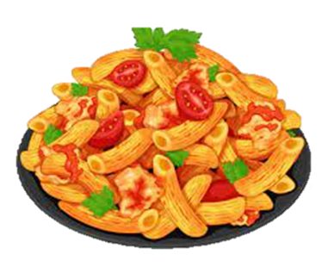

Slide 14




Slide 15


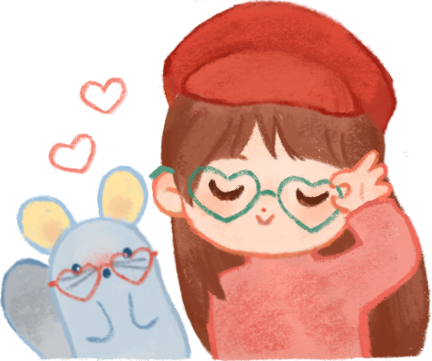

Slide 16




Slide 17
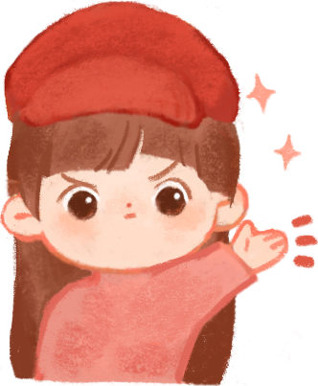
Thank You for listening

