Slide 1
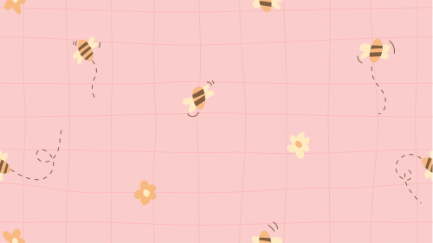

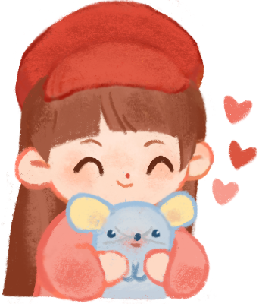

UNIT 1 - LESSON 3
AT MY BIRTHDAY PARTY

Slide 2
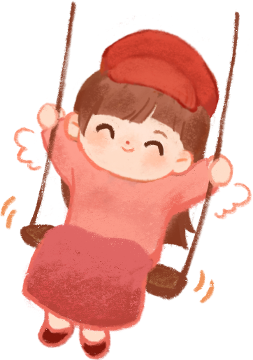

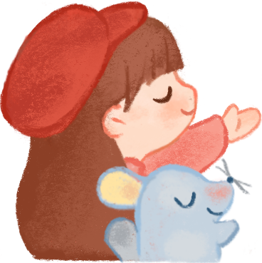
Hello and Welcome To My English Class

Slide 3

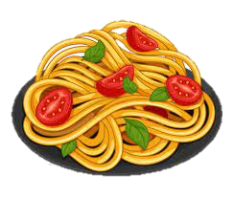
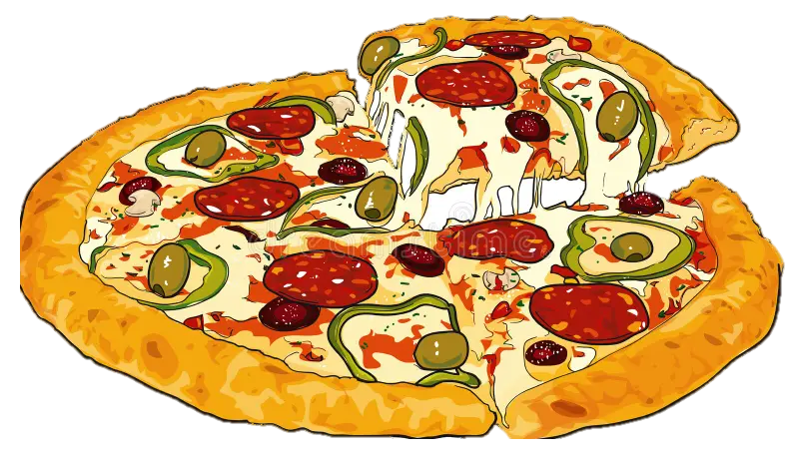

GAME
What’s missing?

Slide 4

GAME
What’s missing?

Slide 5
GAME
What’s missing?

Slide 6
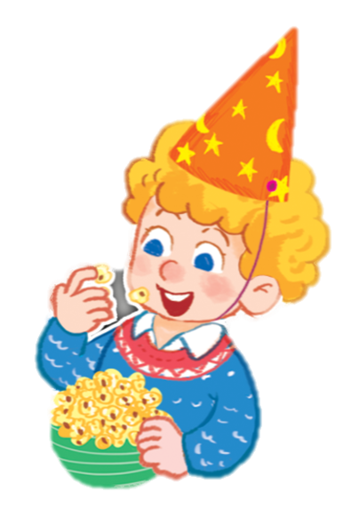
Listen and repeat.
The popcorn is yummy.

Slide 7

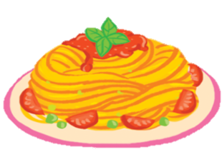
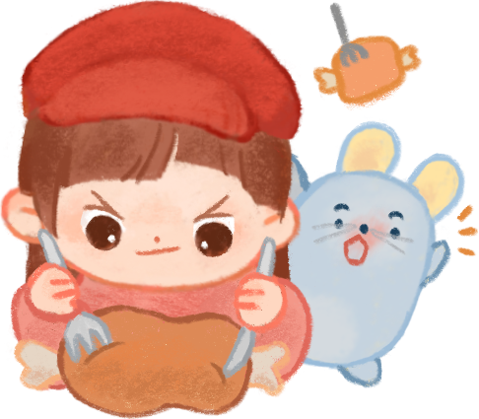
Let’s talk.
pasta
The _______ is yummy.

Slide 8
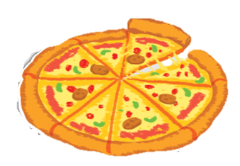

The _______is yummy.
pizza

Slide 9

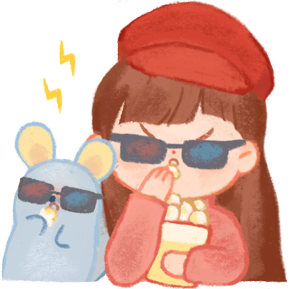
popcorn
The ___________ is yummy.

Slide 10


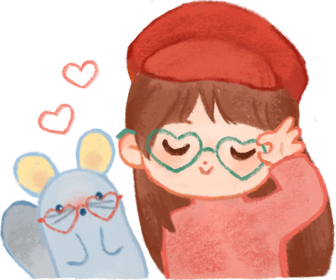
The pasta is yummy.
The popcorn is yummy.
The pizza is yummy.

Slide 11

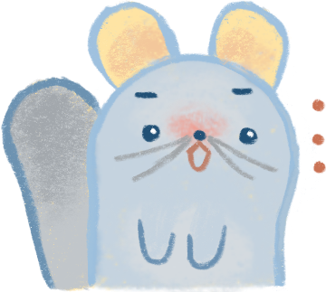

Slide 12

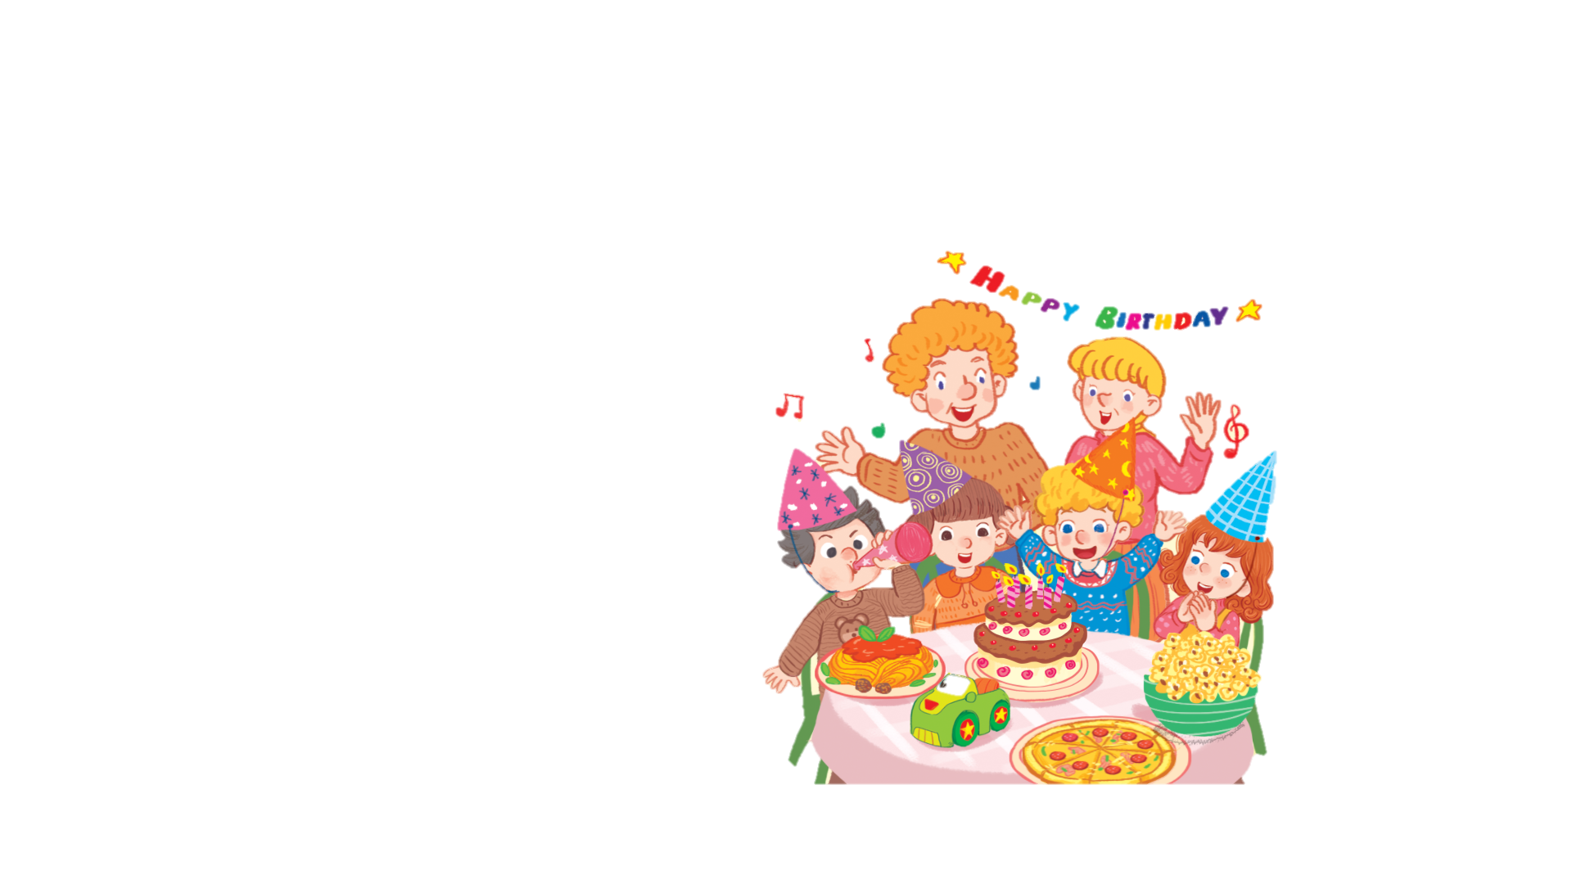
Let’s sing
It’s my birthday party.
I like pasta.
The pasta is yummy.
I like pizza.
The pizza is yummy.
I like popcorn.
The popcorn is yummy.

Slide 13

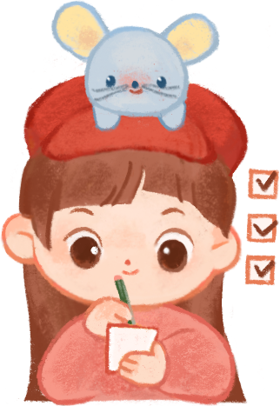
GAME

Slide 14
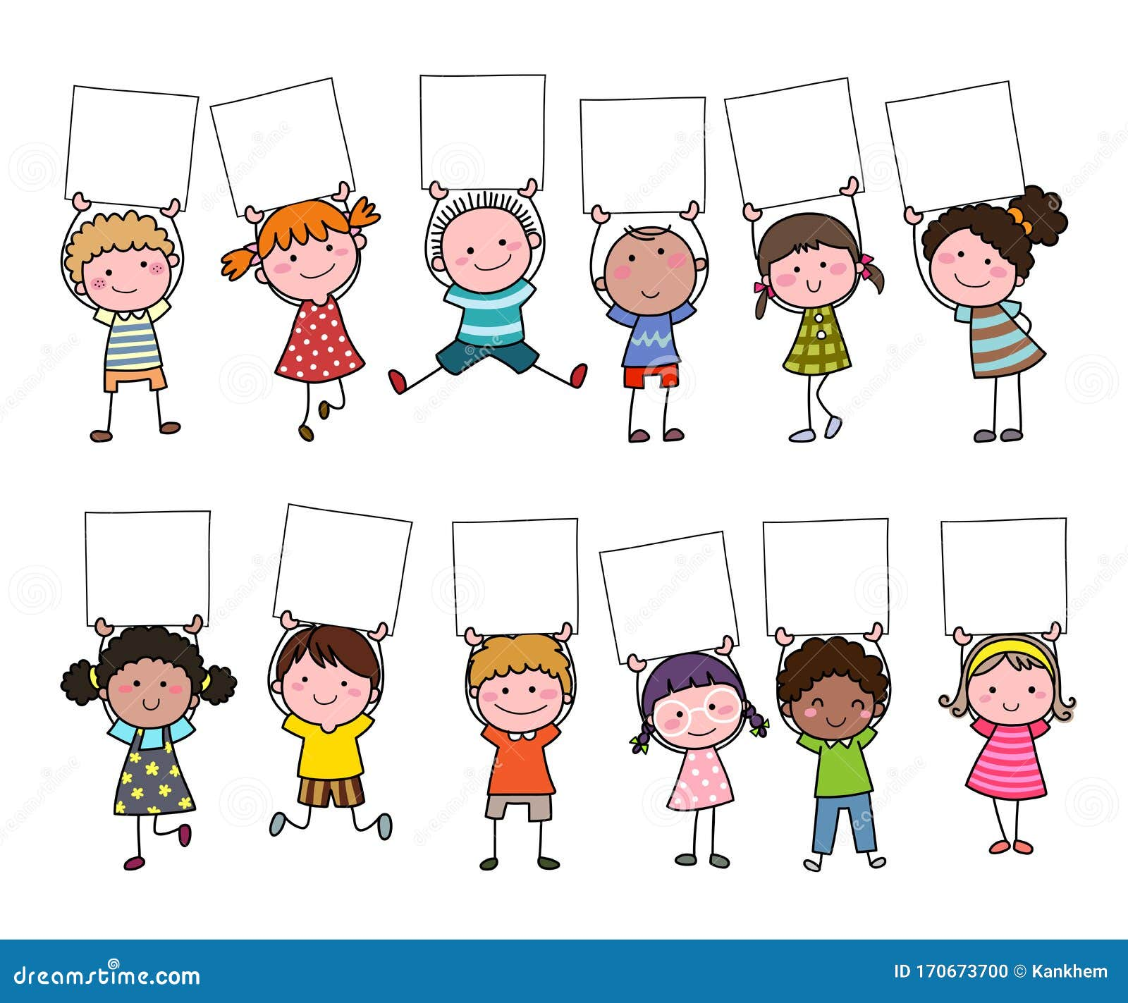
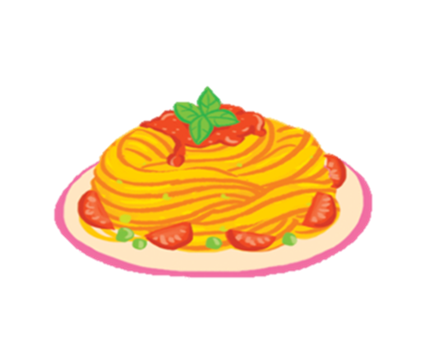



Slide 15


The popcorn is yummy.

Slide 17
The pizza is yummy.

Slide 19


The pasta is yummy.

Slide 20
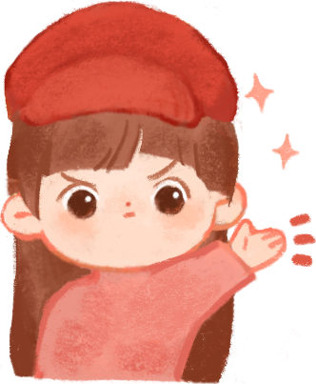
Thank You!
DO YOU HAVE ANY QUESTIONS FOR ME?

Slide 21


Requirements for Class

Slide 22
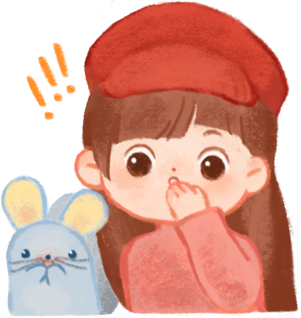
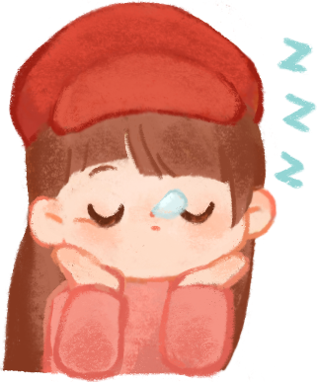

Requirements for Class

Slide 23

Evaluation

