Slide 1
UNBD QUẬN DƯƠNG KINH
TRƯỜNG TIỂU HỌC ANH DŨNG
HELLO AND WELCOME TO MY ENGLISH CLASS

Slide 2






Unit 15
IN THE CLOTHES SHOP
Lesson 1

Slide 3






1
  Warm-up and review.

Slide 4



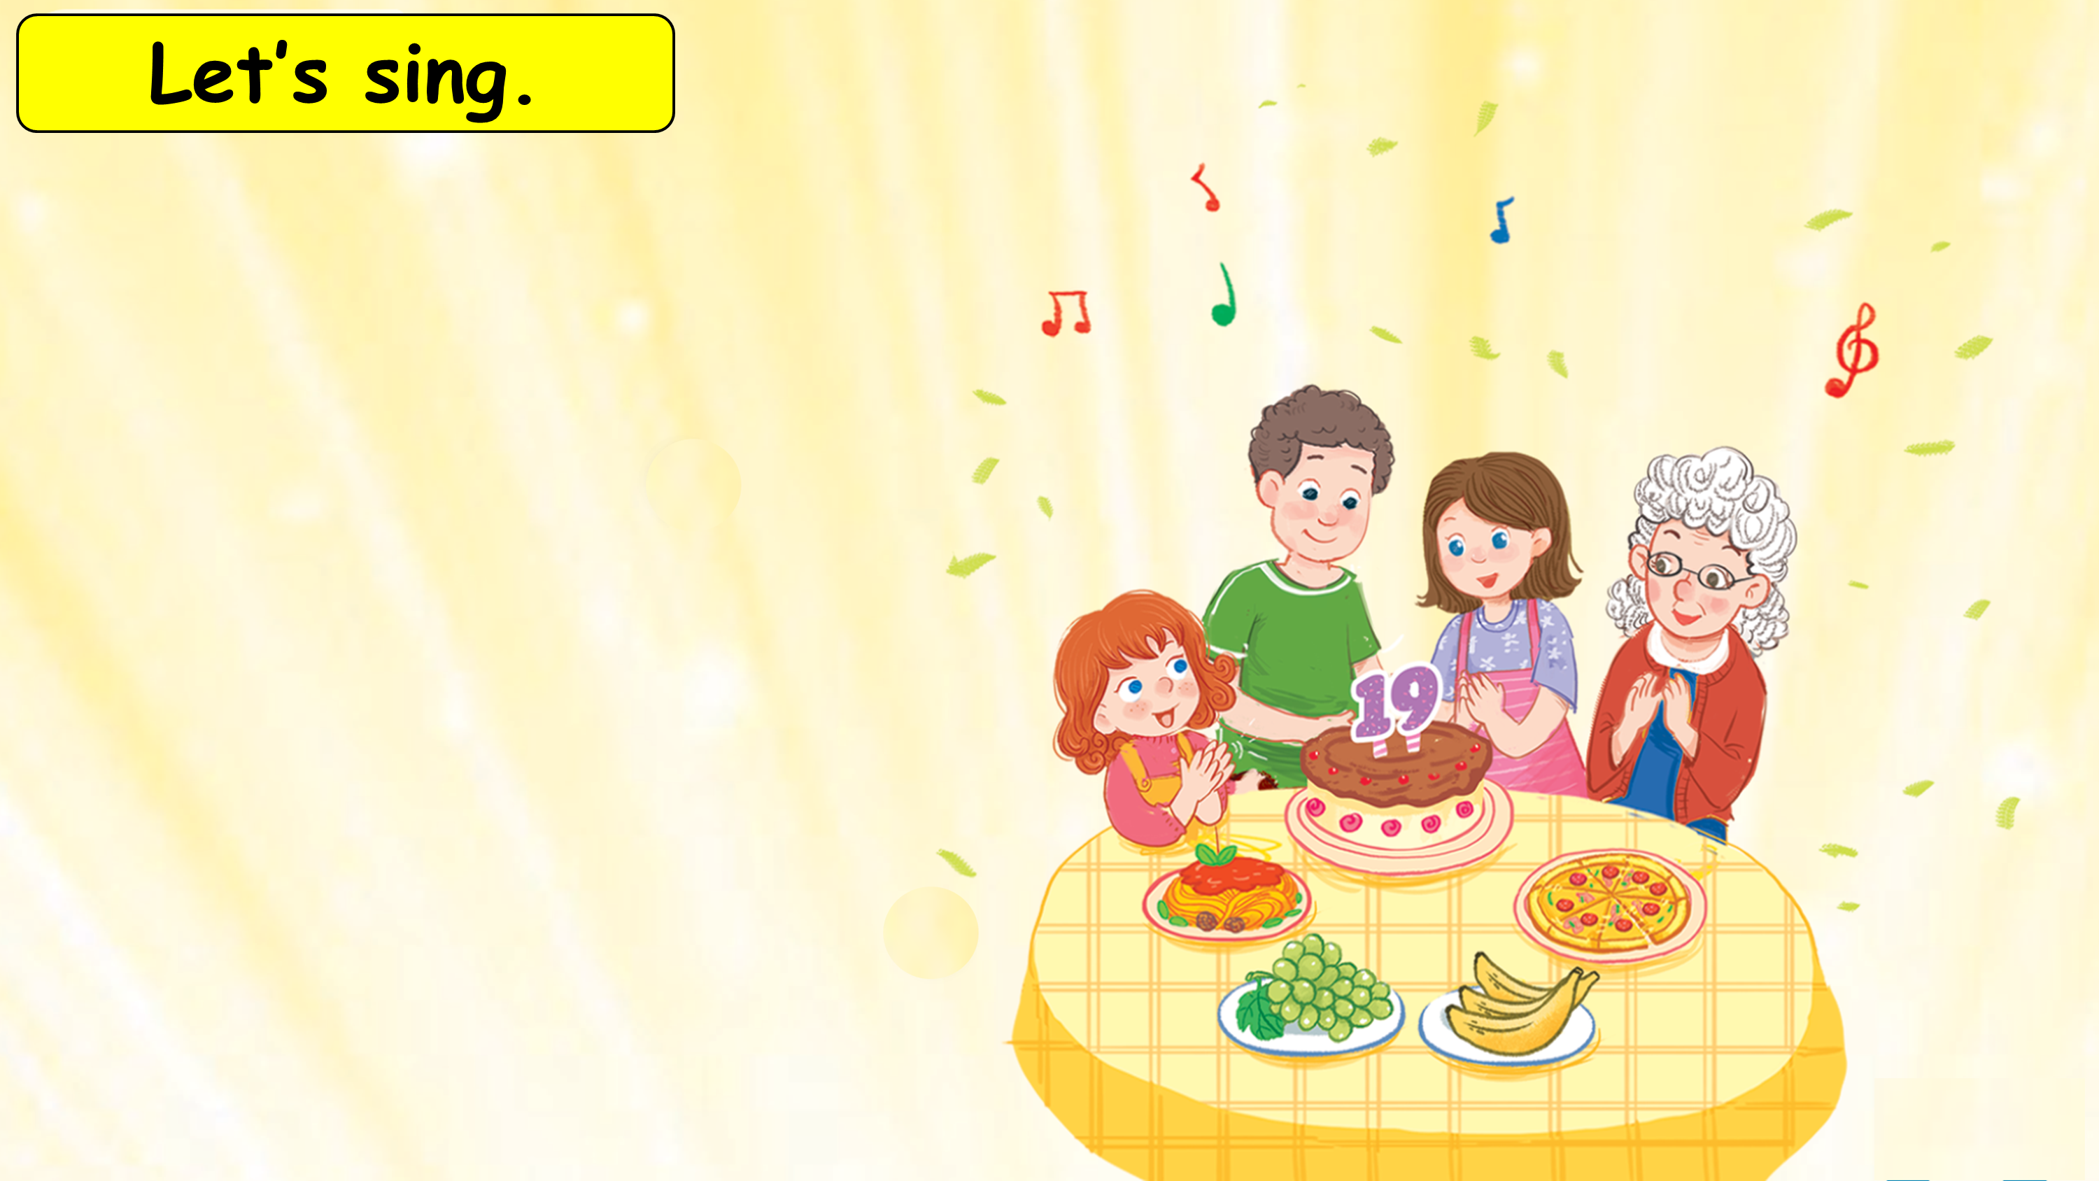






That’s my brother.
How old is he?
He’s nineteen.
My grandmother is here.
My sister is here.
We are all here.
At his birthday party.

Slide 5
2
  Listen and repeat.

Slide 6
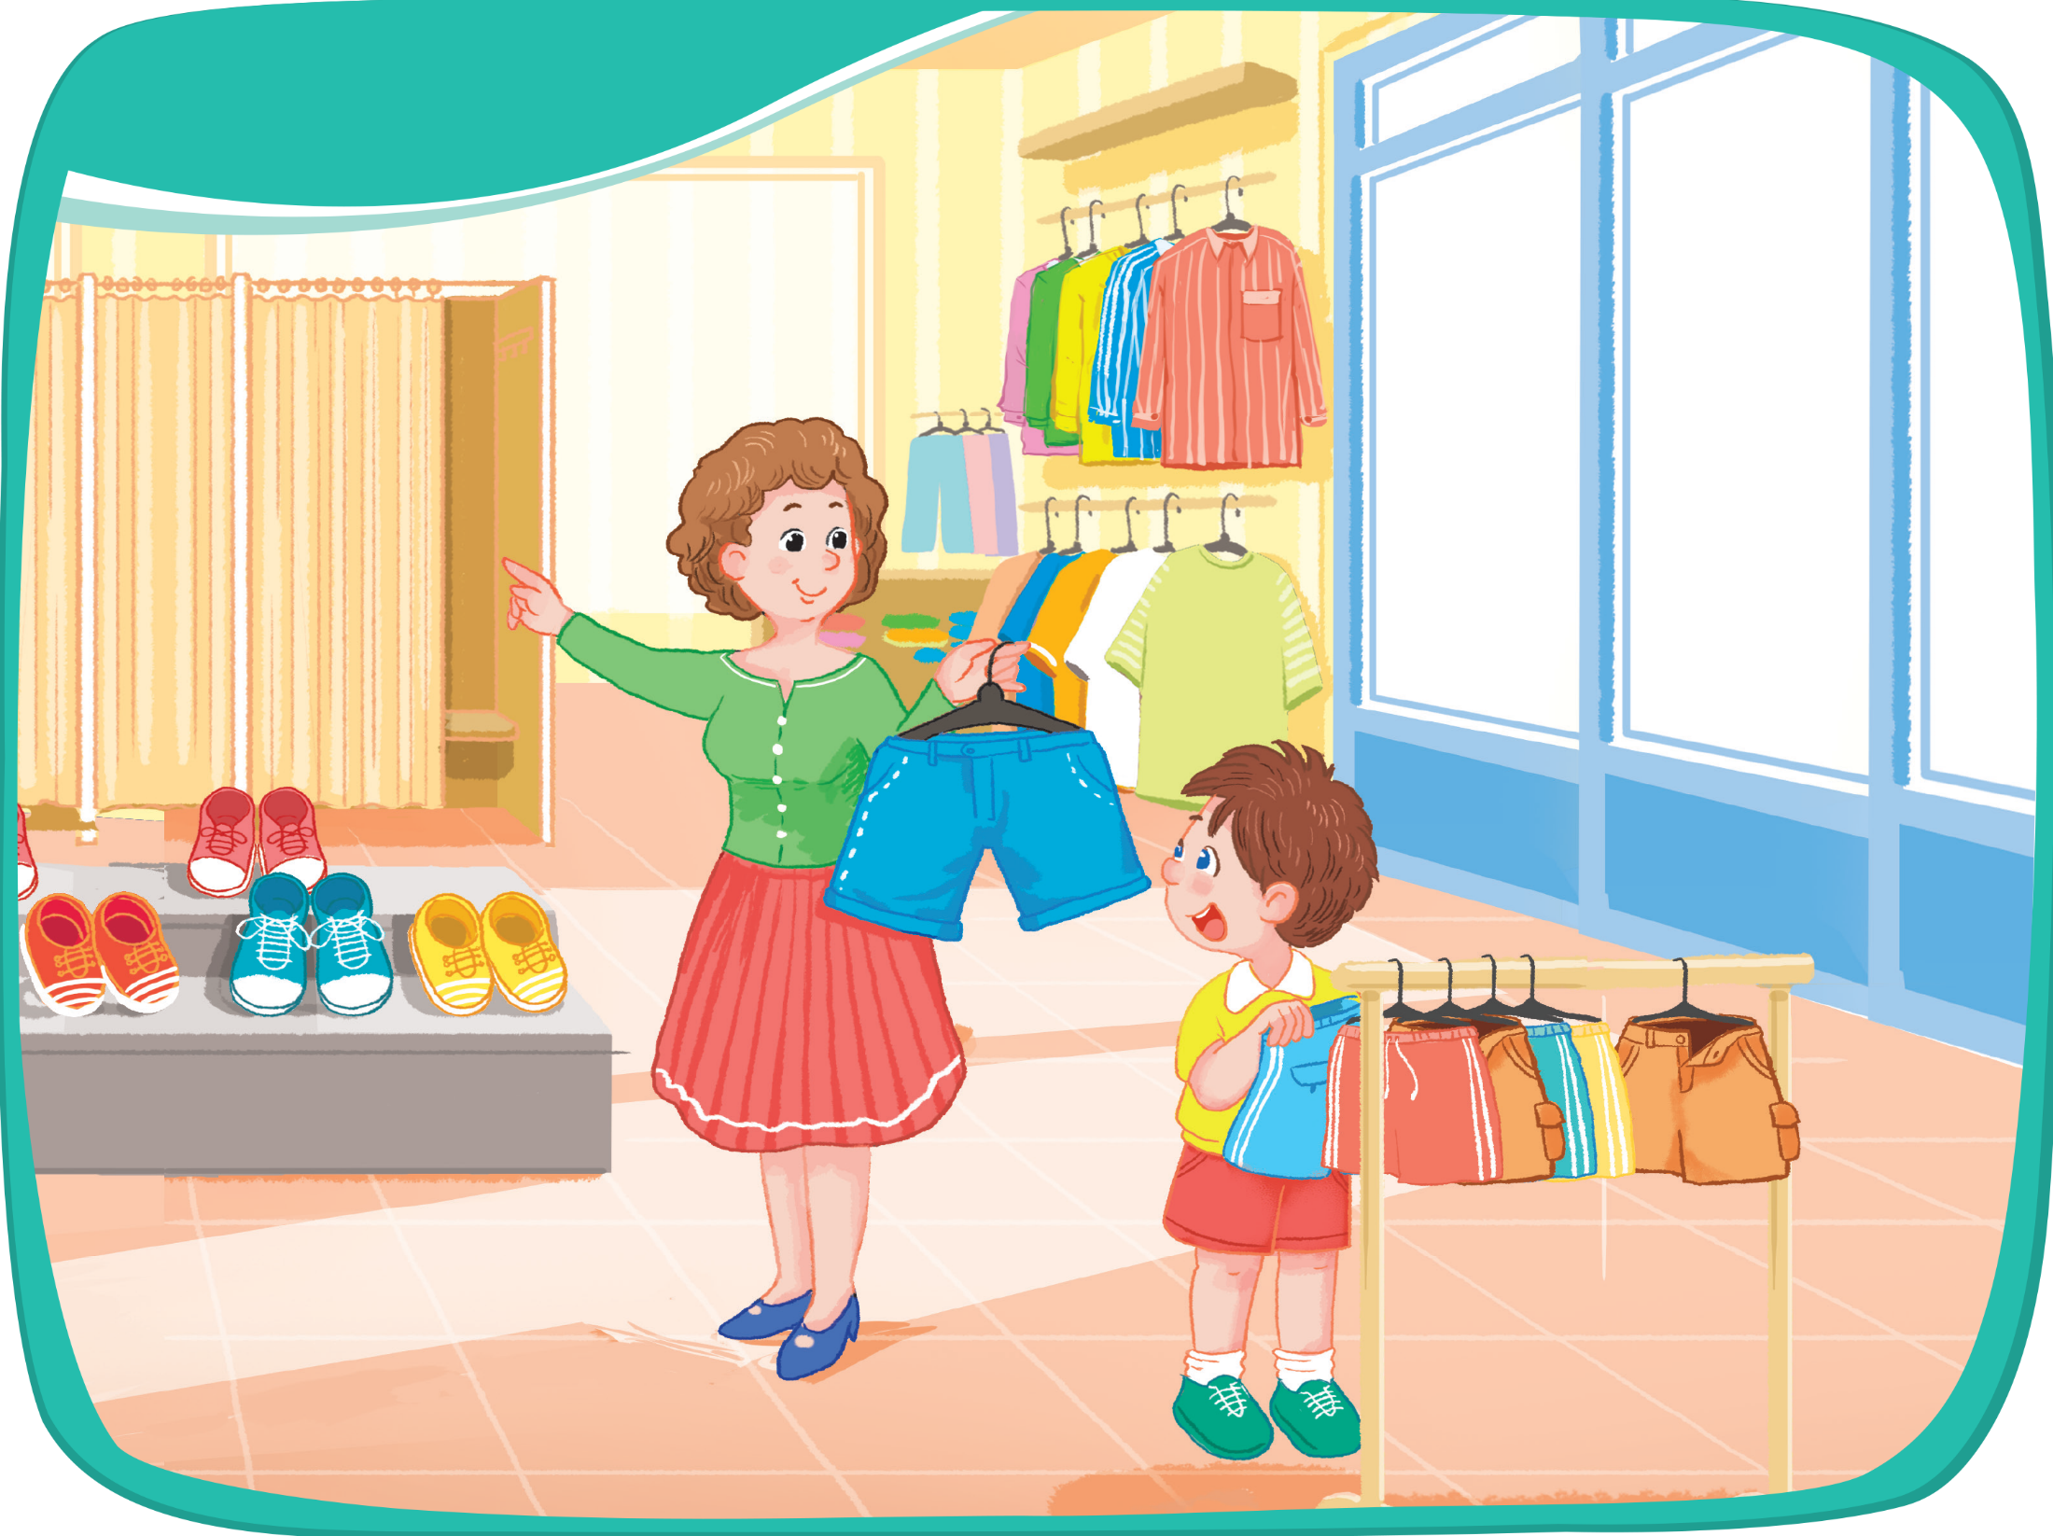
Look and say.

Slide 7


Listen and repeat.

Slide 8
Listen and repeat.
shirts
shorts
shoes

Slide 9
Listen and repeat.
shirts
shorts
shoes

Slide 10
3
  Point and say.

Slide 11

Point and say.
shirts
shorts
shoes

Slide 12
Work in pairs.
shirts
shorts
shoes

Slide 13
4
  Fun corner and wrap-up.

Slide 14






GAME
What’s missing?

Slide 15


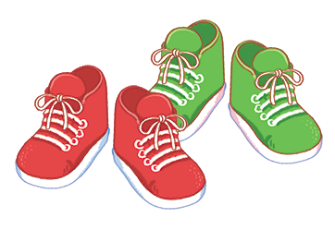
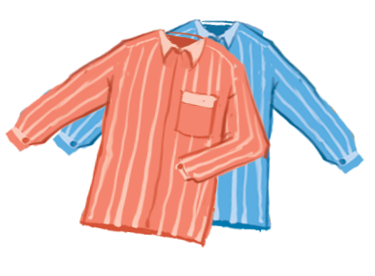
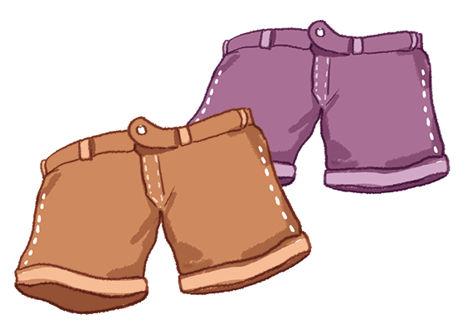
shoes
shirts
shorts

Slide 16

What’s missing?
shirts

Slide 17
What’s missing?
shoes

Slide 18
What’s missing?
shorts

Slide 19
What’s missing?
shoes

Slide 20
Well done!

Slide 21
THANK FOR YOUR LISTENING

