Slide 1
UNBD QUẬN DƯƠNG KINH
TRƯỜNG TIỂU HỌC ANH DŨNG
HELLO AND WELCOME TO MY ENGLISH CLASS

Slide 2



Unit 2: In the backyard
Lesson 1 – Period 1

Slide 3
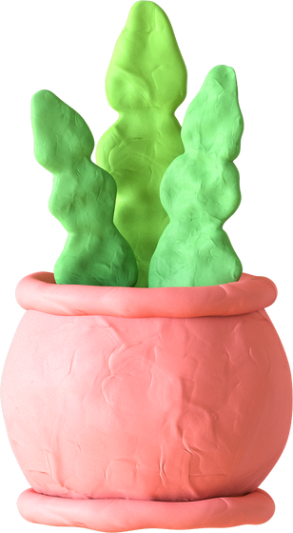

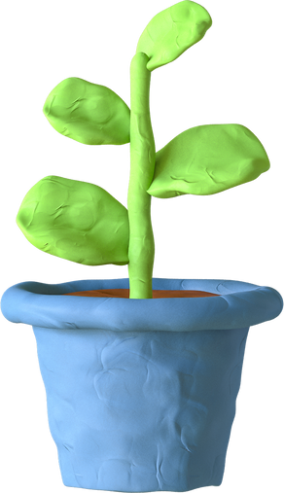
Table of contents
1
Warm-up
& Review
2
Listen
and repeat.
3
Point
and say.
4
Fun corner
& Wrap-up

Slide 4
01
Warm-up and Review

Slide 5
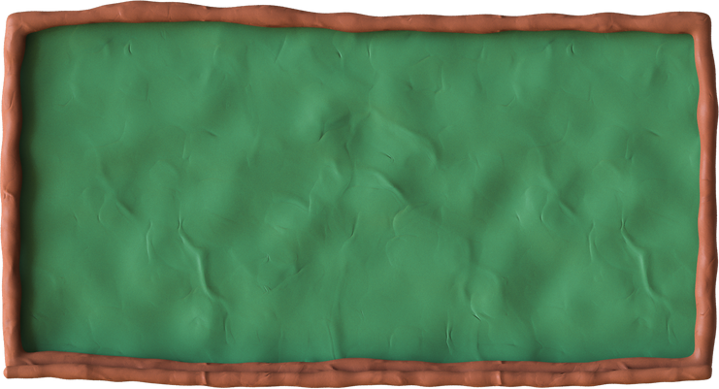

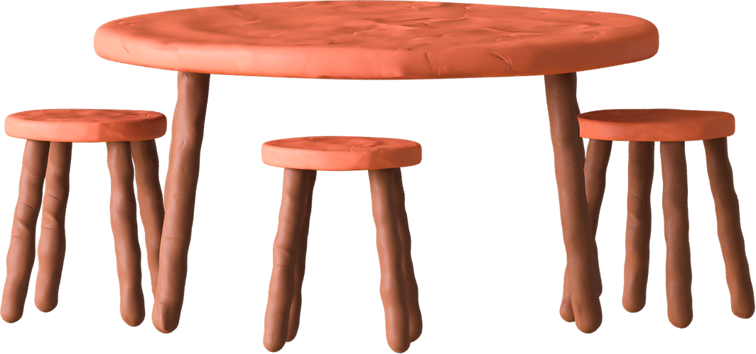
Game
LUCKY FLOWERS

Slide 6














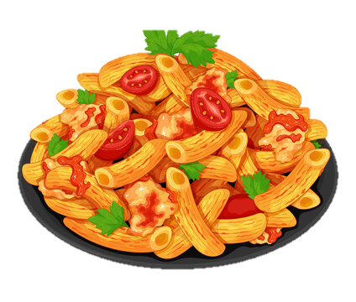



Game
LUCKY FLOWERS
You get
3 points.

Slide 7


Look and say

Slide 8

02
Listen and repeat.

Slide 9



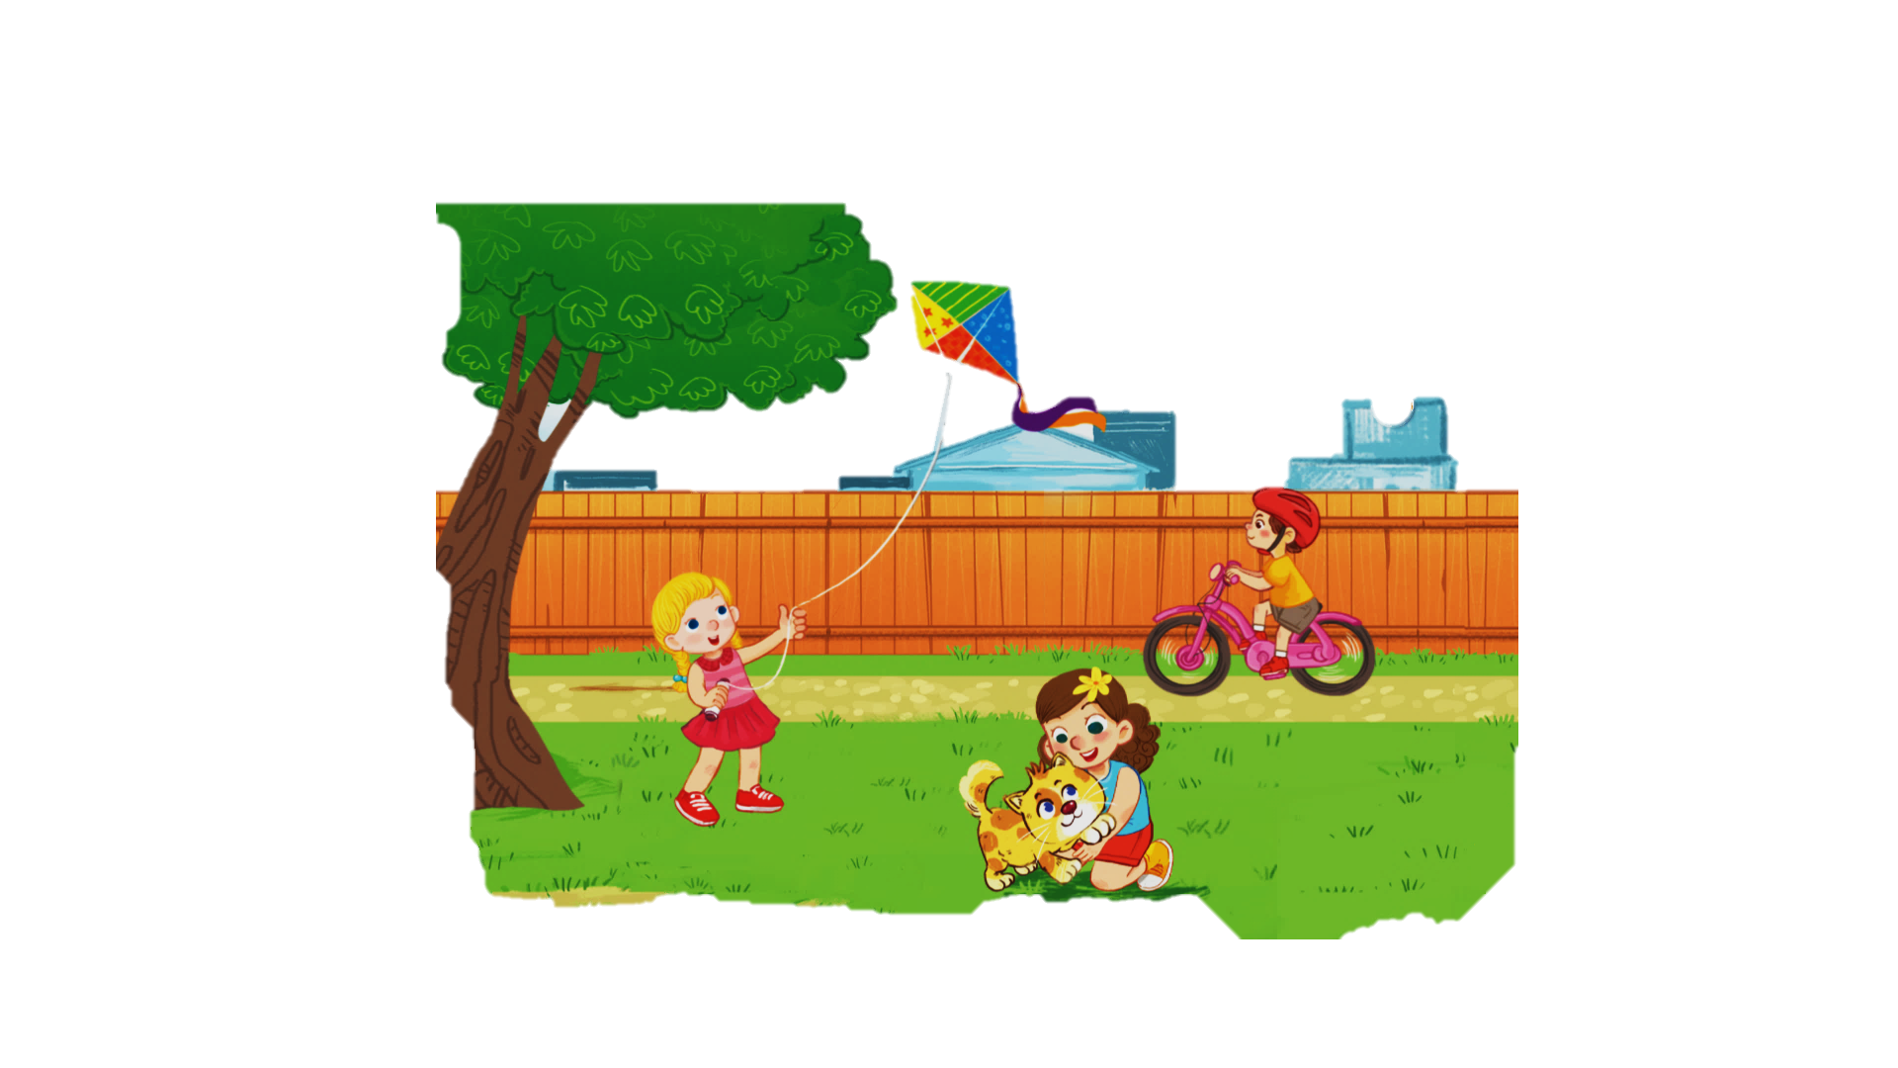

1. Listen and repeat.

Slide 10

1. Listen and repeat.
backyard →

Slide 11

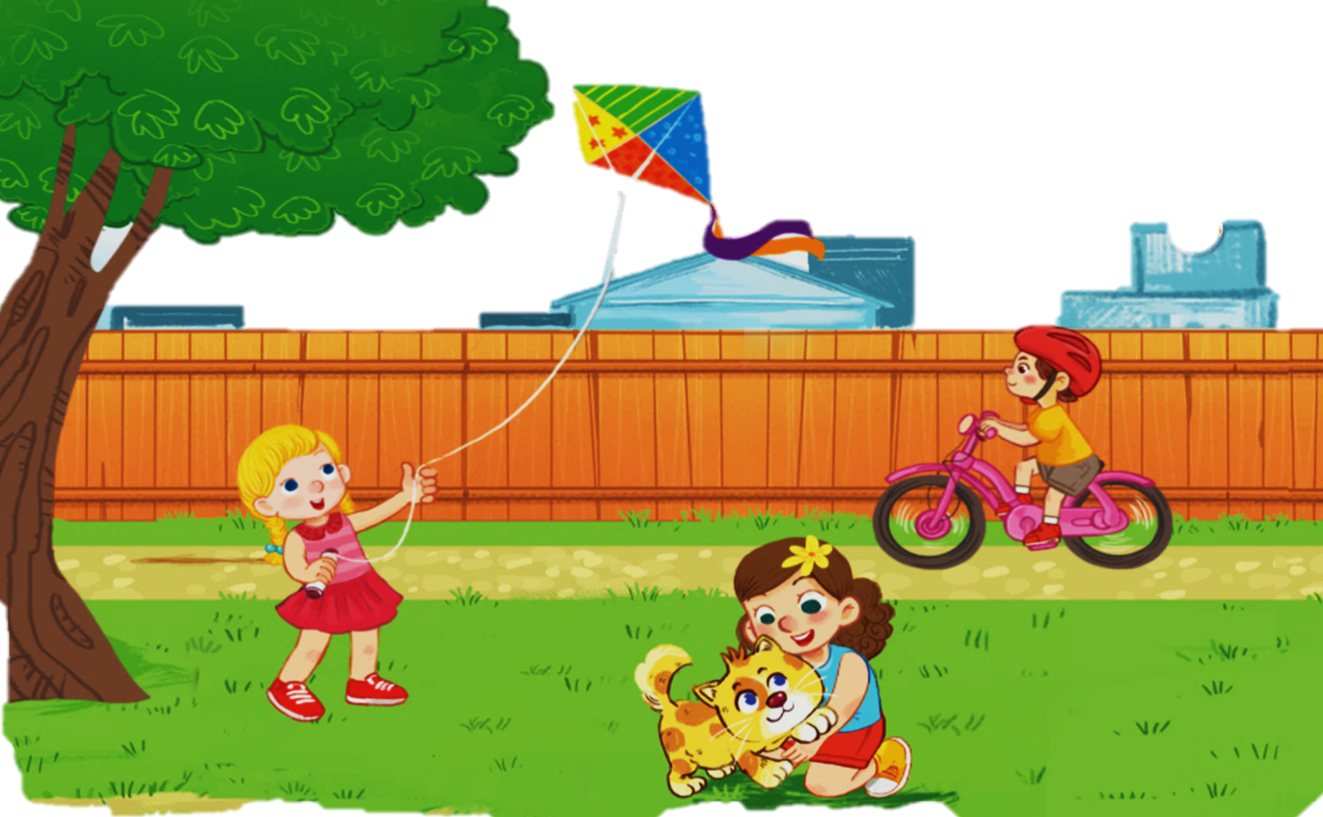

1. Listen and repeat.
Kk
kite
bike
kitten

Slide 12
1. Listen and repeat.
k
ite
k
bi e
k
itten

Slide 13
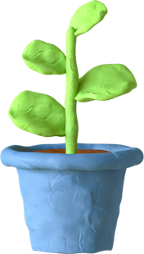
03
Point and say.

Slide 14

2. Point and say.
Kk
kite
bike
kitten

Slide 15


2. Point and say.
WORK IN PAIRS
k
kite

Slide 16
2. Point and say.
WORK IN PAIRS
kitten
k

Slide 17

04
Fun corner
Word Game

Slide 18




FUN CORNER
Word Game
Next
1
3
2
bike

Slide 19


FUN CORNER
Word Game
Next
1
3
2
kite

Slide 20


FUN CORNER
Word Game
Next
1
3
2
popcorn

Slide 21


FUN CORNER
Word Game
Next
1
3
2
pasta

Slide 22


FUN CORNER
Word Game
Next
1
3
2
duck
milk

Slide 23




Slide 24



Say goodbye

Slide 25

Say goodbye

Slide 26
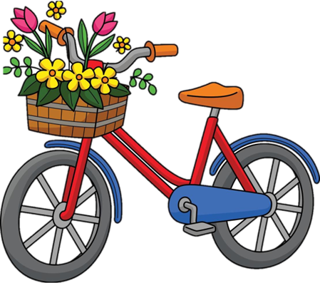
Say goodbye

Slide 27


Goodbye
See you later

