Slide 1




UBND QUẬN DƯƠNG KINH
TRƯỜNG TIỂU HỌC ANH DŨNG

Slide 2
Unit 4: In the countryside
Lesson 2 – Period 2

Slide 3

TABLE OF CONTENTS
Warm-up and Review
2.Activity 3: Listen and chant.
3.Activity 4: Listen and circle.
4.Activity 5: Look and write.
5.Fun corner & Wrap-up

Slide 4

01
Warm up and Review

Slide 5


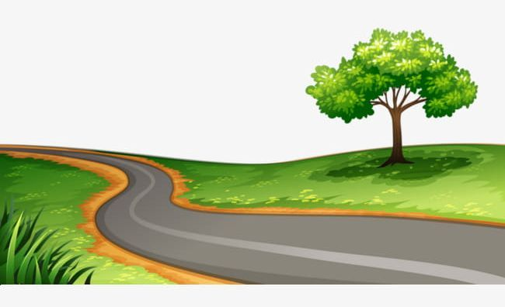

Game: WHAT’S THE PICTURE?
road
Notes:
Click the shapes to see pieces of the picture for pupils to guess
Click the camera to see the picture
Click the word to hear the sound

Slide 6


rainbow
Notes:
Click the shapes to see pieces of the picture for pupils to guess
Click the camera to see the picture
Click the word to hear the sound

Slide 7



river
Notes:
Click the shapes to see pieces of the picture for pupils to guess
Click the camera to see the picture
Click the word to hear the sound

Slide 8
02
Activity 3
Listen and chant.

Slide 9

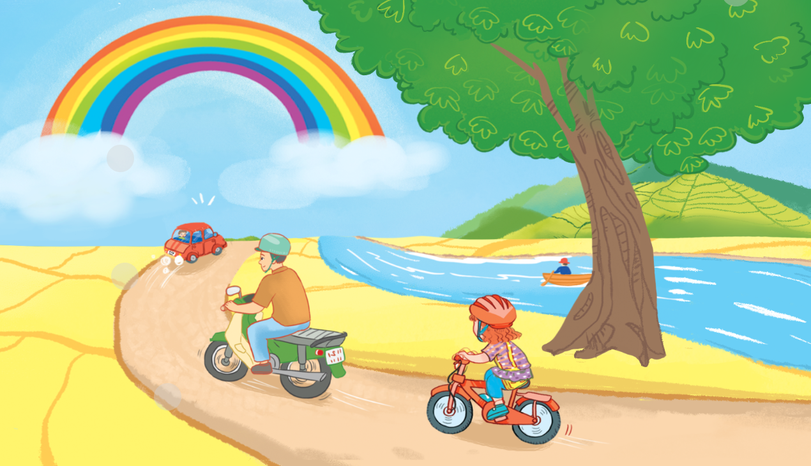

3. Listen and chant.
There’s a rainbow.
There’s a river.
There’s a road.

Slide 10
3. Listen and chant.
R, r, road.
There’s a road.
R, r, river.
There’s a river.
R, r, rainbow.
There’s a rainbow.

Slide 11
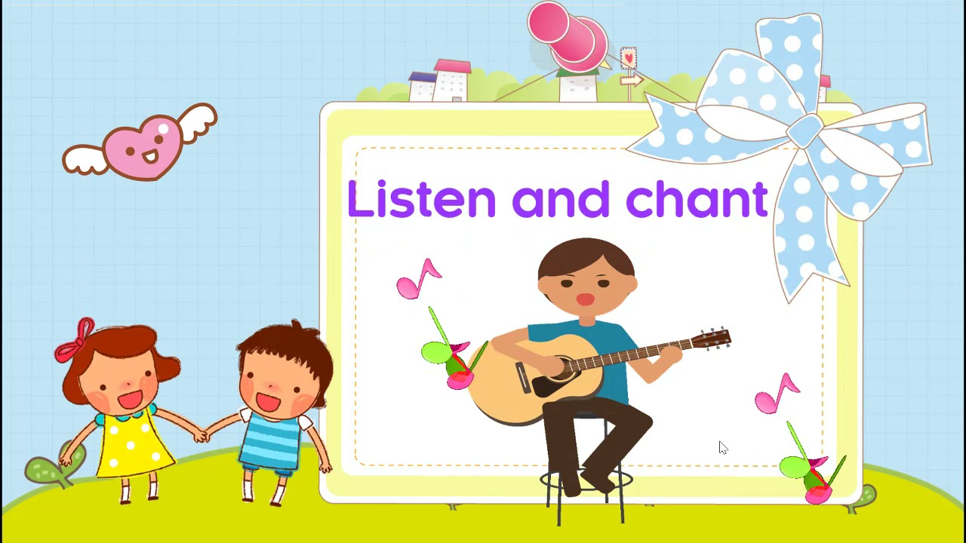
GROUPWORK

Slide 12
03
Activity 4
Listen and tick.

Slide 13


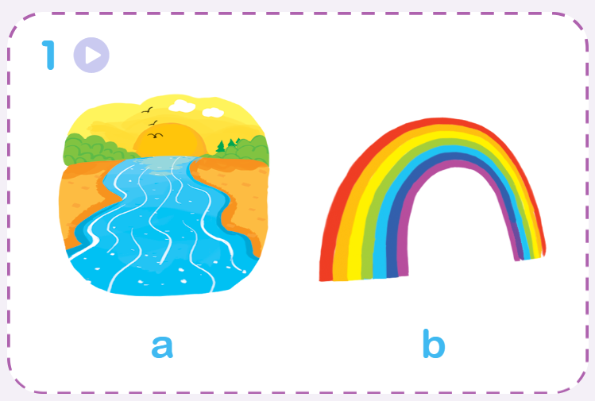
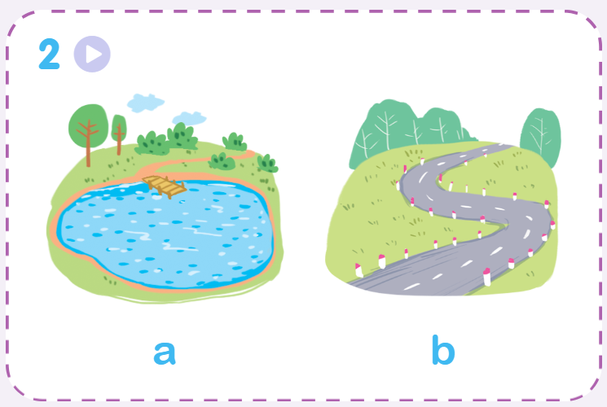
Listen and circle.

Slide 14


Listen and circle.
1.
a
b

Slide 15


Listen and circle.
2.
a
b

Slide 16
04
Activity 5
Look and write.

Slide 17







Look and write.

Slide 18
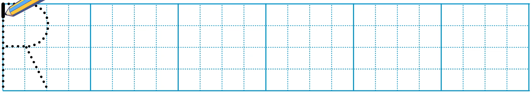
Look and write.

Slide 19
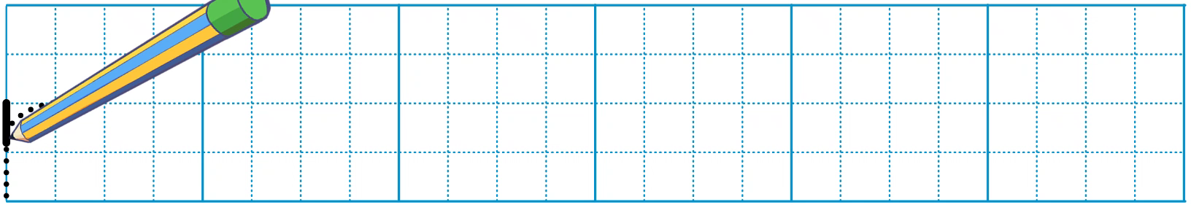
Look and write.

Slide 20
Look and write.
_oad
r

Slide 21
Look and write.
r
_iver

Slide 22
Look and write.
r
_ainbow

Slide 23
05
Fun corner and Wrap-up

Slide 24



Game: PELMANISM
river
ruler
road
Notes:
Click the penguins and hot-air balloons to see the pictures and words
Click the pictures or words to remove them

Slide 25


rainbow
river
road
Notes:
Click the penguins and hot-air balloons to see the pictures and words
Click the pictures or words to remove them

Slide 26


Slide 27

Goodbye! See you again!

