Slide 1


UBND QUẬN DƯƠNG KINH
TRƯỜNG TIỂU HỌC ANH DŨNG
WELCOME
To Our Class

Slide 2
Unit 5: In the classroom
Lesson 2 - Period 2

Slide 3






Table of contents
1. Warm-up and Review
2. Activity 3: Listen and chant.
3. Activity 4: Listen and tick.
4. Activity 5: Look and write.
5. Fun corner and Wrap-up

Slide 4

01
Warm-up
and Review

Slide 5






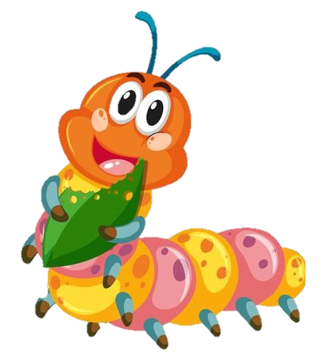



Game: Bees find flowers
square
quiz
red
Notes:
Click the flower to choose the word

Slide 6
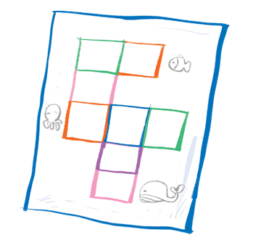

square
quiz
question

Slide 7


square
queen
question

Slide 8

CONGRATULATIONS!

Slide 9
02
Activity 3
Listen and chant.

Slide 10

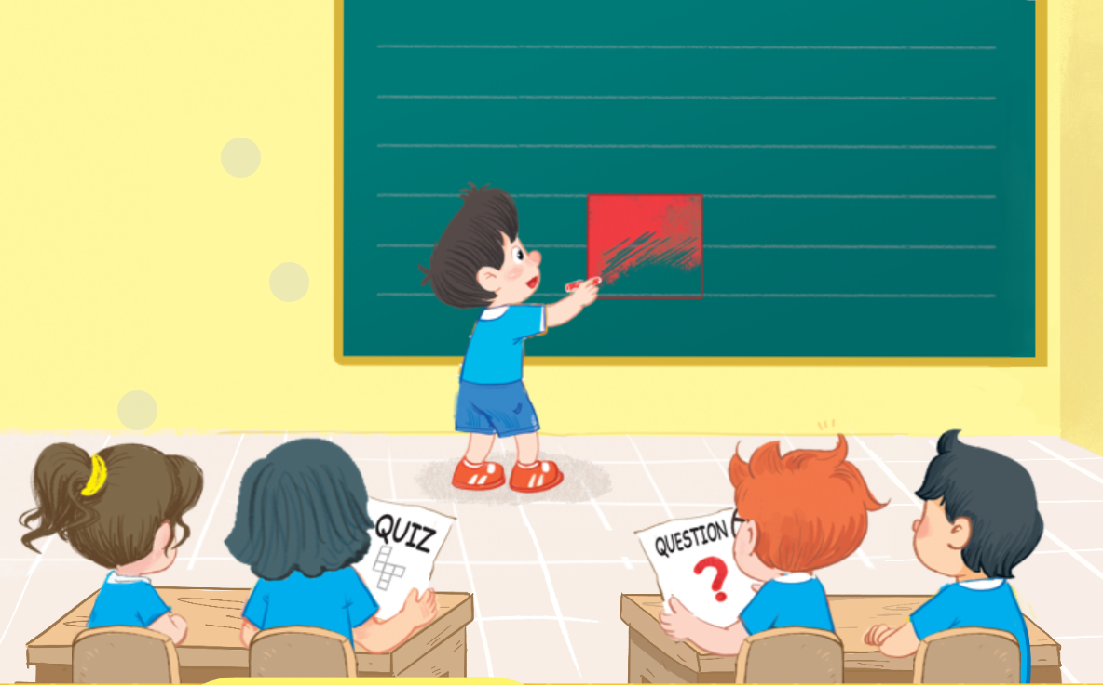
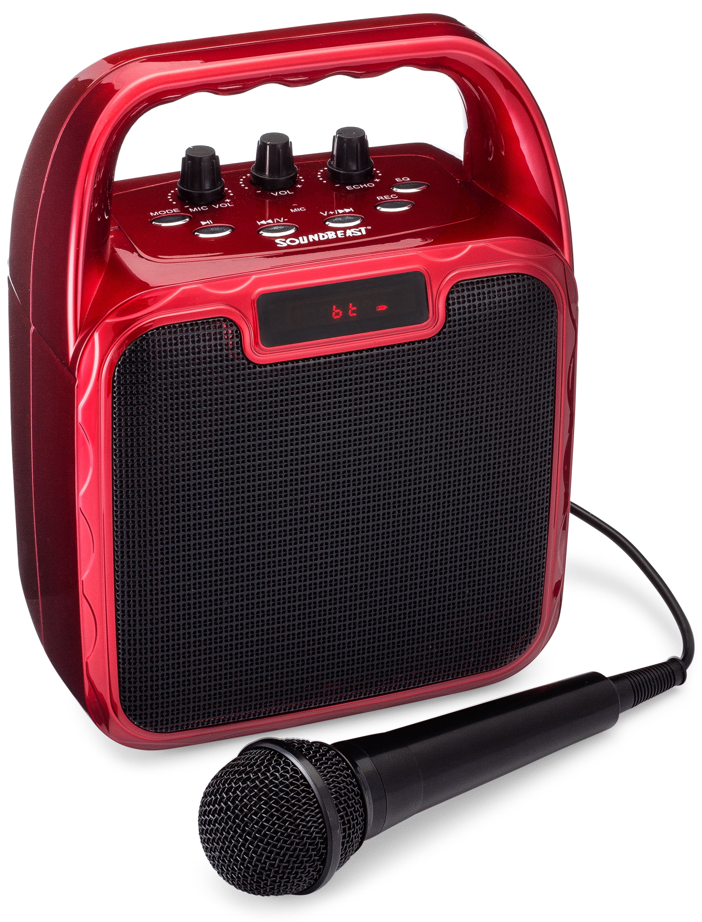
3. Listen and chant.

Slide 11
3. Listen and chant.
Q, q, a square.
He’s colouring a square.
Q, q, a question.
He’s answering a question.
Q, q, a quiz.
She’s doing a quiz.
SPIN WHEEL

Slide 12



Slide 13
03
Activity 4
Listen and tick.

Slide 14


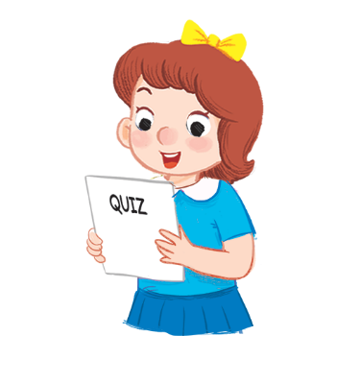




4.Listen and tick.
1
2

Slide 15


4. Listen and tick.
1


Slide 16


4.Listen and tick.
2


Slide 17
04
Activity 5
Look and write.

Slide 18


5. Look and write.

Slide 19

5. Look and write.

Slide 20
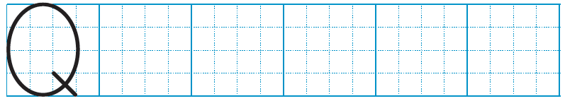

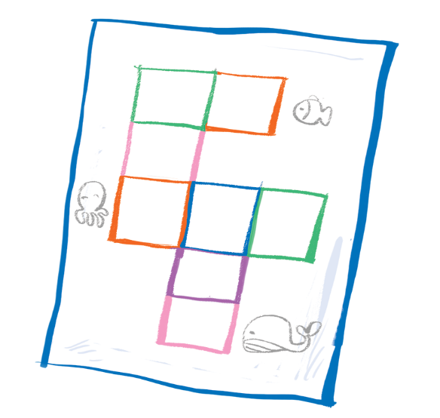


5. Look and write.
q
q
uiz
q
uestion
s uare

Slide 21
05
Fun corner
and Wrap-up

Slide 22

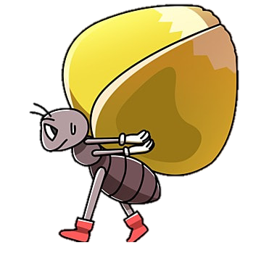



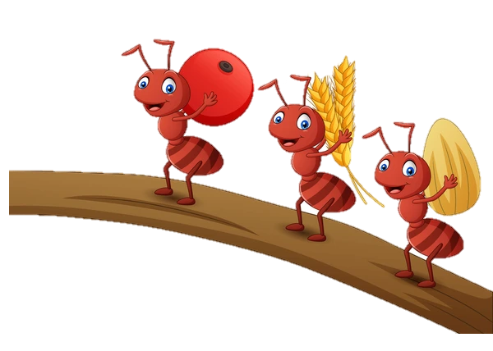
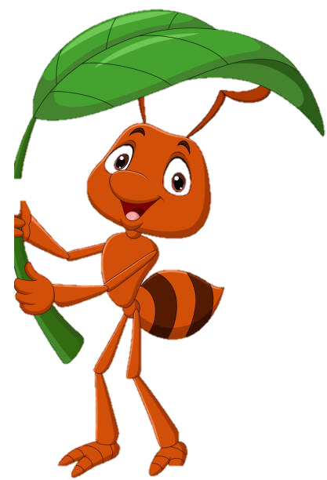
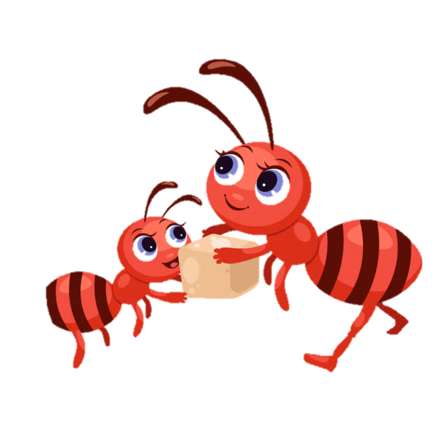
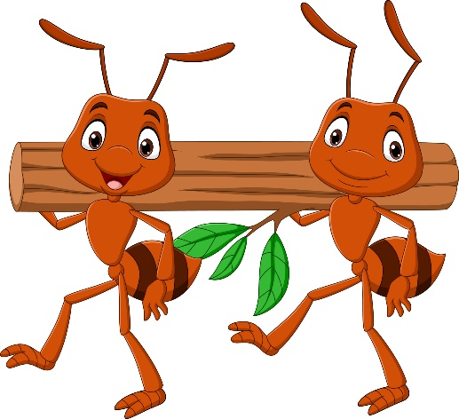
Game: Slow motion
quiz
Notes:
Click the ant to see the picture
Click the picture to see the word
Click the word to hear the sound

Slide 23

square
Notes:
Click the ant to see the picture
Click the picture to see the word
Click the word to hear the sound

Slide 24

question
Notes:
Click the ant to see the picture
Click the picture to see the word
Click the word to hear the sound

Slide 26


