Slide 1


UBND QUẬN DƯƠNG KINH
TRƯỜNG TIỂU HỌC ANH DŨNG
Fun Time 2
Period 1

Slide 2

TABLE OF CONTENTS
Activity 1
Warm-up and Review
Activity 2
Rearrange the letters to make words. Then say.
Activity 3
Let’s play.
Activity 4
Fun corner and Wrap-up

Slide 3

Activity 1
Warm-up
and Review

Slide 4


Game: BALL’S SECRET
2
3
1
4
5
6
CHOOSE A BALL
Notes:
Click the Bottom Right flower to end the game.

Slide 5


Question 1
Q
Say and
Write
the words beginning
with Letter:
OPEN
ANSWER
Notes:
Click Open to open the ball.
Click Answer to show the possible answers.
Click the flower on the bottom left to back to the Ball’s Secret slide.

Slide 6





ANSWER
quiz
question
square
Notes:
Click the picture if you want to disappear it.
Click the word card if you want to hear the pronunciation.

Slide 7
Question 2
X
Say and
Write
the words beginning
with Letter:
OPEN
ANSWER
Notes:
Click Open to open the ball.
Click Answer to show the possible answers.
Click the flower on the bottom left to back to the Ball’s Secret slide.

Slide 8
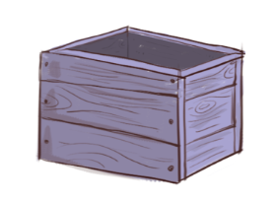

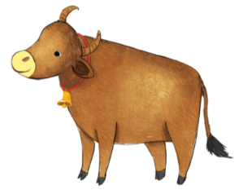
ANSWER
box
fox
ox
Notes:
Click the picture if you want to disappear it.
Click the word card if you want to hear the pronunciation.

Slide 9
Question 3
Q
Say and
Write
the words beginning
with Letter:
OPEN
ANSWER
Notes:
Click Open to open the ball.
Click Answer to show the possible answers.
Click the flower on the bottom left to back to the Ball’s Secret slide.

Slide 10
ANSWER
quiz
question
square
Notes:
Click the picture if you want to disappear it.
Click the word card if you want to hear the pronunciation.

Slide 11
Question 4
X
Say and
Write
the words beginning
with Letter:
OPEN
ANSWER
Notes:
Click Open to open the ball.
Click Answer to show the possible answers.
Click the flower on the bottom left to back to the Ball’s Secret slide.

Slide 12
ANSWER
box
fox
ox
Notes:
Click the picture if you want to disappear it.
Click the word card if you want to hear the pronunciation.

Slide 13
Question 5
Q
Say and
Write
the words beginning
with Letter:
OPEN
ANSWER
Notes:
Click Open to open the ball.
Click Answer to show the possible answers.
Click the flower on the bottom left to back to the Ball’s Secret slide.

Slide 14
ANSWER
quiz
question
square
Notes:
Click the picture if you want to disappear it.
Click the word card if you want to hear the pronunciation.

Slide 15
Question 6
X
Say and
Write
the words beginning
with Letter:
OPEN
ANSWER
Notes:
Click Open to open the ball.
Click Answer to show the possible answers.
Click the flower on the bottom left to back to the Ball’s Secret slide.

Slide 16
ANSWER
box
fox
ox
Notes:
Click the picture if you want to disappear it.
Click the word card if you want to hear the pronunciation.

Slide 17

Good
job!
Keep moving!

Slide 18
Activity 2
Rearrange the letters. Then say.

Slide 19

LOOK and SAY.
Notes:
Make a next click to hear the pronunciation.

Slide 20

LOOK and SAY.
Notes:
Make a next click to hear the pronunciation.

Slide 21
LOOK and SAY.
Notes:
Make a next click to hear the pronunciation.

Slide 22
LOOK and SAY.
Notes:
Make a next click to hear the pronunciation.

Slide 23

REARRANGE the letters
to make words.
aqsuer
square
______________________
Notes:
Make a next click to hear the pronunciation.

Slide 24
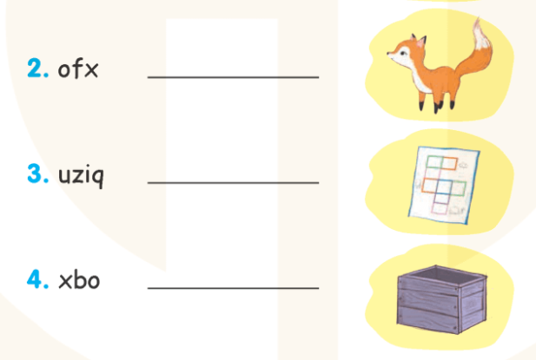
REARRANGE the letters
to make words.
Notes:
Make a next click to hear the pronunciation.

Slide 25







Let’s check.
Work in pairs.

Slide 26

Let’s CHECK.
ofx
fox
______________________
Notes:
Make a next click to hear the pronunciation.

Slide 27

Let’s CHECK.
uziq
quiz
______________________
Notes:
Make a next click to hear the pronunciation.

Slide 28

Let’s CHECK.
xbo
box
______________________
Notes:
Make a next click to hear the pronunciation.

Slide 29
Good
job!
Keep moving!

Slide 30
Activity 3
Let’s play.
BINGO

Slide 31







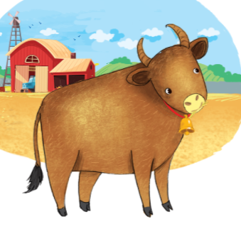

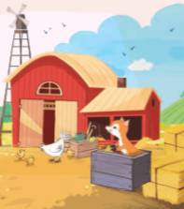
Look and say.
quiz
rainbow
kitten
box
popcorn
fox
ox
sail
question
farm

Slide 32


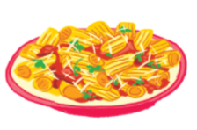





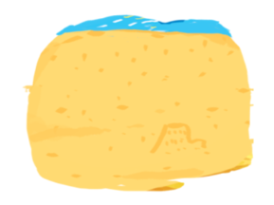
Look and say.
sea
road
square
pasta
pizza
kite
river
sun
bike
sand

Slide 33



B
I
N
G
O
quiz
rainbow
square
box
road
fox
ox
sail
question
Notes:
Pupils choose 4 words to fill in their Bingo card.

Slide 34
B
I
N
G
O
quiz
rainbow
square
box
road
fox
ox
sail
question
Notes:
Pupils choose 4 words to fill in their Bingo card.

Slide 35
B
I
N
G
O
quiz
rainbow
square
box
road
fox
ox
sail
question
Notes:
Pupils choose 4 words to fill in their Bingo card.

Slide 36



Get ALL!
Let's Start!

Slide 37



Are you ready to win?
Shout "Bingo" if you get all!

Slide 38



Congratulations!
Thank you!

Slide 39
Activity 4
Fun corner
and Wrap-up

Slide 40
Game: MUSICAL CHAIRS
Q

Slide 41
X

Slide 42
X

Slide 43
Q

Slide 44
Good
job!

